Slide 1
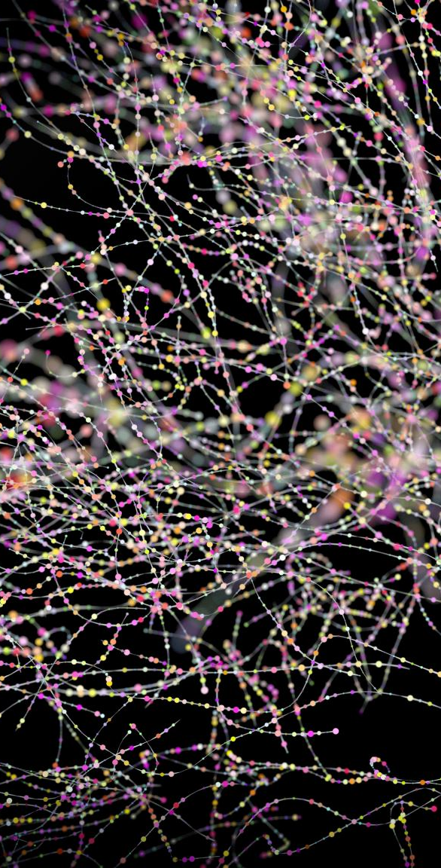
Redbus Data Scraping using Selenium & Dynamic Filtering Using Streamlit
DOMAIN: Transportation
Developed by: Suriya Vignesh

Slide 2
Project Overview
Objective:
- Scrape bus route data from the Redbus website.
- Store the data in a structured format.
- Create a user-friendly interface using Streamlit to visualize the data and apply filters.
Technologies Used:
- Web Scraping: Selenium
- Data Processing & Storage: Pandas, SQLite
- Data Visualization: Streamlit

Slide 3
Data Scraping Process
Scraping Source:
- The Redbus website: https://www.redbus.in
Tools Used:
- Selenium: To automate the process of navigating through the website and scraping data.
- XPATH: For selecting elements like bus names, routes, prices, etc.
Steps in Scraping:
1. Navigate to bus route pages.
2. Extract bus route details (name, type, price, timings, etc.).
3. Scrape pagination to get multiple pages of results.

Slide 4
Data Storage
Data Storage Process:
1. Data Format: CSV files containing bus route details.
2. Database: The data is then stored in a structured format in an SQLite database for future querying.
3. Final Output: A consolidated DataFrame combining all route data.

Slide 5
Data Storage
Database Table Schema:
Bus_name: Name of the bus
Bus_type: Type of bus (e.g., AC, Non-AC)
Start_time: Departure time
End_time: Arrival time
Total_duration: Total travel time
Price: Ticket price
Seats_Available: Number of available seats
Ratings: Bus ratings
Route_link: Link to route details
Route_name: Name of the route

Slide 6
Data Processing and Cleaning
Data Processing Steps:
1. Conversion: Convert price and ratings to numeric values for easier analysis.
2. Handling Missing Data: Replace missing or NaN values with default values (e.g., "Unknown" or 0).
3. Filtering: Remove rows with prices greater than INR 7000 to focus on affordable bus routes.

Slide 7
Data Processing and Cleaning
Cleaning Output:
- Price: Converted to numeric format (INR).
- Ratings: Cleaned to retain only numerical values.

Slide 8
Streamlit Application
Features:
- Dynamic Filters: Users can filter the data based on:
- Route
- Bus Type
- Price Range
- Ratings
- Availability of Seats

Slide 9
Streamlit Application
User Interface: Built with Streamlit, providing a seamless and interactive experience.
Example Features:
- State and Route Selection: Choose from a list of states and routes.
- Fare Range Filter: Set minimum and maximum fare values.
- Departure Time Filter: Filter buses based on the time of day.
- Ratings & Seat Availability: Filter buses by ratings and seat availability.

Slide 10
Key Features
Web Scraping with Selenium:
- Automated extraction of bus route data.
- Supports pagination and dynamic content loading.
Data Analysis & Filtering:
- Data is filtered using user inputs such as price range, departure time, ratings, etc.

Slide 11
Key Features
Streamlit Interface:
- Provides real-time interactive filters for data exploration.
SQLite Database:
- Efficient data storage and querying.

Slide 12
Conclusion
- Successfully scraped and stored bus route data.
- Developed a fully functional Streamlit app for dynamic data filtering.
GitHub link: https://github.com/Suriya-900/capstone-projects
Skills take away From This Project | Web Scraping using Selenium, Python, Streamlit , SQL

