Slide 1

AMCAT data - An Exploratory Data Analysis

Slide 2
About me
Hi there! I’m Suriya [IN1240065], a 21-year-old data enthusiast, currently in pre-final year at VIT University. Sure, I might be fresh, but I'm your one-stop shop for unlocking insights from numbers.
Speaking of Experience, my internship at Hindustan Aeronautics Limited (HAL) was a rocket ship ride! For 45 days, I tackled complex big data, tamed it with SQL magic, built dashboards using tableau that told stories, and learned to clean data.
Feel free to reach out! I'm always down to connect with you all. ☺
Github
LinkedIn
Portfolio

Slide 3
Objective
To find the insights and decode the patterns on how the salary pay scale is impacted based on various parameters like academic achievements, AMCAT scores, Age, Years of Work Experiences etc..

Slide 4
Summary of the Dataset
There are total of 38 columns that are used to find their individual impacts on salary.
With 4000 data points that make our analysis to the optimal insights with all the required information.

Slide 5
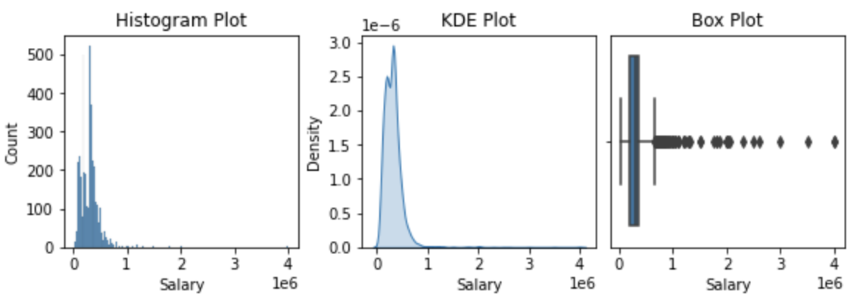
What is our Target variable ‘Salary’ informs to us?
count 3998
min 35000
max 4000000
mean 307699
median 300000
var 4.52e+10
std 2.12e+05
skew 6.45
kurt 80.9
Salary ranges from 35k to 40L with higher density of 3L
It is right skewed

Slide 6
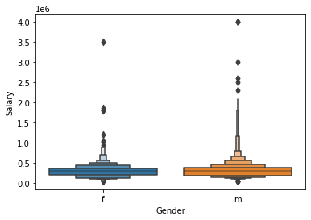

Do you think there is salary difference for genders?
Yes, of course. Male has higher median salary than Female.
[F – Female]
[M – Male]
Getty Images

Slide 7
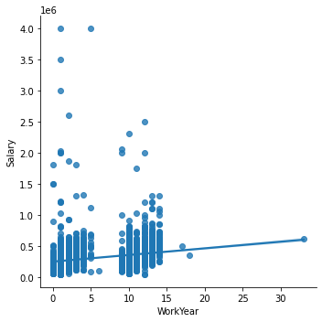
Experience Pays Off? Is Salary increases with Experience?
There is a slight increasing slope for work experience and salary. However we can observe that there are some good pay scale for the freshers, but still there is increasing proportion of salary based on experience

Slide 8
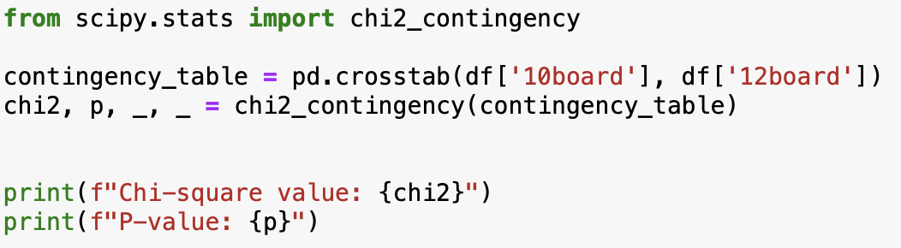

Lets Explore Board Transitions Across 10th and 12th using Chi Square test:
Chi-square value: 4503.58
P-value: 0.0
Since, P-Value equals to zero, we have enough evidence to reject H0 (Null Hypothesis).
Your 10th board choice might significantly impact your 12th board decision. This analysis reveals a hidden link between the board you choose in 10th grade and where your academic journey takes you in 12th.

Slide 9
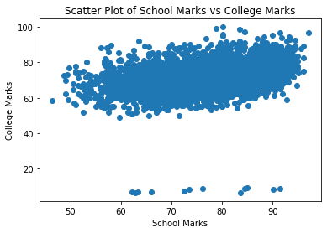
Do Students Maintain Consistent Performance Across School and College?
Pearson correlation coefficient: 0.36
P-value: 1.77e-125
Since, P-Value equals to zero, we have enough evidence to reject H0 (Null Hypothesis).
We could see there is a correlation among school and college performance among students. [r=0.36]

Slide 10
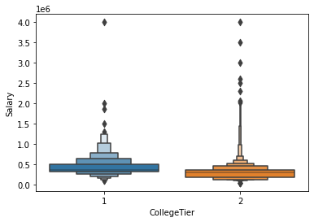
Do companies still look for College Tier?
However there are some outliers in Tier 2, the winner of this race is going to be Tier 1.
This boxplot suggests attending a tier 1 college could be the key to unlocking a higher salary, but remember, SKILLSET matters!

Slide 11
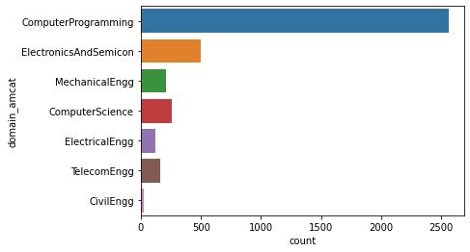
Are Students Following the Crowd or Charting Their Own Path?
We get it, we get it, CSE is popular. Can we move on to the next plot point now?
Maybe next time, Civil Engineers

Slide 12
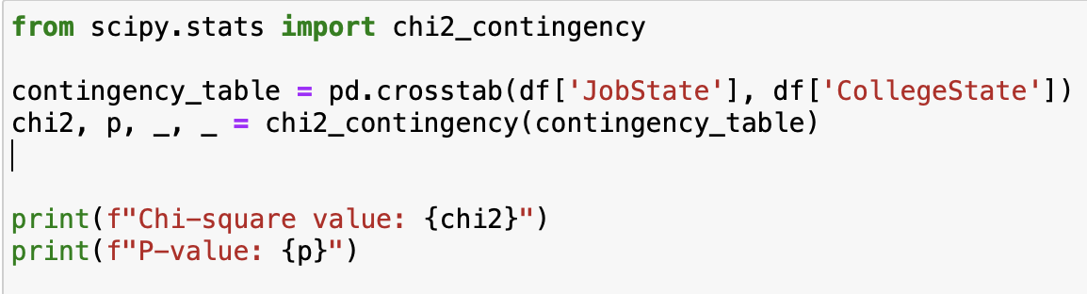

Are students getting rid of home sickness? Let’s explore
Chi-square value: 15325.94
P-value: 0.0
Since, P-Value equals to zero, we have enough evidence to reject H0 (Null Hypothesis).
Students don’t prefer to work on the same place they studied. (Campus farewells turn into farewells to the city)
******************************************************************************
[JobState] = The state where they are working
[CollegeState] = The state where they studied

Slide 13

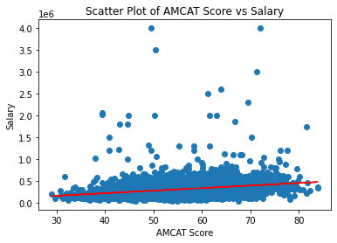
Check how AMCAT Scores will determine pay scale
Pearson correlation coefficient: 0.25
P-value: 4.42e-59
Since, P-Value equals to zero, we have enough evidence to reject H0 (Null Hypothesis).
We could see there is a correlation among AMCAT scores and salary. [r=0.25]

Slide 14
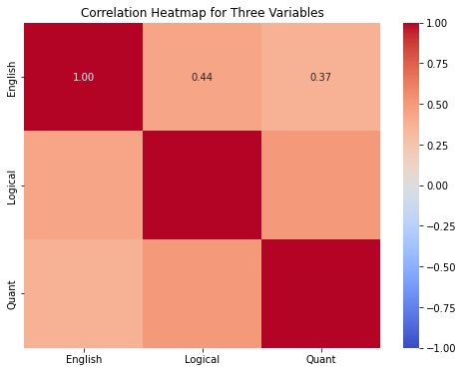
Are English, Logical and Quant marks correlated?
The Answer is YES!. All these 3 variables are positively correlated.
Hmm. Forget rock-paper-scissors, it's English-Quant-Logical in the AMCAT arena, and they're all working together!

Slide 15
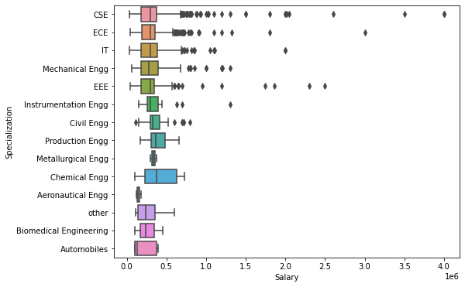
Forget the Billionaires, Which Specialization Makes You a Millionaire?
The plot twist nobody saw coming: Chemical Engineers take home the salary crown.
Looks like the periodic table pays better than the binary code these days. (😂)

Slide 16
RESEARCH QUESTION - 1
Times of India article dated Jan 18, 2019 states that “After doing your Computer Science Engineering if you take up jobs as a Programming Analyst, Software Engineer, Hardware Engineer and Associate Engineer you can earn up to 2.5-3 lakhs as a fresh graduate.” Test this claim with the data given to you.

Slide 17
Test used – 1 Sample T-Test
Level of Significance – 0.05
Designation | Test Statistic | P - Value | Conclusion
Software Engineer | 13.02 | 1.85e-36 | Reject H0
Hardware Engineer | 0.68 | 0.513 | Do not reject H0
Associate Engineer | 1.06 | 0.29 | Do not reject H0
Programming Analyst | 5.40 | 1.99e-07 | Reject H0
Conclusion:
Only Software Engineer and Programming Analysts are having higher income range.
Hardware and Associate Engineers do not have proper evidence to prove against.

Slide 18
RESEARCH QUESTION - 2
According to (AMEO-2015) dataset. It has been observed from the analysis that B.Tech is the most preferred course in India with Electronics and Communication engineering stream as the most preferred branch with highest package around 13 lakhs per annum and average package around 5 lakhs
Source: ResearchGate

Slide 19
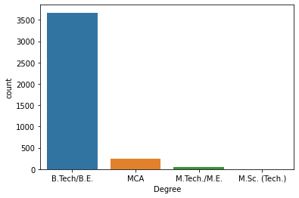

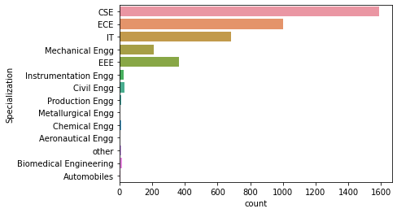

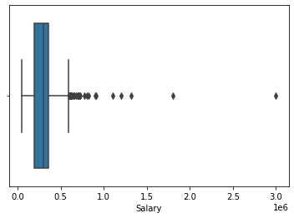
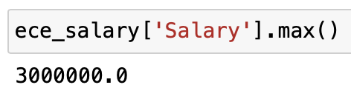
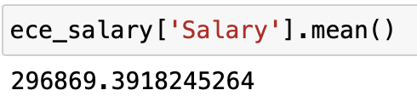

Slide 20
Conclusion:
Male earns more salary
Experience pays you higher salary
10th & 12th board are same (Chi-sq test)
Students maintain consistence performance in school and college as well
Top Tier college graduates have chance of getting more salary pay
Students wish to relocate themselves for works
AMCAT Scores is one of the key feature that determines your pay

Slide 21

THANK YOU

