Slide 1
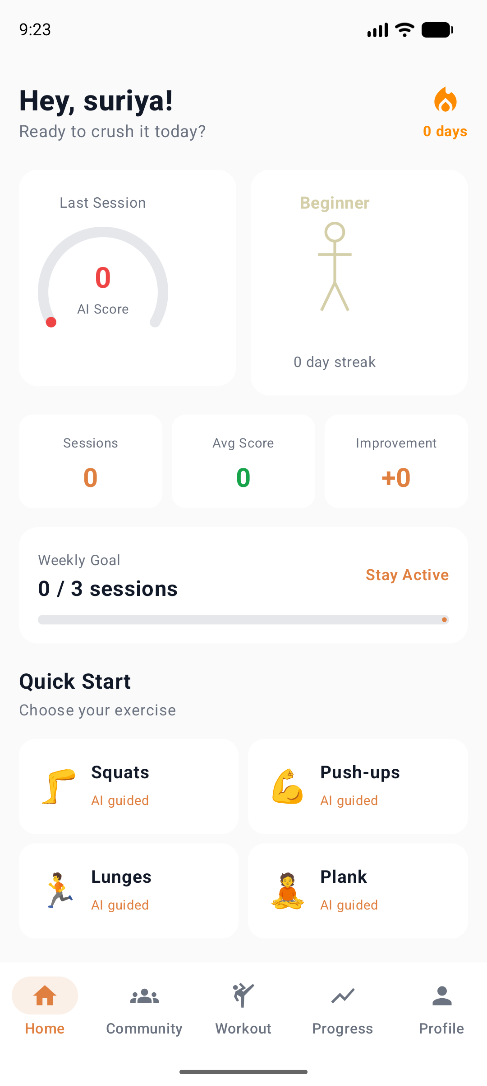
FIT
AI
AI-Driven Personalized Workout Intelligence
Real-Time Posture Assessment · Progress Tracking · Injury Risk Prediction
Android App
MediaPipe BlazePose
Jetpack Compose
Suriya Sittharth | 2026

Slide 2
The Problem
Injury Epidemic
Market Pain
1
67% of gym-goers injure themselves from incorrect form — yet no app detects it in real-time.
$111B
Blind Progress
Global fitness app
market by 2026
2
Apps log reps & sets but never explain WHY form declines or flag oncoming fatigue before injury.
67%
No Environmental Awareness
Gym users report
form-related injury
3
Lighting, camera angle & body visibility critically affect pose quality — every existing app ignores this.
82%
Missing Biomechanics
Quit apps within
3 months — no feedback
4
Balance, symmetry, stability & speed are as critical as accuracy per rep — tracked by zero competitors.
#1
Fitness is Isolated
5
Complaint: "No
real coaching"
There's no platform to train live with others, share routines, run challenges, or post meal progress.

Slide 3
The Solution
FitAI — your real-time AI personal trainer on your phone
SCIENCE
VISION AI
SAFETY
AI Workout Score
Real-Time Pose Analysis
Fatigue & Injury Predict
5-dimensional score per rep: Accuracy, Balance,
Stability, Symmetry & Speed. All computed on-device.
MediaPipe BlazePose — 33-landmark skeleton
overlay on live camera feed at 30fps.
Linear regression on score trend — detects
decline and fires "STOP NOW" before injury.
SMART
GAMIFIED
SOCIAL
Environment QA Check
3D Fitness Avatar
Social Fitness Platform
Analyzes brightness, sharpness, camera angle
& body visibility before every session starts.
5-level evolution: Beginner → Warrior →
Athlete → Champion → Legend driven by streak.
Discord-style servers, channels, live WebRTC
co-workouts, shared routines & challenges.

Slide 4
App Showcase — Home Dashboard
Intelligence at a glance — every KPI visible before your first rep
Personalized Greeting
Name + daily motivational prompt — feels personal from day 1.
AI Score Gauge
Circular gauge showing last session's composite AI Workout Score.
Fitness Avatar
Evolving avatar reflects consistency level — Beginner to Legend.
Stats Row
Sessions · Avg Score · Improvement trend — all at a glance.
Weekly Goal Tracker
Progress bar: sessions done vs. weekly target with named goal.
Quick Start Grid
One-tap into any AI-guided exercise — instant session start.

Slide 5
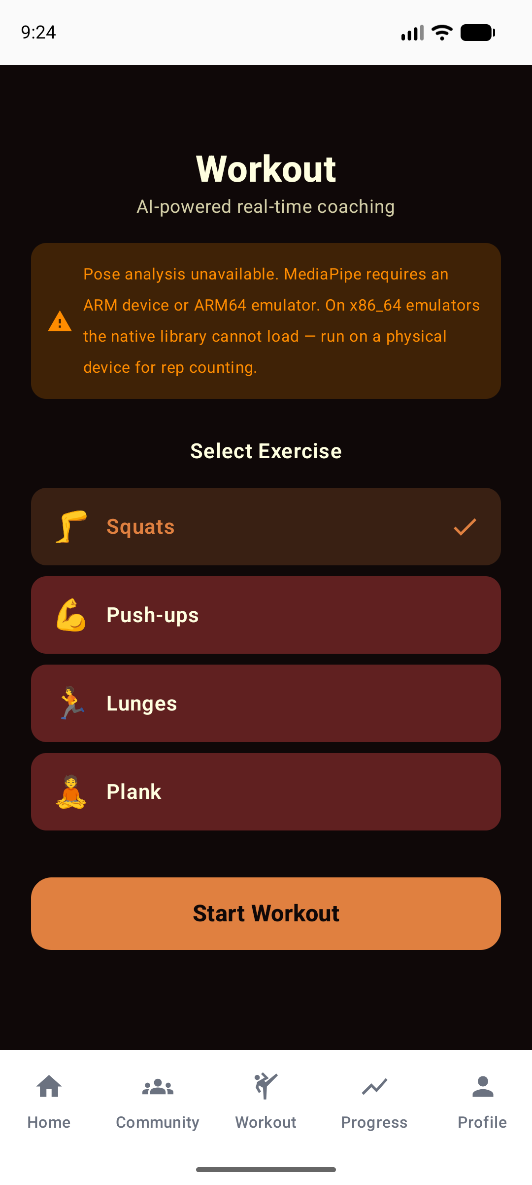
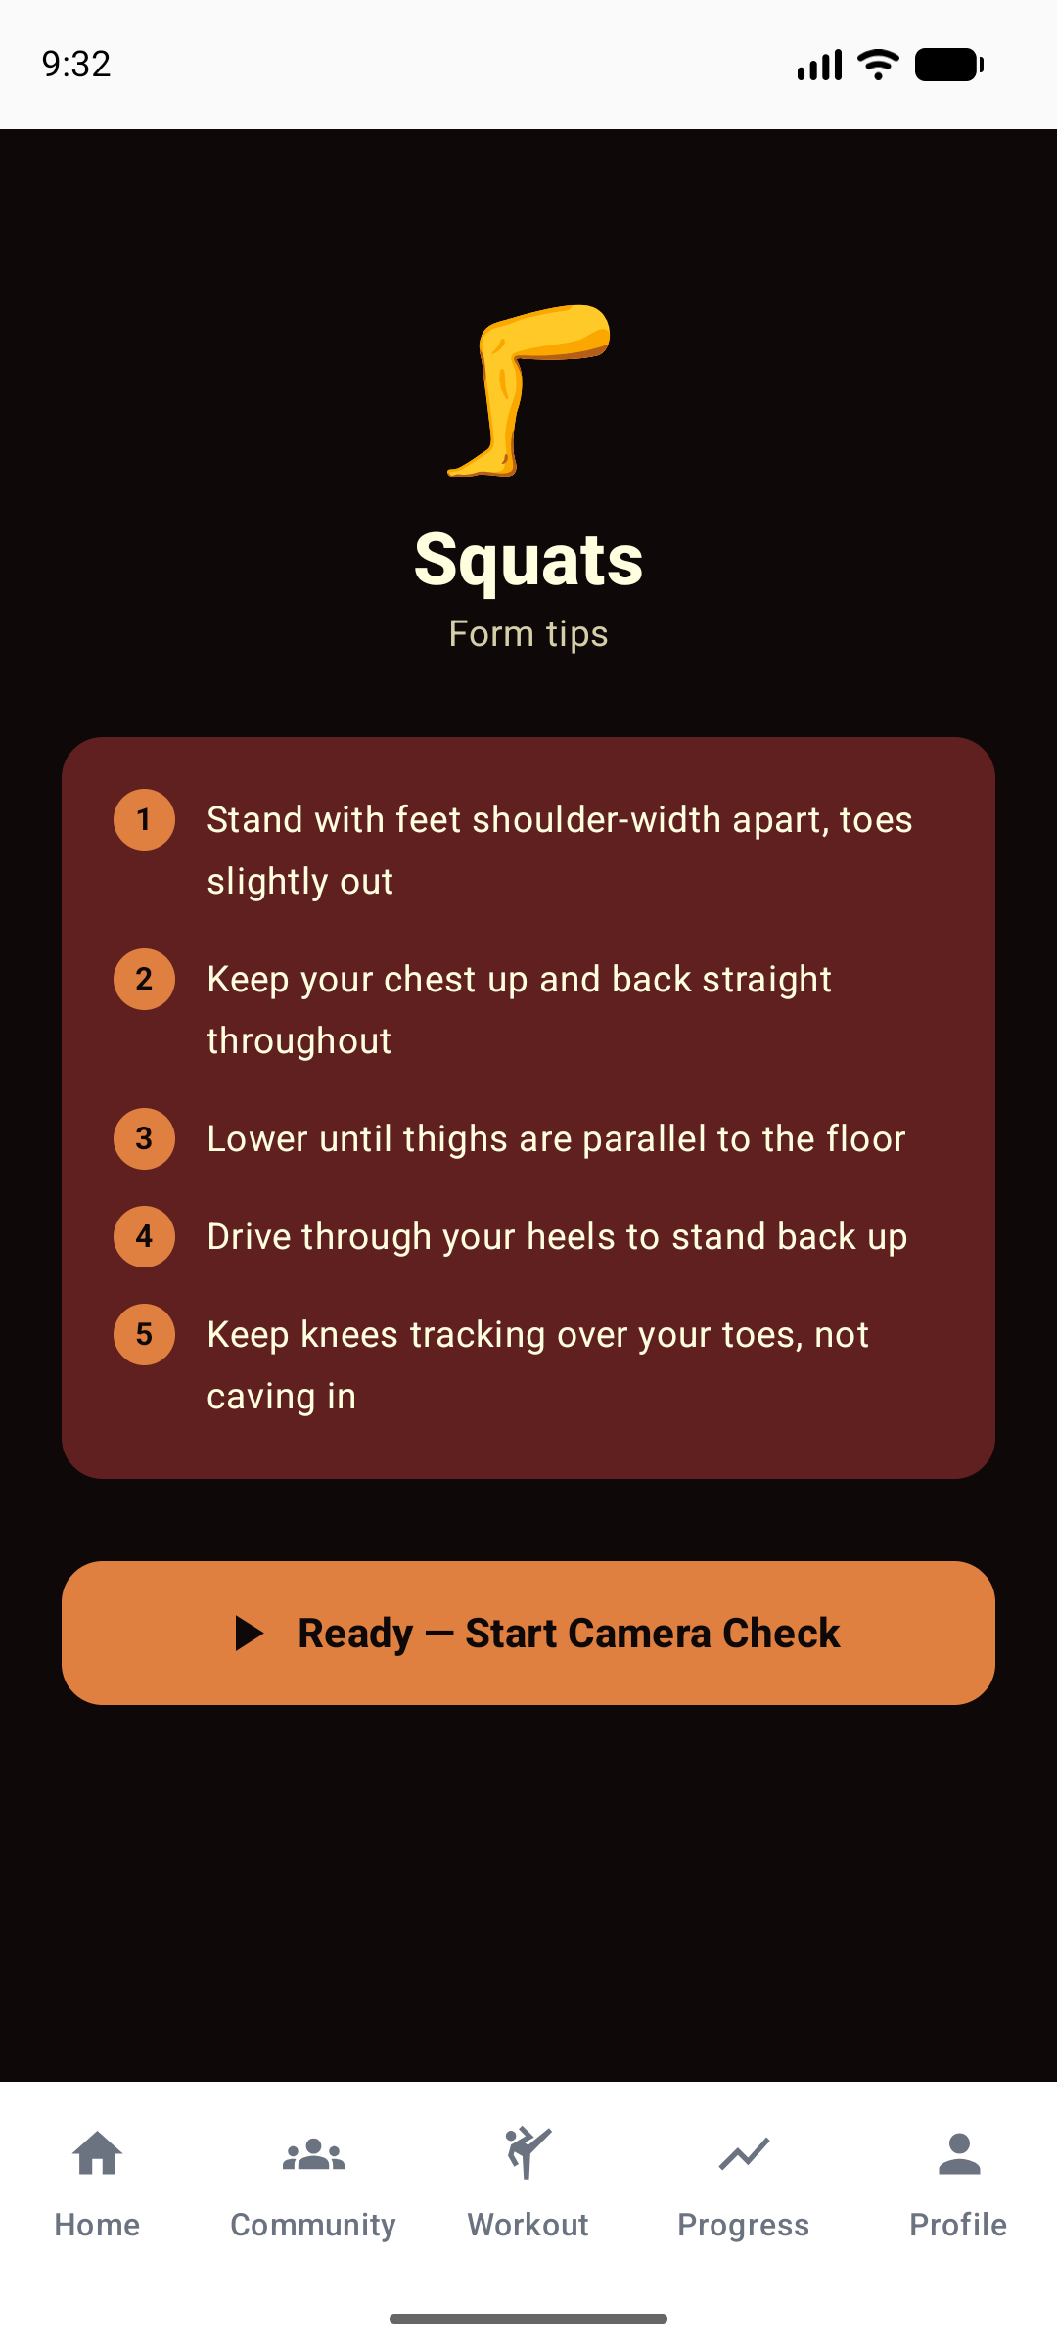
AI Workout Flow
Four-stage intelligent workout pipeline — from selection to summary
STAGE 1 — EXERCISE SELECT
Pick from Squats, Push-ups, Lunges, or Plank.
AI scoring model adapts biomechanics per exercise.
STAGE 2 — FORM INSTRUCTIONS
Exercise-specific biomechanical tips shown
before camera starts — injury prevention first.
STAGE 3 — ENVIRONMENT CHECK
Camera analyzes lighting, body visibility &
camera angle. Must score ≥60% to proceed.
STAGE 4 — ACTIVE WORKOUT
Live HUD: AI Score + Rep Counter + Fatigue
Alert + 5-metric breakdown per rep in real-time.

Slide 6
AI Workout Score Engine
World's first 5-dimensional per-rep fitness intelligence — grounded in biomechanics research
ACCURACY
BALANCE
STABILITY
SYMMETRY
SPEED
Measures joint angle vs.
exercise-specific ideal
range. Squat knee: 90–130°
= 100 points.
Hip or shoulder height
difference. Even 0.01
screen-unit offset starts
penalizing score.
Variance of 30-frame
rolling angle window.
High variance = shaky,
uncontrolled movement.
Left vs right limb angle
delta per rep. Catches
undetected muscle
imbalances over time.
Rep tempo: 2–4 sec =
100pts. Too fast (<1s)
or slow (>6s) penalises.
Ideal muscle time-under-tension.
OVERALL = 0.20 × Accuracy + 0.20 × Balance + 0.20 × Stability + 0.20 × Symmetry + 0.20 × Speed
FATIGUE PREDICTOR
ENVIRONMENT ANALYZER
Linear regression on 60-frame score history. fatigueLevel > 0.7 AND slope < −2 → injuryRisk = 0.8 → STOP alert.
Bitmap Luma (0.299R+0.587G+0.114B) · Laplacian sharpness kernel · Landmark visibility >0.5 · Shoulder tilt deviation angle.

Slide 7
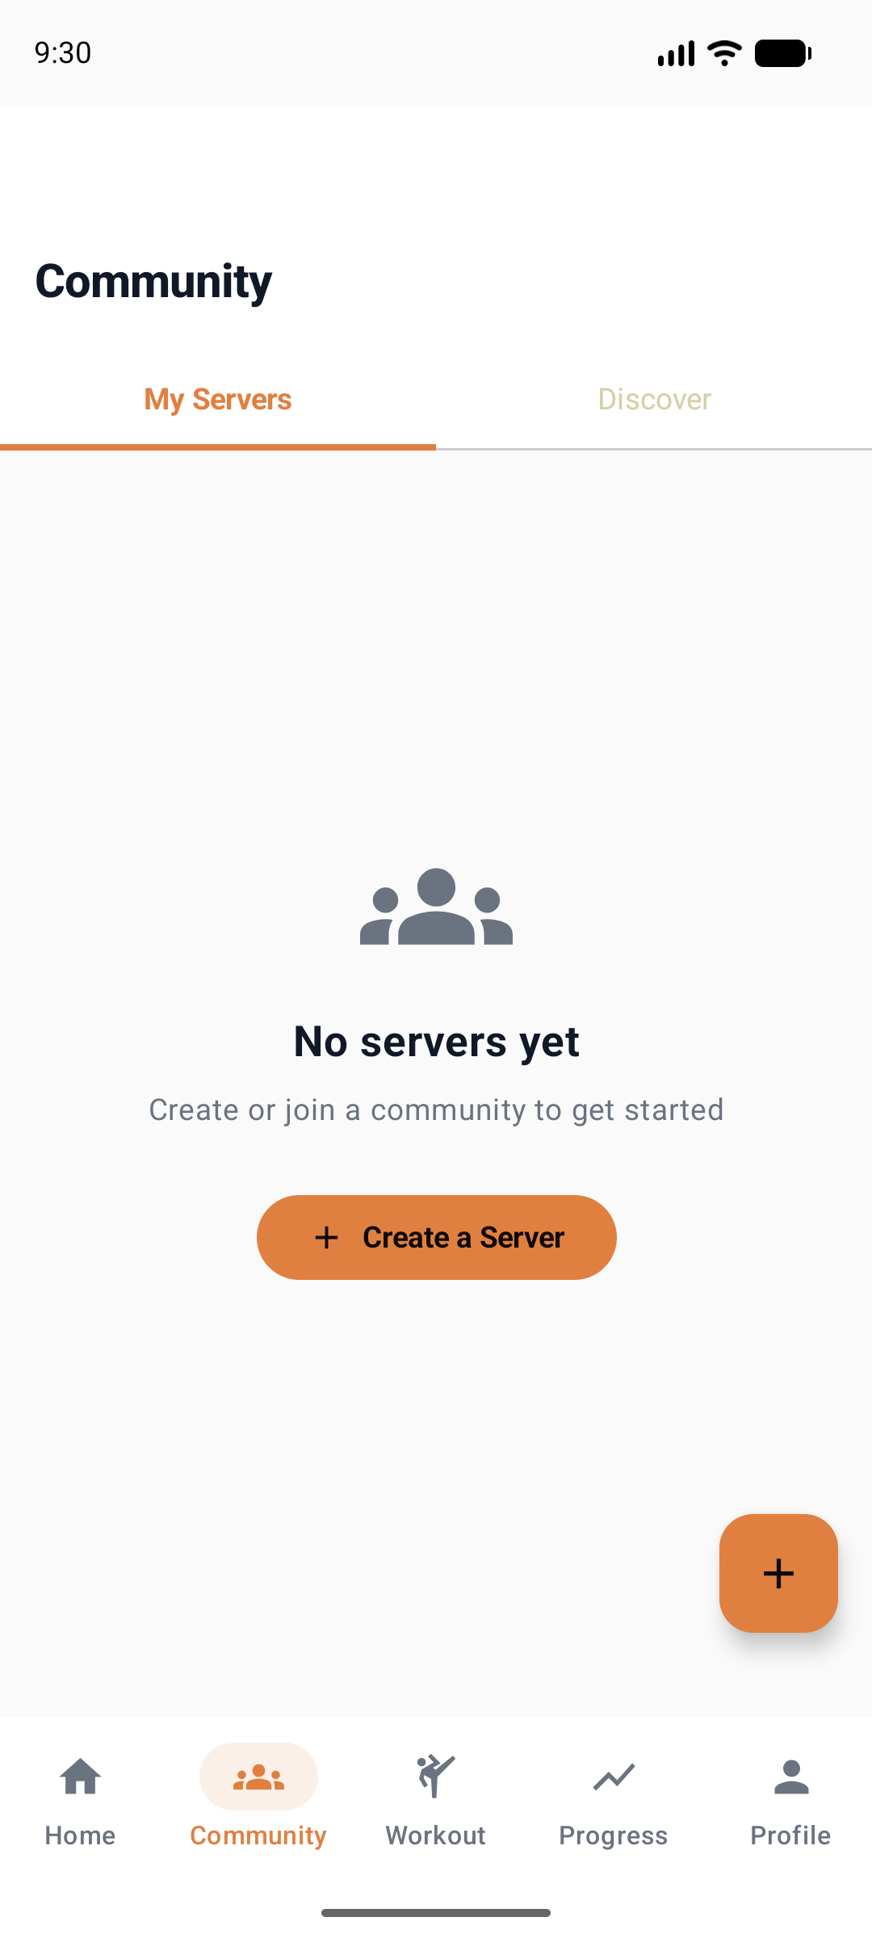
Social Fitness Platform
Beyond solo training — a full Discord-style social layer for the fitness world
Fitness Servers
Channel Chat
Shared Routines
Create or join named communities.
Each has channels, roles, routines & challenges.
Real-time messaging in topic channels.
Shared tips, form checks, workout videos.
Build multi-exercise programs,
publish them, let members copy & follow.
Live WebRTC Workout
Challenges & Badges
Meal Posts & Feed
Host or join live co-workout sessions
via WebRTC P2P video — train together.
Server-wide fitness challenges with
leaderboards, reactions, community awards.
Social feed: meals, workouts, progress
photos with reactions + threaded comments.

Slide 8
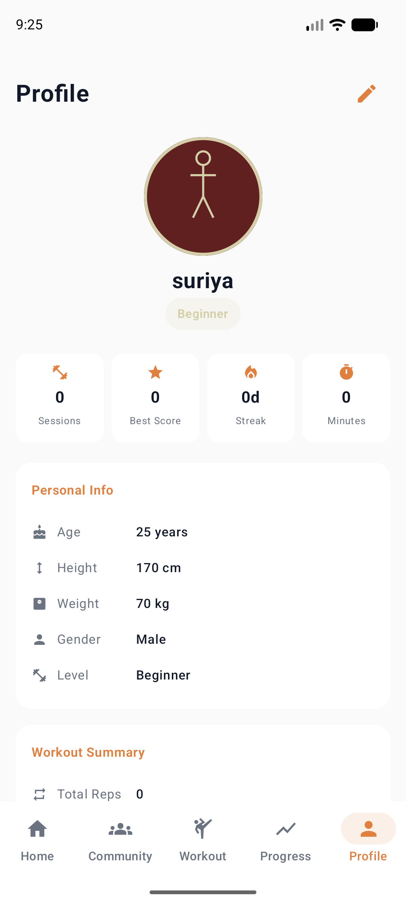
Progress Intelligence & Avatar System
Gamification meets data science — every session builds your digital self
FITNESS AVATAR EVOLUTION
LV 0
›
LV 1
›
LV 2
›
LV 3
›
LV 4
Beginner
Warrior
Athlete
Champion
Legend
PERSONALIZED PROGRESS ENGINE
Weekly Chart
AI Insights Panel
Canvas-drawn 7-day AI score line chart — spot improvement trends week over week.
Identifies your best metric (Strength) and your focus area (what to fix next).
Consistency Tracker
Session History
Daily heatmap powers avatar evolution — streak counter keeps users coming back.
Room DB stores all sessions: exercise, reps, duration, 5 sub-scores, injury risk.

Slide 9
Technology Stack
Built for scale, performance, and research-grade accuracy — all on-device
AI / Vision Layer
Application Layer
▸ MediaPipe BlazePose (pose_landmarker_full.task) — 33 landmarks at 30fps
▸ Kotlin 2.2.10 + Jetpack Compose Material 3 — declarative, reactive UI
▸ WorkoutScoreEngine — angle-threshold + rolling-variance scoring per exercise
▸ MVVM + StateFlow + Repository Pattern — clean architecture throughout
▸ FatiguePredictor — linear regression on 60-sample score time series
▸ CameraX 1.4.0 — ImageAnalysis 640×480 RGBA_8888 for MediaPipe feed
▸ EnvironmentAnalyzer — Laplacian sharpness + luminance + visibility QA
▸ Compose Navigation — 17 type-safe destination screens
Data Layer
Social / Network Layer
▸ Room 2.6.1 + KAPT — WorkoutSession, UserProfile, Server, Channel + 12 more entities
▸ WebRTC (org.webrtc) — P2P live co-workout video via SurfaceViewRenderer
▸ Firebase Firestore — real-time community sync: posts, reactions, messages
▸ Firebase RTDB — WebRTC signaling: ICE candidates, offer/answer exchange
▸ Firebase Auth — secure sign-in with token-based session management
▸ Firestore community data — roles, invites, challenges, live sessions
▸ DataStore Preferences — goals, avatar level, streak, user settings
▸ Room-cached feed — offline-first community experience

Slide 10
Market Opportunity
TAM
SAM
SOM
$111B
$28B
$2.4B
Global Health &
Fitness App Market
(2026 Estimate)
AI-Powered Personal
Training & Coaching
Apps Segment
Mobile Real-Time
Pose Analysis
Niche (5-yr target)
Why Now?
▸ MediaPipe BlazePose reached production-grade quality (2023) — enabling on-device inference at 30fps on mid-range phones.
▸ Post-pandemic home fitness explosion — 43% of users now prefer working out at home (2024 Global Fitness Survey).
▸ Gen Z expects AI-native apps — generic rep counters no longer satisfy the digital-first fitness generation.
▸ Smartphone cameras now support millimeter-accurate joint detection — the hardware barrier to entry is gone.

Slide 11
Business Model
FREE
PRO
TEAM
$0 / month
$9.99 / month
$24.99 / month
✓ 4 core exercises
✓ Full 5-metric score breakdown
✓ Everything in Pro (unlimited users)
✓ Basic overall AI Score
✓ Unlimited history & charts
✓ Private fitness server + channels
✓ 7-day session history
✓ Fatigue & injury risk alerts
✓ Live WebRTC co-workout sessions
✓ Community read-only
✓ All 5 avatar evolution levels
✓ Team leaderboards & challenges
✓ Beginner avatar only
✓ Community posting & reactions
✓ Admin roles & invite management
✓ Custom workout routines
✓ Priority AI model updates

Slide 12
Competitive Landscape
Feature
FitAI
MyFitnessPal
Nike Training
Freeletics
Whoop
Real-time Pose AI (on-device)
✓
✗
partial
✗
✗
5-Metric Score per Rep
✓
✗
✗
✗
✗
Fatigue & Injury Prediction
✓
✗
✗
partial
✓ HRV
Environment Quality Analysis
✓
✗
✗
✗
✗
Gamified Avatar System
✓
✗
✗
✓
✗
Social Servers + Channels
✓
✗
✗
✓
✗
Live Co-Workout (WebRTC)
✓
✗
✗
✗
✗
Fully On-Device (No cloud AI)
✓
partial
✗
✗
✗
Research Paper–Backed Science
✓
✗
✗
✗
partial

Slide 13
Product Roadmap
From research prototype to market leader
Q4 2026
LAUNCH
Q1 2027
GROWTH
Q2–Q3 2027
SCALE
2028+
VISION
▸ Play Store public release
▸ LLM coaching feedback
▸ B2B gym & PT licensing
▸ Wearable sensor fusion
▸ Pro & Team subscriptions
▸ Personalized rep targets
▸ Custom ML model fine-tune
▸ Clinical rehab partner
▸ 10 additional exercises
▸ Apple Watch HR fusion
▸ AR pose overlay (ARCore)
▸ Sports team analytics
▸ Firebase backend hardening
▸ iOS port (KMM)
▸ Nutrition AI integration
▸ Series B readiness
▸ Onboarding A/B optimization
▸ 10,000 MAU milestone
▸ 100K MAU milestone
▸ 1M+ MAU global platform

Slide 14
The Ask
Seeking $500,000 Seed Round
Contact
to take FitAI from research prototype to 10,000 paying users on the Play Store
Suriya Sittharth
Founder & Developer
40% — Engineering
suriyasittharth4@gmail.com
iOS port, 10 more exercises, LLM coaching layer, backend infrastructure & scalability.
Built on peer-reviewed
research. Every feature
grounded in biomechanics
science — not marketing.
25% — Marketing
User acquisition campaigns, fitness influencer partnerships, Play Store ASO.
20% — AI Research
FIT AI
Custom model fine-tuning on labeled pose datasets. Expand to 20+ exercise types.
15% — Operations
Train Smarter. Not Harder.
Team: 2 engineers + 1 designer. Legal, compliance, and office setup.

