Slide 1
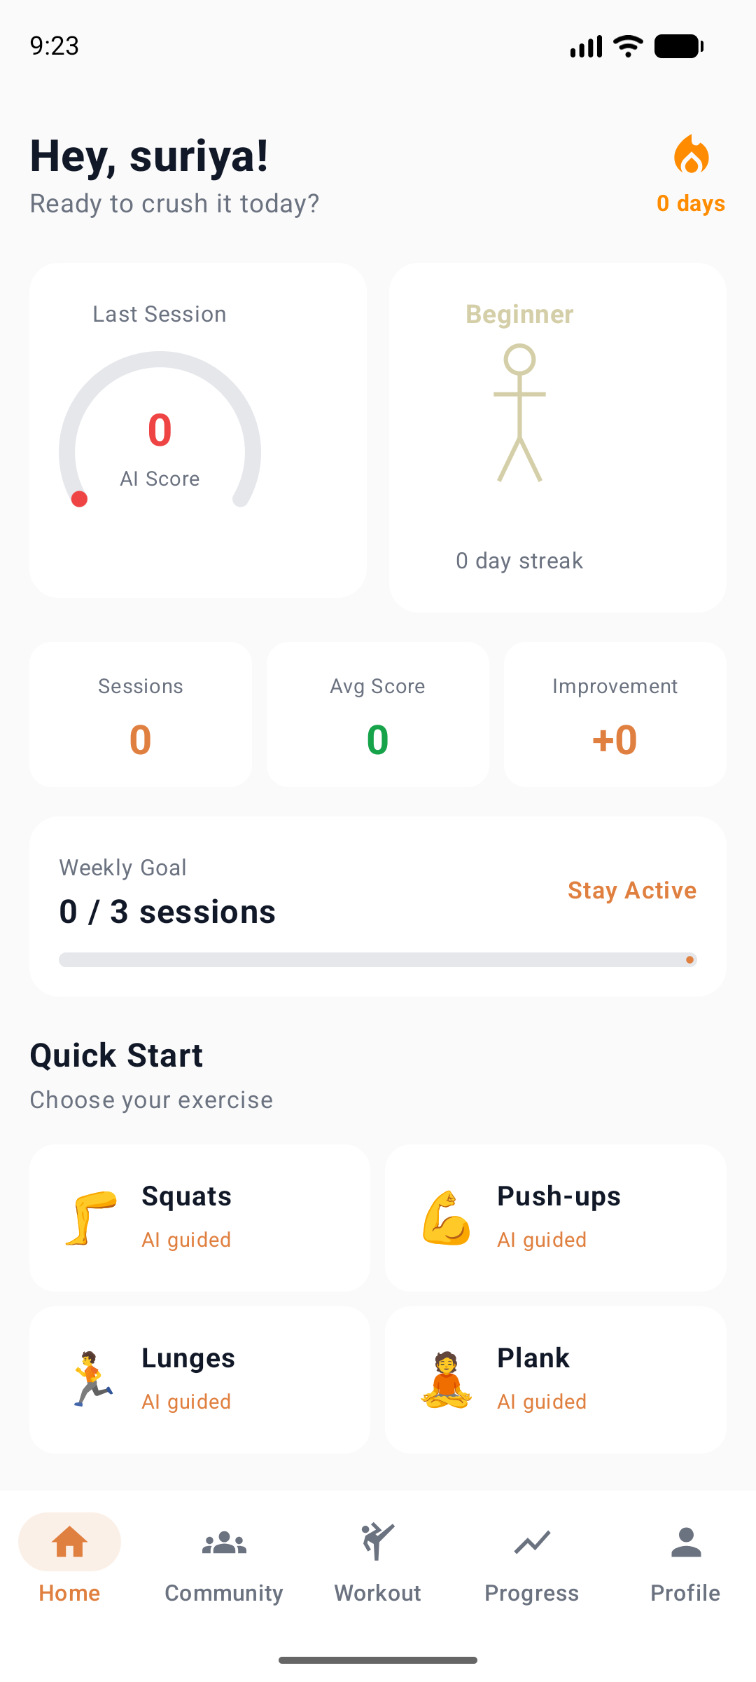
FIT
AI
Your Real-Time AI Personal Trainer
On-device pose analysis · 5-metric AI score · Injury prediction · Social fitness platform
MediaPipe BlazePose
Jetpack Compose
Firebase + WebRTC
Suriya Sittharth · suriyasittharth4@gmail.com · 2026

Slide 2
The Problem
67%
82%
0
of gym users get
injured from bad form
quit fitness apps
within 3 months
platforms combine
AI + social fitness
No app watches your posture in real-time and tells you before you hurt yourself.
Apps count reps but never explain WHY you're improving or declining — no real coaching.
Fitness is social — but there's no place to train live with friends, share routines, or run community challenges.
"I want a coach that sees me move — not an app that just logs my workout." — Real user feedback

Slide 3
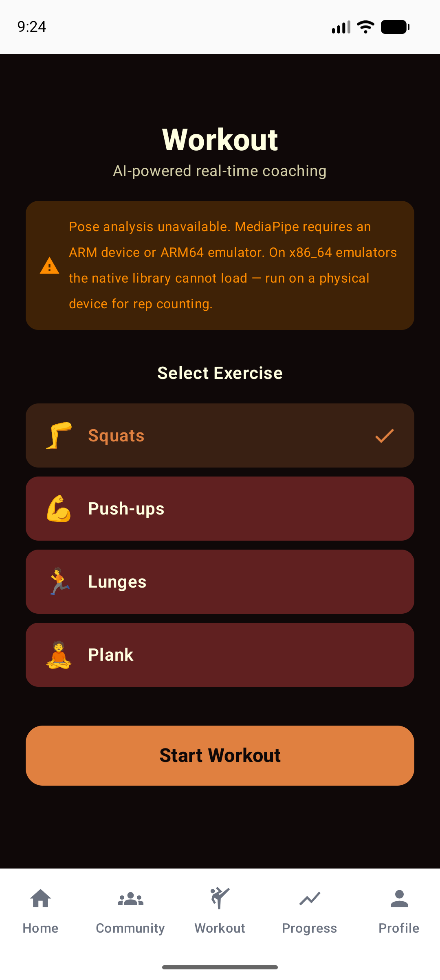
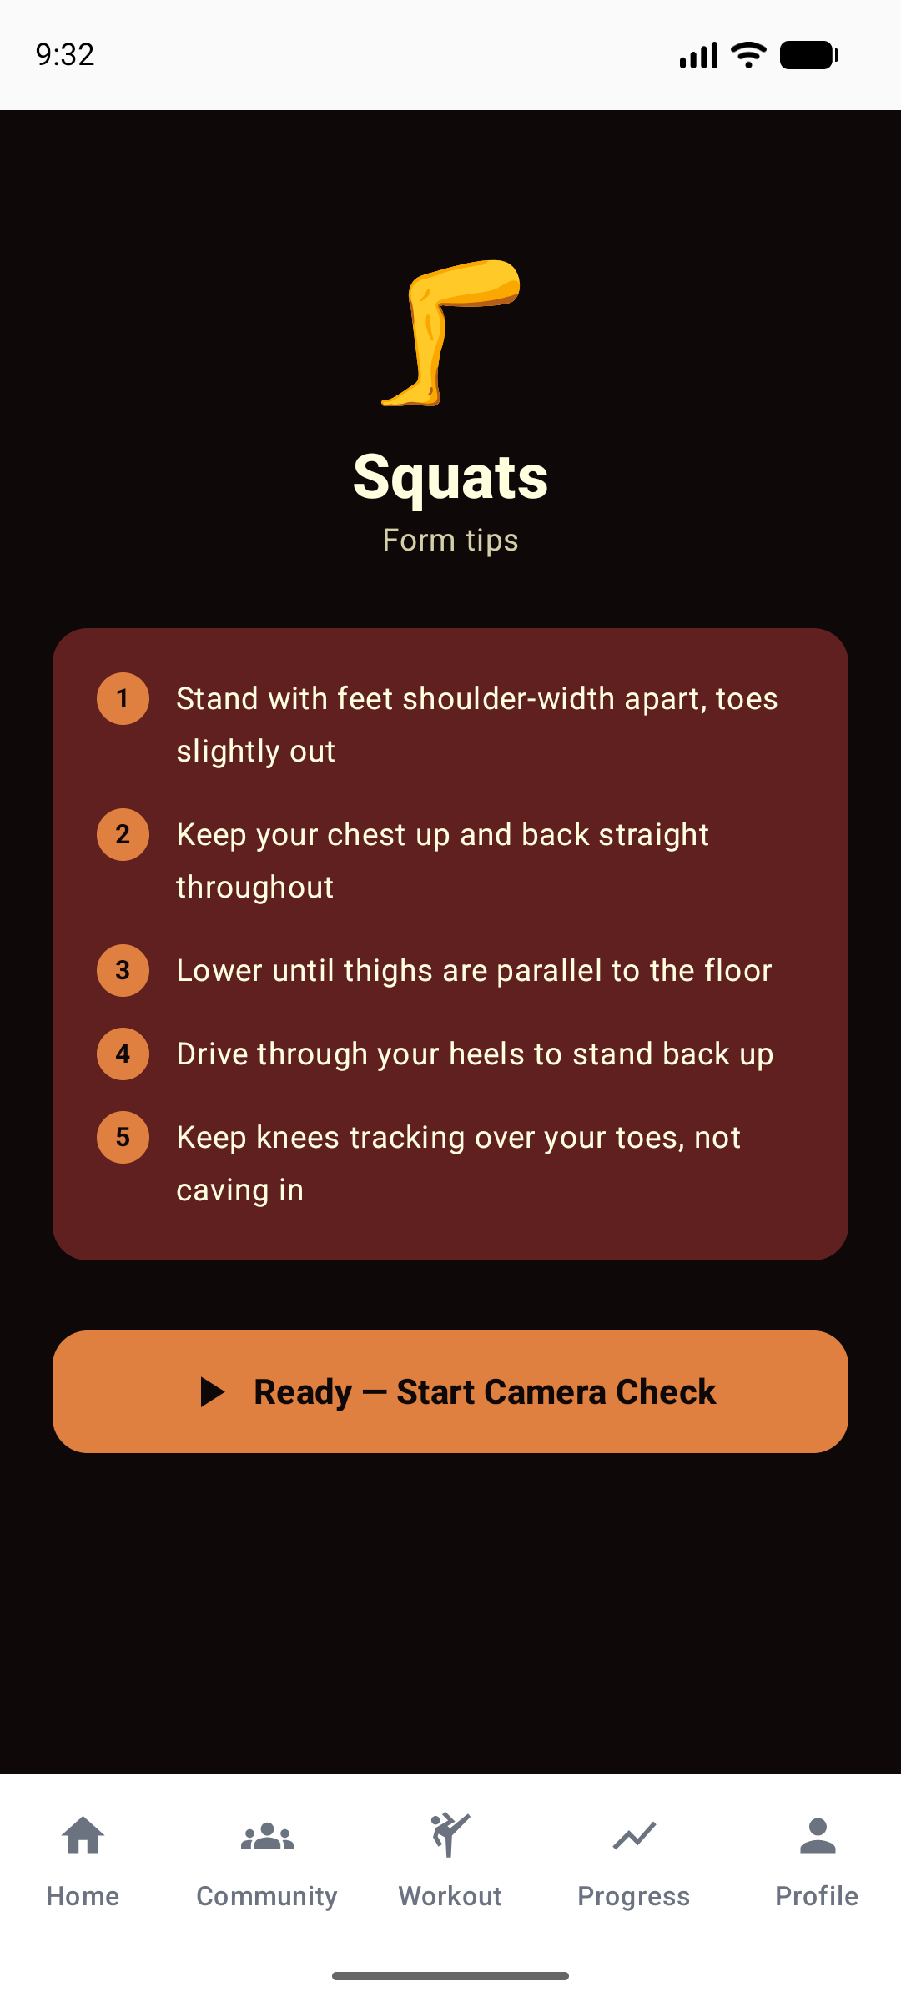
Meet FitAI
A full AI workout intelligence platform — built and running on Android today
Home Dashboard
Workout Selection
Form Coach
AI score · avatar · weekly goal
AI-guided exercise picker
Step-by-step biomechanics tips

Slide 4
How the AI Works
Every single rep is graded across 5 dimensions — in real-time, entirely on your phone
1 CAMERA
2 POSE AI
3 SCORE
4 ALERT
Front camera captures
your movement at 30fps
using CameraX.
MediaPipe BlazePose
detects 33 body landmarks
on your skeleton.
Custom engine calculates
5 metrics per rep from
joint angles & timing.
Fatigue predictor watches
your score trend and warns
before injury occurs.
→
→
→
The 5-Metric AI Workout Score — computed every rep:
ACCURACY
BALANCE
STABILITY
SYMMETRY
SPEED
Is your joint angle
in the ideal range?
Are both sides of
your body even?
Are your movements
smooth and controlled?
Left vs right —
are you compensating?
Is your rep tempo
2–4 seconds? Ideal.
Overall AI Score = average of all 5 metrics · Fatigue predictor fires when score drops sharply over time

Slide 5
The Market Opportunity
How to read this: Investors use three numbers to measure market size.
TAM = the entire industry · SAM = the part our product directly serves · SOM = what we can realistically capture in 5 years
TAM
SAM
SOM
$111 Billion
$28 Billion
$2.4 Billion
Global fitness app market (2026 forecast)
AI coaching & smart training apps
Real-time pose analysis niche (5-yr target)
Total Addressable Market
Serviceable Addressable Market
Serviceable Obtainable Market
Every person on Earth who uses or could use a health & fitness app.
The slice we directly target: people who want AI-powered personal training on their phone.
What FitAI can realistically capture in 5 years with our team, product, and go-to-market plan.
Why now? MediaPipe BlazePose (2023) made on-device 30fps pose analysis possible on any mid-range phone — the tech barrier is gone.

Slide 6
Business Model
Freemium → subscription — hook users free, convert on value
FREE
PRO
TEAM
$0
$9.99
$24.99
/month
/month
/month
✓ 4 exercises (Squats, Push-ups, Lunges, Plank)
✓ Full 5-metric score per rep
✓ Everything in Pro for unlimited members
✓ Overall AI Score (no breakdown)
✓ Unlimited history + weekly chart
✓ Private fitness server + channels
✓ 7-day session history
✓ Fatigue & injury risk alerts
✓ Live WebRTC co-workout video sessions
✓ Community — read only
✓ All 5 avatar levels (Beginner → Legend)
✓ Team challenges & leaderboards
✓ Beginner avatar only
✓ Post, react & chat in communities
✓ Admin roles + invite management
✓ Create custom workout routines
Get users in the door
Core monetisation driver
B2B: gyms, PT coaches, sports teams

Slide 7
Why FitAI Wins
No existing app combines real-time AI coaching + social fitness in one place
FitAI
MyFitnessPal
Nike Training
Freeletics
Our
Edge
Real-time pose AI (on-device)
✓
✗
✗
✗
Research-backed
Built from a published
peer-reviewed paper on
AI workout intelligence.
Score breakdown per rep
✓
✗
✗
✗
Fatigue & injury prediction
✓
✗
✗
partial
Zero cloud cost
Environment quality check
✓
✗
✗
✗
All AI runs on-device.
No GPU servers.
95% margin product.
Evolving gamified avatar
✓
✗
✗
✓
Social servers + live workout
✓
✗
✗
First mover
✗
No competitor combines
real-time pose AI +
community in one app.
100% on-device (no cloud cost)
✓
✗
✗
✗

Slide 8
Roadmap & The Ask
Q4 2026
Q1 2027
Q3 2027
2028+
LAUNCH
GROWTH
SCALE
VISION
▸ Play Store public launch
▸ LLM coaching feedback
▸ B2B gym licensing
▸ Wearable fusion
▸ Pro & Team subscriptions
▸ iOS port (KMM)
▸ AR pose overlay
▸ Clinical rehab partner
▸ 10 more exercises
▸ Apple Watch HR fusion
▸ Nutrition AI
▸ 1M+ MAU global
▸ Onboarding flow
▸ 10K paying users
▸ 100K MAU
▸ Series B
Seeking $500,000 Seed Round
to launch on Play Store and reach 10,000 paying users
40%
Engineering
25%
Marketing
20%
AI Research
15%
Operations
iOS port, 10 more exercises, LLM coaching, backend
User acquisition, influencer fitness, Play Store ASO
Custom model fine-tuning on labeled pose datasets
2 engineers + 1 designer, legal & compliance
Suriya Sittharth · suriyasittharth4@gmail.com · FitAI — Train Smarter. Not Harder.

