Slide 1
Data Spark-Illuminating Insights For Global Electronics Capstone Proect-2 By: SURIYA S S

Slide 2
Customer Analysis

Slide 3
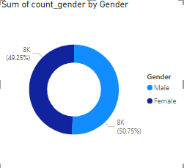
Gender Distribution
We have seen male customers are dominating in number when compared to female customer.
Male represents a slight majority at 7748(50.75%), compared to females 7518(49.25%).Both categories are equally labeled as 8K,indicating rounded numbers.

Slide 4
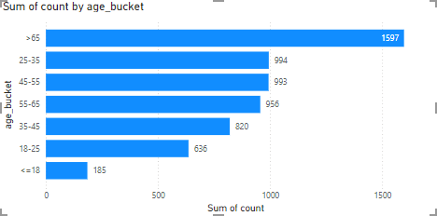
Age Distribution
The customers are bucketed based on their age and then visualized using bar chart.
We can see that the above 65 years is the largest age group with 1,597 customers.
Other age groups:
<=18 years 186 customers
18-25 years 636 customers
25-35 years 994 customers
35-45 years 820 customers
45-55 years 993 customers
55-65 years 956 customers

Slide 5
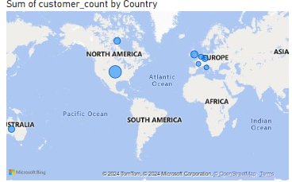
Country distribution
The location wise analysis was represented using the world map.
The size of each bubble reflects the number of customers from that country.
The majority of customers are concentrated in North America

Slide 6
Sales Analysis

Slide 7
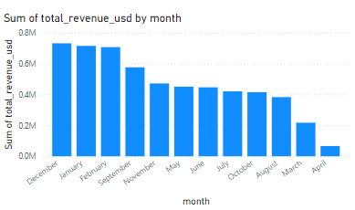
Sales by month
We can see tha highest sales are there in Jan,Feb,Dec
The April and march has recorded the lowest sales

Slide 8
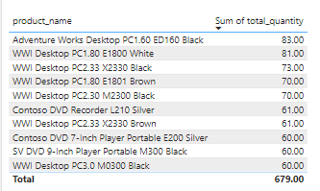
Product quantity analysis
We can see that the Adventure works desktop pc1.60 sold the highest quantity.
Other products, including DVD players and WWI desktops, also performed well.

Slide 9
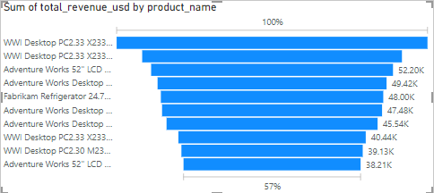
Top revenue product
We can see that WWI Desktop PC2.33 * 2330 has highest revenue.
Desktops appear to be the most demanded category , both in terms of revenue and quantity sold.

Slide 10
Product Analysis

Slide 11
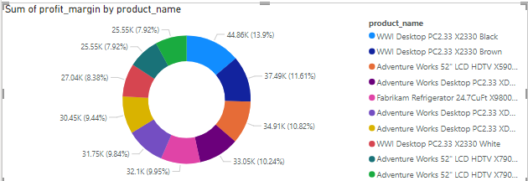
Profit margin distribution by product
From the donut chart the top products (wwi desktop pc2.33 x2330 black )contributes higher profit margins compared to other products.

Slide 12
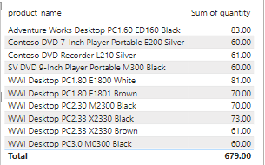
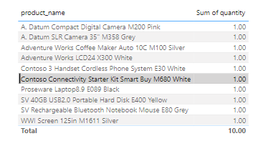
Product quantity analysis
top 10 products
The top selling products are from the desktop and computers segment
Least 10 products
Cameras,laptops,and refrigerators have very low sales (1 unit each), suggesting low market demand

Slide 13
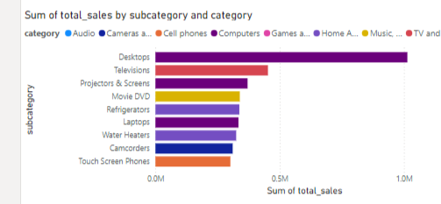
Sales by subcategory and category
we see that the desktops and televisions lead in sales within the category of computers , tv and videos

Slide 14
Store analysis

Slide 15
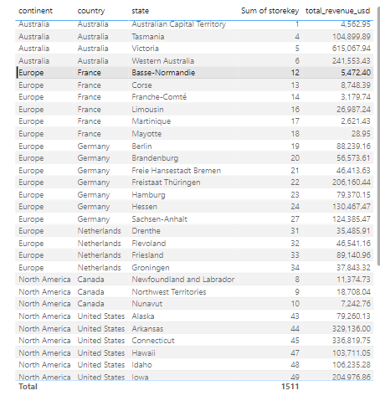
Overall analysis
After seeing the total revenue, it has been understood that the sales from north American has the highest sales.
There are very less number of stores in Australia

Slide 16
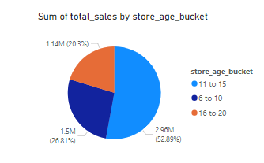
Store age analysis
We can see that the age of the store is between 10-15 they are contributing to the highest amount of sales.

Slide 17
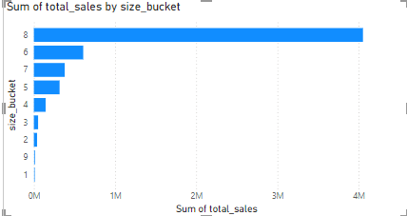
Store size analysis
We can see the the largest stores contributing the majority of sales, with size bucket 8.

Slide 18
Thank you

