Slide 1
COLLECTIONS

Slide 2
COLLECTIONS
Collections are used to group objects into single entity. Once the objects are stored in a collection you can then perform operations on single object or multiple objects (bulk operations).
Can do insert, update, delete, and retrieve objects into entity

Slide 3
Java collections are made up of following:
Interfaces
Implementations
Algorithms
Benefits:
Reduced Programming effort
Reduced learning effort
Reusability

Slide 4
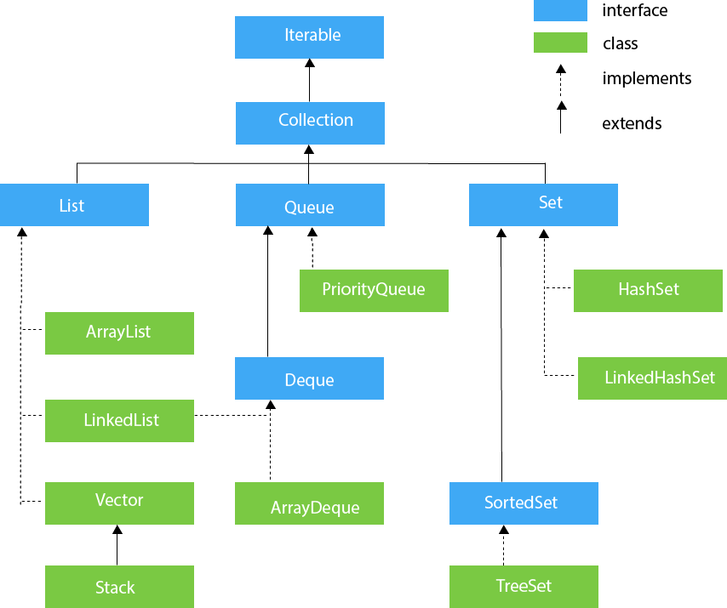
Hierarchy of Collection Framework

Slide 5
The java.util package contains all the classes and interfaces for the Collection framework.
Iterable Interface
The Iterable interface is the root interface for all the collection classes. The Collection interface extends the Iterable interface and therefore all the subclasses of Collection interface also implement the Iterable interface.
It contains only one abstract method. i.e.,
Iterator<T> iterator()
It returns the iterator over the elements of type T.

Slide 6
Collection Interface
The Collection interface is the interface which is implemented by all the classes in the collection framework. It declares the methods that every collection will have.
Some of the methods of Collection interface are Boolean add ( Object obj), Boolean addAll ( Collection c), void clear(), etc. which are implemented by all the subclasses of Collection interface.

Slide 7
List Interface
List interface is the child interface of Collection interface.
It inhibits a list type data structure in which we can store the ordered collection of objects.
It can have duplicate values.
List interface is implemented by the classes ArrayList, LinkedList, Vector, and Stack.

Slide 8
To instantiate the List interface, we must use :
List <data-type> list1= new ArrayList();
List <data-type> list2 = new LinkedList();
List <data-type> list3 = new Vector();
List <data-type> list4 = new Stack();

Slide 9
ArrayList
ArrayList is the implementation class of List Interface which is used to store a group of individual objects where duplicate values are allowed.
ArrayList all the elements are stored in contiguous memory locations same as an array, but ArrayList size is not fixed.

Slide 10
LinkedList
LinkedList implements the Collection interface.
It uses a doubly linked list internally to store the elements.
It can store the duplicate elements.
It maintains the insertion order and is not synchronized. In LinkedList, the manipulation is fast because no shifting is required.

Slide 11
Stack
The stack is the subclass of Vector.
It implements the last-in-first-out data structure.
The stack contains all of the methods of Vector class .
It provides methods like boolean push(), boolean peek(), boolean push(object o), which defines its properties.

Slide 12
Queue Interface
Queue interface maintains the first-in-first-out order.
It can be defined as an ordered list that is used to hold the elements which are about to be processed.
There are various classes like PriorityQueue, Deque, and ArrayDeque which implements the Queue interface.

Slide 13
Queue interface can be instantiated as:
Queue<String> q1 = new PriorityQueue();
Queue<String> q2 = new ArrayDeque();
Queue<String> q2 = new LinkedList();
PriorityQueue
Implements the Queue interface.
It holds the elements or objects which are to be processed by their priorities.
It doesn't allow null values to be stored in the queue.

Slide 14
Methods like offer(),peek() and pop() are used to add and remove the elements.
we can also use add(),element(),remove() but this methods will throw exception if the element is performed is specified task/operations.

Slide 15
ArrayDeque
ArrayDeque class implements the Deque interface.
It facilitates us to use the Deque.
Unlike queue, we can add or delete the elements from both the ends.
ArrayDeque is faster than ArrayList and Stack and has no capacity restrictions.

Slide 16
Set Interface
Set Interface in Java is present in java.util package.
It extends the Collection interface.
It represents the unordered set of elements which doesn't allow us to store the duplicate items.
We can store at most one null value in Set.
Set is implemented by HashSet, LinkedHashSet, and TreeSet.

Slide 17
Set can be instantiated as:
Set<data-type> s1 = new HashSet<data-type>();
Set<data-type> s2 = new LinkedHashSet<data-type>();
Set<data-type> s3 = new TreeSet<data-type>();

Slide 18
Java Map Interface
A map contains values on the basis of key, i.e. key and value pair.
Each key and value pair is known as an entry.
A Map contains unique keys.
A Map is useful if you have to search, update or delete elements on the basis of a key.

Slide 19
Java Map Hierarchy

Slide 20
A Map can't be traversed, so you need to convert it into Set using keySet() or entrySet() method.
Class | Description
HashMap | HashMap is the implementation of Map, but it doesn't maintain any order.
LinkedHashMap | LinkedHashMap is the implementation of Map. It inherits HashMap class. It maintains insertion order.
TreeMap | TreeMap is the implementation of Map and SortedMap. It maintains ascending order.

Slide 21
Equals() and Hashcode() in Java
The equals() and hashcode() are the two important methods provided by the Object class for comparing objects.
Since the Object class is the parent class for all Java objects, hence all objects inherit the default implementation of these two methods.

Slide 22
equals()
The java equals() is a method of lang.Object class, and it is used to compare two objects.
To compare two objects that whether they are the same, it compares the values of both the object's attributes.
By default, two objects will be the same only if stored in the same memory location.
Syntax:
public boolean equals(Object obj)

Slide 23
Java hashcode()
A hashcode is an integer value associated with every object in Java.Since this method is defined in the Object class, hence it is inherited by user-defined classes also.
Syntax:
public int hashCode()

Slide 24
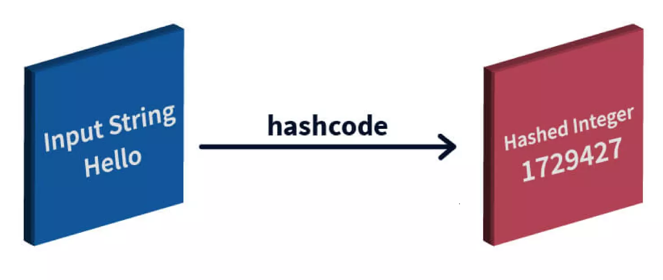
The hashcode() method returns the same hash value when called on two objects, which are equal according to the equals() method.
And if the objects are unequal, it usually returns different hash values.

Slide 25
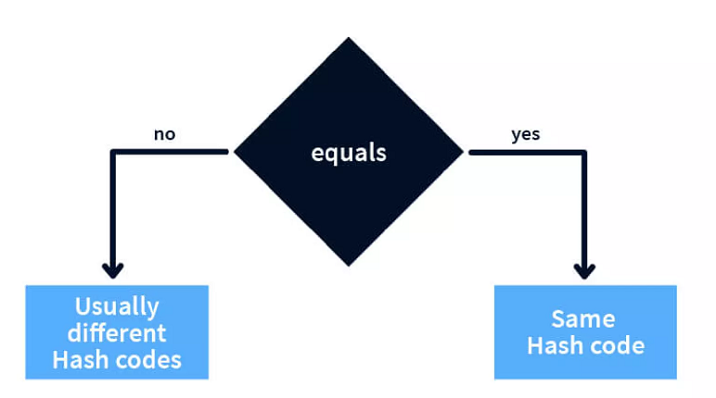

Slide 26
Thank you

