Slide 1
JDBC
(Java Database Connectivity)

Slide 2
JDBC’s full form is Java Database Connectivity. It is basically a Java API that is used to execute and connect query along with the database.
It is considered to be part of Java SE, that is, Java Standard Edition. API of JDBC makes uses of drivers of JDBC in order to get connected along with the database.

Slide 3
JDBC API can be used in order to access the tabular data stored in any of the relational databases.
By using JDBC API, you can save, update, delete, and fetch the data from the database. Therefore, it is considered to be Open Database Connectivity, that is, ODBC provided by Microsoft.

Slide 4
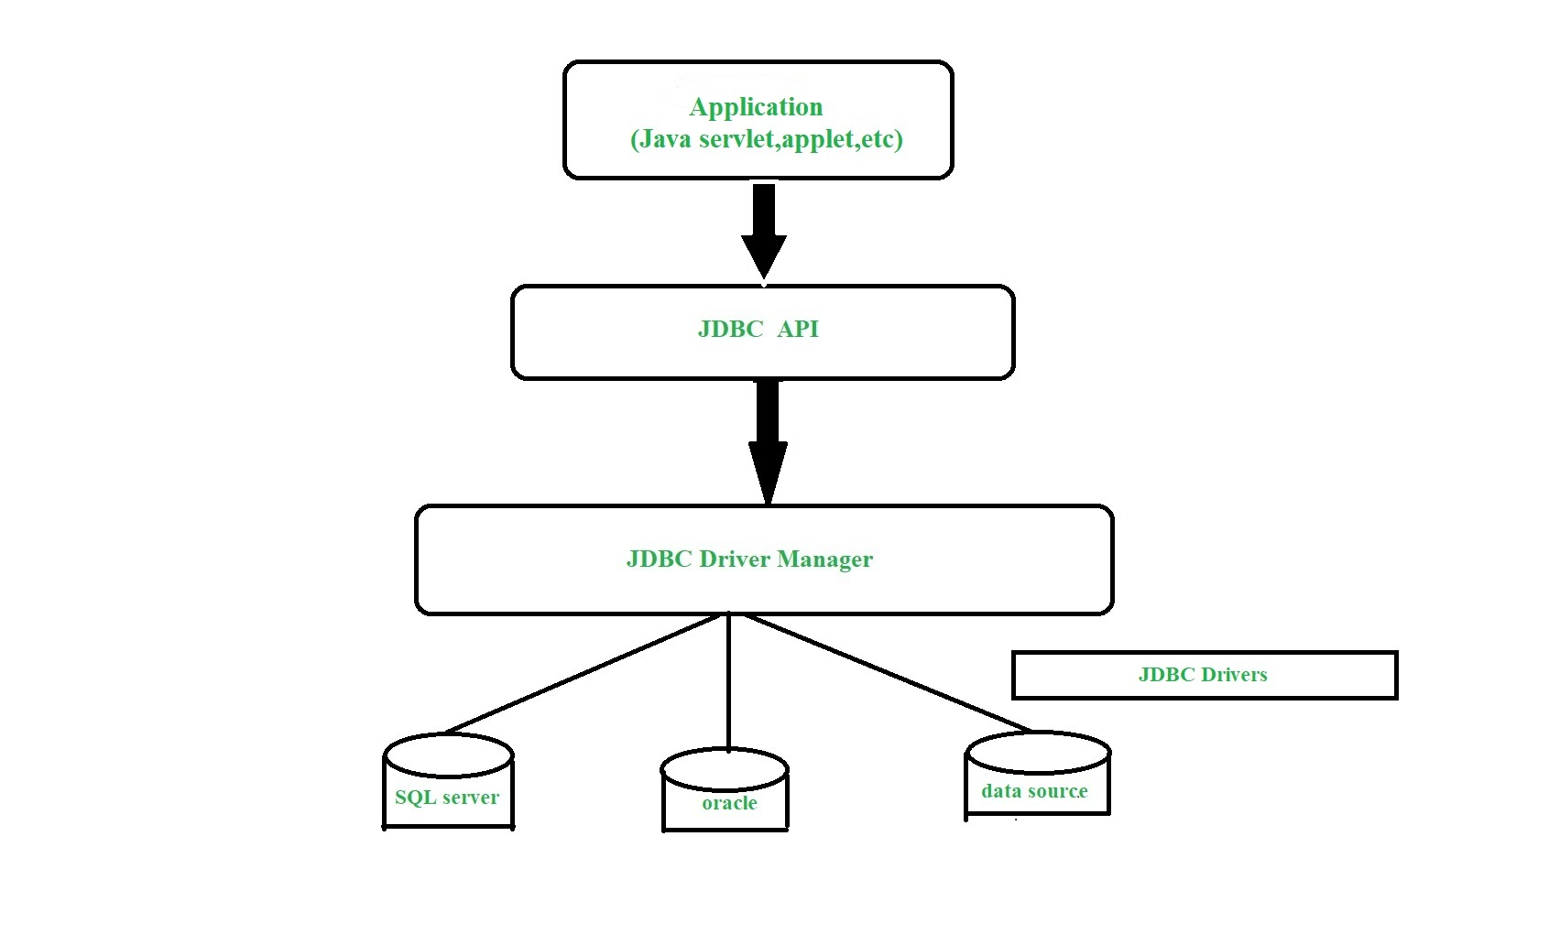
Architecture Of JDBC

Slide 5
The java.sql package contains classes and interfaces for JDBC API.
A list of popular interfaces of JDBC API are given below:
Driver interface
Connection interface
Statement interface

Slide 6
PreparedStatement interface
CallableStatement interface
ResultSet interface
ResultSetMetaData interface
Classes of JDBC API are :
DriverManager class

Slide 7
Java Database Connectivity Steps
Load & Register the Driver class
Create connection
Create statement
Execute queries
Close connection

Slide 8
1. Load &Register the driver class
The forName() method of Class class is used to register the driver class. This method is used to dynamically load the driver class.
Syntax
public static void forName(String className)throws ClassNotFoundException

Slide 9
2. Create the connection object
The getConnection() method of DriverManager class is used to establish connection with the database.
Syntax
public static Connection getConnection(String url)throws SQLException
public static Connection getConnection(String url,String name,
String password )throws SQLException

Slide 10
3.Create the Statement object
The createStatement() method of Connection interface is used to create statement. The object of statement is responsible to execute queries with the database.
Syntax
public Statement createStatement()throws SQLException

Slide 11
4.Execute the query
The executeQuery() method of Statement interface is used to execute queries to the database. This method returns the object of ResultSet that can be used to get all the records of a table.
Syntax
public ResultSet executeQuery(String sql)throws SQLException

Slide 12
5.Close the connection object
By closing connection object statement and ResultSet will be closed automatically. The close() method of Connection interface is used to close the connection.
Syntax
public void close()throws SQLException

Slide 13
JDBC Scrollable ResultSet
A scrollable ResultSet is one which allows us to retrieve the data in forward direction as well as backward direction but no updations are allowed.
In order to make the non-scrollable ResultSet as scrollable ResultSet we must use the following createStatement() method which is present in Connection interface.

Slide 14
public Statement createStatement(int Type , int Mode)
Here type represents the type of scrollability and mode represents either read only or updatable.
The value of Type and the Modes are present in ResultSet interface as constant data members and they are:
TYPE_FORWARD_ONLY
TYPE_SCROLL_INSENSITIVE
CONCUR_READ_ONLY

Slide 15
Methods
public boolean next ()
public void beforeFirst ()
public boolean isFirst ()
public void first ()
public boolean isBeforeFirst ()
public boolean previous ()
public void last ()
public boolean isAfterLast ()
public void absolute (int)
public void relative (int)

Slide 16
JDBC Updatable ResultSet
To make the ResultSet object updatable and scrollable we must use the following constants which are present in the ResultSet interface.
TYPE_SCROLL_SENSITIVE
CONCUR_UPDATABLE

Slide 17
Statement st=con.createStatement(ResultSet.TYPE_SCROLL-SENSITIVE,
ResultSet.CONCUR_UPDATABLE)
Perform the following three operations:
Inserting a record.
Deleting a record.
Updating a record.

Slide 18
Thank you

