Slide 1
MULTITHREADING

Slide 2
Thread Priority
Thread priority in Java is a number assigned to a thread that is used by Thread scheduler to decide which thread should be allowed to execute.
Thread priorities are represented by a number from 1 to 10 that specifies the relative priority of one thread to another.

Slide 3
The default priority of a thread is 5. Thread class in java also provides several priority constants to define the priority of a thread. These are:
1. MIN_PRIORITY = 1 2. NORM_PRIORITY = 5 3. MAX_PRIORTY = 10
These constants are public, final, and static members of the Thread class.

Slide 4
Methods: getPriority() and setPriority()
The getPriority() that is used to determine the priority of a thread. It returns the priority of a thread through which it is called.
The setPriority() of Thread class is used to set the priority of a thread. This method accepts an integer value as an argument and sets that value as priority of a thread through which it is called.

Slide 5
Syntax:
ThreadName.setPriority(n)
Where n is an integer value ranges from 1 to 10.
Higher the priority to a thread, the higher is the chance for thread execution.

Slide 6
yield() method
The yield() method is used in Java to hint the task scheduler to move the currently executing task to the Ready state and move another task or thread to the running state. The task scheduler is free to ignore the hint.
Syntax
static void yield()
It can be called with its class name as : Thread.yield()

Slide 7
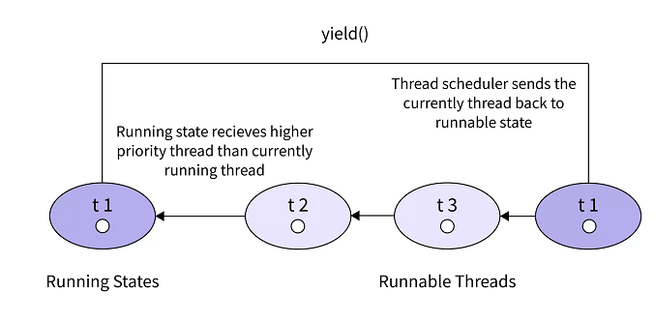

Slide 8
Synchronization
Synchronization in java is the capability to control the access of multiple threads to any shared resource.
In the Multithreading concept, multiple threads try to access the shared resources at a time to produce inconsistent results. The synchronization is necessary for reliable communication between threads.
Use Of Synchronization
Synchronization helps in preventing thread interference.
Synchronization helps to prevent concurrency problems.

Slide 9
Types of Synchronization
1.Process Synchronization
2.Thread Synchronization
Process Synchronization:
The process is nothing but a program under execution.
It runs independently isolated from another process.
The resources like memory and CPU time, etc. are allocated to the process by the operation System.

Slide 10
Thread Synchronization
Thread synchronization is two types, they are:
1.Mutual Exclusive:
A Mutex or Mutual Exclusive helps only one thread to access the shared resources.
It can be achieved in the following ways.
1.Synchronized Method
2.Synchronized block
3.Static Synchronization

Slide 11
Drawback Of Synchronization
Increase the waiting time period of threads.
Create performance problem

Slide 12
Lock Concept in Java
Synchronization Mechanism developed by using the synchronized keyword. It is built on top of the locking mechanism, this locking mechanism is taken care of by Java Virtual Machine (JVM).
The synchronized keyword is only applicable for methods and blocks, it can’t apply to classes and variables.
Synchronized keyword in java creates a block of code is known as a critical section. To enter into the critical section thread needs to obtain the corresponding object’s lock.

Slide 13
2. Cooperation (Inter Thread Communication in java)
Inter – Thread communication or cooperation is a communication of two or more threads with each other.
It can be done by using the following methods.
1.wait()
2.notify()
3.notifyAll()

Slide 14
89,526,124$
Why we need Inter – Thread Communication?
There is a situation on the thread that keeps on checking some conditions repeatedly, once that condition satisfies thread moves with the appropriate action. This situation is known as polling.
This is a wastage of CPU time, to reduce the wastage of CPU time due to polling, java uses Inter – Thread Communication Mechanism.
wait(), notify(), notifyAll() methods must be called within a synchronized method or block otherwise program will compile but when you run it, it will throw illegal monitor State Exception.

Slide 15
Sr.No. | Method & Description
1 | public final void wait() Causes the current thread to wait until another thread invokes the notify().
2 | public final void notify() Wakes up a single thread that is waiting on this object's monitor.
3 | public final void notifyAll() Wakes up all the threads that called wait( ) on the same object.

Slide 16
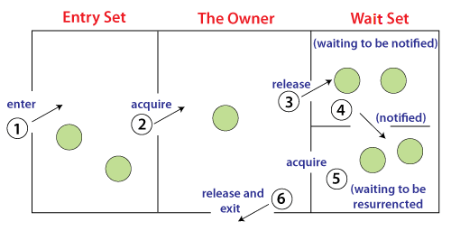
Process of inter-thread communication

Slide 17
Thank you

