Slide 1
RESTful API

Slide 2
What is REST?
A REST API (also known as RESTful API) is an application programming interface (API or web API).

Slide 3
The REST stands for REpresentational State Transfer.
State means data
REpresentational means formats (such as XML, JSON, YAML, HTML, etc)
Transfer means carrying data between consumer and provider using the HTTP protocol

Slide 4
Roy Fielding - inventor of the HTTP protocol.
Intermediary Application Programming Interface
Architectural style
The need for REST APIs increased a lot with the drastic increase of mobile devices.

Slide 5
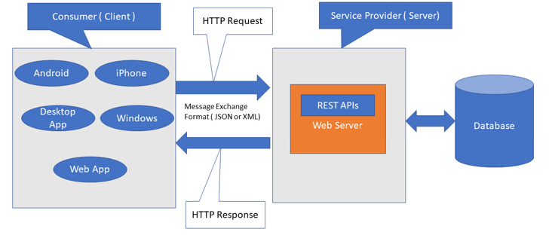
REST Architecture

Slide 6
REST Architectural Constraints
Client-server architecture
Stateless
Cacheable

Slide 7
Uniform Interface
Layered System
Code-On-Demand

Slide 8
Restful Methods
POST – This would be used to create a new resources using the RESTful web service
GET – This would be used to get a list of resources using the RESTful web service

Slide 9
PUT – This would be used to update the resource based on the request using the RESTful web service
DELETE – This would be used to delete resource using the RESTful services

Slide 10
Advantages
Fast
Language and Platform independent
Permits different data format

Slide 11
Thank you

