Slide 1
SPRINGBOOT

Slide 2
What is SpringBoot?
Spring Boot is a project that is built on the top of the Spring Framework.
Easier and faster way to set up, configure, and run both simple and web-based applications.

Slide 3
Spring Framework
Embedded Server
XML
bean Configuration
SpringBoot
+
-
=
Spring Boot is the combination of Spring Framework and Embedded Servers.

Slide 4
Why should we use Spring Boot Framework?
Dependency injection approach is used in Spring Boot.
Powerful database transaction management.
Simplifies integration with other Java frameworks like JPA/Hibernate ORM, Struts, etc.
Reduces the cost and development.

Slide 5
Advantages of Spring Boot
Develop Stand-alone Spring applications and web applications .
'starter' POMs to simplify our Maven configuration.
No requirement for XML configuration.
It offers a CLI tool.

Slide 6
It offers the number of plug-ins.
It also minimizes writing multiple boilerplate codes
It increases productivity and reduces development time.

Slide 7
Spring Application
public static void main(String[] args)
{
SpringApplication.run(ClassName.class, args);
}

Slide 8
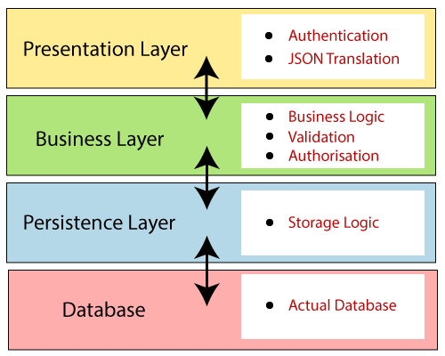
Spring Boot Architecture

Slide 9
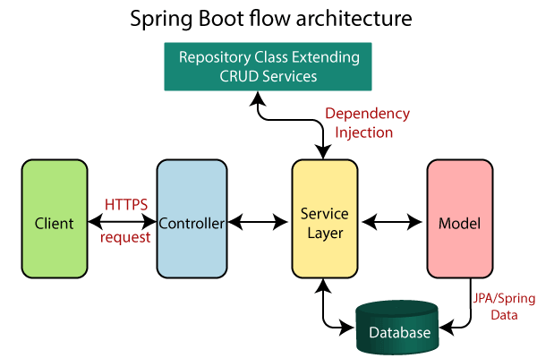

Slide 10
Create SpringBoot Project
Spring Initializr
Following are the steps to create a simple Spring Boot Project.
Step 1: Open the Spring initializr https://start.spring.io.
Step 2: Provide the Group and Artifact name. We have provided Group name com.javatpoint and Artifact spring-boot-example.
Step 3: Now click on the Generate button.

Slide 11
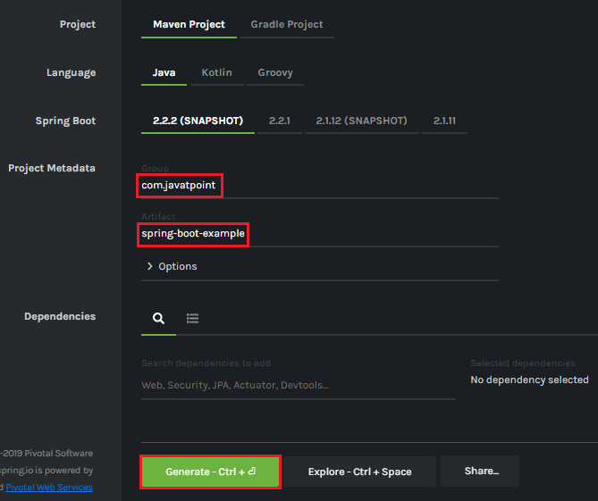

Slide 12
Spring Tool Suite (STS) IDE
1. Download and Install STS based on the OS

Slide 13
Thank you

