Slide 1
Tomato Grand Challenge
For development of Comprehensive and focused intervention in design of tomato value chain
Basic Details of the Team and Problem Statement
Track: 1
Participant Category: Student
Vertical Title: Innovative post-harvest treatments, packaging and technologies for long term storage to minimize post- harvest losses during transportation and storage to avoid panic selling due to perishability (Annexure II).
Team Name: AIHT
Team Leader Name: G.Suriya
No. of Team Members: 1
No. of Team Mentor (If any): 1

Slide 2
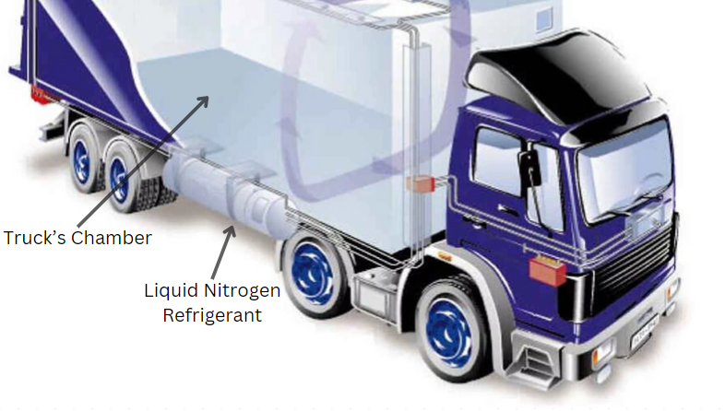
Idea / Approach Details
Harvest only mature green tomatoes, so if the temperature is less than 10*C while transportation then we can store the tomatoes for 6 weeks.
After harvesting the tomatoes, we need to cool them using a pre-cooling system that reduces the heat in the tomatoes by washing them using ice water.
The pre-cooling process reduces the temperature of fruit and the incidence of disease.
Use paper-made trays for each tomato and organize each tray in a box to reduce damage while transporting. Paper trays are made of recycled pulp material, so that we can recycle it.
Recycled pulp material contains certain substances such as cellulose and lignin
We calculate the temperature inside the truck's chamber that stores tomatoes using a temperature sensor and notify us through a microcontroller.
If the temperature is higher than 10*C then the transport refrigerator will automatically release the liquid nitrogen.
Describe your Technology stack here
Arduino IDE
STM32CubeIDE
These two tools are used to program the microcontroller.

Slide 3

Idea / Approach Details
Describe your Use Cases here
Describe your Dependencies/ Resources
Customers can buy our products such as paper-made tray, Pre-cooling system, Liquid Nitrogen Refrigerant, Entire Refrigerated vehicle setup on our website.
To visit our website just visit on https://suriyaopm.github.io/ress/
, that‘s a prototype of our website
Pre-cooling system: Implemented in harvesting (or) exporting site before transporting a tomatoes.
Transport refrigerator: Refrigerated vehicle will be build as per the model explained in previous slide.
Power supply: Power supply is essentially installed in refrigerated vehicle to supply liquid nitrogen in the truck’s chamber.
Liquid nitrogen refrigerant: Liquid nitrogen is filled in a cylinder that is placed at the bottom of the truck’s chamber
Packaging material: Recycled pulp paper is used to make trays for tomato.

Slide 4
Proposal for Stage 1: Idea to Proof of Concept/ Prototype
Research methodology, including research design,
data collection methods, and data analysis techniques
Objectives and Outputs (3-4 months), Development cost
Refrigerated vehicles for transportation:
A container is placed under the refrigerated vehicle that stores the liquid nitrogen as a refrigerant.
This liquid nitrogen then releases its cold to the refrigeration chamber via a heat exchange.
Both single and multiple-chamber cooling is possible
When cooling is required, liquid nitrogen is sprayed into the chamber via a spray tube.
The liquid nitrogen evaporates and displaces oxygen in the chamber, the heated nitrogen gas is released into the atmosphere via a pressure equalization flap.
The main objective of this project is to reduce the tomatoes wastage after harvesting.
In the first month, we need to customize a refrigerated vehicle for transportation, implement pre-cooling system on harvesting site and design trays to carry tomatoes using paper.
These are essential needs must be completed within 1 month and then next 2 months, we’ll implement the entire idea by exporting tomatoes to different regions and monitor the result (reduce the wastage of tomatoes).
Development cost would be approximately 5 lakhs, because of refrigerated vehicle installed and other things.

Slide 5


Team Member and Mentor Details (include name, email, contact no, photo)
Team leader:
Name : G.Suriya
Email : suriyastark072@gmail.com
Contact No: 9384157873
Mentor:
Name : Dr.K.Karnavel
Email : karnavelk.cse@aiht.ac.in
Contact No: 9994387814

Slide 6
Important Pointers
Please ensure below pointers are met while uploading the document-
All the topics should be utilized for description of your idea proposal
Keep the maximum slides’ limit to 7 pages
Try to avoid paragraphs and post your idea/innovation as pointers
Keep your explanation precise and easy to understand
In Stage 1 proposal, clearly mention the research design, data collection methods, and data analysis techniques, objective to specific outputs, and develop a realistic timeline for the completion (duration of 3 - 4 months).
Idea should be unique and novel.
You need to save the file in PDF and upload the same at portal.
Total time for presentation is 4-5 mins

