Slide 1
1st station: Valve Plate, Spring, Filler Piece & Clamping sleeve assembly
Product Name/No: AL Hand Primer Assembly/2447.222.126
Quality Inspection Software

Slide 2
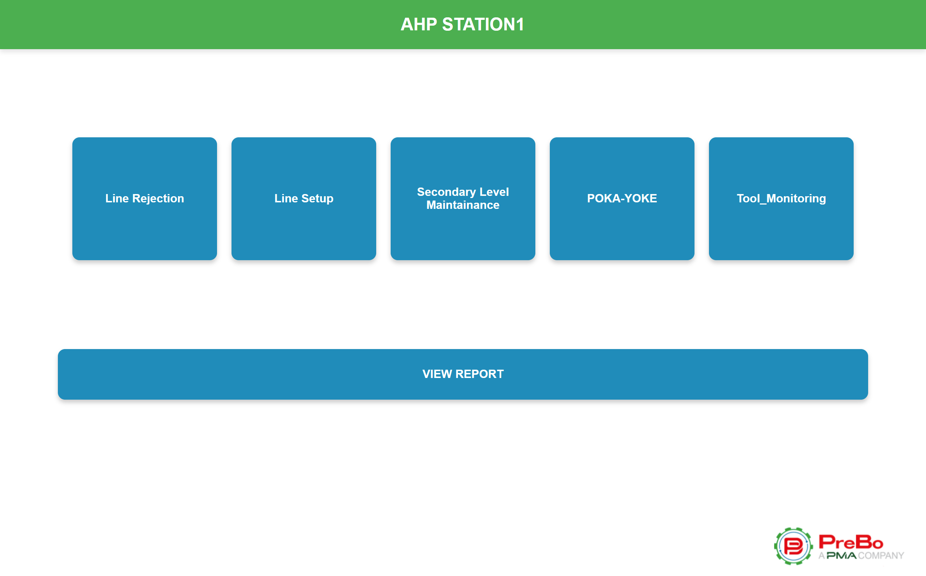
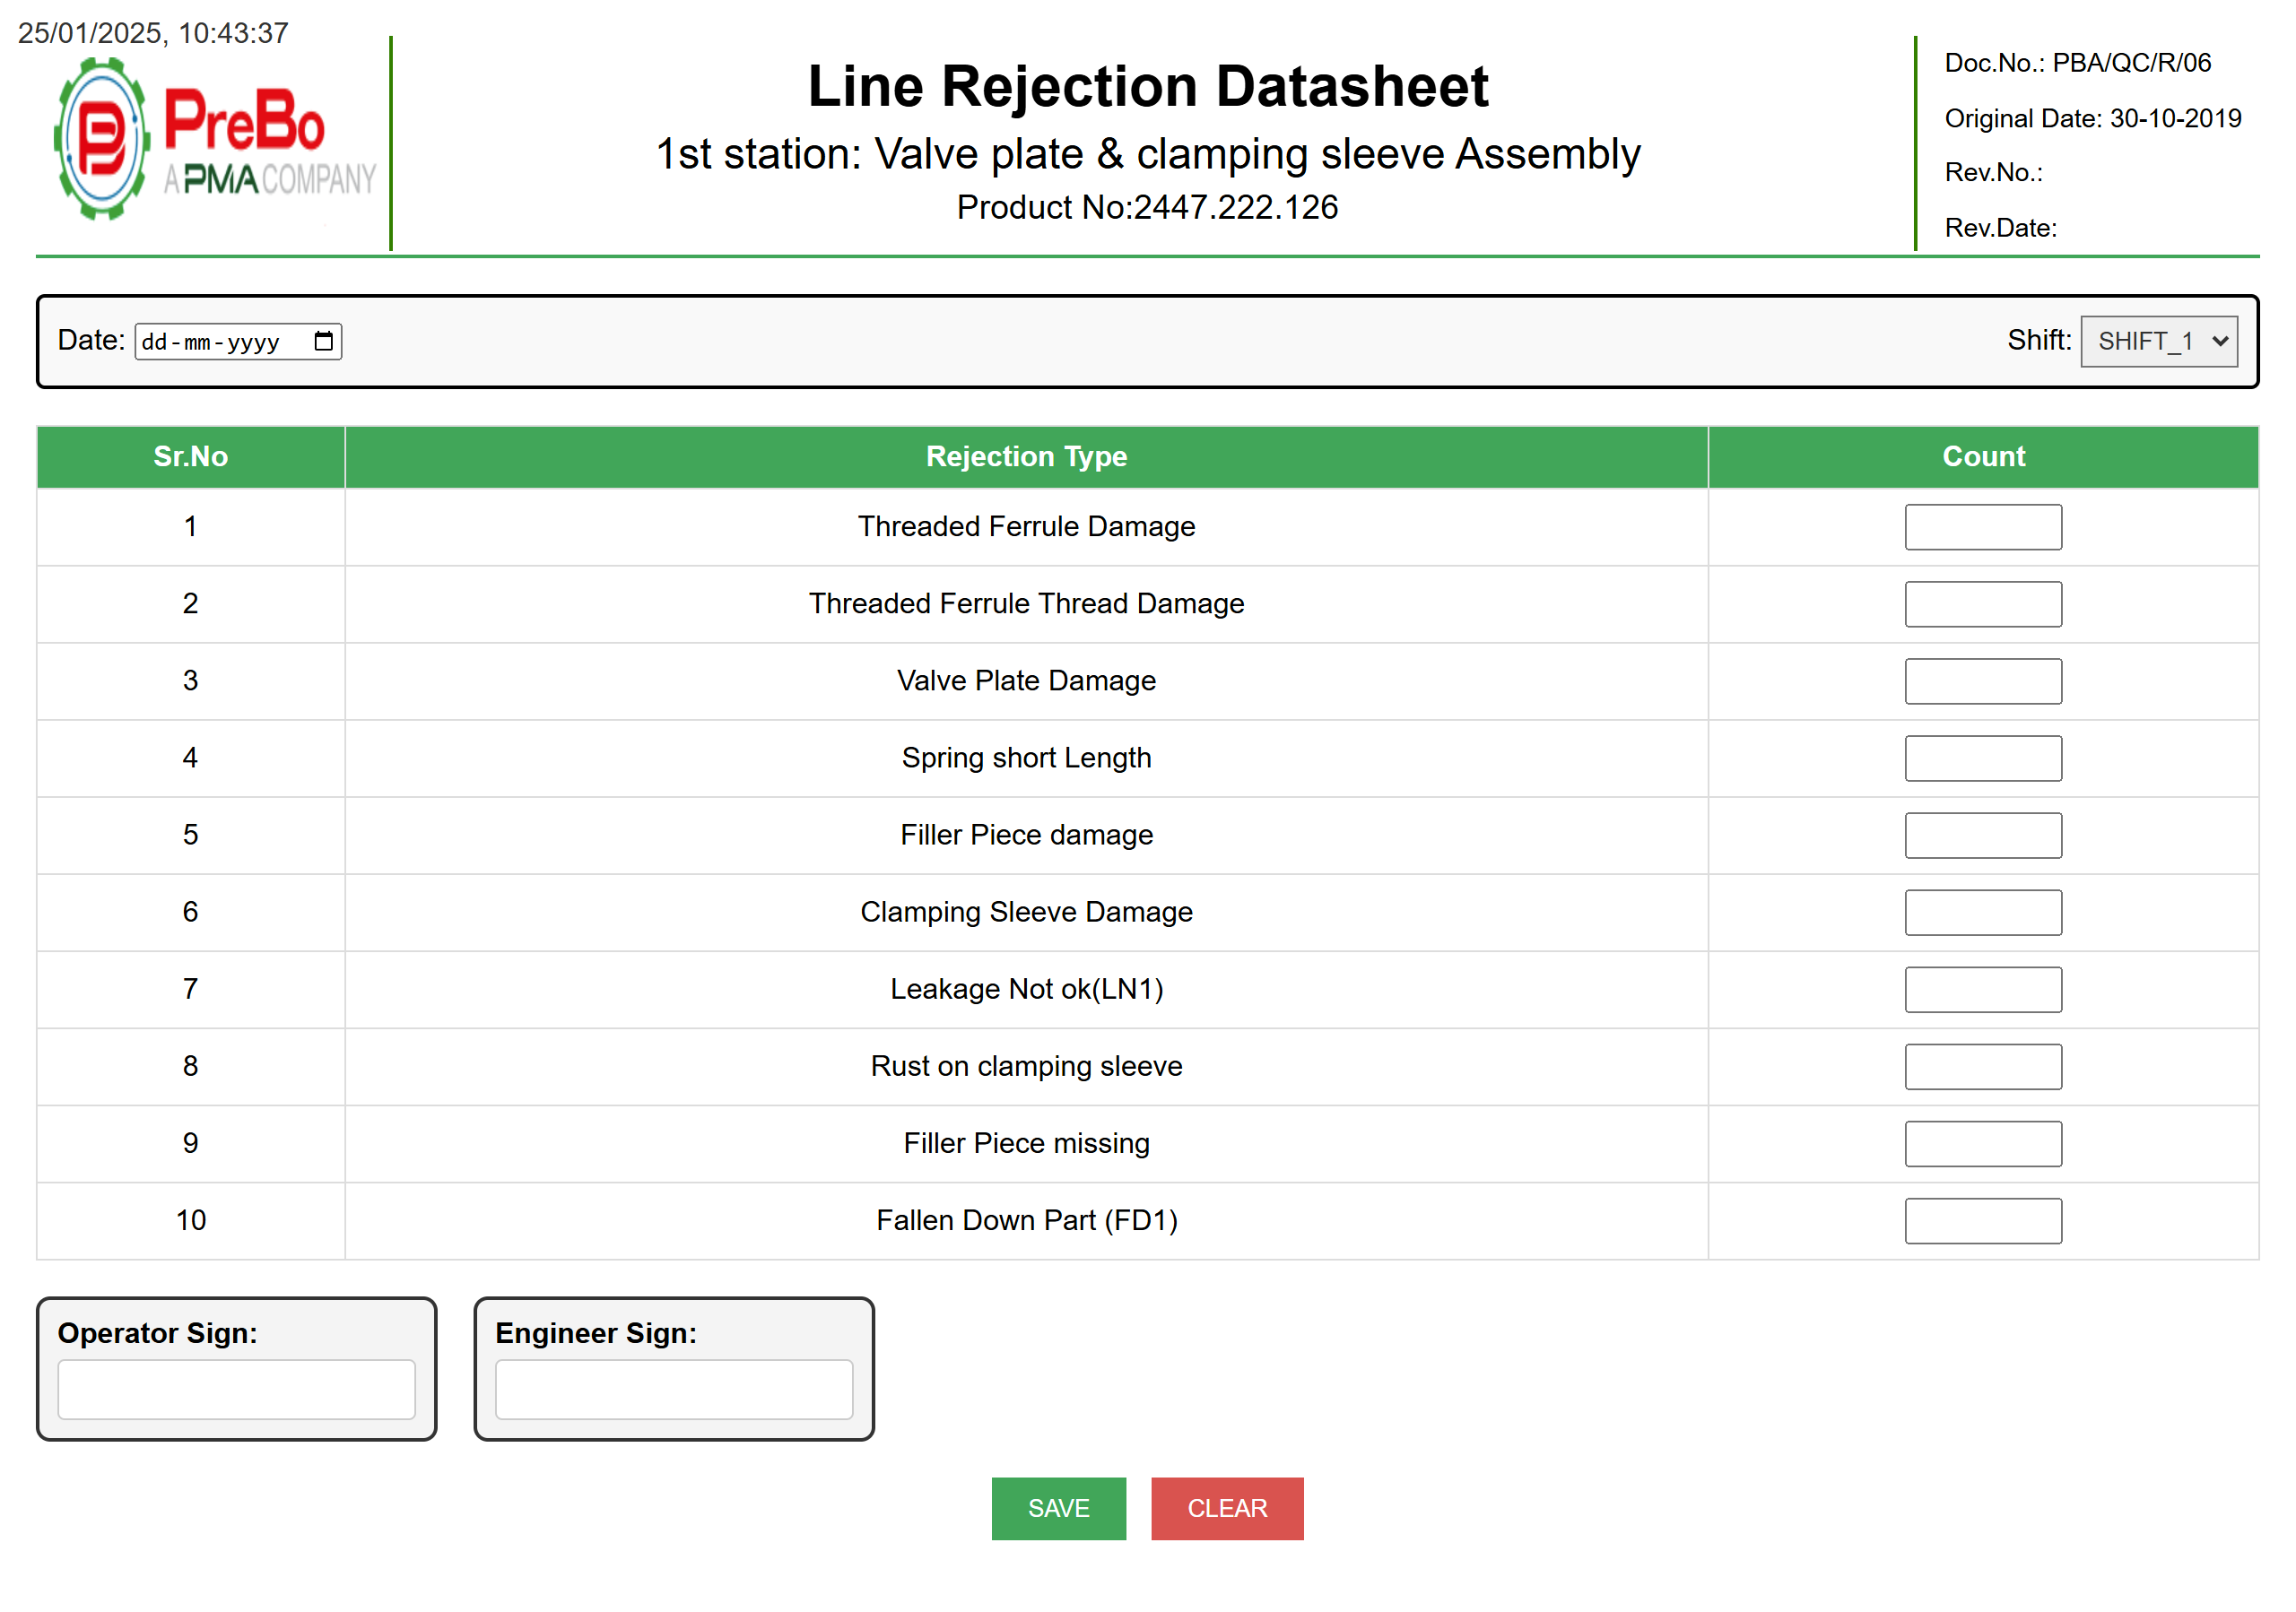
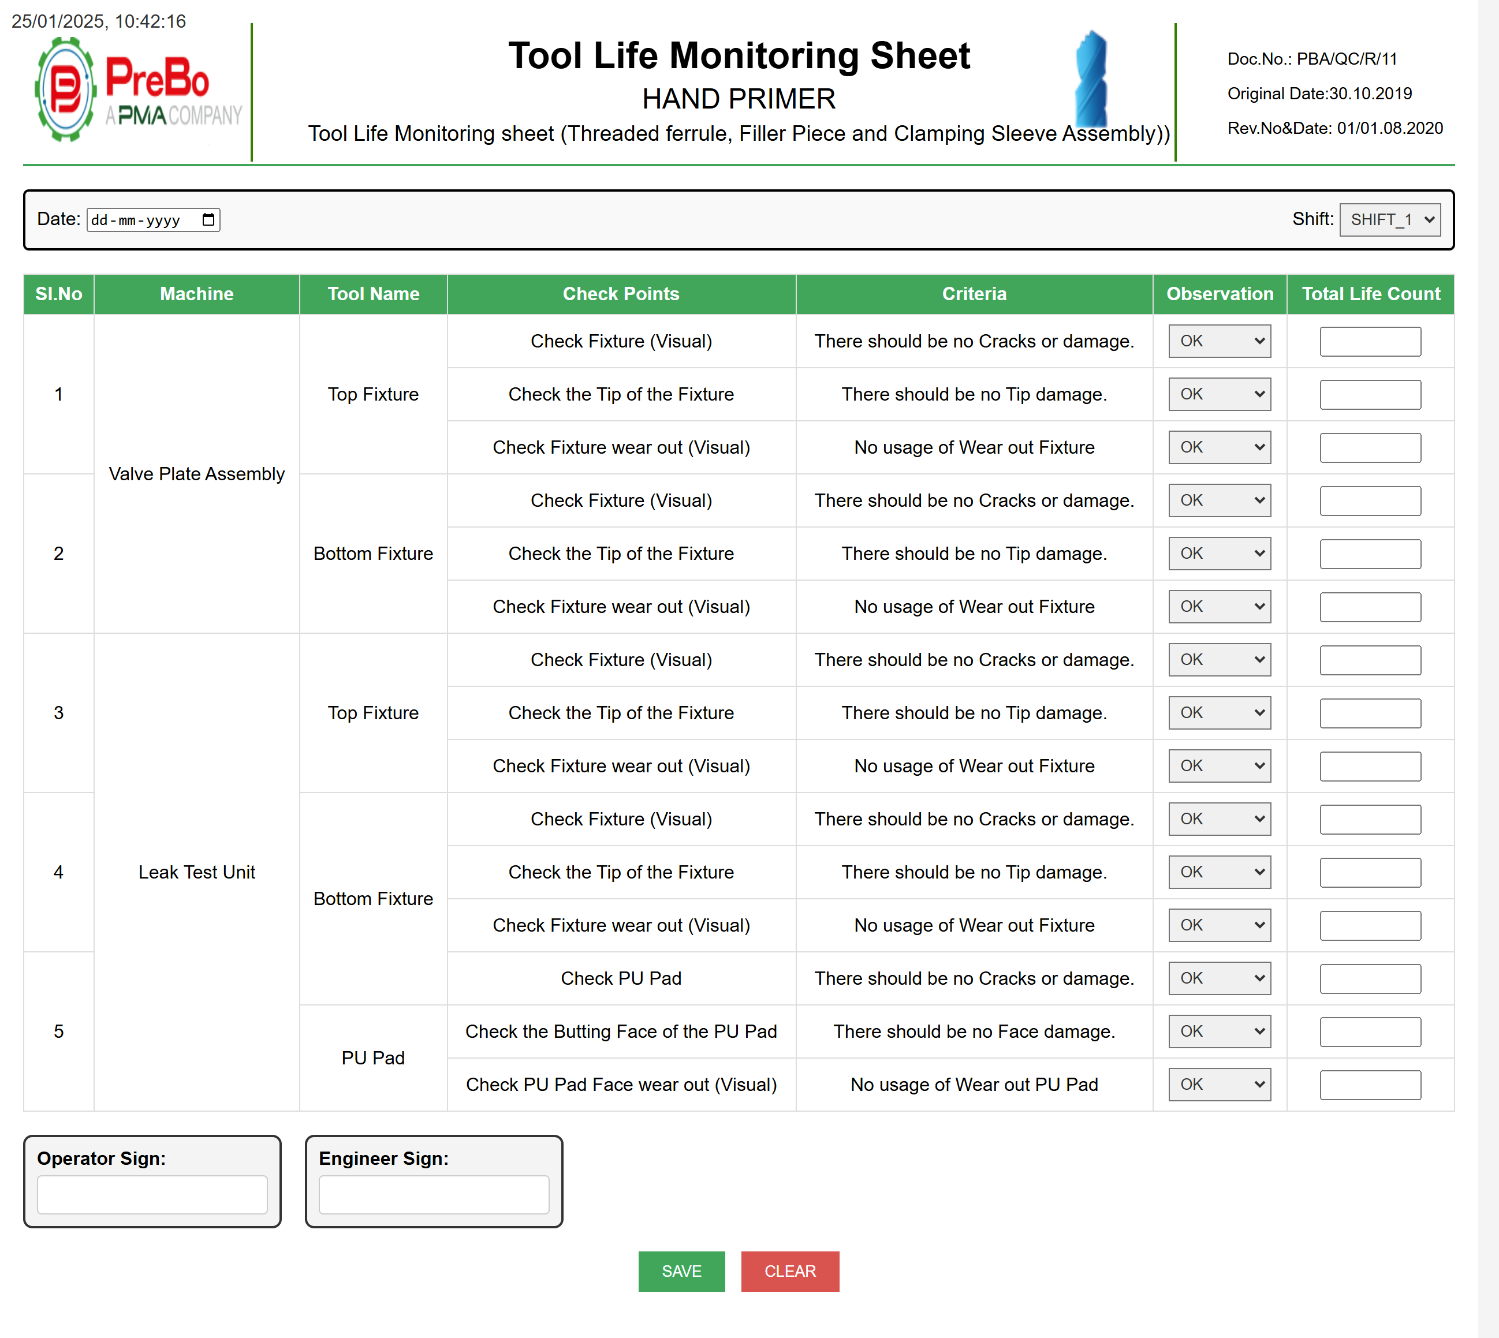
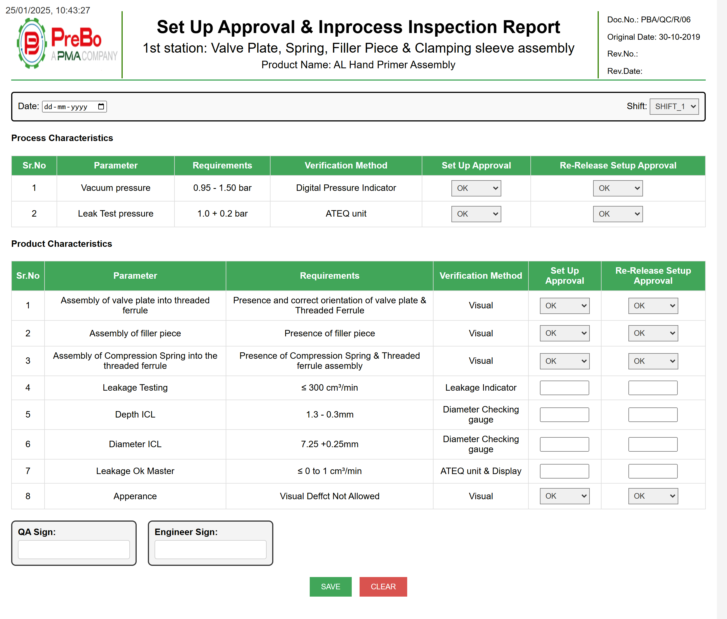
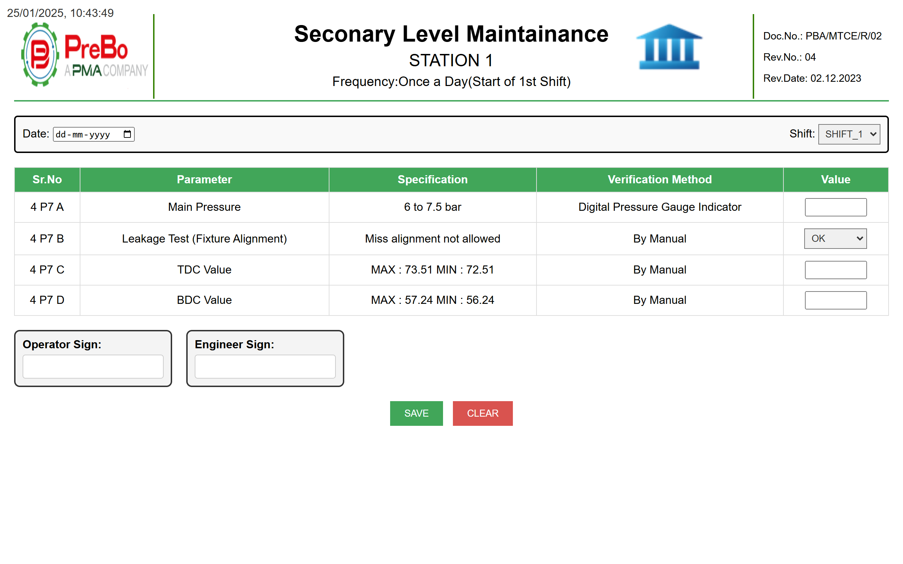
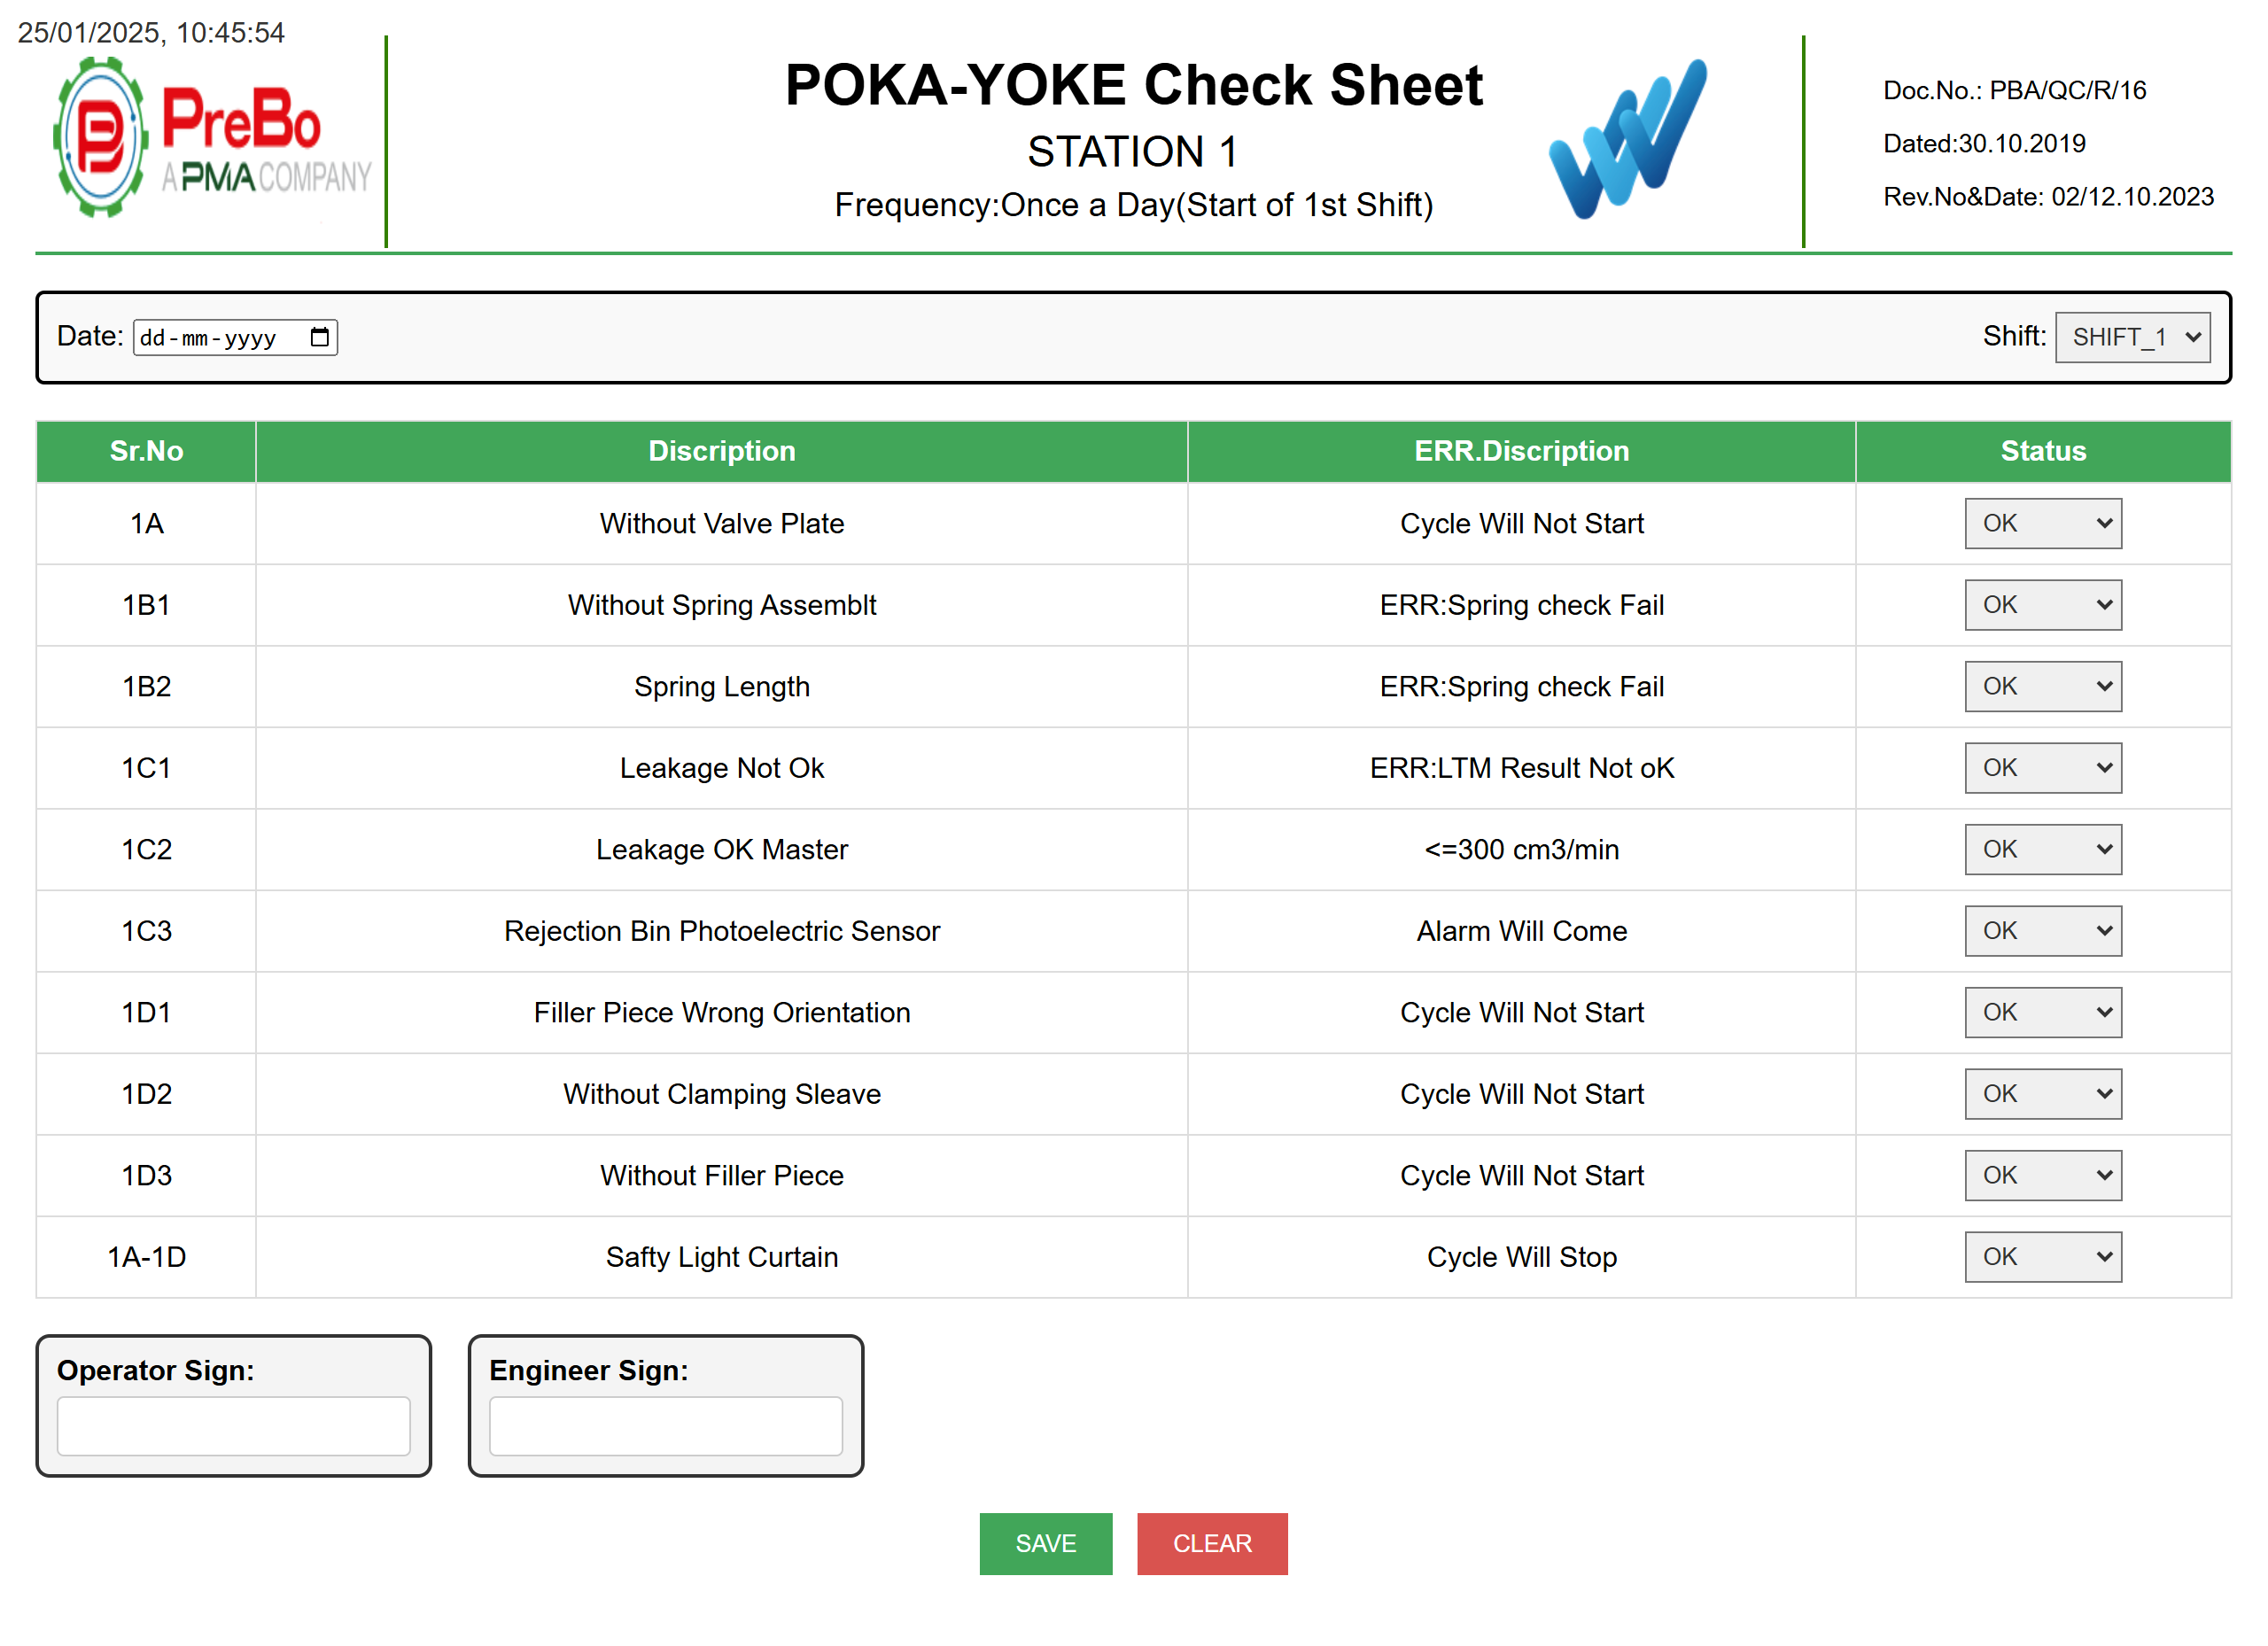
PAGES OVERVIEW
Quality Inspection Software

Slide 3
Quality Inspection Software
FIRST PAGE

Slide 4
Quality Inspection Software
Line_Rejection

Slide 5
Quality Inspection Software
Poka-yoke

Slide 6
Quality Inspection Software
Secondary_Level_Maintainance

Slide 7
Quality Inspection Software
Setup_approval

Slide 8
Quality Inspection Software
Tool_Monitoring

Slide 9
Quality Inspection Software
Page Function
Go to Home
Date & Time option
SAVE Data to excel
Clear Data

Slide 10
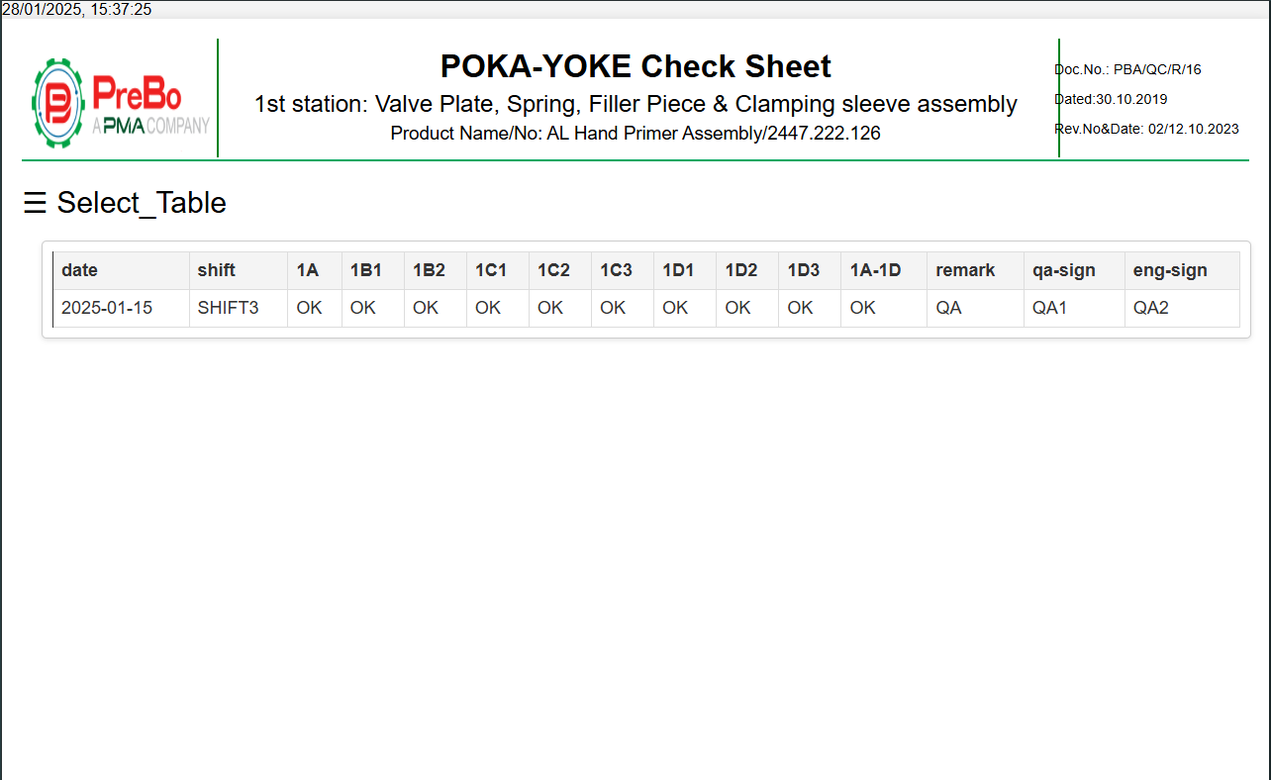
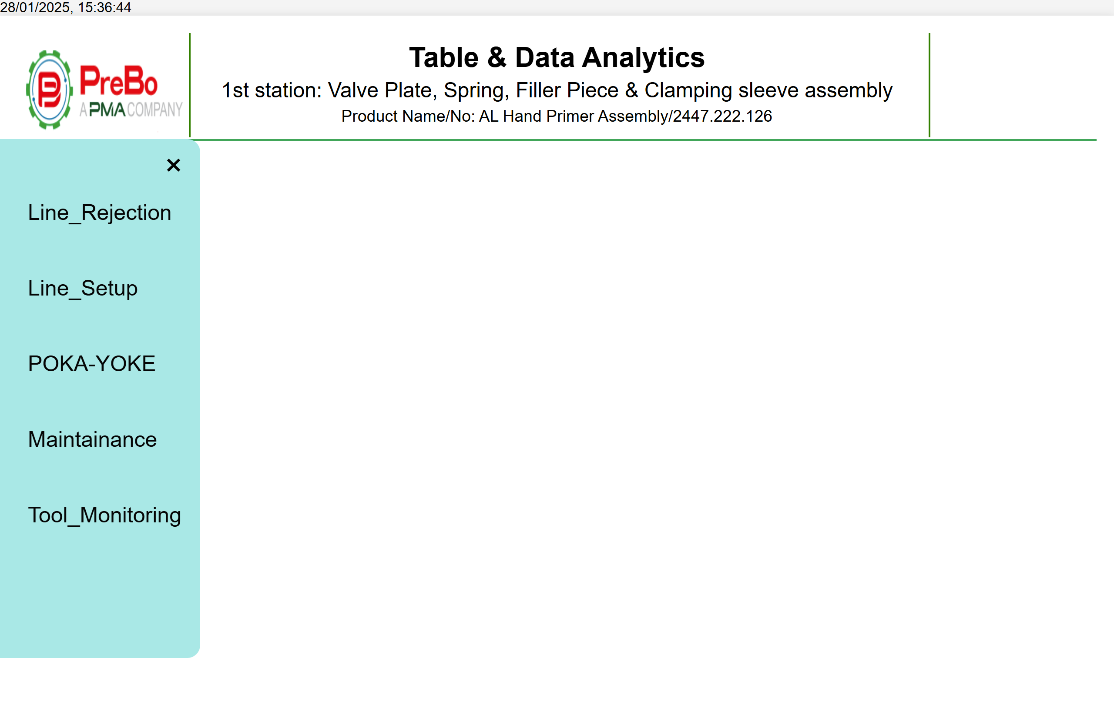
Quality Inspection Software
Table and chart view

Slide 11
Thank you

