Slide 1
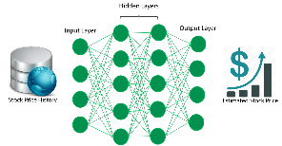
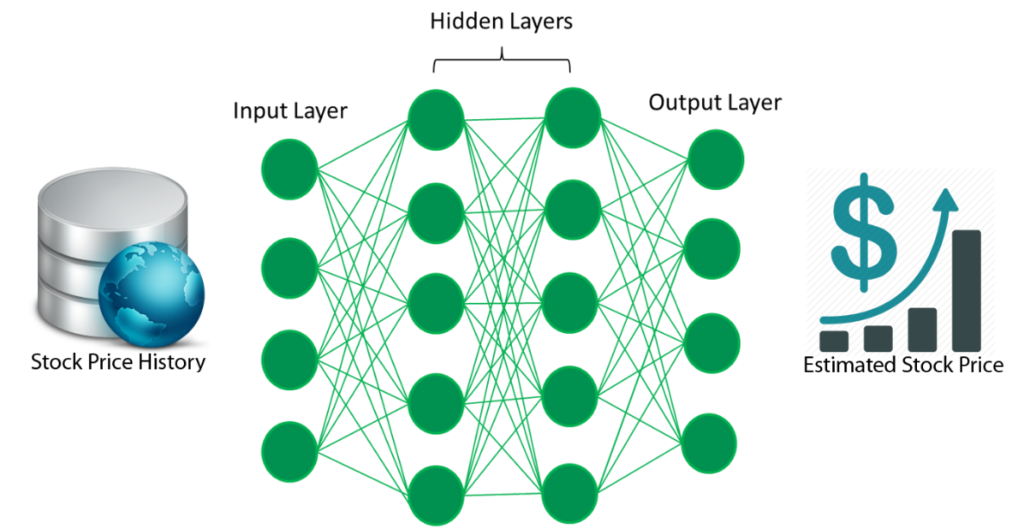
Stock Price Prediction Deep learning - LMST
Student Name: Surjit Singh Jagpal Singh Walia (PMP, MCSD, MCAD, OCA, MCPD, PSD) ☎: 555-555-5555 ✉: swalia@njcu.edu | NJCU School Of Business Subject: BUSI 799 - Capstone Busi Administration By: Professor Christopher Versace

Slide 2

OBJECTIVE:
To predict daily closing price of selected stock with greater than 95% accuracy using Deep learning - LMST and price history price data from http://finance.yahoo.com or http://finance.google.com.
To understand Deep learning - LMST.

Slide 3

What Is Stock Price Perdition?
Definition:
Is an act of trying to determine the future value of a company stock or other financial instrument traded on an exchange. The successful prediction of a stock's future price could yield significant profit.
Difficulties:
Fluctuation in human behavior.
Unknown company developments.
Sudden macro economics turmoil.

Slide 4
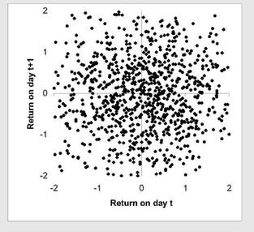
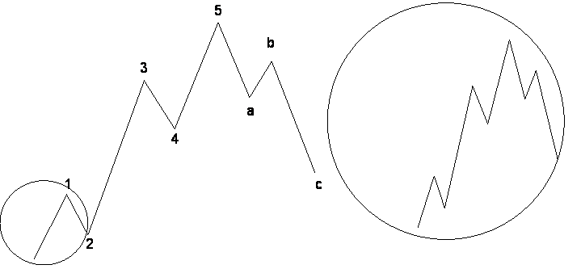
Prevailing Theories on Stock Prediction
EMH Theories: The efficient market hypothesis (EMH) is an investment theory that states it is impossible to "beat the market" because stock market efficiency causes existing share prices to always incorporate and reflect all relevant information. Uses linear model.
Choas Theories: 'Chaos' is an interdisciplinary theory stating that within the apparent randomness of chaotic complex systems, that can be “learn”.
It uses dynamic models such as NARX (nonlinear autoregressive network with exogenous inputs – both historical price of stock and market sentiments).

Slide 5
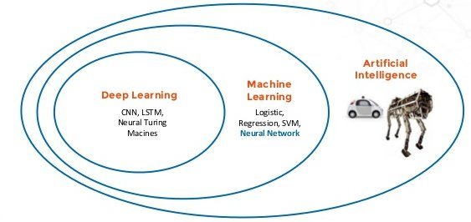
What is Neural Network (NARX)?
The best way to think of this relationship is to visualize them as concentric circles.
At the outer most ring you have artificial intelligence
One layer inside of that is machine learning
With artificial neural networks and deep learning at the center.

Slide 6
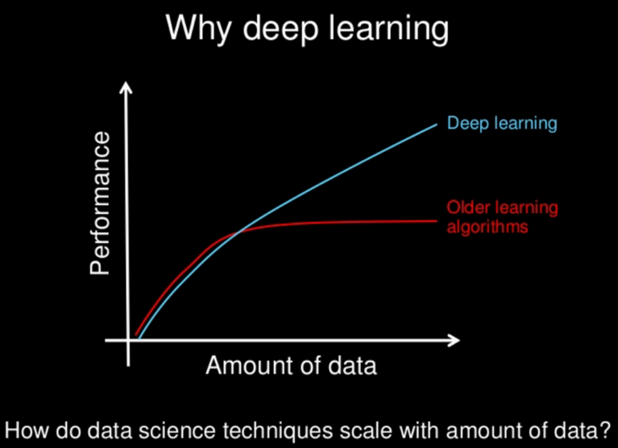
Why Deep learning
Improve Performance With Data.
Easy Performance Tuning With Choosing Right Algorithms.
Easy Performance Improvement With Algorithm Tuning.
Easy Performance With Ensembles.

Slide 7
Broad classes of machine learning methods
Supervised learning:
In supervised learning, a machine learning algorithm uses a labeled dataset to infer the desired outcome.
This takes a lot of data and time, since the data needs to be labeled by hand.
Supervised learning is great for classification and regression problems.
Unsupervised learning:
With unsupervised learning, there aren’t any predefined or corresponding answers. The goal is to figure out the hidden patterns in the data. It’s usually used for clustering and associative tasks, like grouping customers by behavior.
Example: Amazon’s “customers who also bought…” recommendations are a type of associative task.

Slide 8

The Deep Learning Revolution

Slide 9
Classification of deep learning models
Data Sector | Use Case | Input | Transform | Neural Net
Text | Sentiment Analysis Named-entity recognition Part-of-speech tagging Semantic-role labeling | Word Vector | Gaussian Rectified | RNTN or DBN (with moving window)
Document | Topic Modeling/ Sematic hashing (unsupervised) | Word count probability | Can be binary | Deep Autoencoder (wrapping a DBN or SDA)
 | Document classification | RF-IDF (or word count prob.) | Binary | Deep-belief network, stacked denoising Autoencoder
Image | Image Recognition | Binary | Binary (visible and hidden) | Deep-belief network
 |  | Continuous | Gaussian Rectified | Deep-belief network
 | Multi-object recognition |  |  | Convolutional Net, RNTN (image vectorization forthcoming)
 | Image search / semantic hashing |  | Gaussian Rectified | Deep Autoencoder (wrapping a DBN)
Sound | Voice recognition |  | Gaussian Rectified | Recurrent Net
 |  |  |  | Moving window for DBN or ConvNet
Time Series | Predictive Analytics |  | Gaussian Rectified | LMST, Recurrent Net
 |  |  |  | Moving window for DBN or ConvNet

Slide 10
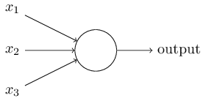
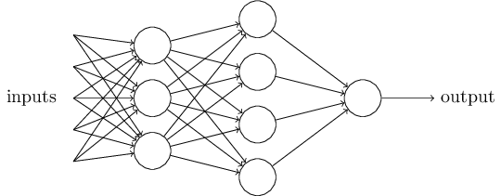
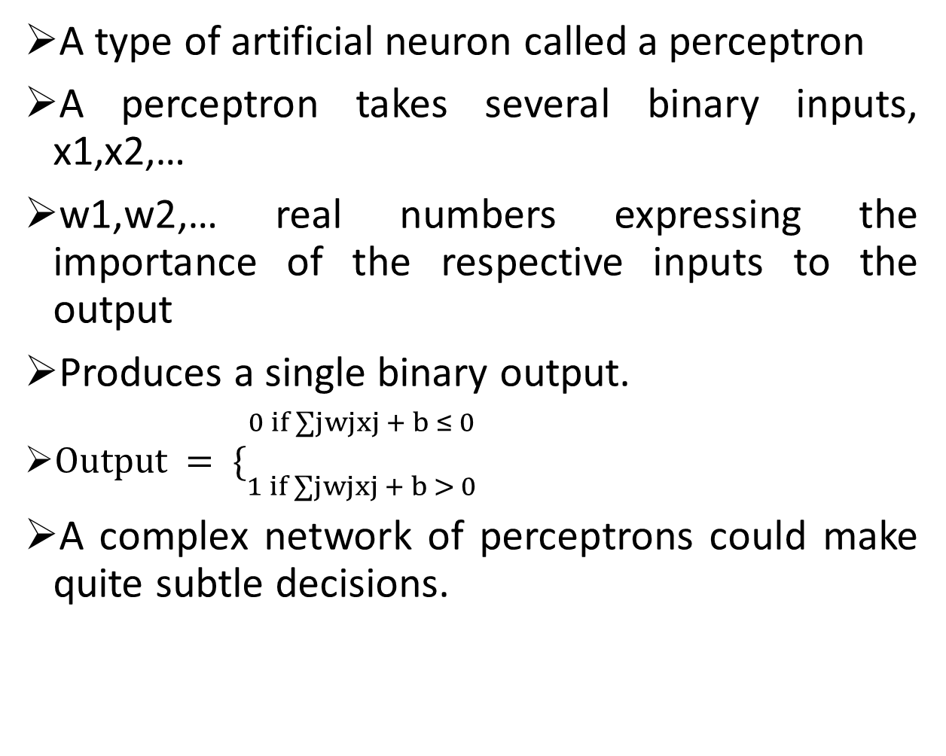
Perceptrons & How it works
A type of artificial neuron called a perceptron
A perceptron takes several binary inputs, x1,x2,…
w1,w2,… real numbers expressing the importance of the respective inputs to the output
Produces a single binary output.
$Output = \{{\begin{aligned}0 if ∑jwjxj + b ≤ 0 \\ \end{aligned} \atop 1 if ∑jwjxj + b > 0}$
A complex network of perceptrons could make quite subtle decisions.

Slide 11

Perceptrons
This notation for input perceptrons, in which we have an output, but no input, is a shorthand
a network of perceptrons can be used to simulate a circuit containing many NAND gates
These learning algorithms enable us to use artificial neurons in a way which is radically different to conventional logic gates.
Instead of explicitly laying out a circuit of NAND and other gates, our neural networks can simply learn to solve problems, sometimes problems where it would be extremely difficult to directly design a conventional circuit.
A small change in the weights or bias of any single perceptron in the network can sometimes cause the output of that perceptron to completely flip, say from 0 to 1.

Slide 12
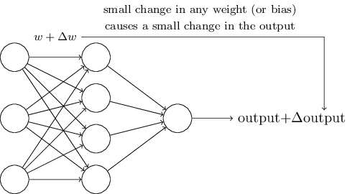
Sigmoid neurons
It is important when calculating the weight updates in the network.
A small change in the weights and bias will cause small change in the output
A fairly simple non-linear function, the sigmoid function such as the logistic function also has an easily calculated derivative
It thus makes the network more easily manipulable mathematically, and was attractive to early computer scientists who needed to minimize the computational load of their simulations.

Slide 13
What is Neural Network (NARX)?
A NARX model is a dynamic network which used for prediction and nonlinear filtering.
Recurring Network, with feedback connections spanning several layers
Analyses data for patterns and relates the current value of a time series with the trained and predicted past values of the driving (exogenous) series.

Slide 14
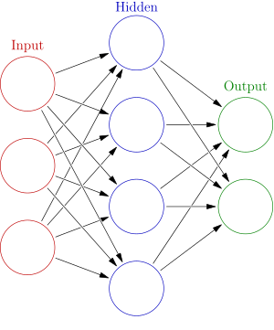
Neural Networks for Prediction
NNs in 60 seconds
Mimic human biological neurons
Neurons take input: many inputs summed with weights to produce activation input
If activation input triggers activation function: output
NNs composed of stacked layers of neurons
Issues with regular NNs – Lack of Memory
This sucks when you’re working with anything time series related
Vanishing Gradient problem.

Slide 15
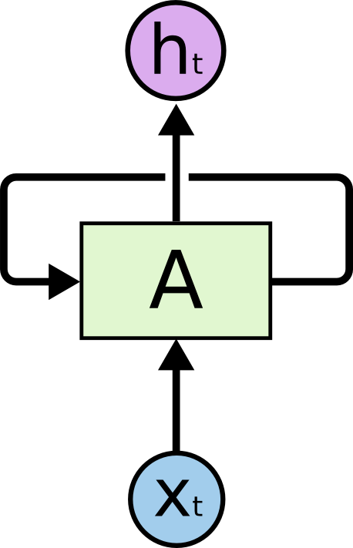

Understanding LSTM Networks
Recurrent neural networks address this issue. They are networks with loops in them, allowing information to persist.
A chunk of neural network, A, looks at some input xt and outputs a value ht. A loop allows information to be passed from one step of the network to the next.
Figure 2: Recurrent Neural Networks have loops.
Figure 3: An unrolled recurrent neural network.

Slide 16
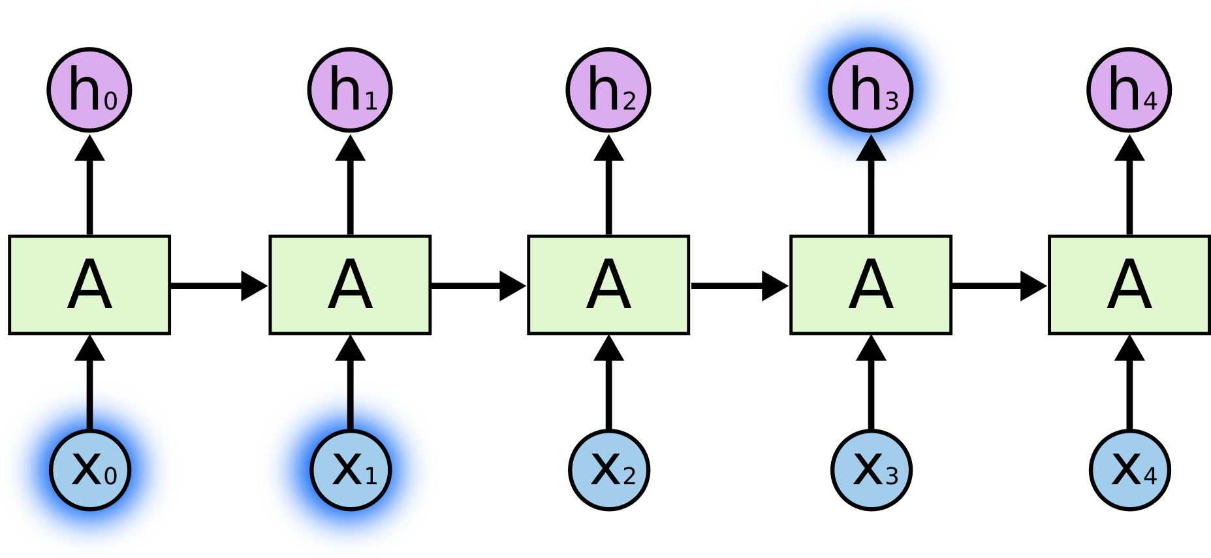
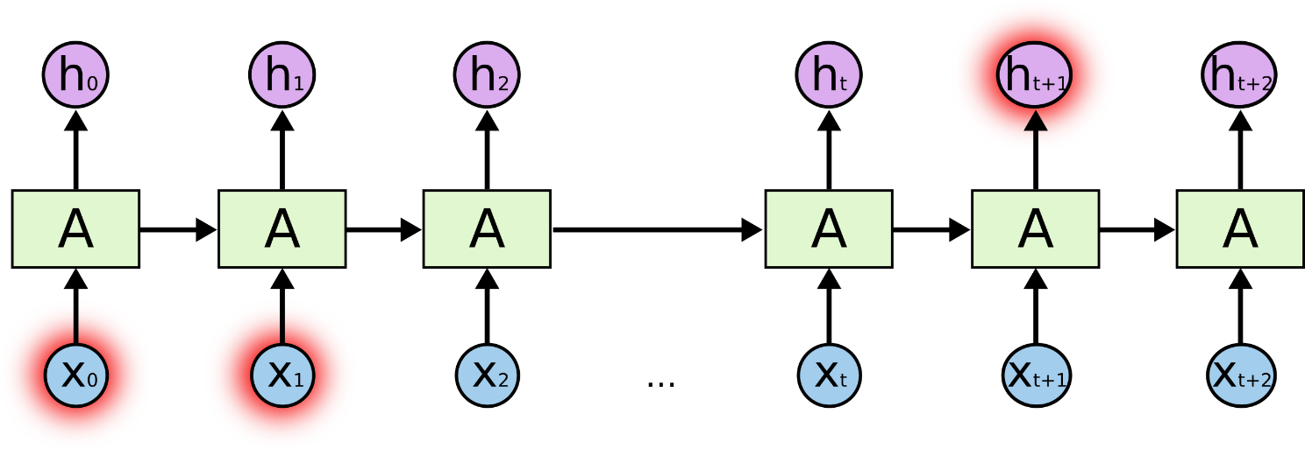
The Problem of Long-Term Dependencies
As that gap grows, RNNs become unable to learn to connect the information.
In theory, RNNs are absolutely capable of handling such “long-term dependencies.” A human could carefully pick parameters for them to solve toy problems of this form.
In practice, RNNs don’t seem to be able to learn them.

Slide 17
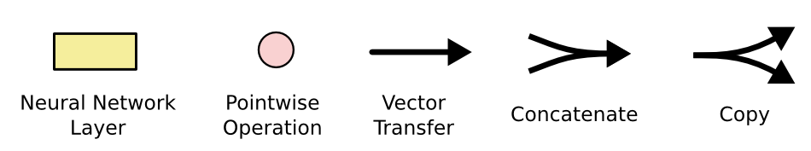
Standard Notation used
Each line carries an entire vector, from the output of one node to the inputs of others
The pink circles represent pointwise operations, like vector addition
The yellow boxes are learned neural network layers
Lines merging denote concatenation
line forking denote its content being copied and the copies going to different locations.

Slide 18
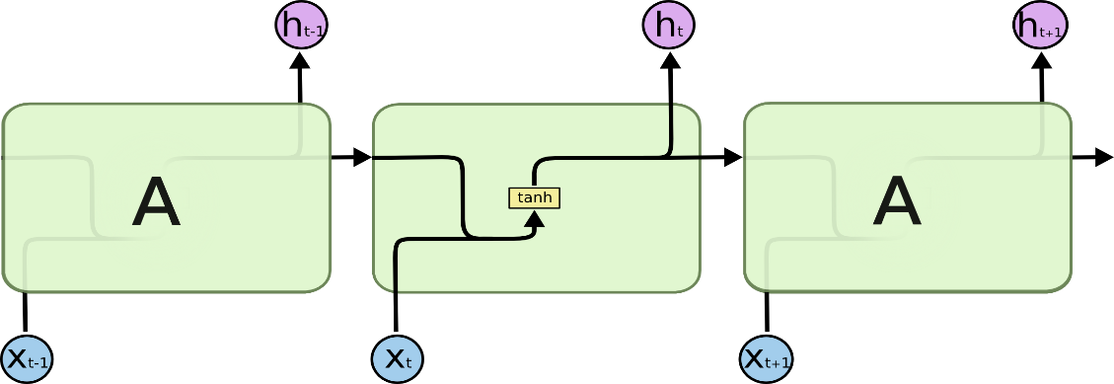
What are LSTM Neural Networks
Long Short-Term Memory, an evolution on a Recurrent Neural Network (a special kind of RNN), capable of learning long-term dependencies.
LSTMs are explicitly designed to avoid the long-term dependency problem.
Remembering information for long periods of time is practically their default behavior
This repeating module will have a very simple structure, such as a single than layer.
Figure 4: The repeating module in a standard RNN contains a single layer.

Slide 19
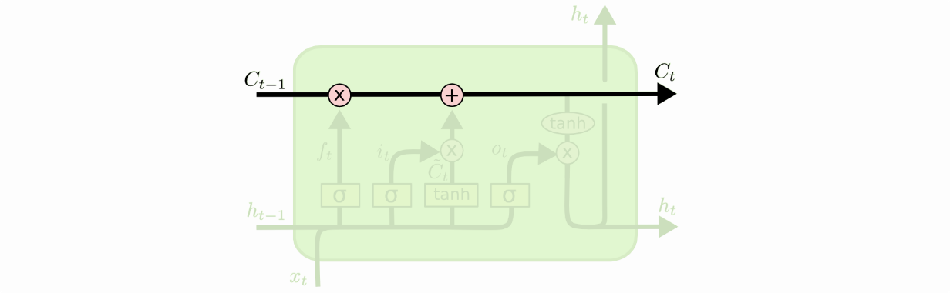
The Core Idea behind LSTMs
The key to LSTMs is the cell state, the horizontal line running through the top of the diagram.
The cell state is kind of like a conveyor belt. It runs straight down the entire chain, with only some minor linear interactions.
The LSTM does have the ability to remove or add information to the cell state, carefully regulated by structures called gates.
Gates are a way to optionally let information through. They are composed out of a sigmoid neural net layer and a pointwise multiplication operation.
The sigmoid layer outputs numbers between zero and one, describing how much of each component should be let through. A value of zero means “let nothing through,” while a value of one means “let everything through!”
An LSTM has three of these gates, to protect and control the cell state.

Slide 20
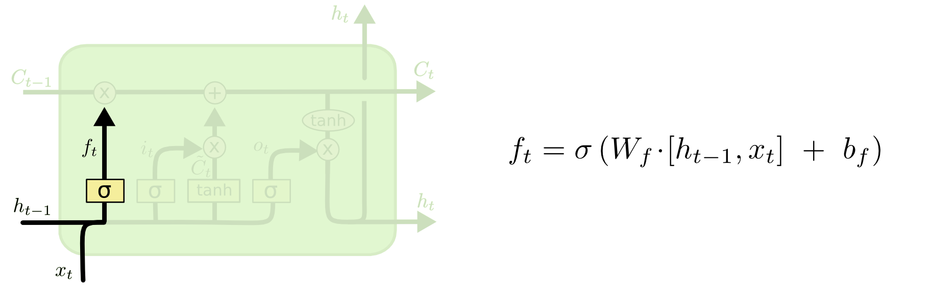
Step-by-Step LSTM Walk Through – First Step
The first step in our LSTM is to decide what information we’re going to throw away from the cell state.
This decision is made by a sigmoid layer called the “forget gate layer.” It looks at ht−1 and xt, and outputs a number between 0 and 1 for each number in the cell state Ct−1.
A 1 represents “completely keep this” while a 0 represents “completely get rid of this.”
The cell state might include the gender of the present subject, so that the correct pronouns can be used. When we see a new subject, we want to forget the gender of the old subject.

Slide 21
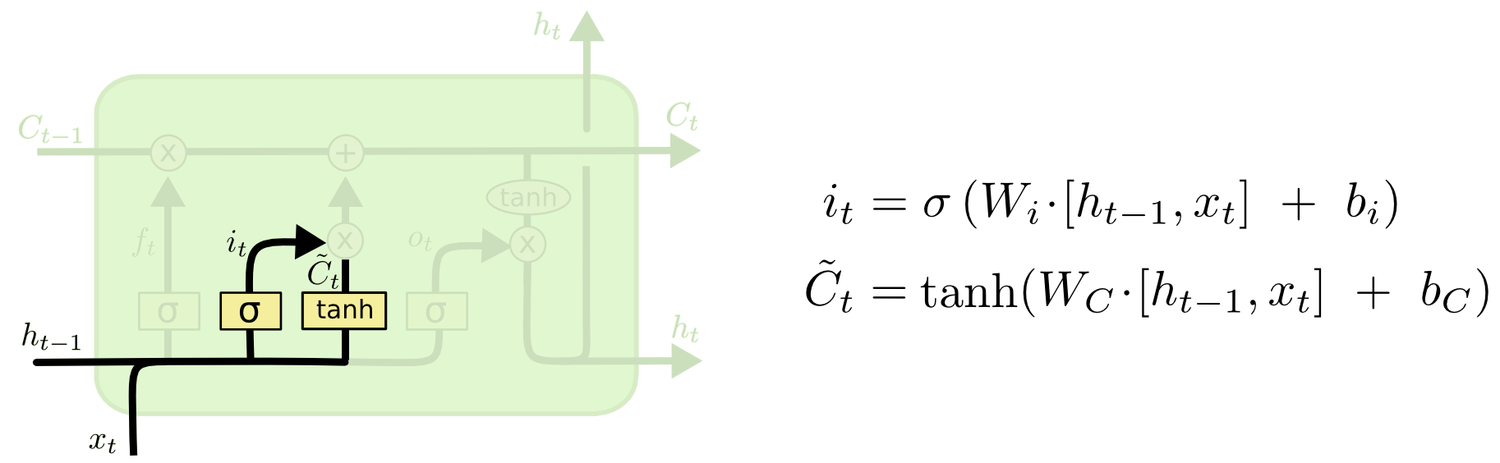
Step-by-Step LSTM Walk Through – Next Step
The next step is to decide what new information we’re going to store in the cell state.
First, a sigmoid layer called the “input gate layer” decides which values we’ll update.
Next, a tanh layer creates a vector of new candidate values, C~t, that could be added to the state.
In the example of our language model, we’d want to add the gender of the new subject to the cell state, to replace the old one we’re forgetting.

Slide 22
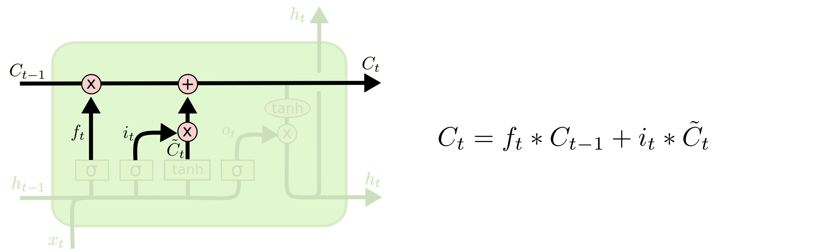
Step-by-Step LSTM Walk Through – Next Step
We multiply the old state by ft, forgetting the things we decided to forget earlier
Add i_{t}∗C~t. This is the new candidate values, scaled by how much we decided to update each state value.
In the case of the language model, this is where we’d actually drop the information about the old subject’s gender and add the new information, as we decided in the previous steps.

Slide 23
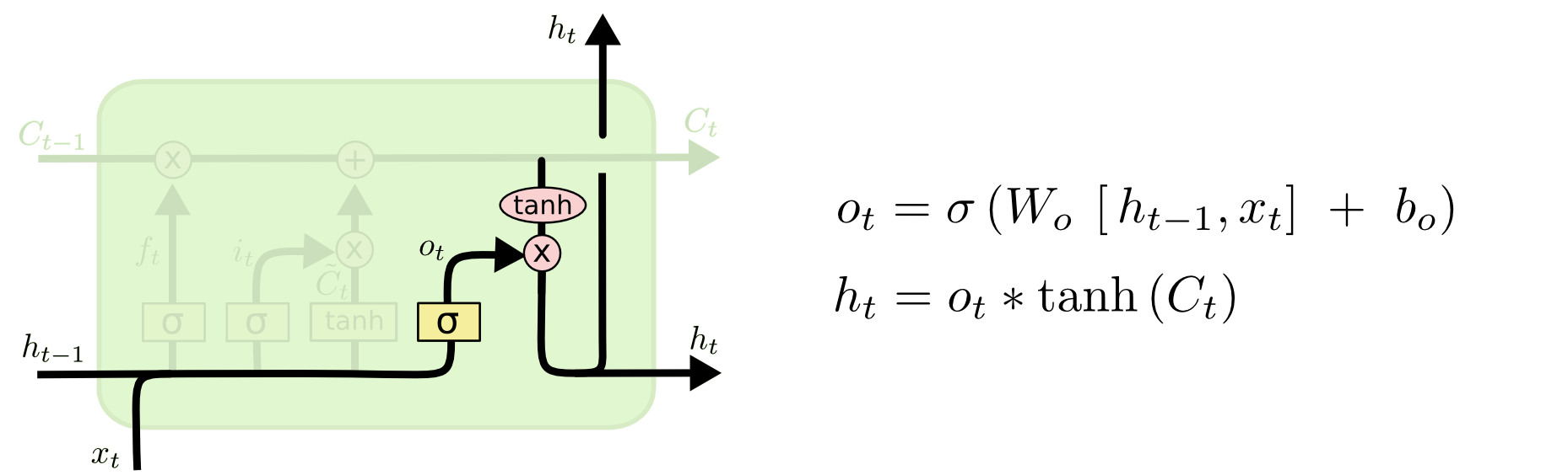
Step-by-Step LSTM Walk Through – Final Step
The output will be based on our cell state, but will be a filtered version.
First, we run a sigmoid layer which decides what parts of the cell state we’re going to output.
we put the cell state through tanh (to push the values to be between −1 and 1) and multiply it by the output of the sigmoid gate, so that we only output the parts we decided to.
For the language model example, since it just saw a subject, it might want to output information relevant to a verb, in case that’s what is coming next.

Slide 24
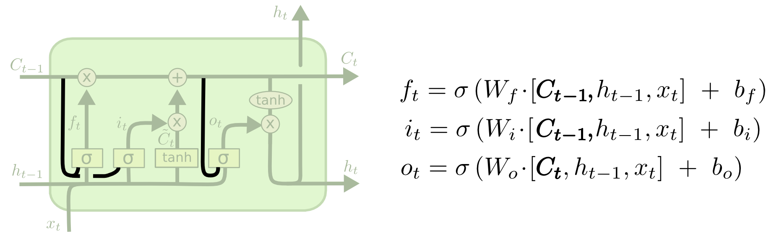
Variants on Long Short Term Memory (Another variation)
One popular LSTM variant, introduced by Gers & Schmidhuber (2000), is adding “peephole connections.” This means that we let the gate layers look at the cell state.
The diagram adds peepholes to all the gates, but many papers will give some peepholes and not others.

Slide 25
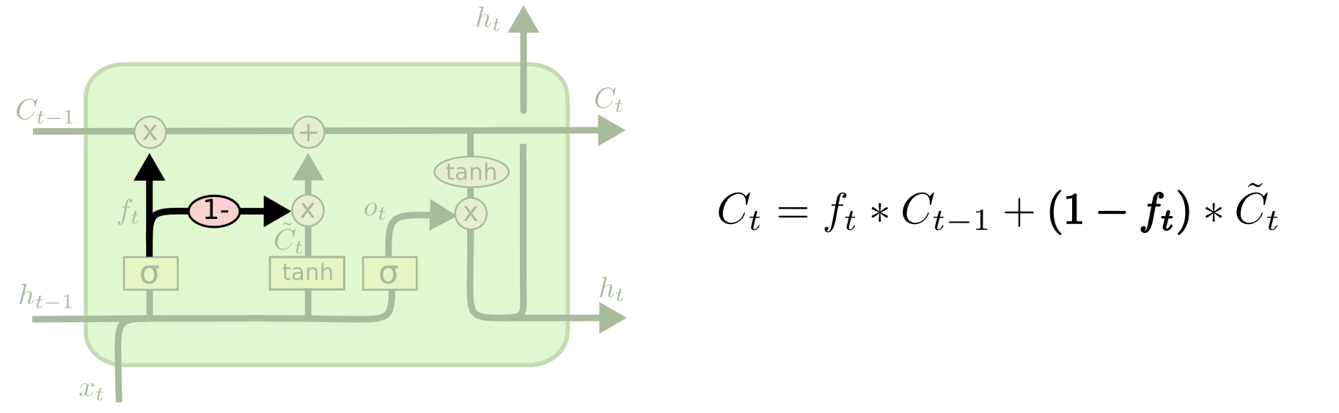
Variants on Long Short Term Memory (Another variation)
variation is to use coupled forget and input gates. Instead of separately deciding what to forget and what we should add new information to, we make those decisions together.
We only forget when we’re going to input something in its place.
We only input new values to the state when we forget something older.

Slide 26
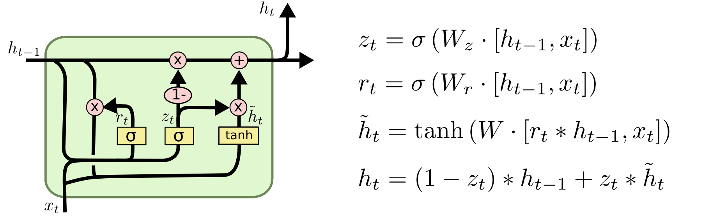
Variants on Long Short Term Memory
It combines forget and input gates into a single “update gate.” It also merges the cell state and hidden state, and makes some other changes.
The resulting model is simpler than standard LSTM models, and has been growing increasingly popular.

Slide 27
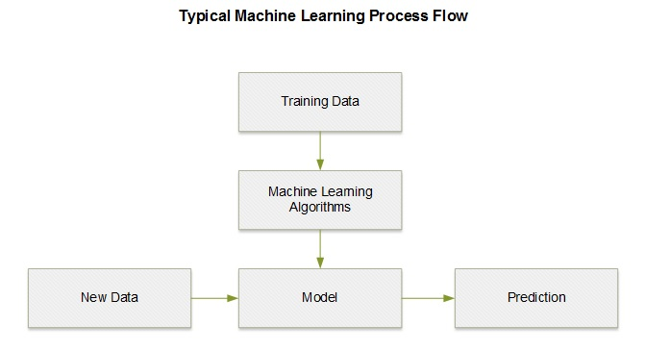
Steps To predict stock prices
Download Data
Normalize data
Using ni = (pi/p0) -1
Build Model
Train the model
Validation Data
Test Data
Feedback corrections
Load New Data
Predictions
De-normalize data
Using pi = p0(ni+1)
Plot the predictions

Slide 28
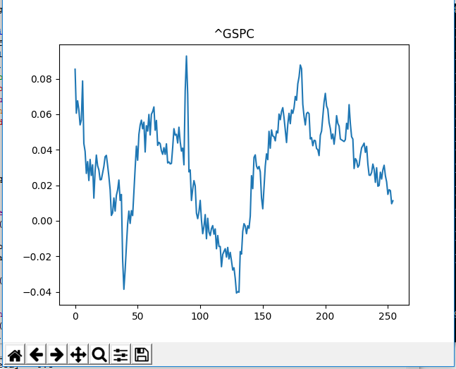
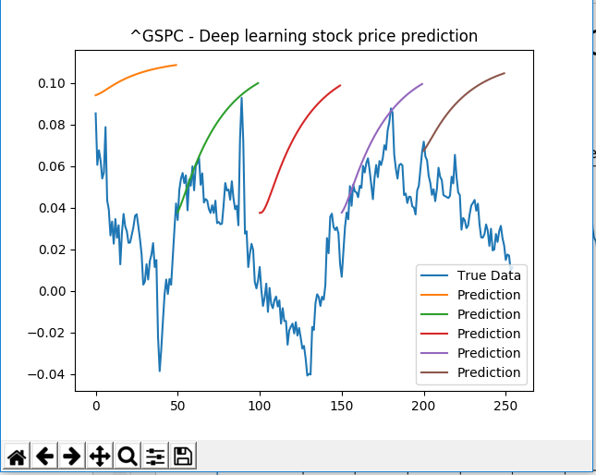
S&P 500 (^GSPC) Predictions
S&P 500 for 1-Jan-2007 to 8-May-2017
S&P 500 for 1-Jan-2007 to 8-May-2017 with predictions

Slide 29


Demo

Slide 30

What's Next

Slide 31

Q&A

Slide 32
Source Code & REFERENCES
Source Code
https://github.com/SurjitW/Stock-Price-Prediction-Deep-Learning
REFERENCES
https://www.cs.toronto.edu/~frossard/post/tensorflow/
https://www.bloomberg.com/news/articles/2017-03-27/hedge-fund-quants-close-in-on-designing-ultimate-trader-s-brain
https://docs.microsoft.com/en-us/azure/machine-learning/machine-learning-algorithm-choice
http://machinelearningmastery.com/improve-deep-learning-performance/

