Slide 1
Comparative Analysis amongst the cultural hotspots of the World
Analysis in terms of Attraction Venues

Slide 2
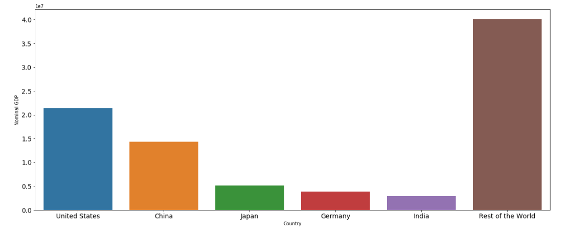
LARGEST ECONOMIES OF THE WORLD

Slide 3
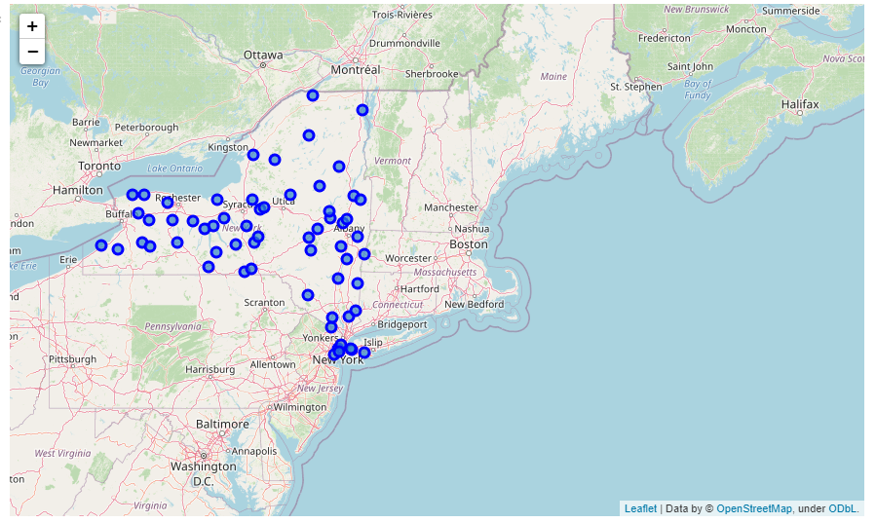
New York Major Neighbourhoods

Slide 4
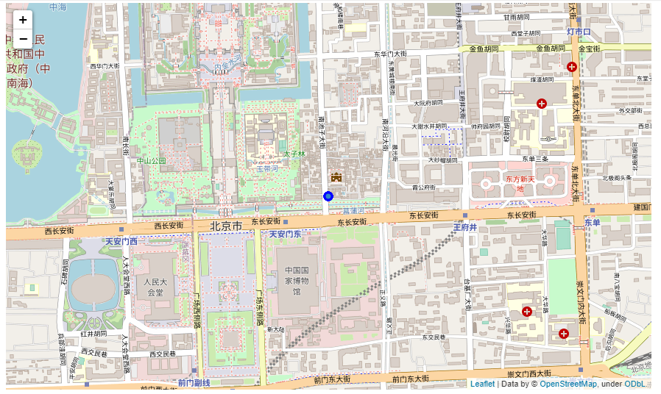
Beijing Major Neighbourhoods

Slide 5
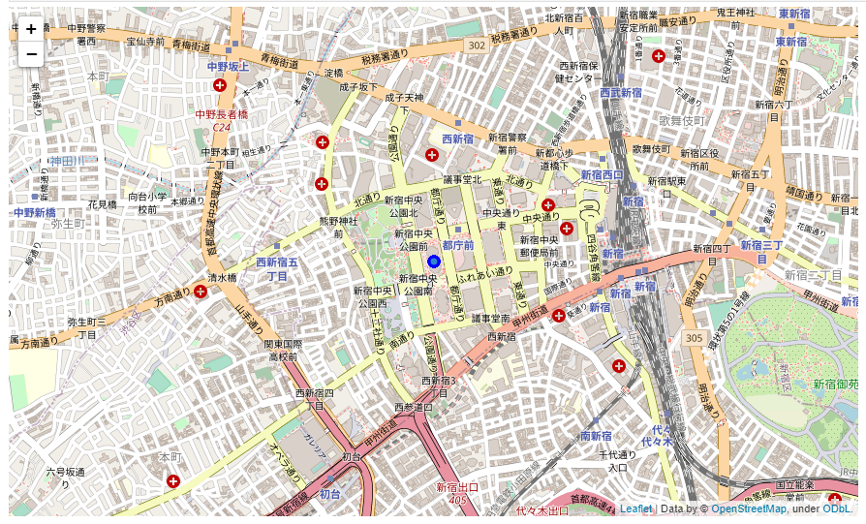
Tokyo Major Neighbourhoods

Slide 6
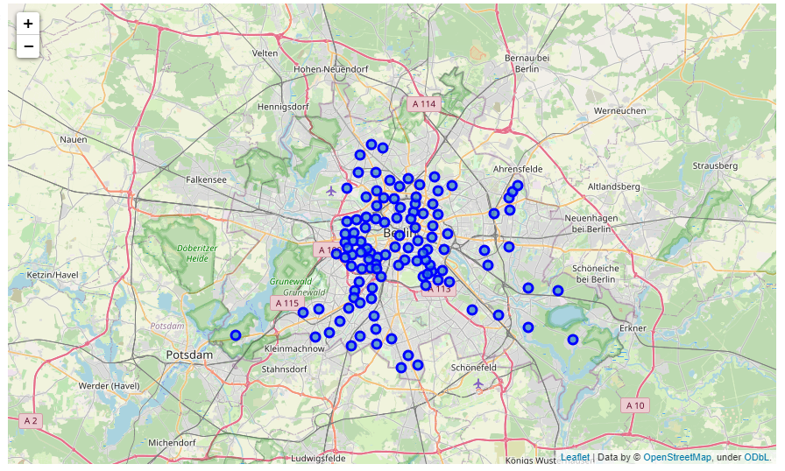
Berlin Major Neighbourhoods

Slide 7
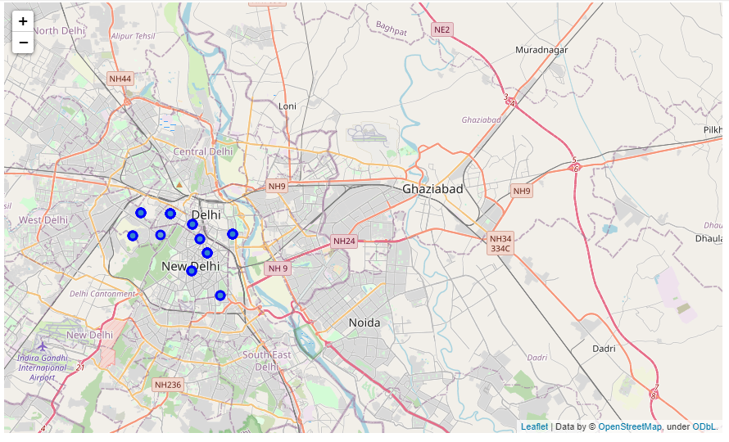
New Delhi Major Neighbourhoods

Slide 8
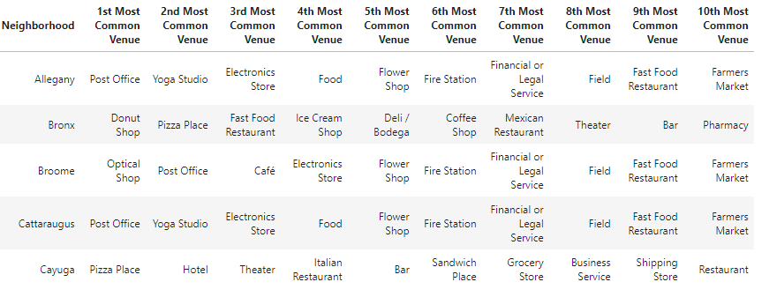
New York Prevalent Establishments/Businesses Random 5 Neighbourhoods displayed for purpose of simplicity

Slide 9

Beijing Prevalent Establishments/Businesses

Slide 10
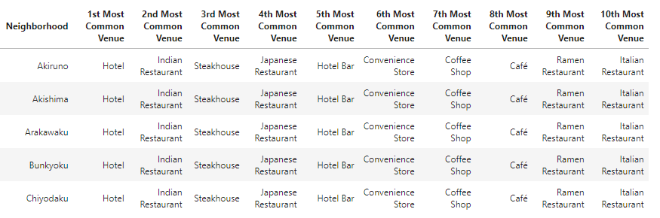
Tokyo Prevalent Establishments/Businesses Random 5 Neighbourhoods displayed for purpose of simplicity

Slide 11
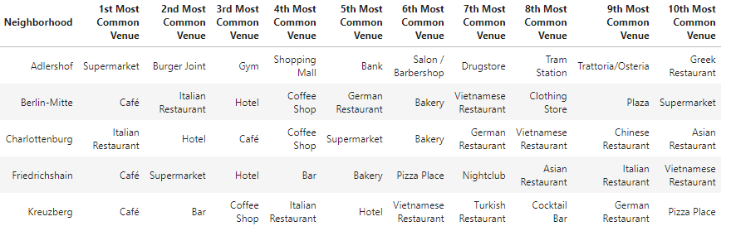
Berlin Prevalent Establishments/Businesses Random 5 Neighbourhoods displayed for purpose of simplicity

Slide 12
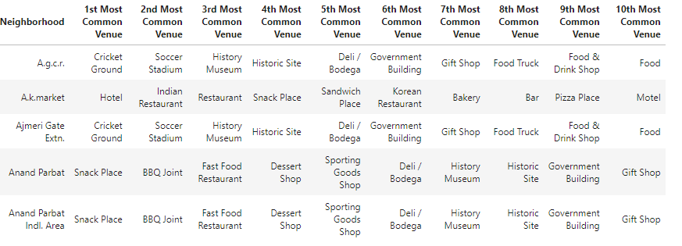
New Delhi Prevalent Establishments/Businesses Random 5 Neighbourhoods displayed for purpose of simplicity

Slide 13
APPLICATION OF UNSUPERVISED LEARNING ALGORITHM TO CLUSTER DATASET
ALGORITHM- Kmeans Clustering

Slide 14
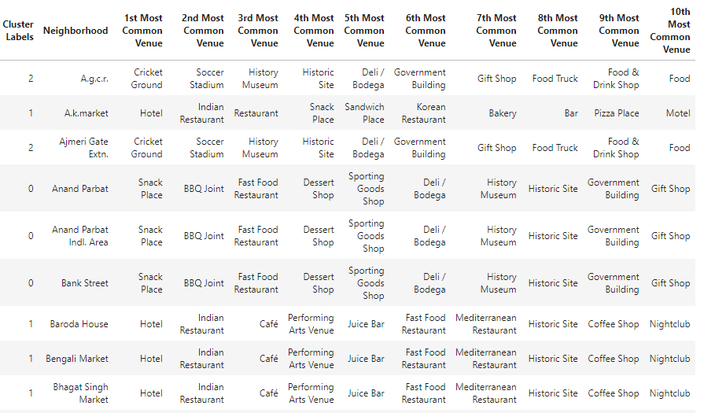
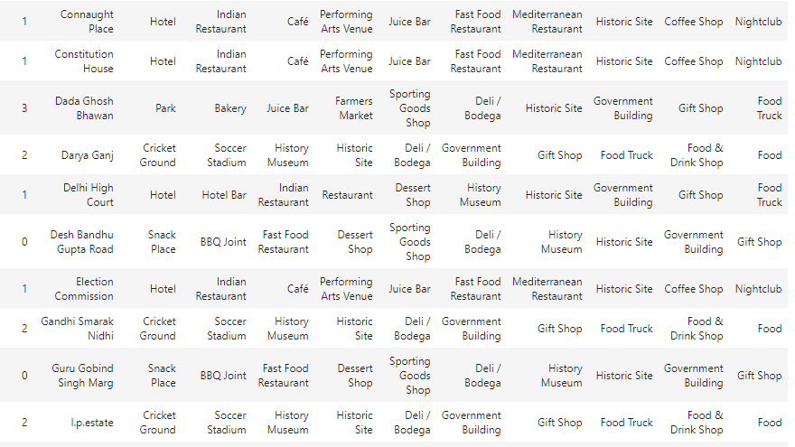
Clustered Dataset – New Delhi

Slide 15
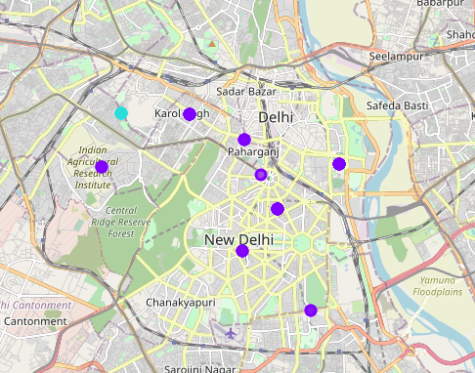
Clustered Dataset – New Delhi

