Slide 1


Activity By Sales Rep
Last data refresh:
Downloaded at:

Slide 2
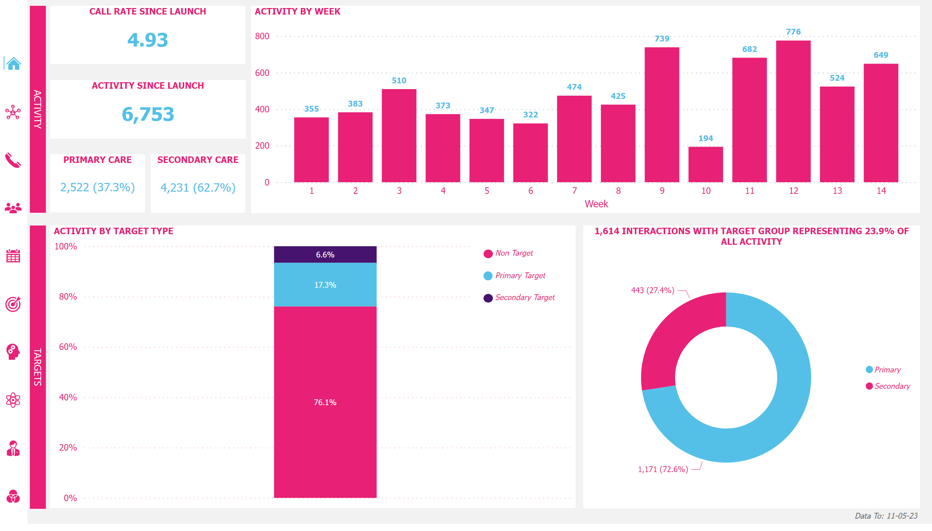
Overview
Notes:
ACTIVITY BY WEEK
No alt text provided
CALL RATE SINCE LAUNCH
No alt text provided
1,614 INTERACTIONS WITH TARGET GROUP REPRESENTING 23.9% OF ALL ACTIVITY
No alt text provided
ACTIVITY SINCE LAUNCH
No alt text provided
shape
No alt text provided
actionButton
No alt text provided
shape
No alt text provided
actionButton
No alt text provided
shape
No alt text provided
actionButton
No alt text provided
Legend_Shp
No alt text provided
ACTIVITY BY TARGET TYPE
No alt text provided
PRIMARY CARE
No alt text provided
SECONDARY CARE
No alt text provided
ActivityPanel_Shp
No alt text provided
TargetsPanel_Shp
No alt text provided
DataTo_Btn
No alt text provided
InvokanaActivity_Icon
No alt text provided
InvokanaCallRate_Icon
No alt text provided
InvokanaVOthProd_Icon
No alt text provided
OthProdActivity_Icon
No alt text provided
OthProdByKAM_Icon
No alt text provided
OthProd_Icon
No alt text provided
InvokanaByKAM_Icon
No alt text provided
InvokanaTargets_Icon
No alt text provided
InvokanaByWk_Icon
No alt text provided
HomePg_Icon
No alt text provided
shape
No alt text provided

Slide 3
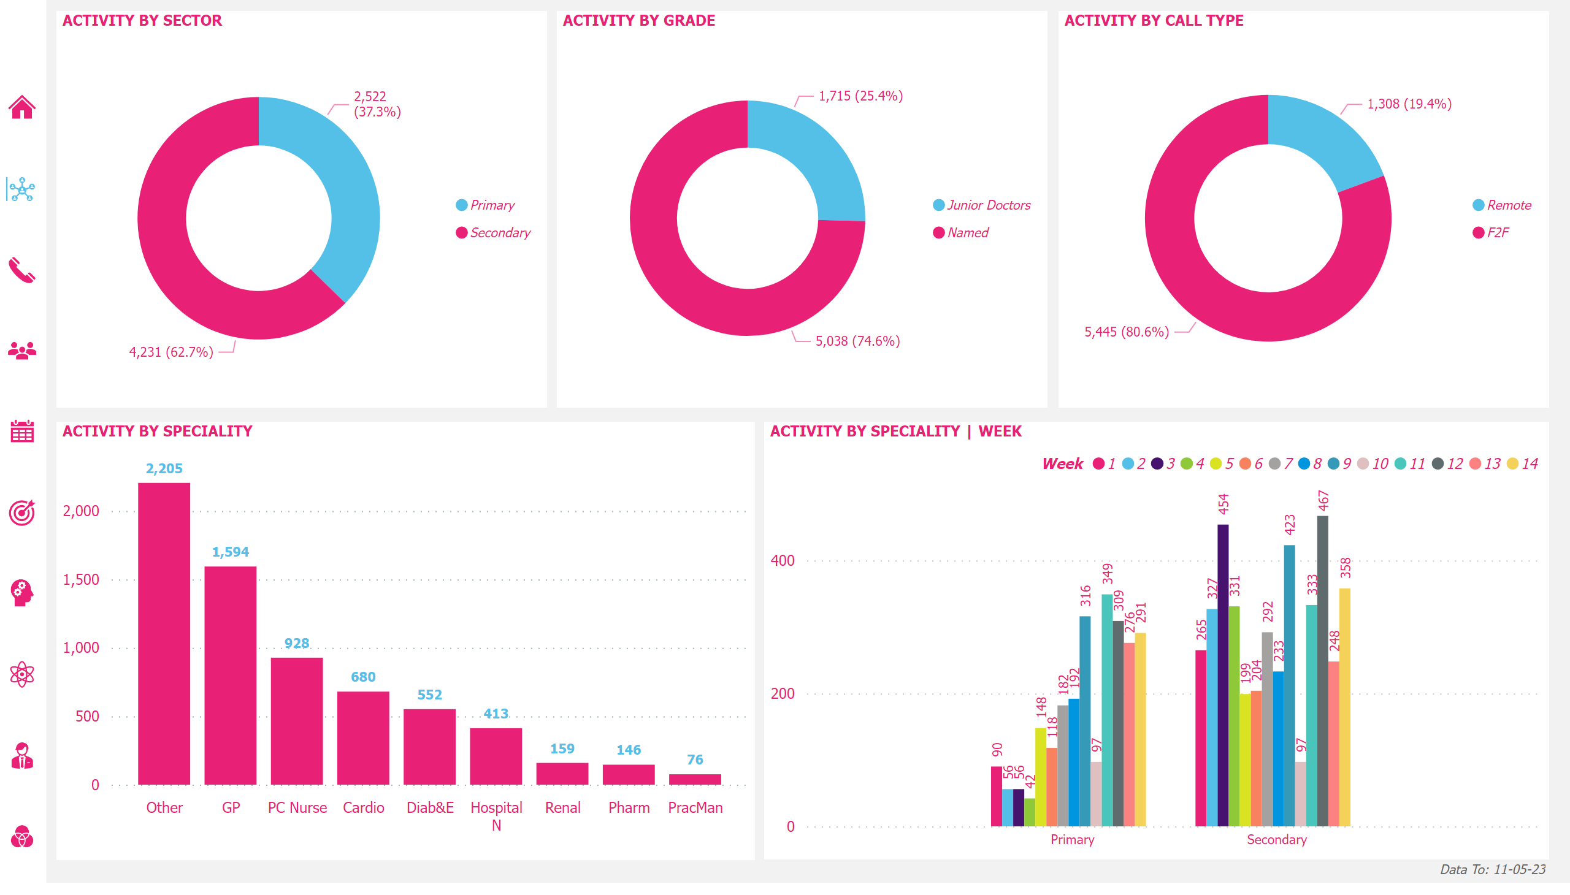
Activity
Notes:
ACTIVITY BY SPECIALITY
No alt text provided
ACTIVITY BY GRADE
No alt text provided
ACTIVITY BY SECTOR
No alt text provided
DataTo_Btn
No alt text provided
ACTIVITY BY CALL TYPE
No alt text provided
InvokanaByWk_Icon
No alt text provided
HomePg_Icon
No alt text provided
InvokanaTargets_Icon
No alt text provided
InvokanaByKAM_Icon
No alt text provided
OthProd_Icon
No alt text provided
OthProdByKAM_Icon
No alt text provided
OthProdActivity_Icon
No alt text provided
InvokanaVOthProd_Icon
No alt text provided
InvokanaCallRate_Icon
No alt text provided
InvokanaActivity_Icon
No alt text provided
ACTIVITY BY SPECIALITY | WEEK
No alt text provided
shape
No alt text provided

Slide 4
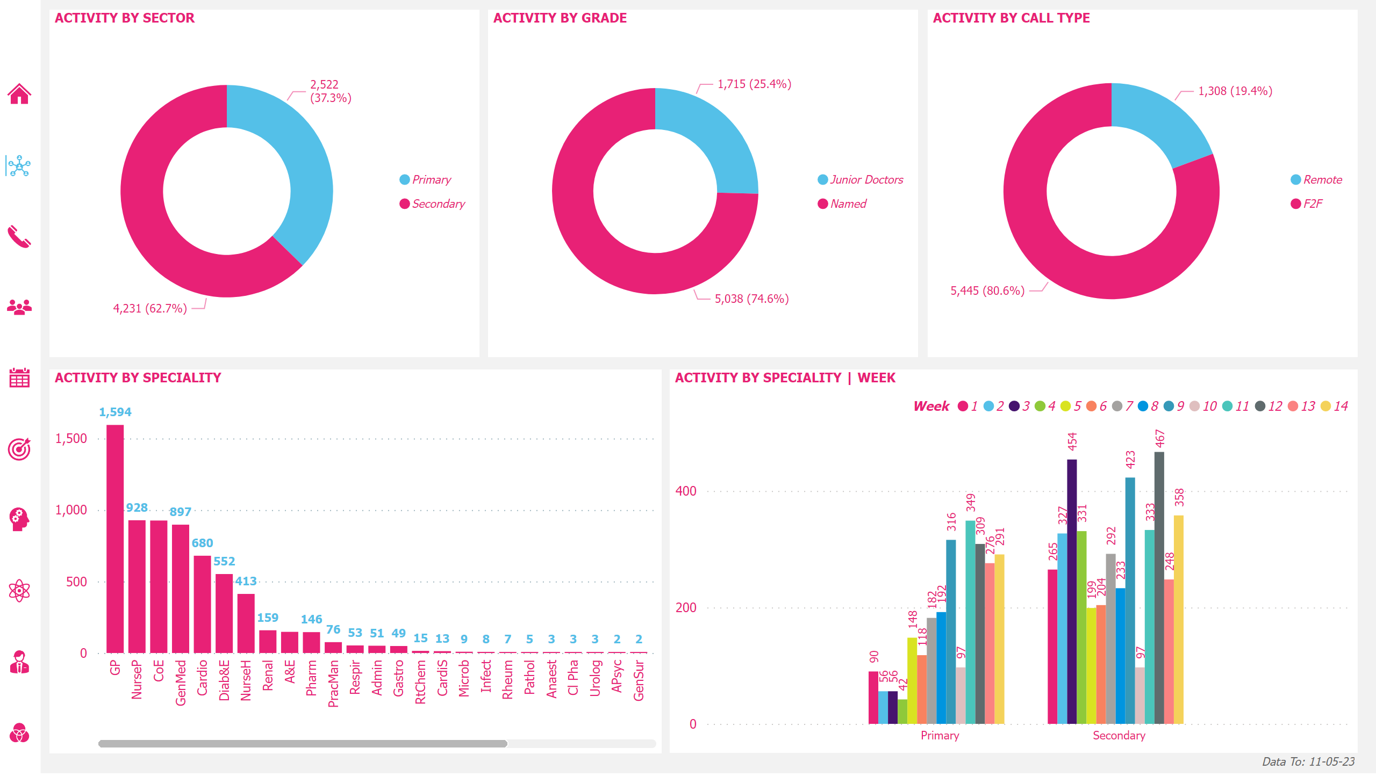
Activity
Notes:
ACTIVITY BY SPECIALITY
No alt text provided
ACTIVITY BY GRADE
No alt text provided
ACTIVITY BY SECTOR
No alt text provided
DataTo_Btn
No alt text provided
ACTIVITY BY CALL TYPE
No alt text provided
InvokanaByWk_Icon
No alt text provided
HomePg_Icon
No alt text provided
InvokanaTargets_Icon
No alt text provided
InvokanaByKAM_Icon
No alt text provided
OthProd_Icon
No alt text provided
OthProdByKAM_Icon
No alt text provided
OthProdActivity_Icon
No alt text provided
InvokanaVOthProd_Icon
No alt text provided
InvokanaCallRate_Icon
No alt text provided
InvokanaActivity_Icon
No alt text provided
ACTIVITY BY SPECIALITY | WEEK
No alt text provided
shape
No alt text provided

Slide 5
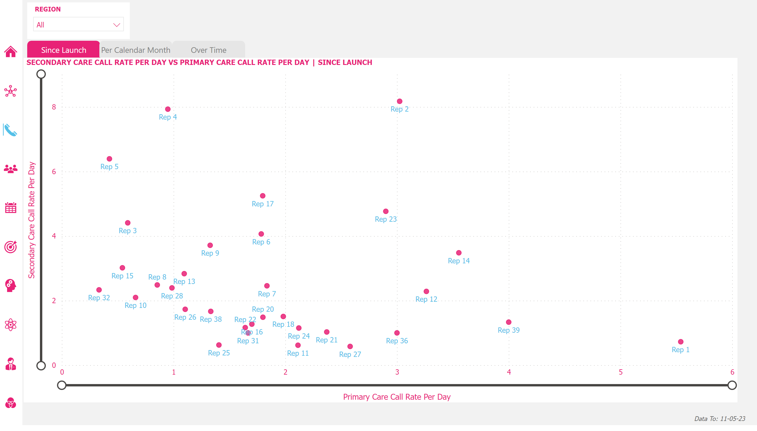
Call Rate
Notes:
SECONDARY CARE CALL RATE PER DAY VS PRIMARY CARE CALL RATE PER DAY | SINCE LAUNCH
No alt text provided
DataTo_Btn
No alt text provided
InvokanaByWk_Icon
No alt text provided
HomePg_Icon
No alt text provided
InvokanaTargets_Icon
No alt text provided
InvokanaByKAM_Icon
No alt text provided
OthProd_Icon
No alt text provided
OthProdByKAM_Icon
No alt text provided
OthProdActivity_Icon
No alt text provided
InvokanaVOthProd_Icon
No alt text provided
InvokanaActivity_Icon
No alt text provided
InvokanaCallRate_Icon
No alt text provided
Region_Slicer
No alt text provided
scatterChart
No alt text provided
PCMUnselected_Shp
No alt text provided
SinceLaunchSelected_Shp
No alt text provided
shape
No alt text provided
shape
No alt text provided
shape
No alt text provided
OverTimeUnselected_Shp
No alt text provided
deneb7E15AEF80B9E4D4F8E12924291ECE89A
No alt text provided
slicer
No alt text provided
slicer
No alt text provided
shape
No alt text provided

Slide 6
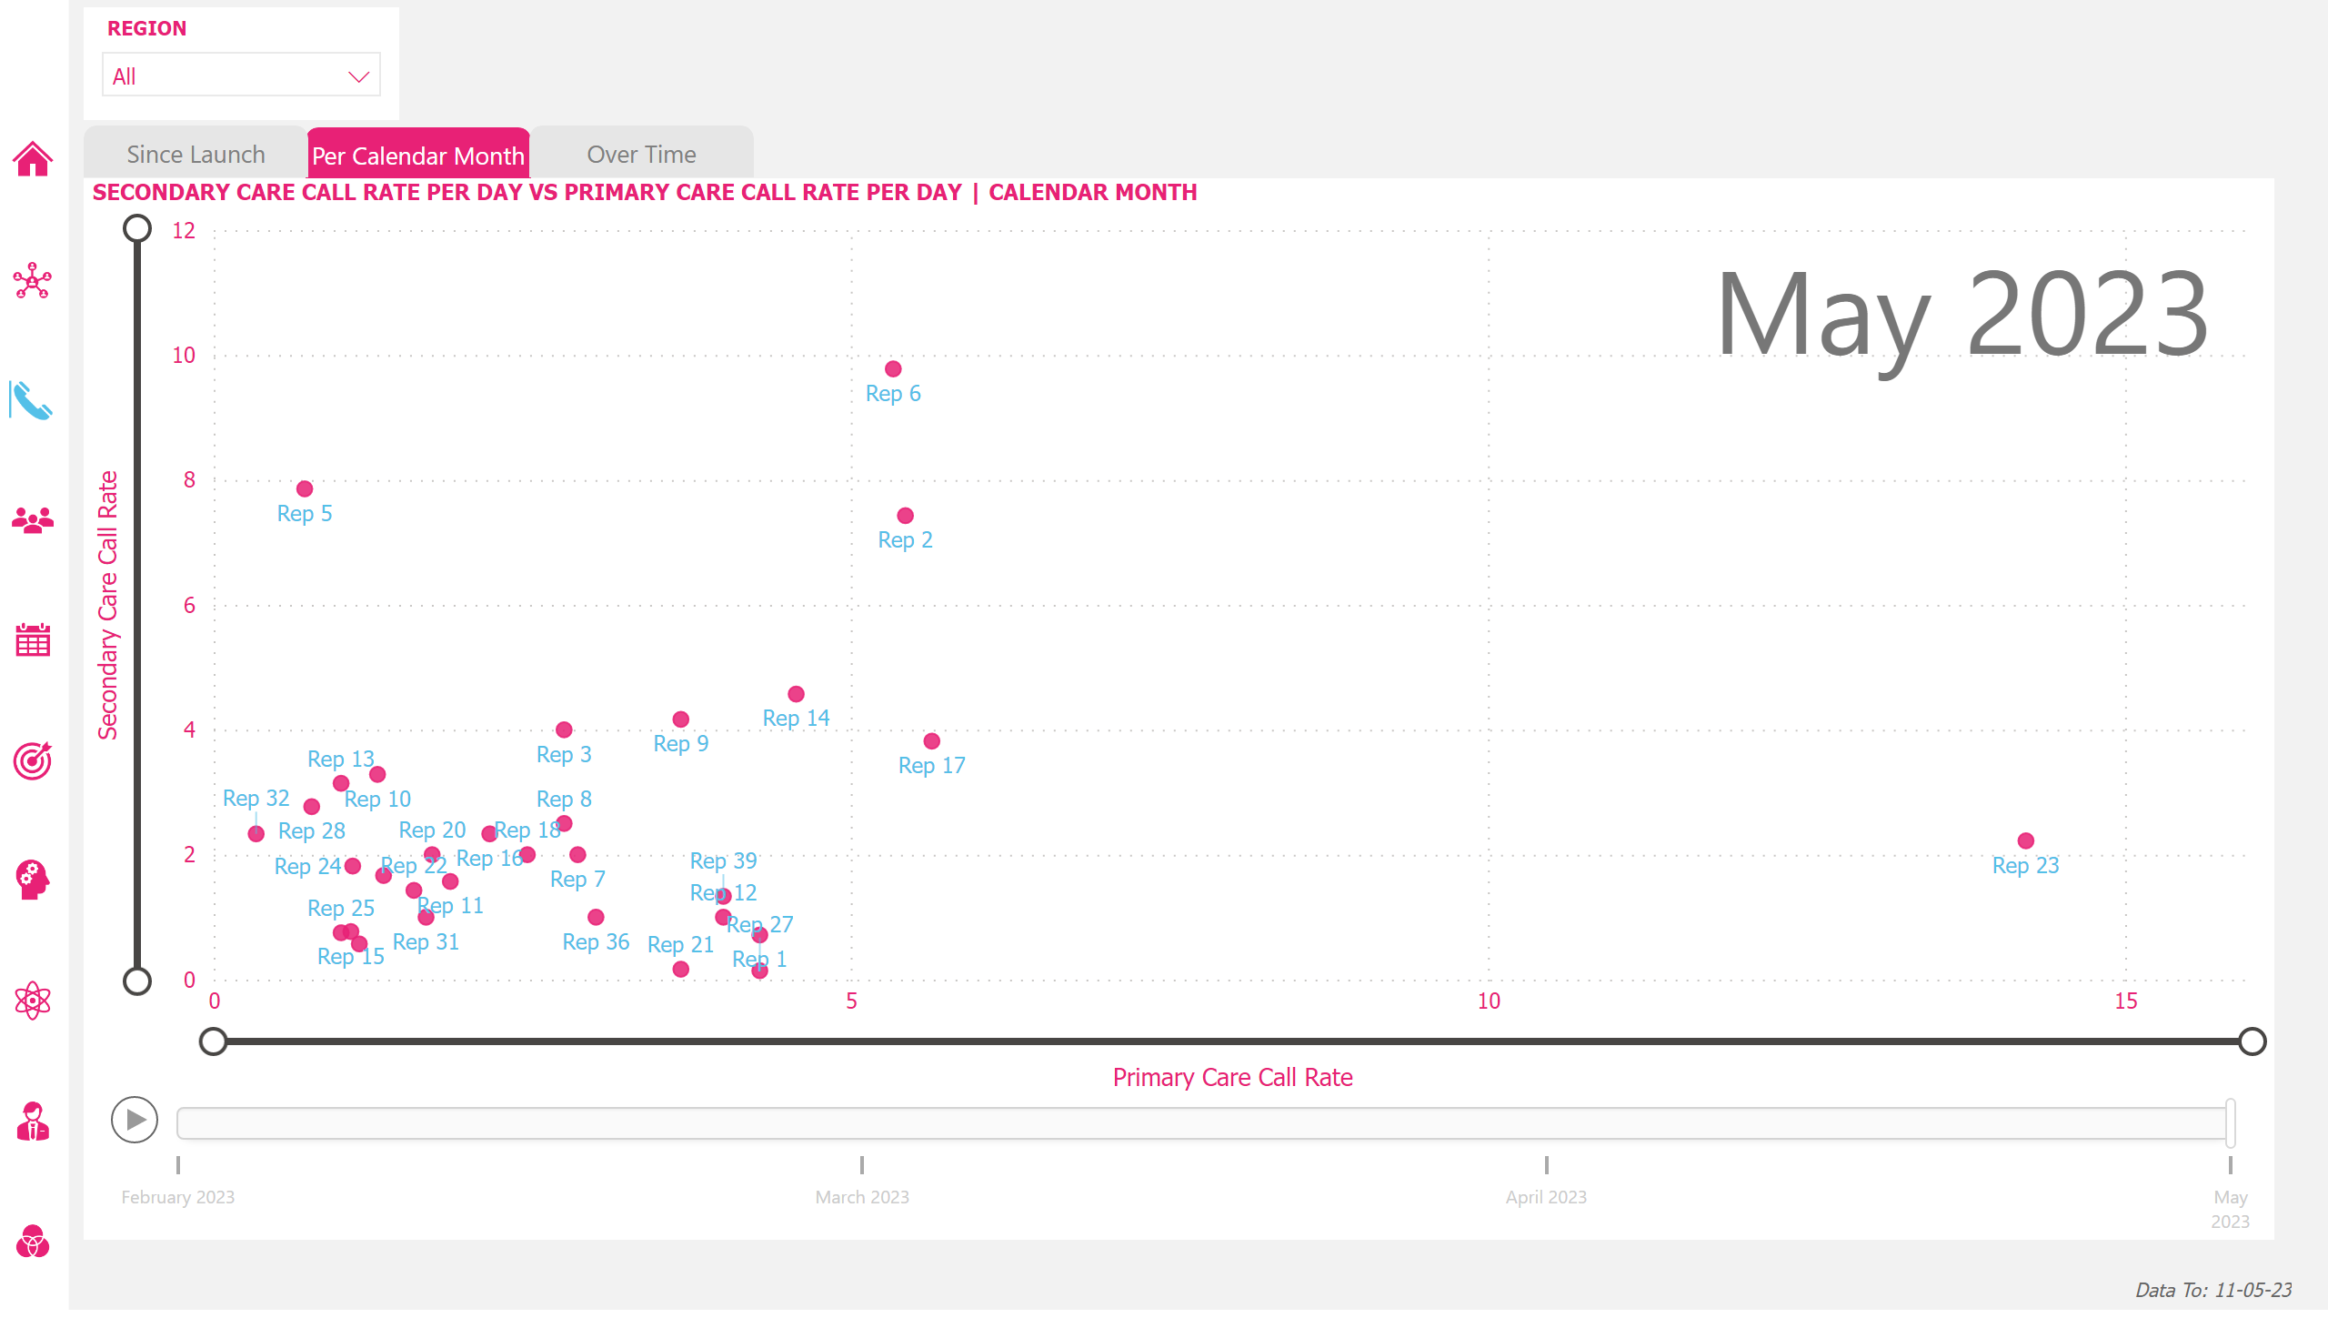
Call Rate
Notes:
scatterChart
No alt text provided
DataTo_Btn
No alt text provided
InvokanaByWk_Icon
No alt text provided
HomePg_Icon
No alt text provided
InvokanaTargets_Icon
No alt text provided
InvokanaByKAM_Icon
No alt text provided
OthProd_Icon
No alt text provided
OthProdByKAM_Icon
No alt text provided
OthProdActivity_Icon
No alt text provided
InvokanaVOthProd_Icon
No alt text provided
InvokanaActivity_Icon
No alt text provided
InvokanaCallRate_Icon
No alt text provided
Region_Slicer
No alt text provided
SECONDARY CARE CALL RATE PER DAY VS PRIMARY CARE CALL RATE PER DAY | CALENDAR MONTH
No alt text provided
shape
No alt text provided
shape
No alt text provided
SinceLaunchUnselected_Shp
No alt text provided
PCMSelected_Shp
No alt text provided
shape
No alt text provided
OverTimeUnselected_Shp
No alt text provided
deneb7E15AEF80B9E4D4F8E12924291ECE89A
No alt text provided
slicer
No alt text provided
slicer
No alt text provided
shape
No alt text provided

Slide 7
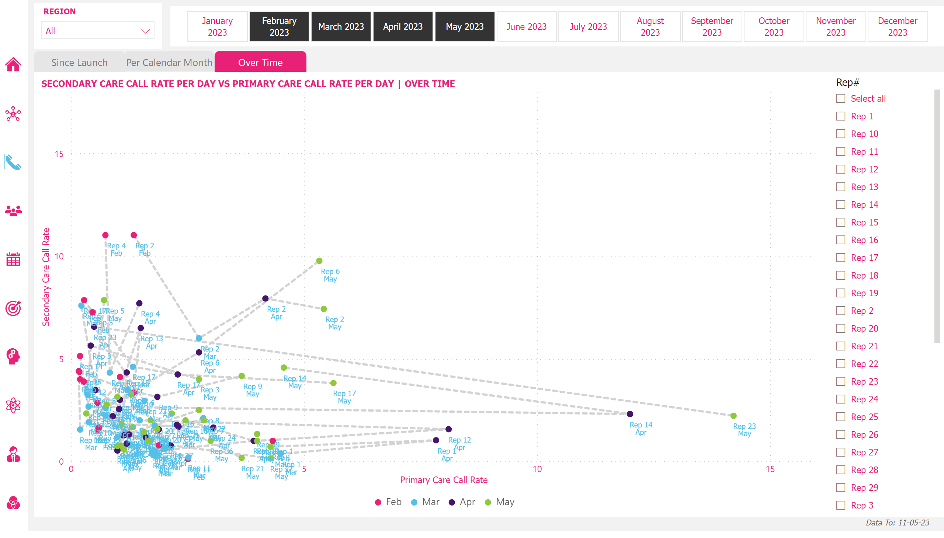
Call Rate
Notes:
scatterChart
No alt text provided
DataTo_Btn
No alt text provided
InvokanaByWk_Icon
No alt text provided
HomePg_Icon
No alt text provided
InvokanaTargets_Icon
No alt text provided
InvokanaByKAM_Icon
No alt text provided
OthProd_Icon
No alt text provided
OthProdByKAM_Icon
No alt text provided
OthProdActivity_Icon
No alt text provided
InvokanaVOthProd_Icon
No alt text provided
InvokanaActivity_Icon
No alt text provided
InvokanaCallRate_Icon
No alt text provided
Region_Slicer
No alt text provided
scatterChart
No alt text provided
PCMUnselected_Shp
No alt text provided
shape
No alt text provided
SinceLaunchUnselected_Shp
No alt text provided
shape
No alt text provided
OverTimeSelected_Shp
No alt text provided
shape
No alt text provided
SecCareVPriCareOverTime
No alt text provided
KAM_Slicer
No alt text provided
Month_Slicer
No alt text provided
shape
No alt text provided

Slide 8
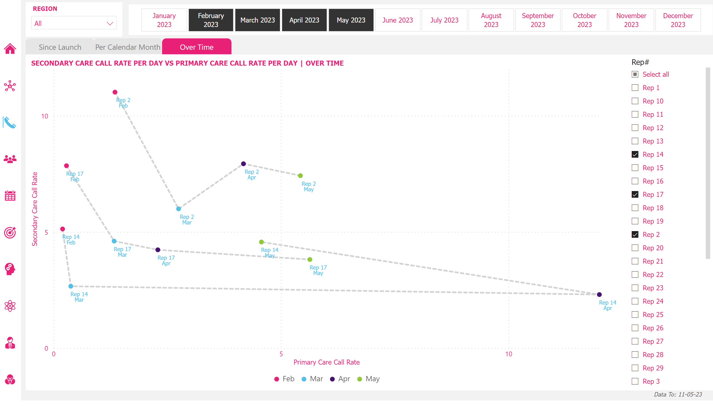
Call Rate
Notes:
scatterChart
No alt text provided
DataTo_Btn
No alt text provided
InvokanaByWk_Icon
No alt text provided
HomePg_Icon
No alt text provided
InvokanaTargets_Icon
No alt text provided
InvokanaByKAM_Icon
No alt text provided
OthProd_Icon
No alt text provided
OthProdByKAM_Icon
No alt text provided
OthProdActivity_Icon
No alt text provided
InvokanaVOthProd_Icon
No alt text provided
InvokanaActivity_Icon
No alt text provided
InvokanaCallRate_Icon
No alt text provided
Region_Slicer
No alt text provided
scatterChart
No alt text provided
PCMUnselected_Shp
No alt text provided
shape
No alt text provided
SinceLaunchUnselected_Shp
No alt text provided
shape
No alt text provided
OverTimeSelected_Shp
No alt text provided
shape
No alt text provided
SecCareVPriCareOverTime
No alt text provided
KAM_Slicer
No alt text provided
Month_Slicer
No alt text provided
shape
No alt text provided

Slide 9
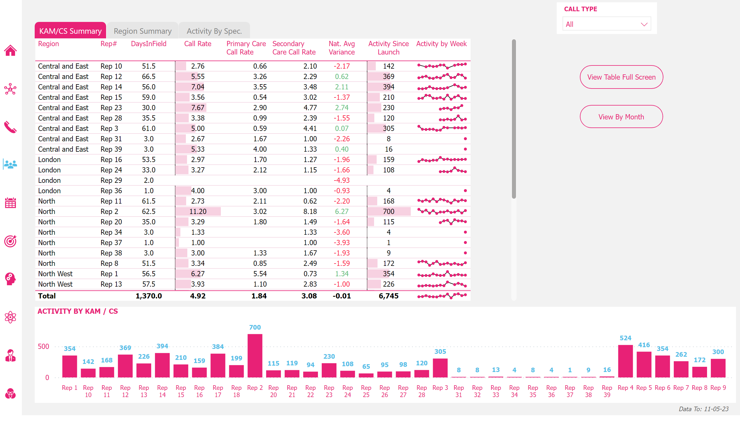
Reps
Notes:
RepTable
No alt text provided
pivotTable
No alt text provided
DataTo_Btn
No alt text provided
ACTIVITY BY KAM / CS
No alt text provided
InvokanaByWk_Icon
No alt text provided
HomePg_Icon
No alt text provided
InvokanaTargets_Icon
No alt text provided
OthProd_Icon
No alt text provided
OthProdByKAM_Icon
No alt text provided
OthProdActivity_Icon
No alt text provided
InvokanaVOthProd_Icon
No alt text provided
InvokanaCallRate_Icon
No alt text provided
InvokanaActivity_Icon
No alt text provided
InvokanaByKAM_Icon
No alt text provided
CallType_Slicer
No alt text provided
pivotTable
No alt text provided
shape
No alt text provided
KAM/CSSelected_Shp
No alt text provided
RegSumUnselected_Shp
No alt text provided
shape
No alt text provided
actionButton
No alt text provided
ActBySpecUnselected_Shp
No alt text provided
shape
No alt text provided
tableEx
No alt text provided
actionButton
No alt text provided
ViewTblFullScreen_Btn
No alt text provided
ViewTblFullScreen_Btn
No alt text provided
shape
No alt text provided

Slide 10
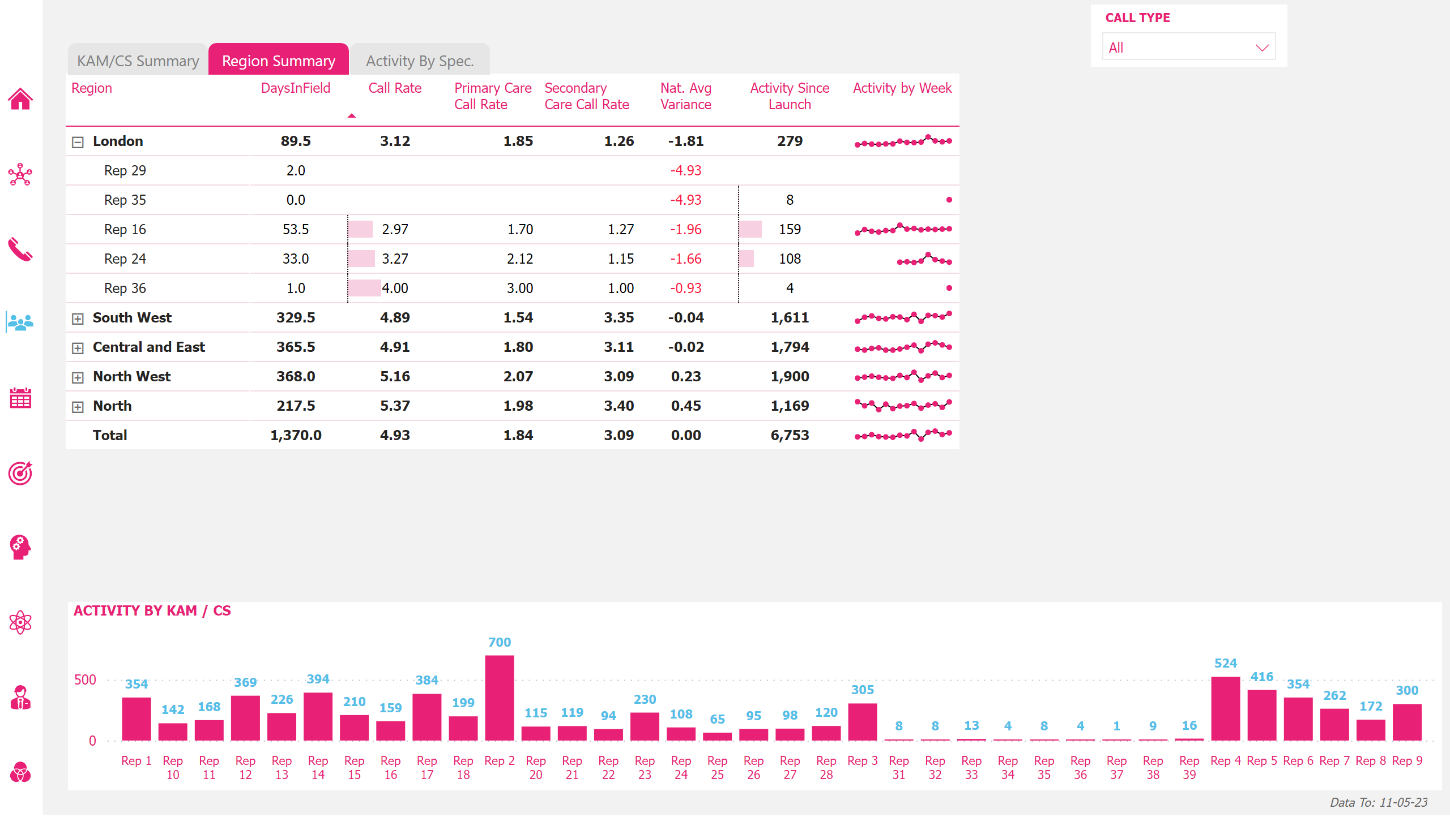
Reps
Notes:
tableEx
No alt text provided
pivotTable
No alt text provided
DataTo_Btn
No alt text provided
ACTIVITY BY KAM / CS
No alt text provided
InvokanaByWk_Icon
No alt text provided
HomePg_Icon
No alt text provided
InvokanaTargets_Icon
No alt text provided
OthProd_Icon
No alt text provided
OthProdByKAM_Icon
No alt text provided
OthProdActivity_Icon
No alt text provided
InvokanaVOthProd_Icon
No alt text provided
InvokanaCallRate_Icon
No alt text provided
InvokanaActivity_Icon
No alt text provided
InvokanaByKAM_Icon
No alt text provided
CallType_Slicer
No alt text provided
RegionSummaryMatrix
No alt text provided
RegSumSelected_Shp
No alt text provided
shape
No alt text provided
shape
No alt text provided
KAM/CSUnselected_Shp
No alt text provided
actionButton
No alt text provided
ActBySpecUnselected_Shp
No alt text provided
shape
No alt text provided
tableEx
No alt text provided
actionButton
No alt text provided
actionButton
No alt text provided
actionButton
No alt text provided
shape
No alt text provided

Slide 11
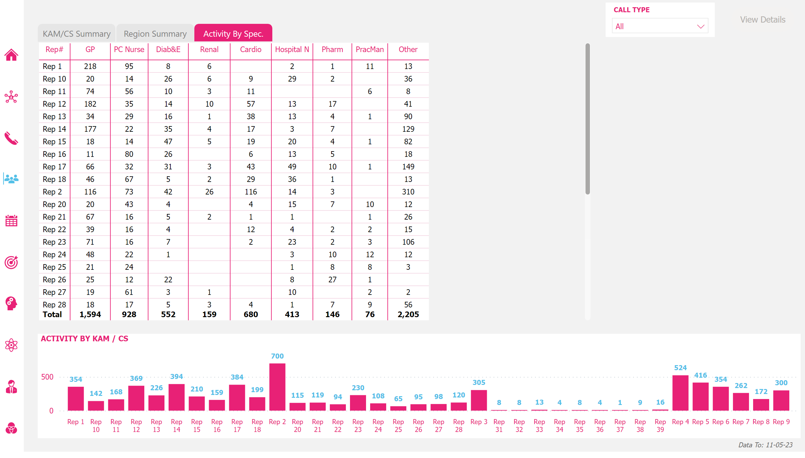
Reps
Notes:
tableEx
No alt text provided
ActivityBySpec
No alt text provided
DataTo_Btn
No alt text provided
ACTIVITY BY KAM / CS
No alt text provided
InvokanaByWk_Icon
No alt text provided
HomePg_Icon
No alt text provided
InvokanaTargets_Icon
No alt text provided
OthProd_Icon
No alt text provided
OthProdByKAM_Icon
No alt text provided
OthProdActivity_Icon
No alt text provided
InvokanaVOthProd_Icon
No alt text provided
InvokanaCallRate_Icon
No alt text provided
InvokanaActivity_Icon
No alt text provided
InvokanaByKAM_Icon
No alt text provided
CallType_Slicer
No alt text provided
pivotTable
No alt text provided
shape
No alt text provided
shape
No alt text provided
RegSumUnselected_Shp
No alt text provided
KAM/CSUnselected_Shp
No alt text provided
SpecDrillThru_Btn
No alt text provided
shape
No alt text provided
RegSumSelected_Shp
No alt text provided
tableEx
No alt text provided
actionButton
No alt text provided
actionButton
No alt text provided
actionButton
No alt text provided
shape
No alt text provided

Slide 12
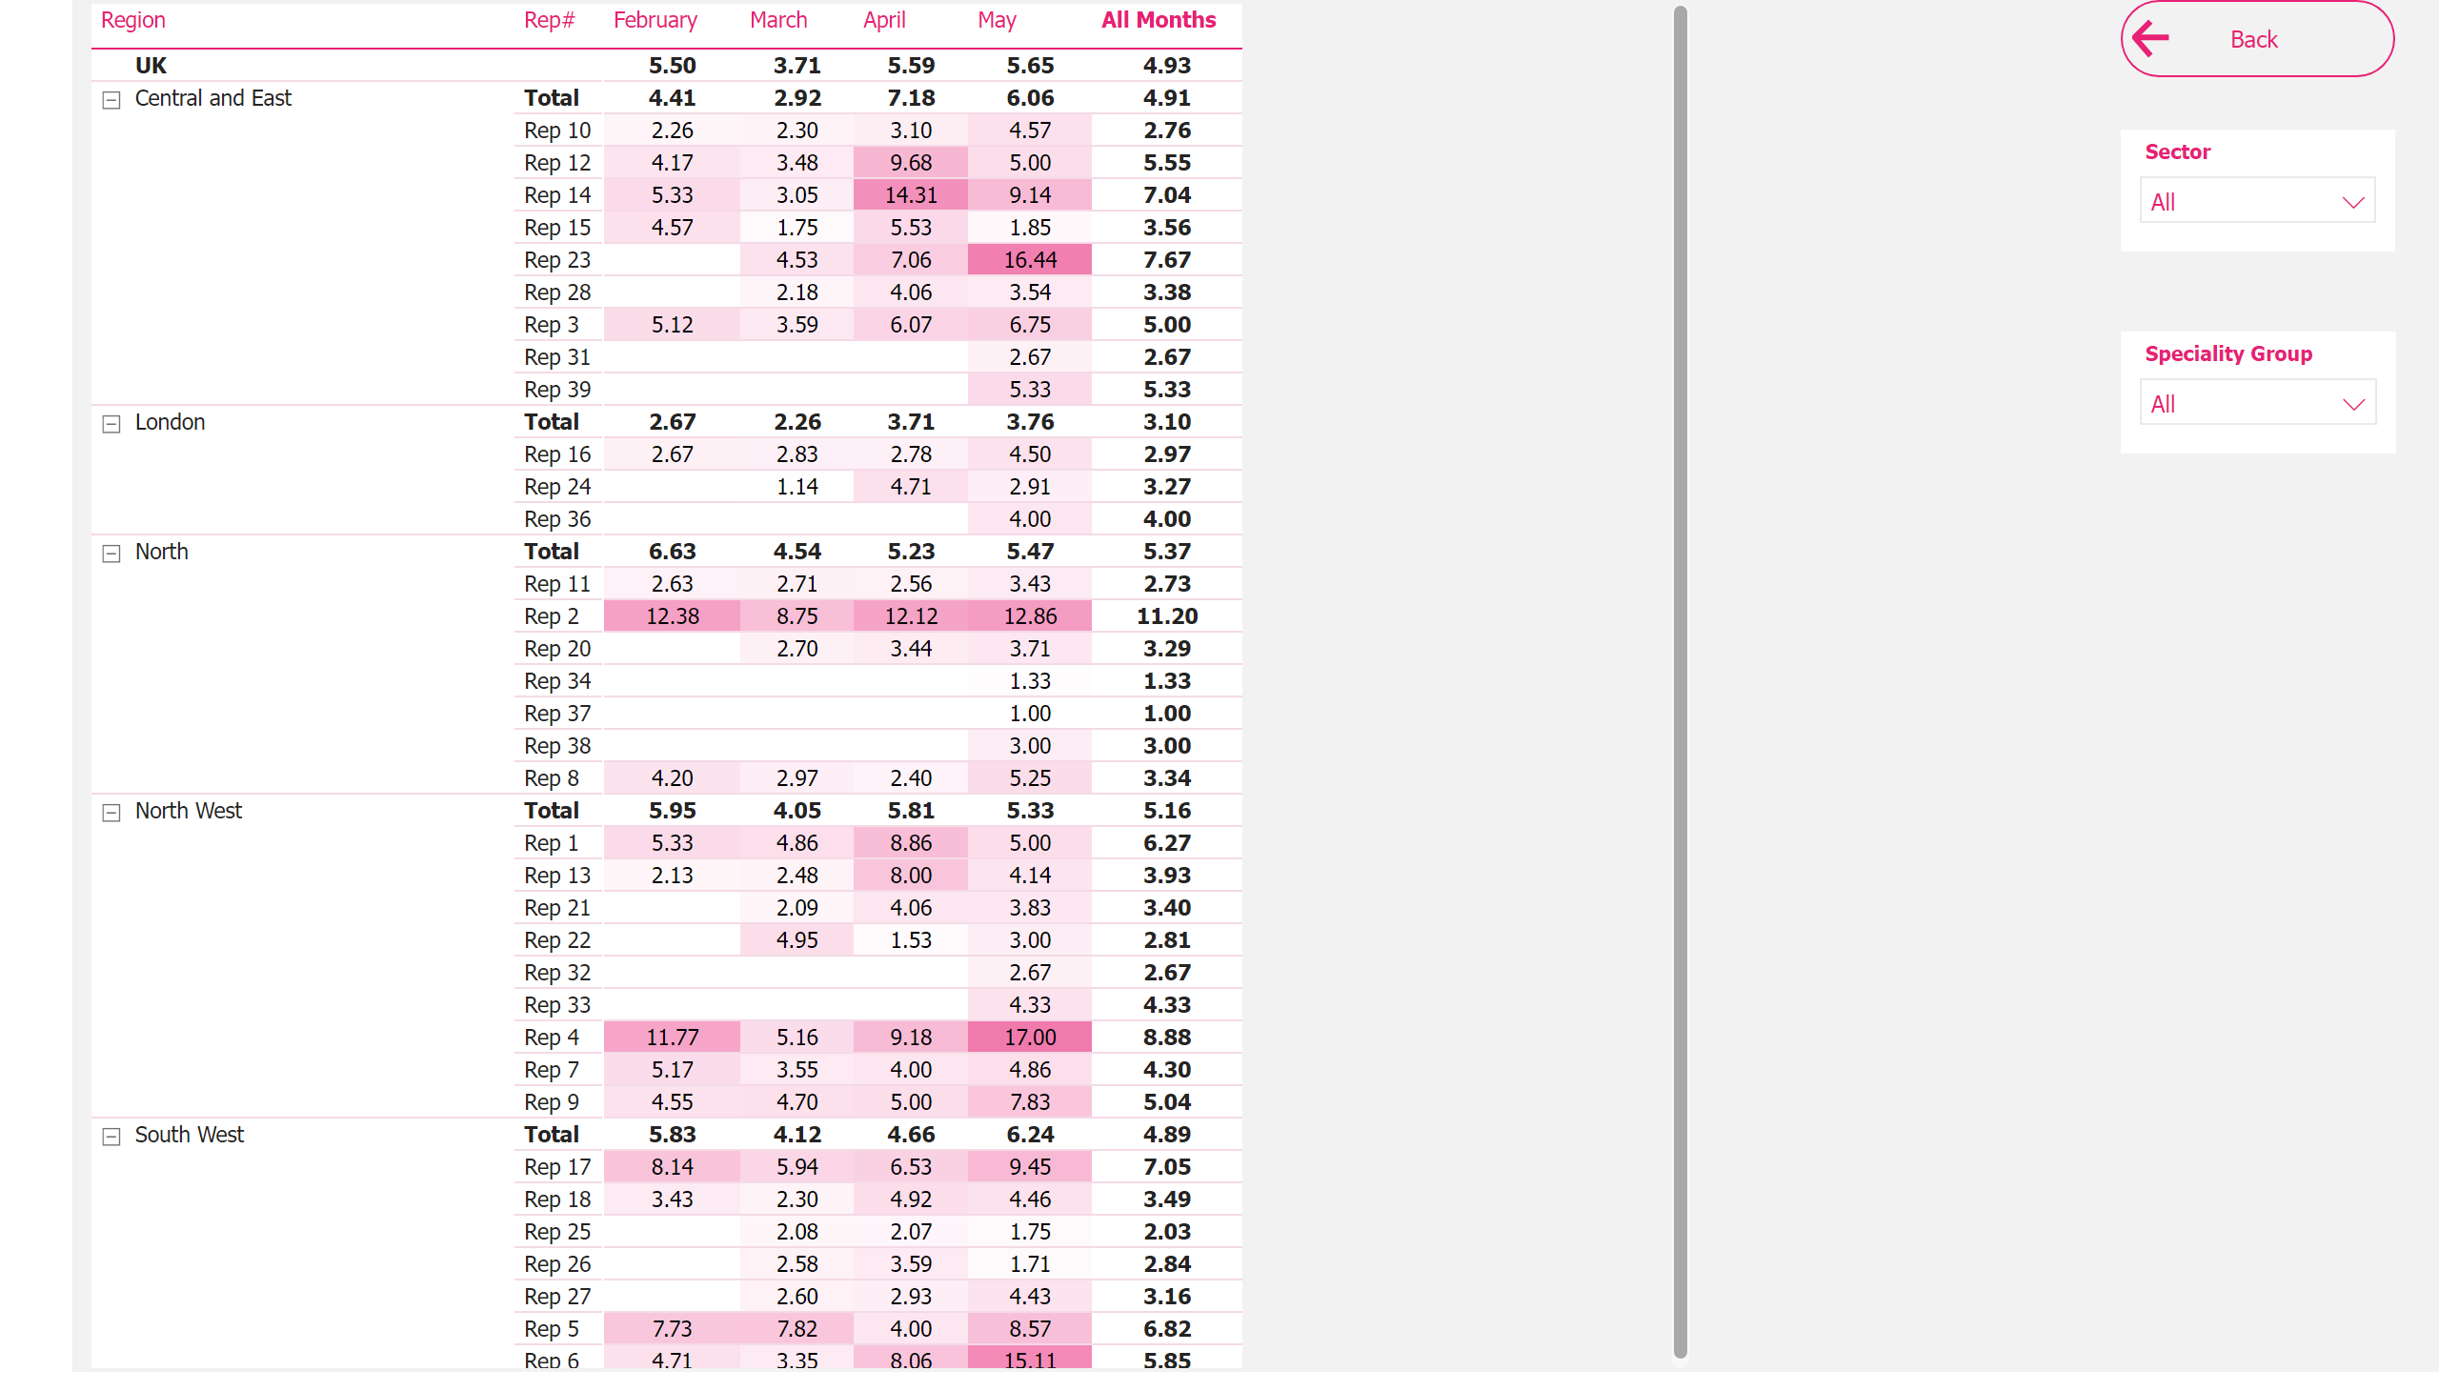
CallRateByMth
Notes:
RepTable
No alt text provided
TblFullScreenBack_Btn
No alt text provided
slicer
No alt text provided
slicer
No alt text provided
shape
No alt text provided

Slide 13
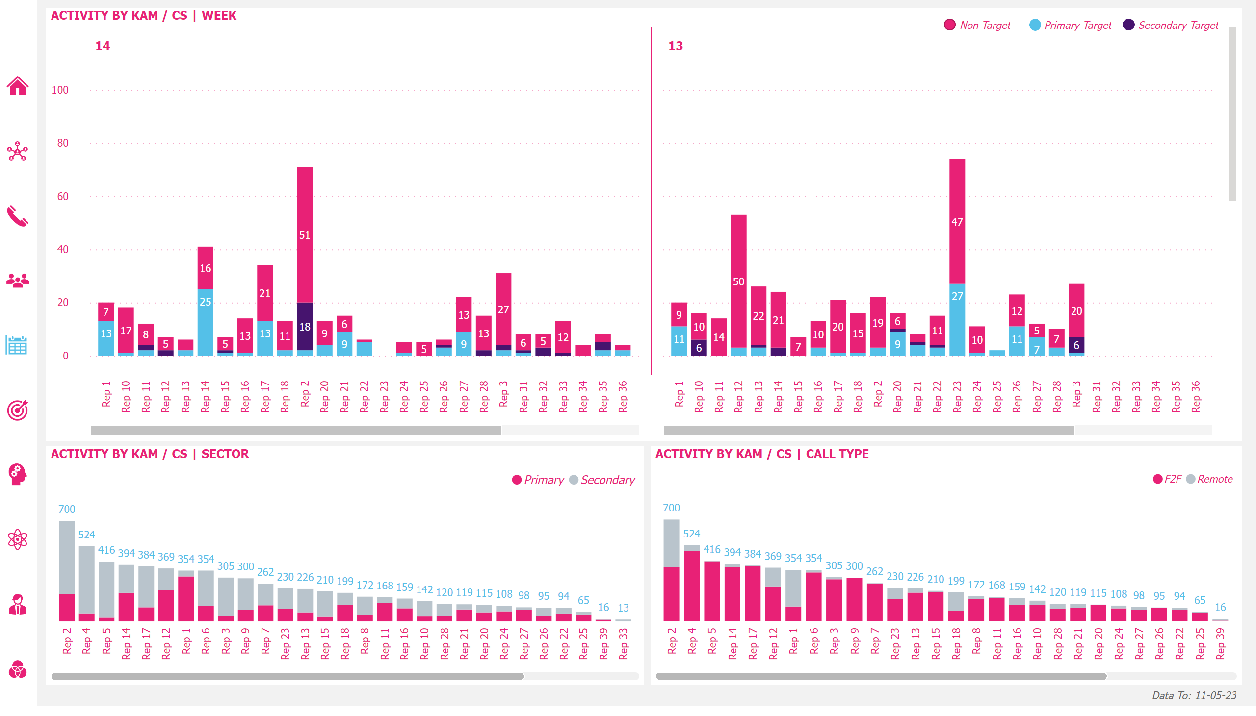
Rep Activity Weekly
Notes:
ACTIVITY BY KAM / CS | WEEK
No alt text provided
NonTarget_Shp
No alt text provided
NonTarget_Btn
No alt text provided
PriTarget_Shp
No alt text provided
PriTarget_Btn
No alt text provided
SecTarget_Shp
No alt text provided
SecTarget_Btn
No alt text provided
DataTo_Btn
No alt text provided
ACTIVITY BY KAM / CS | SECTOR
No alt text provided
ACTIVITY BY KAM / CS | CALL TYPE
No alt text provided
InvokanaByWk_Icon
No alt text provided
InvokanaTargets_Icon
No alt text provided
InvokanaByKAM_Icon
No alt text provided
OthProd_Icon
No alt text provided
OthProdByKAM_Icon
No alt text provided
OthProdActivity_Icon
No alt text provided
InvokanaVOthProd_Icon
No alt text provided
InvokanaCallRate_Icon
No alt text provided
InvokanaActivity_Icon
No alt text provided
HomePg_Icon
No alt text provided
shape
No alt text provided

Slide 14
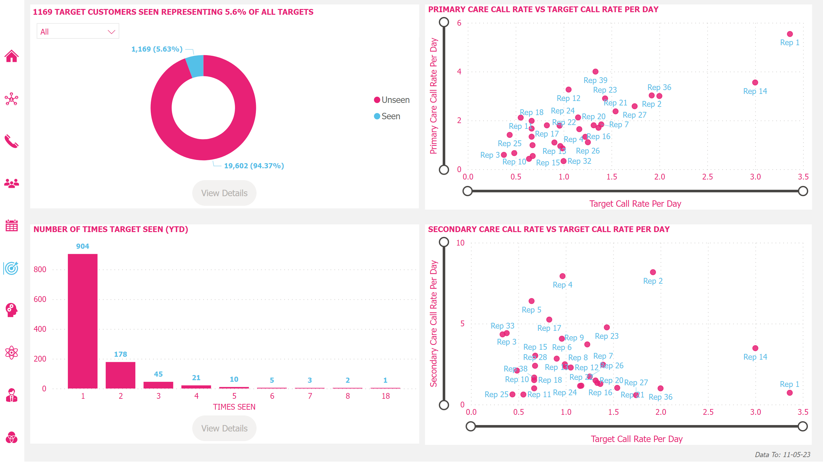
Targets
Notes:
NUMBER OF TIMES TARGET SEEN (YTD)
No alt text provided
1169 TARGET CUSTOMERS SEEN REPRESENTING 5.6% OF ALL TARGETS
No alt text provided
TargetCustDrillThru_Btn
No alt text provided
TargetCustDrillThru_Shp
No alt text provided
SECONDARY CARE CALL RATE VS TARGET CALL RATE PER DAY
No alt text provided
PRIMARY CARE CALL RATE VS TARGET CALL RATE PER DAY
No alt text provided
InvokanaTargets_Icon
No alt text provided
InvokanaByWk_Icon
No alt text provided
InvokanaByKAM_Icon
No alt text provided
OthProd_Icon
No alt text provided
OthProdByKAM_Icon
No alt text provided
OthProdActivity_Icon
No alt text provided
InvokanaVOthProd_Icon
No alt text provided
InvokanaCallRate_Icon
No alt text provided
InvokanaActivity_Icon
No alt text provided
HomePg_Icon
No alt text provided
DataTo_Btn
No alt text provided
TargetCustomer_Slicer
No alt text provided
1169 TARGET CUSTOMERS SEEN REPRESENTING 5.6% OF ALL TARGETS
No alt text provided
NoOfTimesDrillThru_Btn
No alt text provided
NoOfTimesDrillThru_Shp
No alt text provided
shape
No alt text provided

Slide 15
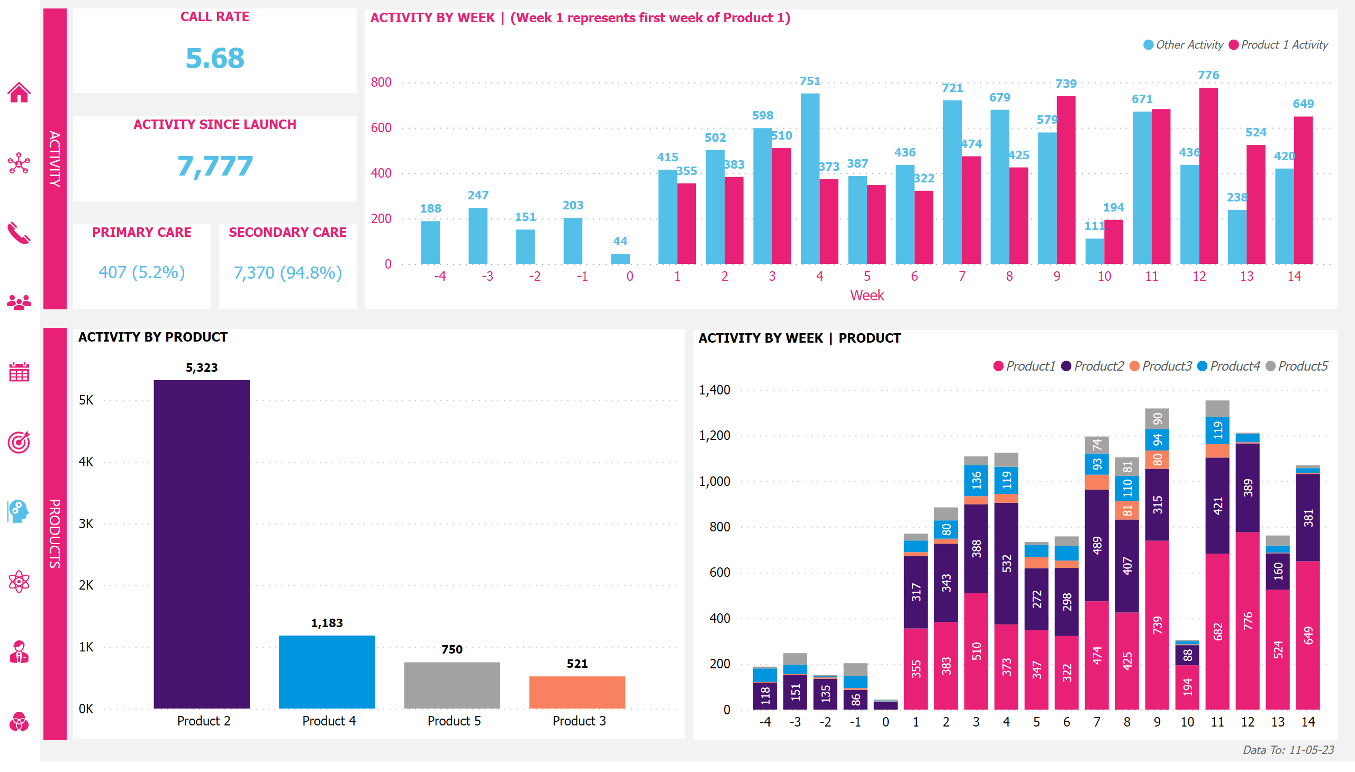
Other Overview
Notes:
ACTIVITY BY WEEK | (Week 1 represents first week of Product 1)
No alt text provided
CALL RATE
No alt text provided
ACTIVITY SINCE LAUNCH
No alt text provided
PRIMARY CARE
No alt text provided
SECONDARY CARE
No alt text provided
ActivityPanel_Shp
No alt text provided
ProductsPanel_Shp
No alt text provided
DataTo_Btn
No alt text provided
ACTIVITY BY PRODUCT
No alt text provided
ACTIVITY BY WEEK | PRODUCT
No alt text provided
OthProd_Icon
No alt text provided
InvokanaByWk_Icon
No alt text provided
InvokanaTargets_Icon
No alt text provided
InvokanaByKAM_Icon
No alt text provided
OthProdByKAM_Icon
No alt text provided
OthProdActivity_Icon
No alt text provided
InvokanaVOthProd_Icon
No alt text provided
InvokanaCallRate_Icon
No alt text provided
InvokanaActivity_Icon
No alt text provided
HomePg_Icon
No alt text provided
shape
No alt text provided

Slide 16
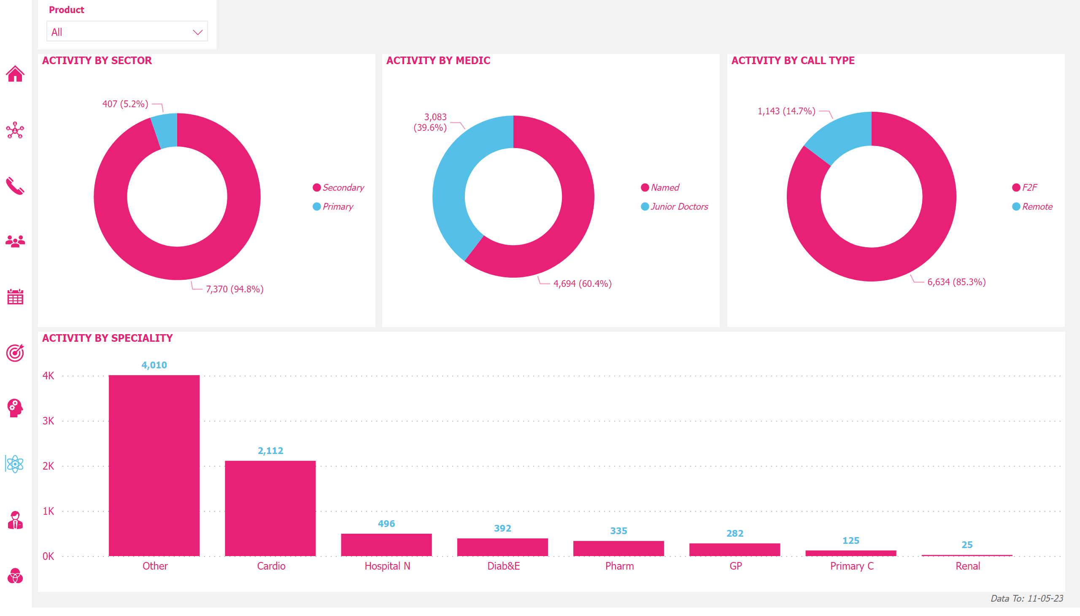
Other Activity
Notes:
ACTIVITY BY SPECIALITY
No alt text provided
ACTIVITY BY MEDIC
No alt text provided
ACTIVITY BY SECTOR
No alt text provided
DataTo_Btn
No alt text provided
ACTIVITY BY CALL TYPE
No alt text provided
OthProdActivity_Icon
No alt text provided
InvokanaByWk_Icon
No alt text provided
InvokanaTargets_Icon
No alt text provided
InvokanaByKAM_Icon
No alt text provided
OthProd_Icon
No alt text provided
OthProdByKAM_Icon
No alt text provided
InvokanaVOthProd_Icon
No alt text provided
InvokanaCallRate_Icon
No alt text provided
InvokanaActivity_Icon
No alt text provided
HomePg_Icon
No alt text provided
Product_Slicer
No alt text provided
shape
No alt text provided

Slide 17
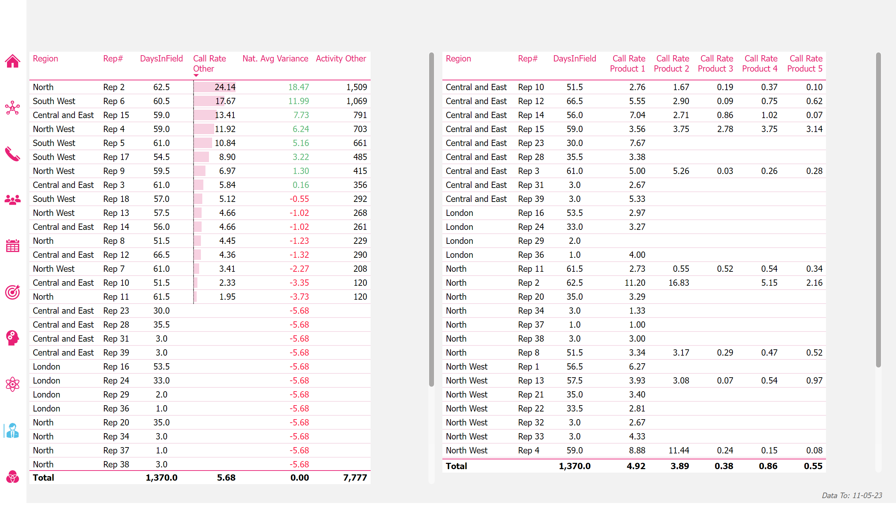
Other Call Rate
Notes:
DataTo_Btn
No alt text provided
KAMTbl
No alt text provided
CallRateTbl
No alt text provided
OthProdByKAM_Icon
No alt text provided
InvokanaByWk_Icon
No alt text provided
InvokanaTarget_Icon
No alt text provided
InvokanaByKAM_Icon
No alt text provided
OthProd_Icon
No alt text provided
OthProdActivity_Icon
No alt text provided
InvokanaVOthProd_Icon
No alt text provided
InvokanaCallRate_Icon
No alt text provided
InvokanaActivity_Icon
No alt text provided
HomePg_Icon
No alt text provided
shape
No alt text provided

Slide 18
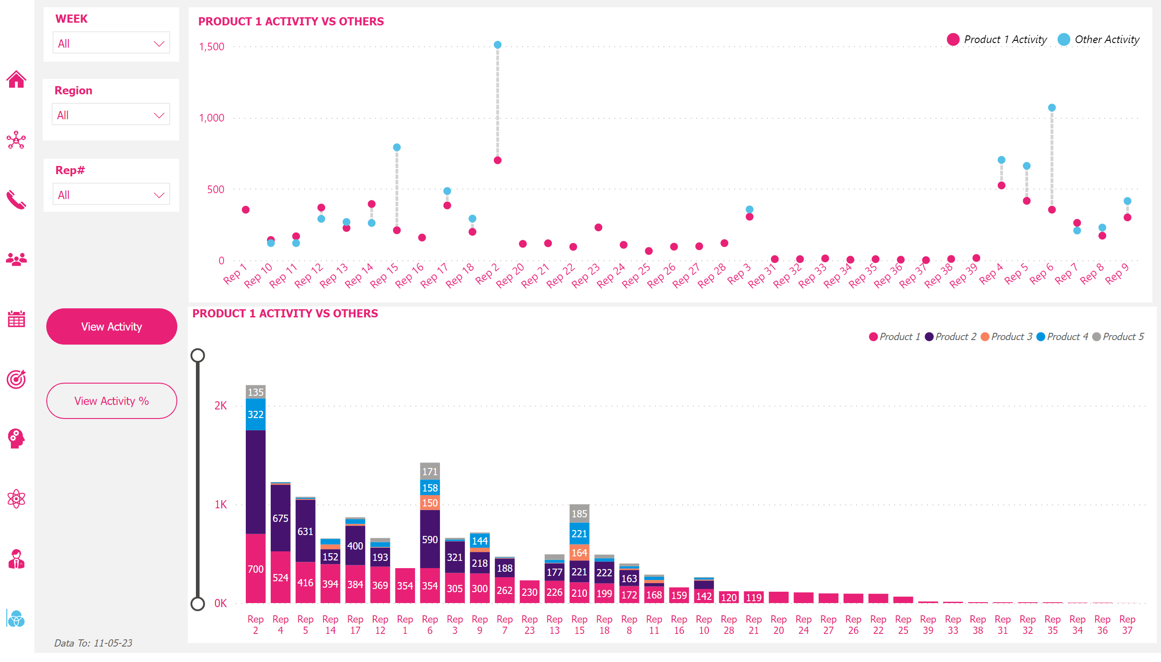
Invokana vs Other
Notes:
InvokanaActVOthAct
No alt text provided
Week_Slicer
No alt text provided
DataTo_Btn
No alt text provided
KAM_Slicer
No alt text provided
Region_Slicer
No alt text provided
InvokanaVOthProd_Icon
No alt text provided
InvokanaByWk_Icon
No alt text provided
InvokanaTargets_Icon
No alt text provided
InvokanaByKAM_Icon
No alt text provided
OthProd_Icon
No alt text provided
OthProdByKAM_Icon
No alt text provided
OthProdActivity_Icon
No alt text provided
InvokanaCallRate_Icon
No alt text provided
InvokanaActivity_Icon
No alt text provided
HomePg_Icon
No alt text provided
PRODUCT 1 ACTIVITY VS OTHERS
No alt text provided
PRODUCT 1 ACTIVITY VS OTHERS
No alt text provided
VwActSelected_Btn
No alt text provided
VwAct%Unselected_Btn
No alt text provided
actionButton
No alt text provided
actionButton
No alt text provided
shape
No alt text provided

Slide 19
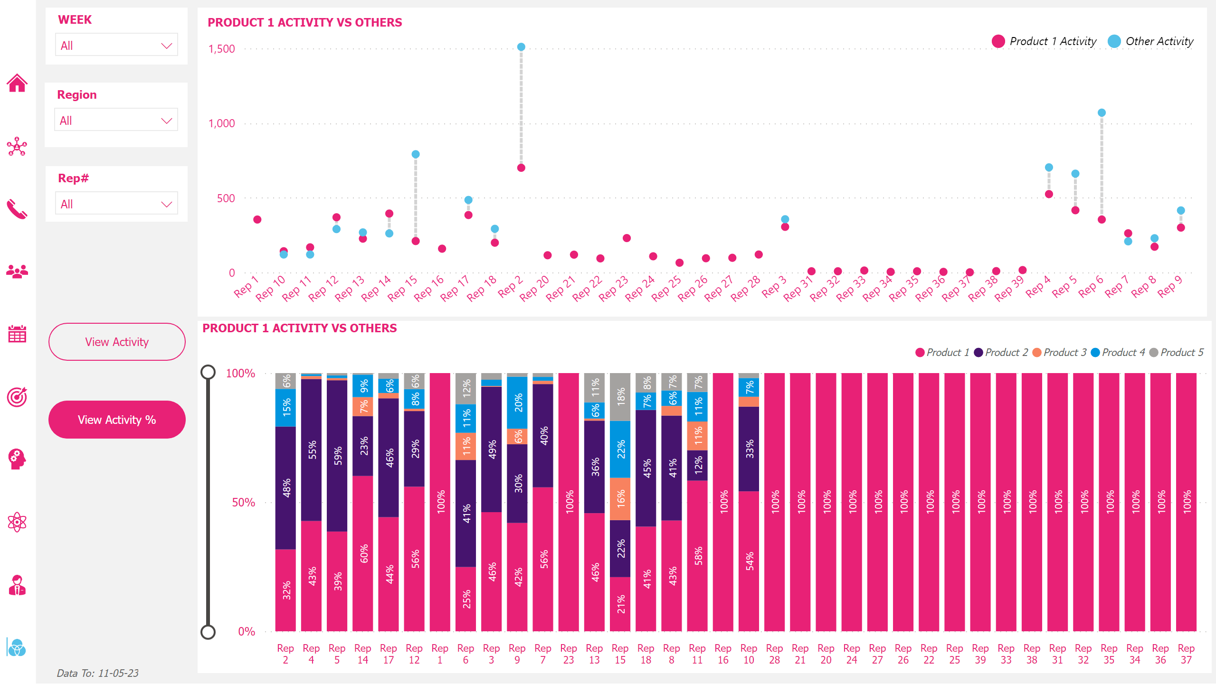
Invokana vs Other
Notes:
InvokanaActVOthAct
No alt text provided
Week_Slicer
No alt text provided
DataTo_Btn
No alt text provided
KAM_Slicer
No alt text provided
Region_Slicer
No alt text provided
InvokanaVOthProd_Icon
No alt text provided
InvokanaByWk_Icon
No alt text provided
InvokanaTargets_Icon
No alt text provided
InvokanaByKAM_Icon
No alt text provided
OthProd_Icon
No alt text provided
OthProdByKAM_Icon
No alt text provided
OthProdActivity_Icon
No alt text provided
InvokanaCallRate_Icon
No alt text provided
InvokanaActivity_Icon
No alt text provided
HomePg_Icon
No alt text provided
columnChart
No alt text provided
PRODUCT 1 ACTIVITY VS OTHERS
No alt text provided
actionButton
No alt text provided
actionButton
No alt text provided
VwActUnselected_Btn
No alt text provided
VwAct%Selected_Btn
No alt text provided
shape
No alt text provided

