Slide 1
Expert System
Francois ancel Lucas Santamaria

Slide 2
Actual Feature
All feature done :
+ forward chain, backward chain
+ AND, OR, XOR and NOT operator
+ complex left and right value
+ braket

Slide 3
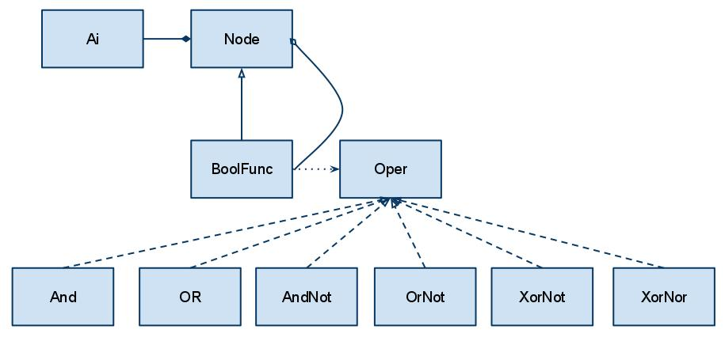
Class diagram

Slide 4
Improvement
Optimise & track last bugs
Optimise :
+ organise initial function by difficulty to treat
+ reevaluate only dependency function when an node value change
+ refactor code

Slide 5
Conclusion
Expert system introduce uncertainty in linear functions.
Next step would be to add statistic status to affinate result.

