Slide 1

MediMind AI: Intelligent Medical Diagnosis and Report Analysis
SESSION 2026-2027
Team Members-
Surosut Senior
Priyanshu Kumar
Tavish Bedi
Shourya Tripathi
UNDER SUPERVISION OF :
SUPERVISOR’S NAME : Kanishk Tolani DESIGNATION: Assistant Professor
COURSE NAME:
ORGANIZATION:

Slide 2
Outlines
Introduction And Project Domain
Problem Statement And Motivation
Literature Review And Research Gap
Objectives And Scope
Novelty / Innovation
Proposed Methodology And System Architecture
Resource Requirements And Feasibility
Expected Outcomes And Social Impact
Conclusion, Future Scope And References

Slide 3
INTRODUCTION & PROJECT DOMAIN
Project domain / application area:
Artificial Intelligence (AI), Machine Learning (ML), Natural Language Processing (NLP), and Healthcare Informatics.
Background and context:
Medical reports often contain complex terminology that is difficult for patients to understand. AI can help interpret laboratory results, analyze reported symptoms, and provide accessible medical information.
Brief overview of the proposed system / solution:
MediMind AI is an AI-powered healthcare assistant that analyzes symptoms, extracts information from medical reports, identifies abnormal laboratory values, and generates easy-to-understand explanations with references to trusted medical sources.
Platforms, tools and technologies likely to be used:
  Frontend: React.js, TypeScript, Tailwind CSS
  Backend: Node.js, Express.js, Python, FastAPI
  Database: MongoDB
  AI/ML: NLP, Scikit-learn, Large Language Models (LLMs), RAG
  Document Processing: PyMuPDF, Tesseract OCR

Slide 4
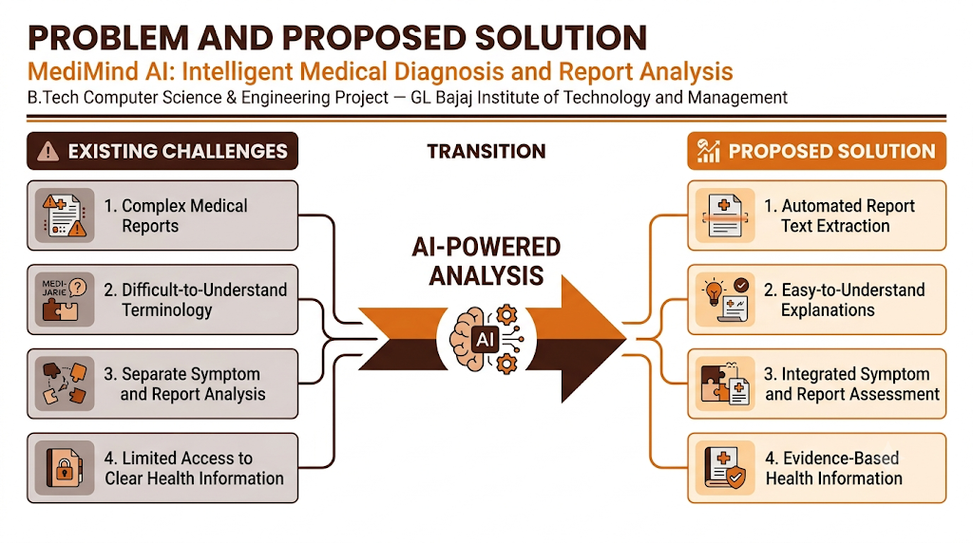
PRESENTATION & FORMATTING GUIDELINES
Suggested presentation duration: 10–15 minutes, followed by discussion.
Heading: 32 pt | Subheading: 18 pt | Body text: 16 pt (as per sample format).
Use consistent fonts, colours, bullet styles and slide layouts throughout.
Keep slides concise; use diagrams, tables or flowcharts where they improve clarity.
Align running text consistently and proofread spelling, grammar and references.
Clearly explain the research gap, novelty, feasibility and practical relevance.

Slide 5
PROBLEM STATEMENT & MOTIVATION
Problem Statement
Medical reports often contain complex terminology that is difficult for non-medical users to understand.
Manual interpretation of laboratory results can be confusing and time-consuming.
Existing symptom-checking tools may provide limited integration with medical report analysis.
Users need accessible health information to understand their symptoms and test results.
Motivation
To simplify medical report interpretation using Artificial Intelligence.
To provide understandable explanations of laboratory findings and reported symptoms.
To integrate symptom assessment with medical report analysis in one platform.
To promote informed healthcare decisions through accessible, evidence-based information.

Slide 6
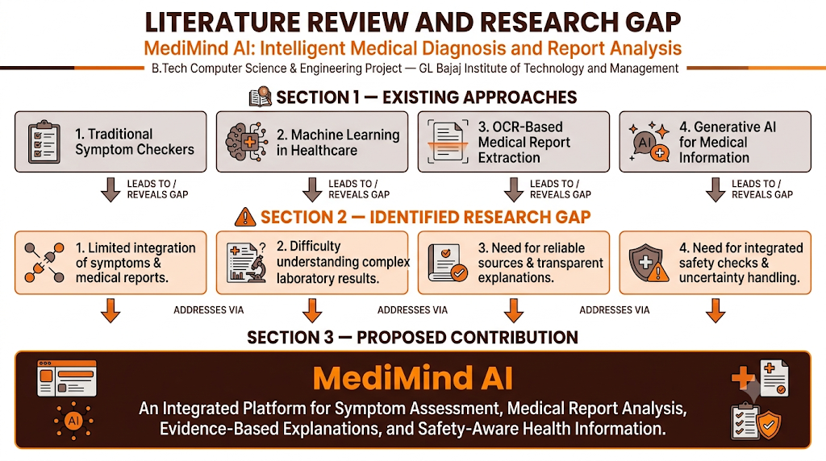
LITERATURE REVIEW & RESEARCH GAP

Slide 7
Thank You

