Slide 1
Image Text Extraction
Presented by : Surabhi Patil

Slide 2
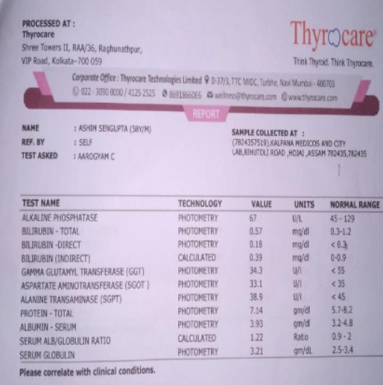
The Challenges of Image Text Extraction:
Medical images often contain valuable information in the form of text, but extracting this text can be challenging due to factors such as:
Poor image quality
Variability in font styles and sizes
Presence of noise or artifacts

Slide 3
Our Approach to Image Text Extraction:
Our project uses a multi-step approach to extract text from medical images:
Image selection and preprocessing: We select the top 10 images based on their sharpness score and preprocess them to enhance quality
Bounding box creation: We define bounding boxes around the regions of interest in each image
Text extraction: We use Tesseract to extract text from each region of interest
Data processing: We process the extracted data to format it into a readable table

Slide 4
Image Selection and Pre-processing:
We used an image selection script to choose the top 10 images from a dataset of 100 images based on their sharpness score
The script calculates the variance of the Laplacian for each image and sorts them in descending order
Formula: Variance of Laplacian = σ^2 ( ∇^2 I )

Slide 5
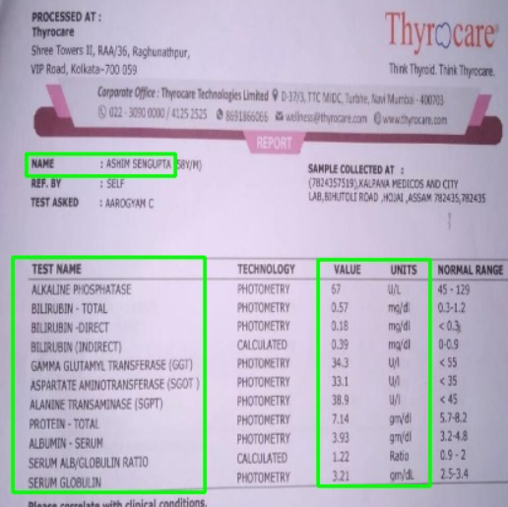
Bounding Box Creation:
We defined bounding boxes around the regions of interest in each image manually using a custom script
The script allows users to draw rectangles around the desired regions, and the coordinates are stored for later use
Benefits:
Manual bounding box creation allows for high accuracy and flexibility in defining regions of interest.

Slide 6
Text Extraction and Data Processing:
We used Tesseract to extract text from each region of interest and processed the extracted data to format it into a readable table
The table includes columns for the test name, value, and units
Benefits: The formatted table provides a clear and concise representation of the extracted data

Slide 7
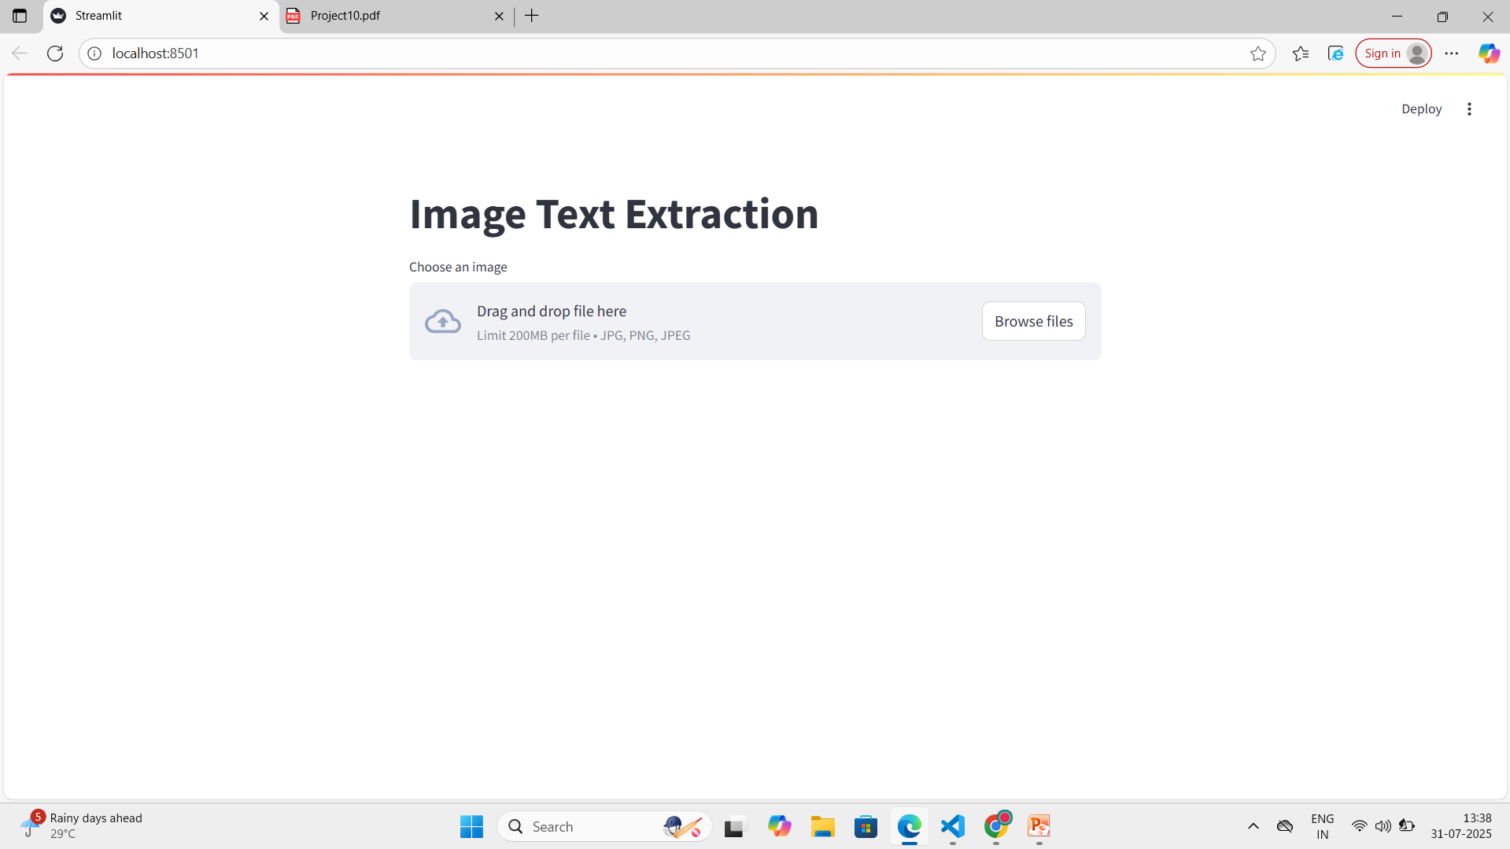
Streamlit Interface:
Our project uses a Streamlit interface to allow users to upload images and extract text.

Slide 8
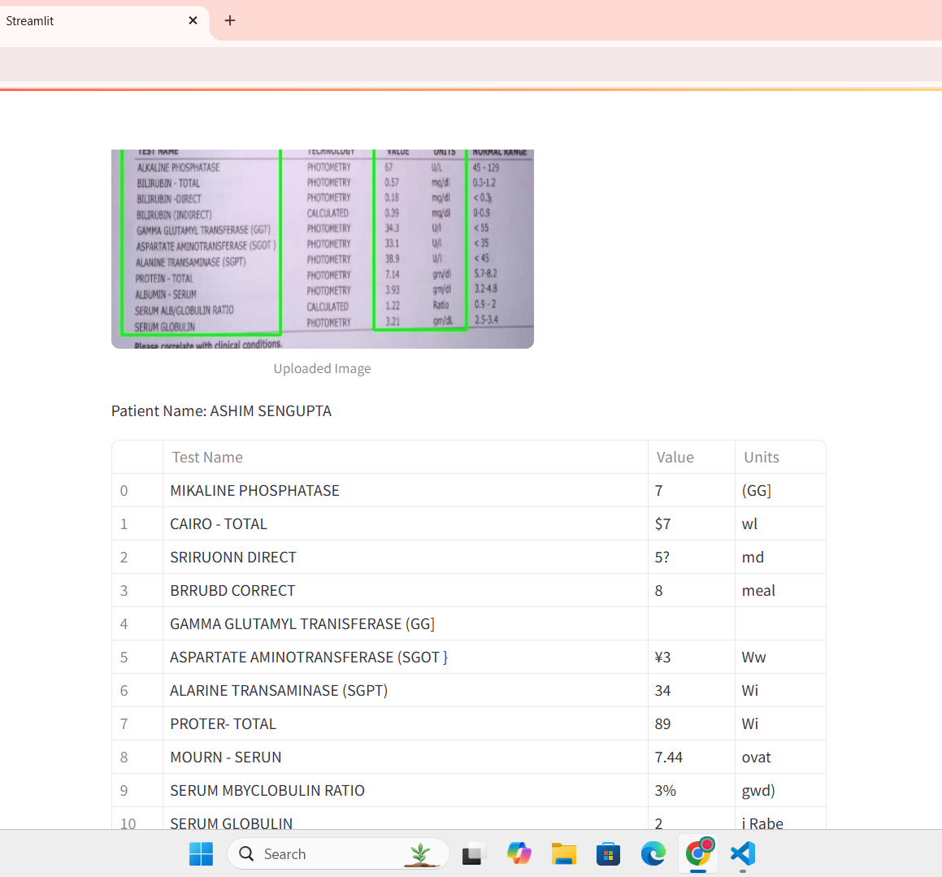
Results:
Our project attempted to extract text from medical images and format it into a readable table.
While the results show some promise, there are limitations to the accuracy of the extracted text
The results highlight the challenges of extracting text from medical images and the need for further refinement and training to achieve high accuracy

Slide 9
Conclusions:
Our project demonstrates the potential of using Streamlit, OpenCV, and Tesseract for image text extraction
While there are limitations to the accuracy of the extracted text, the project highlights the challenges and opportunities for further research and development
Future work: Improving accuracy, handling complex layouts, and integrating with other technologies.

Slide 10
THANK YOU

