Slide 1

Rossmann Store Sales Forecasting
Presented By
- Surabhi Patil

Slide 2
Objectives
Develop a predictive model to forecast daily sales in Rossmann stores
Analyze customer purchasing behavior and identify key factors affecting sales
Compare the performance of machine learning and deep learning models
Deploy the best-performing model as a web application

Slide 3
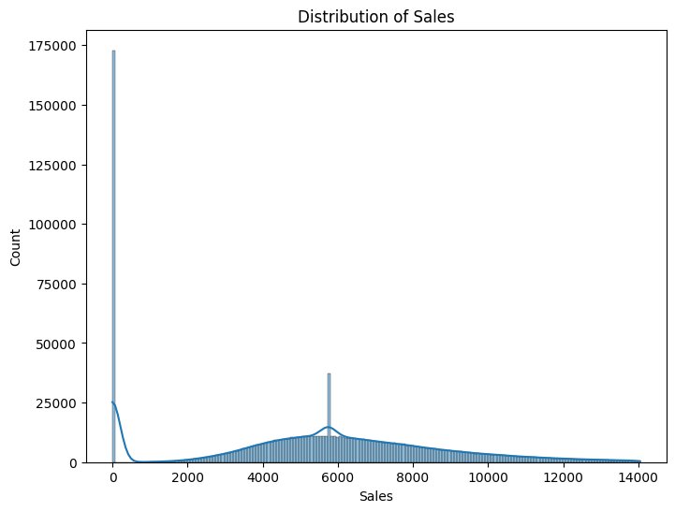
Peaks at Specific Values: Noticeable peaks occur at $4,000, $6,000, and $8,000, indicating these sales values are more common.
High Frequency at $6,000: Over 25,000 transactions occur at the $6,000 mark, making it a significant sales value.

Slide 4
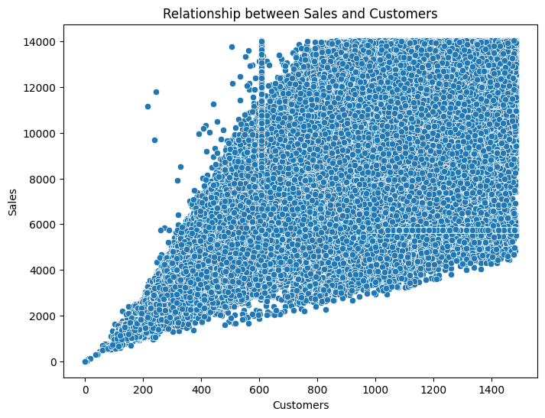
Zero customers correspond to zero sales.
As customer numbers grow, sales gradually increase.

Slide 5
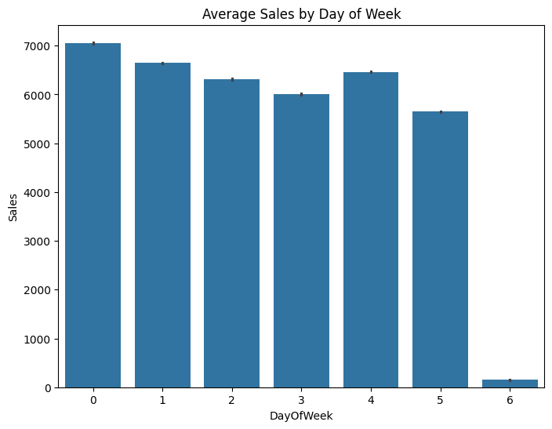
Day 0: Highest average sales, reaching approximately $7,000.
Day 1 to Day 3: Average sales decrease gradually.
Day 4: Average sales increase, surpassing Day 2's level.
Day 5: Average sales decrease again.
Day 6: Lowest average sales.

Slide 6
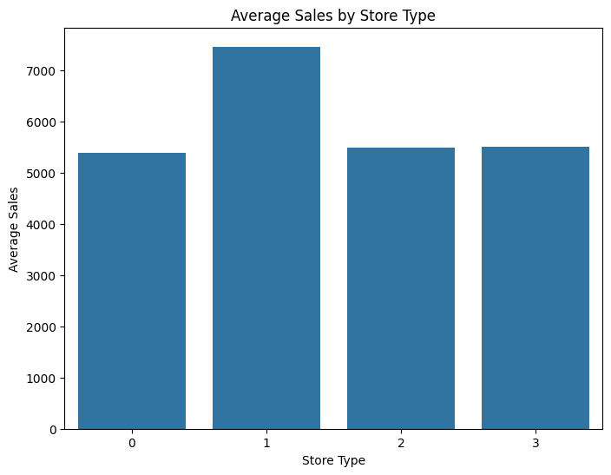
Store Type 0: Lowest average sales.
Store Type 1: Highest average sales, exceeding $7,000.
Store Type 2: Slightly higher average sales than Store Type 0.
Store Type 2 and 3: Similar average sales, tied at the same level.

Slide 7
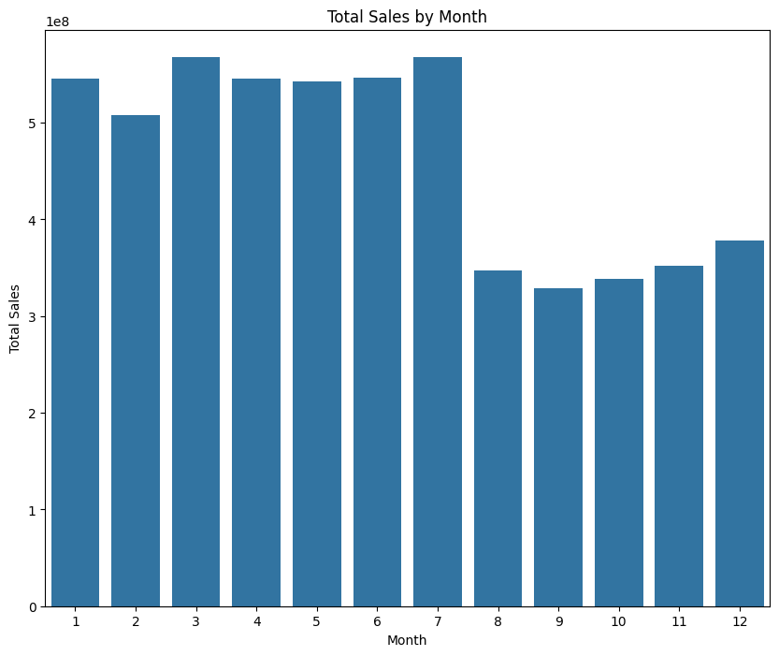

Slide 8
Total sales by months
January records the highest total sales.
February experiences a decline.
March shows an increase.
April decreases.
May decreases further.
June exhibits a slight upturn.
July parallels April's performance.
August hits the lowest point.
September dips below August.
October displays a modest recovery.
November and December demonstrate a gradual sales improvement.

Slide 9
Conclusion
This project aimed to develop a predictive model to forecast daily sales in Rossmann stores. Through exploratory data analysis, we identified key factors affecting sales, including customer purchasing behavior, store type, and seasonal fluctuations.
Our analysis revealed:-
Sales peaks at specific values ($4,000, $6,000, and $8,000)- High frequency of transactions at $6,000
Positive correlation between customer numbers and sales
Variations in average sales across days of the week and months
Store type and seasonal fluctuations significantly impact sales

Slide 10


