Slide 1
Equity Research News Tool
Presented by: Surabhi Patil

Slide 2
Equity Research News Tool: Automating News Research for Improved Efficiency and Accuracy
Introducing Equity Research News Tool:
Manual news research is time-consuming and labor-intensive
Equity research analysts need to stay up-to-date with market news and trends
Automating news research can improve efficiency and accuracy
Utilizes LangChain, GROQ API, and Streamlit to automate news research
Provides summarized news and articles based on user queries
Enhances equity research analysis with relevant and accurate information

Slide 3
Requirements:
LangChain
Streamlit
NewsAPI
GROQ API

Slide 4
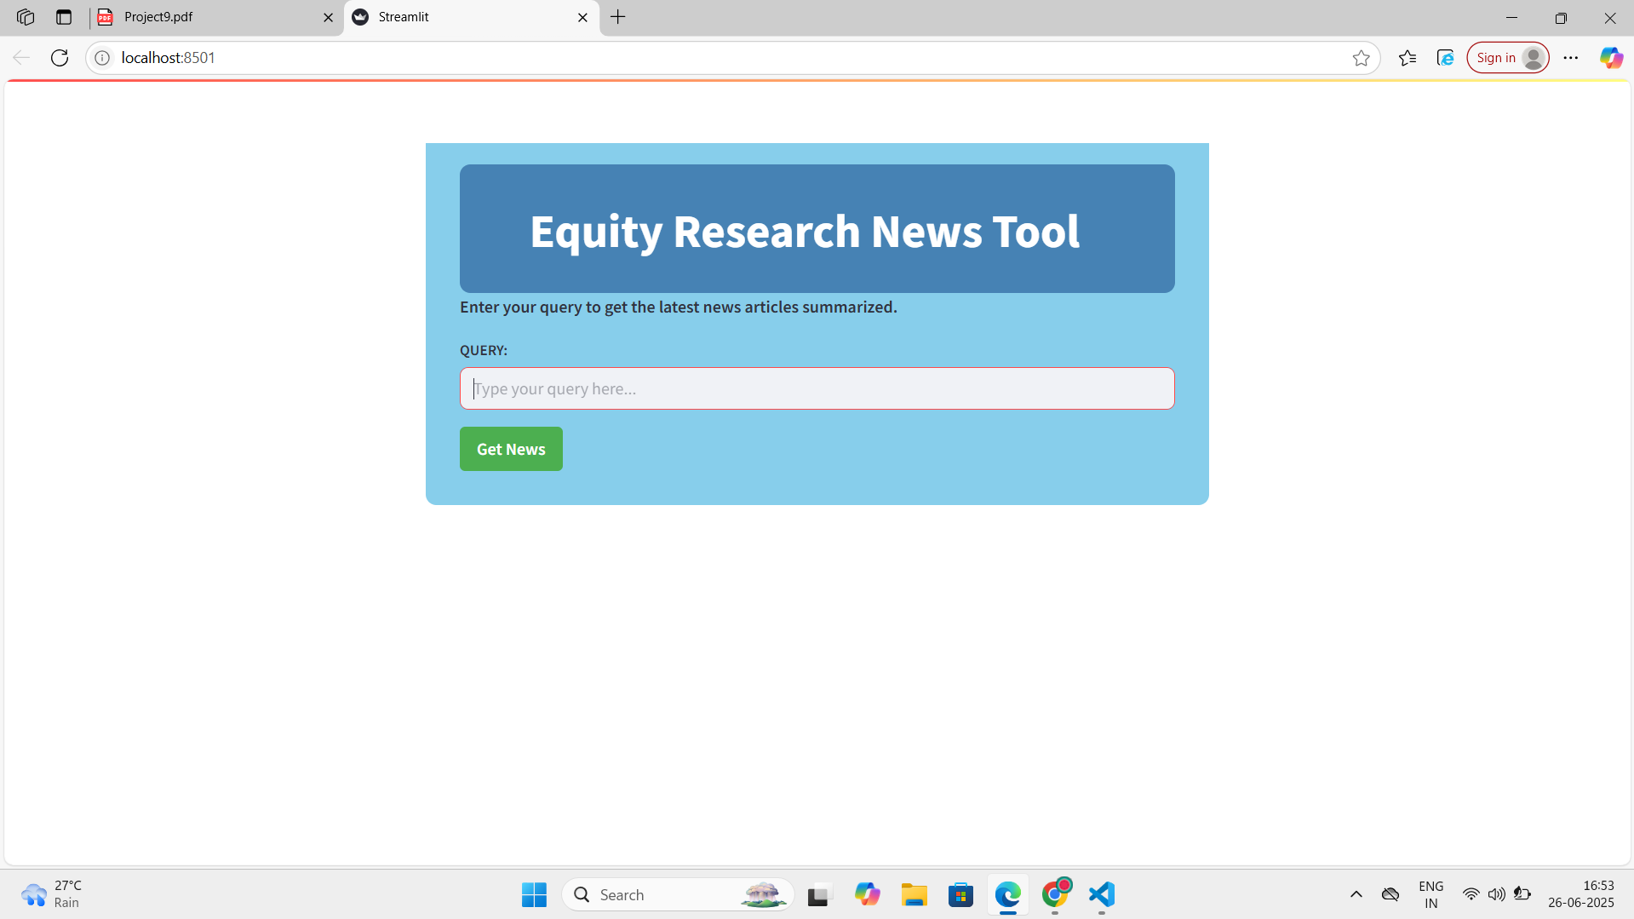
System Architecture:
User Input: User enters query through Streamlit interface
Streamlit Interface: Receives user input and sends query to LangChain
LangChain Configuration: Processes query and integrates with:
NewsAPI: Fetches relevant news articles
GROQ API: Processes and analyses data

Slide 5
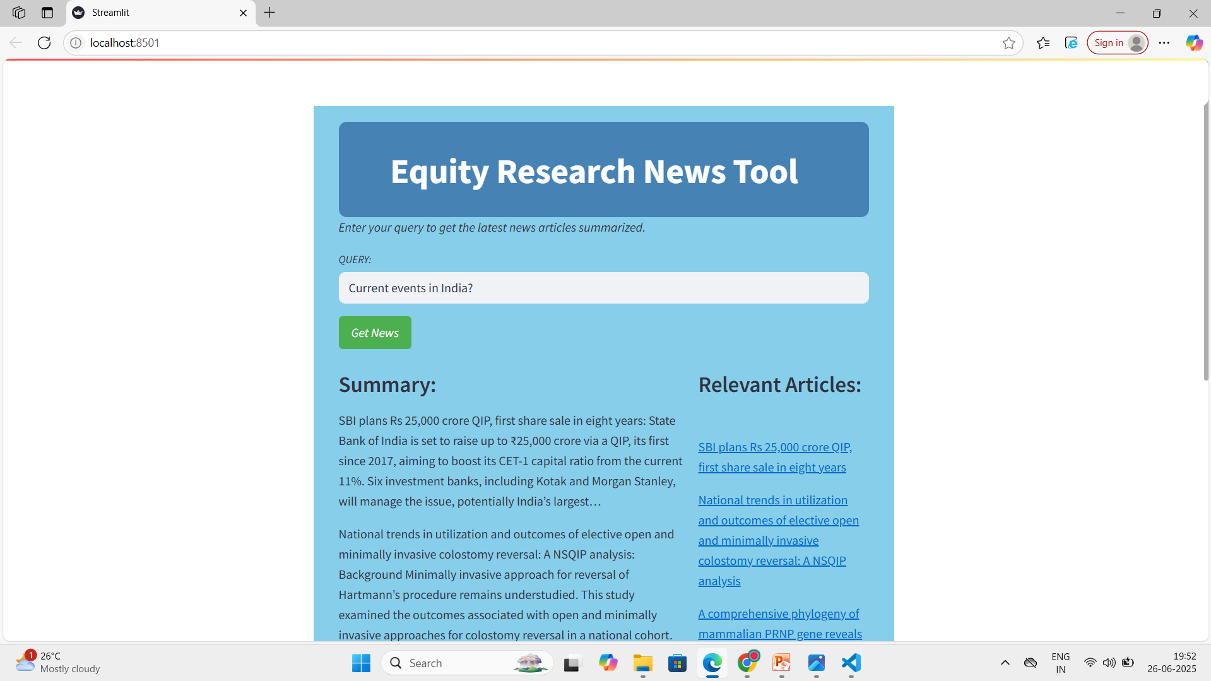
Output Results 1:

Slide 6
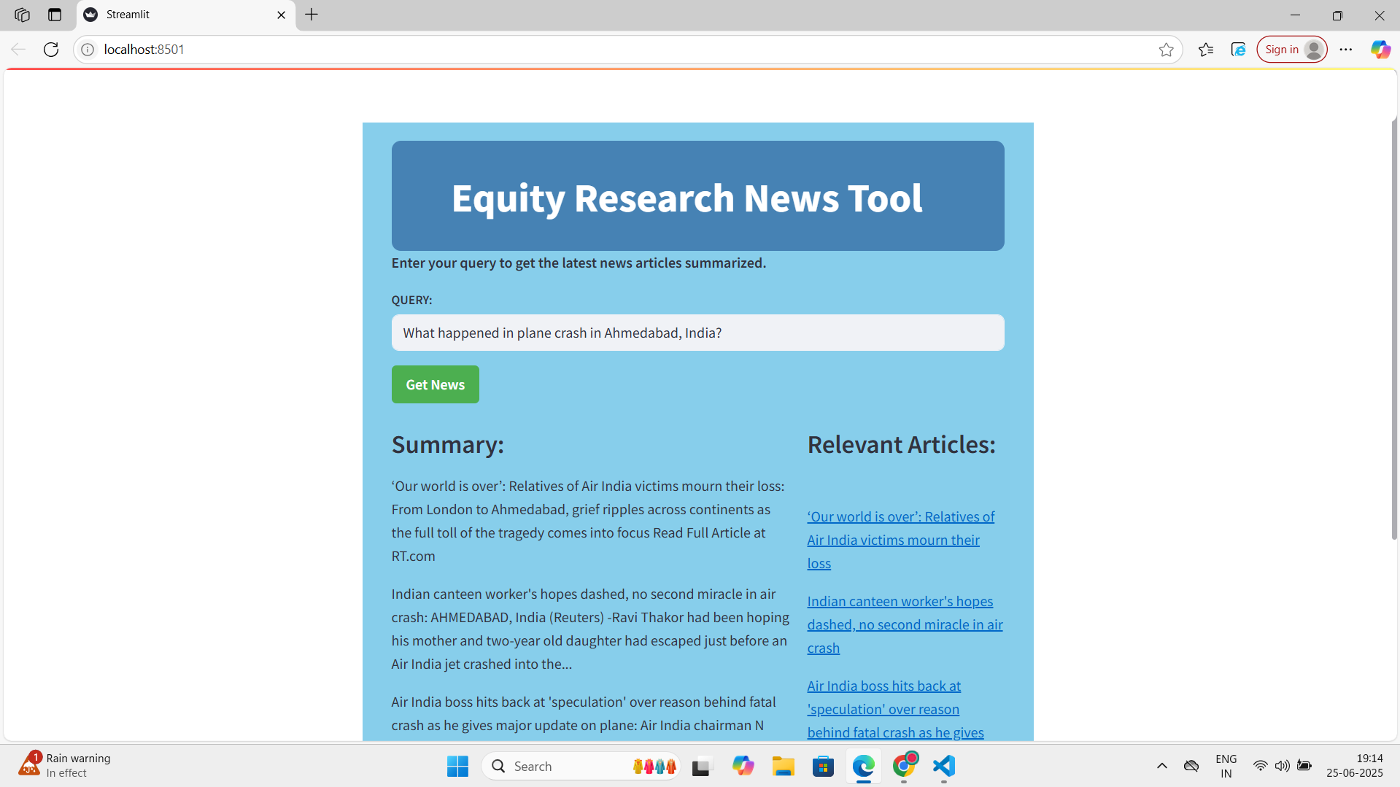
Output Result 2:

Slide 7
THANK YOU

