Slide 1
METIS
Three Phases
Coarsening
Partitioning
Uncoarsening
G. Karypis, V. Kumar, “A fast and high quality multilevel scheme for partitioning irregular graphs,” International Conference on Parallel Processing, 1995.

Slide 2

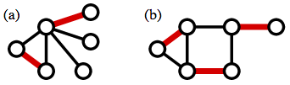

METIS - Coarsening
Maximal Matching
A set of edges without common vertices
An NP-Complete problem

Slide 3
METIS - Partitioning
Two Steps
Randomly Choose a root
BFS to include the vertex leading less edge-cuts
Root

Slide 4
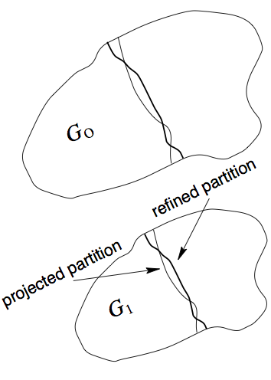
METIS - Uncoarsening
Key Idea
Each super-node comprises a set of nodes
Decrease the edge-cuts by moving a vertex to one partition to another

Slide 5
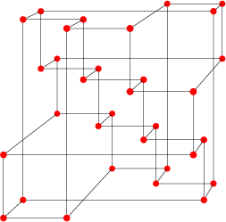


Parallel METIS
Five Phases
Initial Partition
Coloring
Coarsening
Partitioning
Uncoarsening
Each processor keeps two pieces of Information:
1. Sub-graph
2. Adjacency List
G. Karypis, V. Kumar, “Parallel Multilevel k-way Partitioning Scheme for Irregular Graphs,” IEEE/ACM Conference on Supercomputing, 1996.

Slide 6
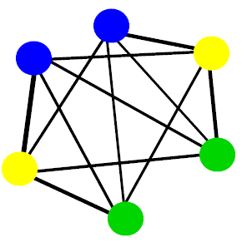
Parallel METIS
Coloring
Adjacent vertices have different colors [Luby’s Algorithm]
The number of distinct colors used is to be minimized

Slide 7
Parallel METIS
Coarsening Phase
Unilateral Matching
Matching Conflicts?
Why do we need coloring?
Node.Match
Remote Edge
Notes:
Iterative Fashion

Slide 8
Parallel METIS
Partitioning Phase
Since the coarsened graph has been relatively small, partition can be done
Further parallelization is also possible
G. Karypis, V. Kumar, “Parallel Multilevel k-way Partitioning Scheme for Irregular Graphs,” IEEE/ACM Conference on Supercomputing, 1996.
Notes:
Iterative Fashion

Slide 9
Parallel METIS
Uncoarsening Phase
This phase is broken up into c sub-phases, where c is the number of colors
During the c^{th} phase, all the vertices of color c are considered for movement
G. Karypis, V. Kumar, “Parallel Multilevel k-way Partitioning Scheme for Irregular Graphs,” IEEE/ACM Conference on Supercomputing, 1996.
Notes:
Iterative Fashion

