Slide 1

High Performance Computing Seminar
Mesh Partitioning with METIS
Caroline Mendonça Costa

Slide 2
Introduction
Parallel large-scale simulations of FE meshes require the distribution of the mesh to the processors
  Same number of elements to each processor
    Work load balance
  Number of adjacent elements assigned to different processors is minimized
    Minimization of the communication
Graph partitioning can be used to satisfy these conditions

Slide 3
Overview of Metis
Serial software package for
  partitioning large irregular graphs
  partitioning large meshes
  computing fill-reducing orderings of sparse matrices
Developed at the Department of Computer Science & Engineering at the University of Minnesota
Freely distributed
Can be downloaded at
  http://www.cs.umn.edu/~metis

Slide 4
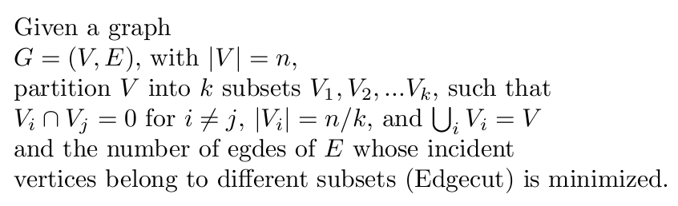
The k-way Graph Partitioning
Metis provides two methods to solve the k-way partitioning problem
  Multilevel recursive bisection partitioning
  Multilevel k-way partitioning

Slide 5
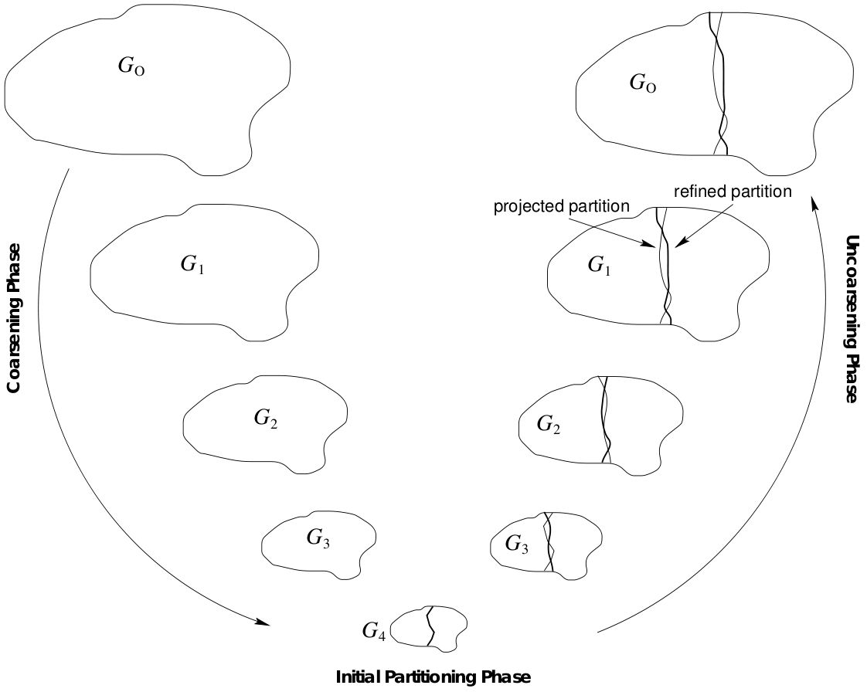
Multilevel Graph Bisection
Coarsening phase
  Vertices are collapsed together to form a series of smaller graphs
Initial partitioning phase
  Partitioning of the coarsest graph is computed
Uncoarsening phase
  Partitioning is projected onto the larger graphs
  Partitioning is refined

Slide 6
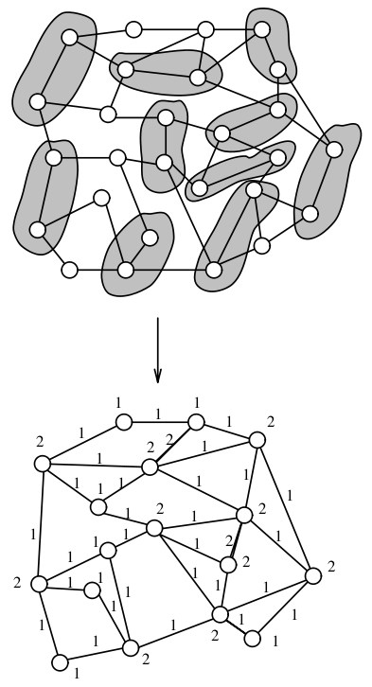
Coarsening Phase
A graph can be coarsened by finding a matching
  Matching: set of edges without any loops
    Vertices are collapsed together to form a multinode
  Maximal matching: any edge in the graph that is not in the matching has at least one of its vertices matched

Slide 7
Coarsening Phase
Random Matching (RM)
  Vertex u is matched with one (randomly selected) of its adjacent vertices
Heavy Edge Matching (HEM)
  The total edge weight of the coarser graph is reduced by the weight of the matching
    W(Ei+1) = W(Ei) – W(Mi) (i)
  Smaller edge-weight > smaller edge-cut
  HEM finds a maximal matching so that (i) decreases faster
  Vertex u is matched with v, such that (u,v) is the heaviest edge

Slide 8
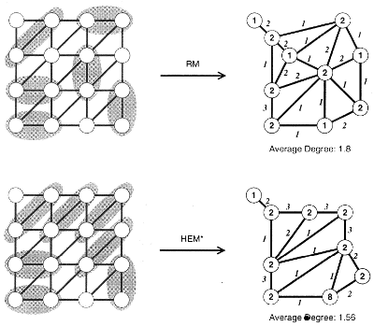
Coarsening Phase
Modified Heavy Edge Matching (HEM*)
  Graphs based on finite element meshes
    Edges have the same weight
    Similar to RM
  HEM matches u with the vertex v that has the highest degree
    Decreases the average degree of the coarser graph

Slide 9
Initial Partitioning Phase
Spectral Bisection
  Computes the eigenvector y corresponding to the second largest eigenvalue of the Laplacian matrix
    y is called the Fiedler vector
    r is chosen as the weighted median of the values of y
      All vertices smaller than r are put in the first partition and other in the second partition
    The Fiedler vector is computed using the Lanczos algorithm
      Iterative algorithm: # of iterations depend on the desired accuracy
  Not used in Metis!

Slide 10
Initial Partitioning Phase
Graph Growing Algorithm (GGP)
  Start from a vertex and grow a region around it in a breadth-first fashion until half of the vertices have been included
  Sensitive to the choice of the first vertex
Greedy Graph Growing Algorithm (GGGP)
  For each vertex v defines a gain of inserting v in the growing region
    The vertex with the largest decrease in the edge-cut is inserted first
  Also sensitive to the choice of the initial vertex, but less than GGP
  Performs better than GGP in terms of time and edge-cut

Slide 11
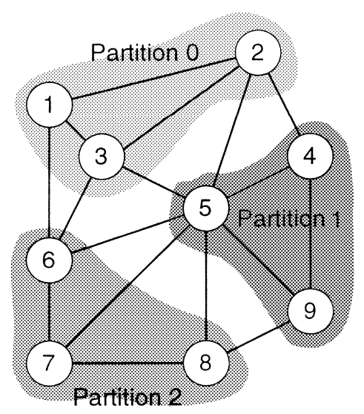
Uncoarsening Phase
Assigns the vertices collapsed to v to the same partition that v belongs to
At each uncoarsening level the partitioning is refined
  Vertices are swapped between the partitions to improve the edge-cut
  Kernighan-Lin Refinement

Slide 12
Uncoarsening Phase
Kernighan-Lin refinement
  Iteratively swaps vertices among partitions of a bisection to reduce the edge-cut
    Uses two priority queues, one for each partition, according to their gains
    Iteratively moves vertices at the top of the priority queues
    Stops when all vertices were moved
    Calculates where the smallest edge-cut was achieved and moves back the vertices that were moved after this point

Slide 13
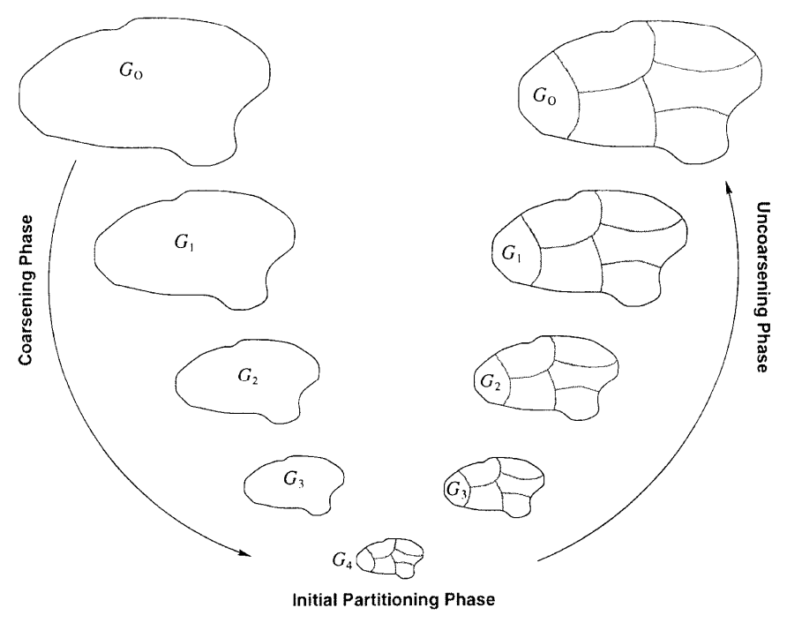
Multilevel k-way Graph Partitioning

Slide 14
Initial Partitioning Phase
One way to produce the initial k-way partitioning is to keep coarsening the graph until it has k vertices left
  The reduction in the size of the graph becomes small after a few coarsening steps
  The weights of the vertices are likely to be quite different, making the initial partition unbalanced
In Metis the initial k-way partitioning is computed using the multilevel bisection algorithm
  Produces good initial partitioning in a small time as long as the size of the original graph is sufficiently larger than k

Slide 15
Uncoarsening Phase
Extension of KL refinement for the case of k-way refinement uses k(k-1) priority queues
  One queue for each type of movement
  Only suited for small values of k
  Sequential nature
Using priority queues allow movement of several vertices sequentially
  In a multilevel context the priority queues become less important
    Nodes of coarsest graph are multinodes
    Nodes with the highest gains are moved anyway

Slide 16
Uncoarsening Phase
Greedy Refinement
  Vertices are moved only if they lead to positive gain
  GR visits the boundary vertices at each iteration in random order
    Moves a vertex v to a partition the leads to the largest reduction in the edge-cut (while preserving the balance conditions) or to an improvement in the balance
  Converges after a small number of iterations
    When combined with HEM or HEM* converges after 4-8 iterations
  Parallel nature
    Communication volume is smaller than in KL refinement

Slide 17
MRBP versus MkP
MRBP
MkP
Coarsening
phase
Uncoarsening
phase
Coarsening
phase
Uncoarsening
phase
Initial
partitioning
MRBP
Initial
partitioning

Slide 18
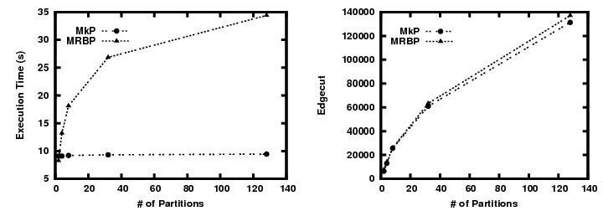
Some results...
Mesh with 4,000,000 elements
MkP (O(|E|)) is much faster than MRBP (O|E| log(k)))
Partitioning with MkP is slightly better

Slide 19
Final Considerations
MkP is significantly faster and produces comparable or better partitions than MRBP
  MkP is O(|E|) and MRBP is O(|E| log(k))
    As MRBP is applied to a much smaller graph the total execution time depends mainly on the number of edges
  HEM* produces a very good smaller replica of the original graph
    MkP produces a good partitioning based on the coarse graph
  Simple refinement as GR improves the partitioning after a few iterations

