Slide 1
Graph Partitioning
Donald Nguyen
October 24, 2011

Slide 2
Overview
Reminder: 1D and 2D partitioning for dense MVM
Parallel sparse MVM as a graph algorithm
Partitioning sparse MVM as a graph problem
Metis approach to graph partitioning

Slide 3
Dense MVM
Matrix-Vector Multiply
y
A
x
=

Slide 4
1D Partitioning
=

Slide 5
2D Partitioning
=

Slide 6
Summary
1D and 2D dense partitioning
2D more scalable
Reuse partitioning over iterative MVMs
y becomes x in next iteration
use AllReduce to distribute results

Slide 7
Sparse MVM
j
y
A
x
0
0
0
=
i
0
0
0
y_{j}
j
x_{j}
A is incidence matrix of graph
y and x are labels on nodes
A_{ij}
x_{i}
y_{i}
i

Slide 8
Graph Partitioning for Sparse MVM
a
b
d
c
e
f
Assign nodes to partitions of equal size minimizing edges cut
AKA find graph edge separator
Analogous to 1D partitioning
assign nodes to processors

Slide 9
Partitioning Strategies
Spectral partitioning
compute eigenvector of Laplacian
random walk approximation
LP relaxation
Multilevel (Metis, …)
By far, most common and fastest

Slide 10
Metis
Multilevel
Use short range and long range structure
3 major phases
coarsening
initial partitioning
refinement
G₁
…
…
coarsening
refinement
…
…
G_{n}
initial partitioning

Slide 11
Coarsening
Find matching
related problems:
maximum (weighted) matching (O(V^{1/2}E))
minimum maximal matching (NP-hard), i.e., matching with smallest #edges
polynomial 2-approximations

Slide 12
Coarsening
Edge contract
a
b
*
c
c

Slide 13
Initial Partitioning
Breadth-first traversal
select k random nodes
b
a

Slide 14
Initial Partitioning
Kernighan-Lin
improve partitioning by greedy swaps
c
D_{c} = E_{c} – I_{c} = 3 – 0 = 3
d
D_{d} = E_{d} – I_{d} = 3 – 0 = 3
Benefit(swap(c, d)) = D_{c} + D_{d} – 2A_{cd} = 3 + 3 – 2 = 4
c
d

Slide 15
Refinement
a
Random K-way refinement
Randomly pick boundary node
Find new partition which reduces graph cut and maintains balance
Repeat until all boundary nodes have been visited
a

Slide 16
Parallelizing Multilevel Partitioning
For iterative methods, partitioning can be reused and relative cost of partitioning is small
In other cases, partitioning itself can be a scalability bottleneck
hand-parallelization: ParMetis
Metis is also an example of amorphous data-parallelism

Slide 17
Operator Formulation
Algorithm
repeated application of operator to graph
Active node
node where computation is started
Activity
application of operator to active node
can add/remove nodes from graph
Neighborhood
set of nodes/edges read/written by activity
can be distinct from neighbors in graph
Ordering on active nodes
Unordered, ordered
i₃
i₁
i₂
i₄
i₅
: active node
: neighborhood
Amorphous data-parallelism: parallel execution of activities, subject to neighborhood and ordering constraints
Notes:
In this slide I would like to briefly introduce a general approach of parallelizing graph algorithms. The parallelization strategy that we
use for metis is essentially an instance of that idea.
We will view an iterative graph algorithm as the repeated application of an operator on that graph…..
For example, each iteration of the for loops in the graph algorithms can be thought as an application of an operator.
The application of the operator is called an activity and it usually starts from some node in the graph. The starting node is called active node. For example, in the right figure, i2 is an active node. When doing the computation,
the activity usually touch subgraph of the graph. It may read or write the nodes or edges, add or delete nodes, edges. The subgraph the activity touches is called neighborhood. In general, There are multiple active nodes in the graph waiting for processing. In some algorithms, the active nodes can be processed in any order while in others, there may be some ordering constraints. Here we focus on unordered algorithm.
So where does the parallelism come from? Click… It comes from the concurrent execution of multiple non-iterferring activities.
This is a generalized form of data parallelism, which also respects ordering and neighborhood constraints, and which we call amorphous data parallelism.

Slide 18
ADP in Metis
Coarsening
matching
edge contraction
Initial partitioning
Refinement

Slide 19
ADP in Metis
Coarsening
matching
edge contraction
Initial partitioning
Refinement

Slide 20
ADP in Metis
Coarsening
Initial partitioning
Refinement

Slide 21
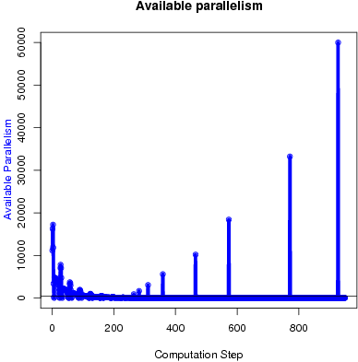
Parallelism Profile
t60k benchmark graph

Slide 22
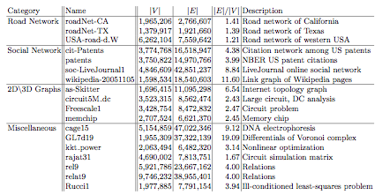
Dataset
Public available large sparse graphs from University of Florida Sparse Matrix Collection and DIMACS shortest path competition
Notes:
Show some

Slide 23
Scalability
Dataset (Metis time in seconds)
Notes:
In the figure, we compare the scalabilities of Parmetis and GHMetis. The scalability is the runtime of one thread vs multiple threads for each partitioner. Again, the dataset is sorted according to the sequential metis runtime. From the blue bars, we can see the scalability of parmetis is range from 1.5 to 3. The red bar shows that the scalability of GHMetis is about 3. The GHMetis is a little better than ParMetis. The gap between them may be because the one thread version of GHMetis is slower than ParMetis. To summarize the experiment results, the GHMetis achieved some speedup over the c based hand tuned sequential version and achieved a little better scalability than ParMetis.

Slide 24
Summary
Graph partitioning arises in many applications
sparse MVM, …
Multilevel partitioning is most common graph partitioning algorithm
3 phases: coarsening, initial partitioning, refinement

