Slide 1

Docker Desktop
The #1 containerization software for developers and teams
Download: 🔗Docker Desktop

Slide 2
1. Introduction
What is Docker and why is it useful ?
Docker is a technology that allows you to package your applications and their dependencies into containers, which are isolated and portable units that can run on any environment
What is Docker Desktop and how does it work ?
Docker Desktop is an application that lets you easily install and use Docker on your Mac or Windows computer.
Docker Desktop provides you with tools such as Docker Engine, Docker CLI, Docker Compose, Kubernetes, and more, that allow you to build, run, share, and deploy your containers.

Slide 3
What are the benefits of using Docker Desktop ?
You can develop and test your applications faster and more reliably, without worrying about compatibility issues or dependencies
You can share your images and containers with others using Docker Hub, a cloud-based registry service that hosts millions of public and private repositories.
You can learn about advanced topics such as networking, security, and image building best practices.
You can run your applications using Docker Compose, a tool that lets you define and orchestrate your multi-container applications using a YAML file.
You can deploy your applications using multiple containers that communicate with each other, using a database or other services.

Slide 4
2. Installing and Running Docker Desktop
How to download and install Docker Desktop on Mac or Windows
Go to 🔗Docker Desktop and choose the version that matches your operating system
Follow the instructions on the screen to complete the installation process
Once the installation is done, you will see the Docker icon in your menu bar (Mac) or system tray (Windows)

Slide 5
Click on the Docker icon in your menu bar (Mac) or system tray (Windows) and select About Docker Desktop
You will see a window that shows the version number and other information about Docker Desktop
You can also check the version by typing docker --version in your terminal
How to verify that Docker Desktop is running and check the version

Slide 6
How to run a simple container using Docker Desktop
Open your terminal and type docker run hello-world.
This command will pull the hello-world image from Docker Hub and run it as a container.
You will see a message that says “Hello from Docker!” and some details about how the container was created and run.

Slide 7
3. Using Docker Compose with Docker Desktop
What is Docker Compose and how does it simplify multi-container applications?
Docker Compose is a tool that lets you define and orchestrate your multi-container applications using a YAML file
Docker Compose simplifies multi-container applications by allowing you to specify the services, networks, and volumes that make up your application in a single file, and then run them all with a single command

Slide 8
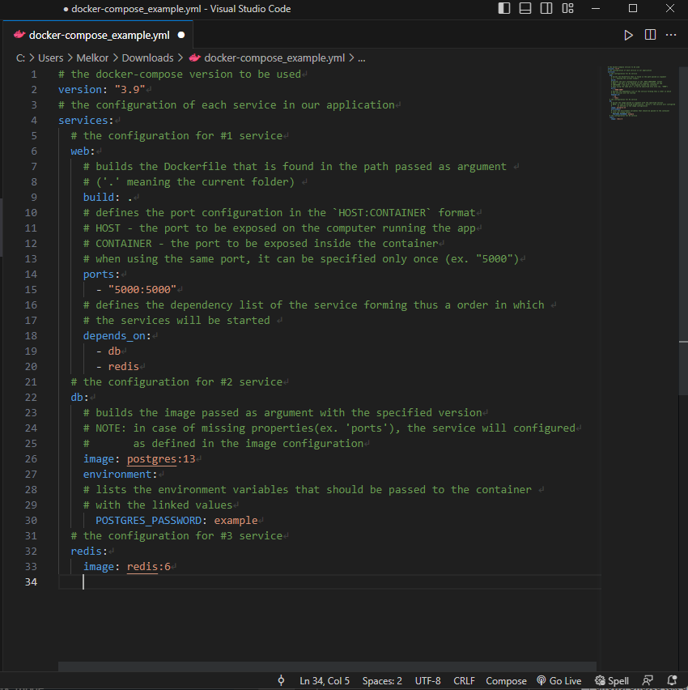
How to create a docker-compose.yml file and define the services, networks, and volumes
Create a file named docker-compose.yml in your project folder and write the configuration for your application.
For example, if you want to create an application that consists of a web server, a database, and a redis cache, you can write something like in the file on the left side.
Save the file and type `docker-compose up` in your terminal. This command will build and run your application as a set of interconnected containers.

Slide 9
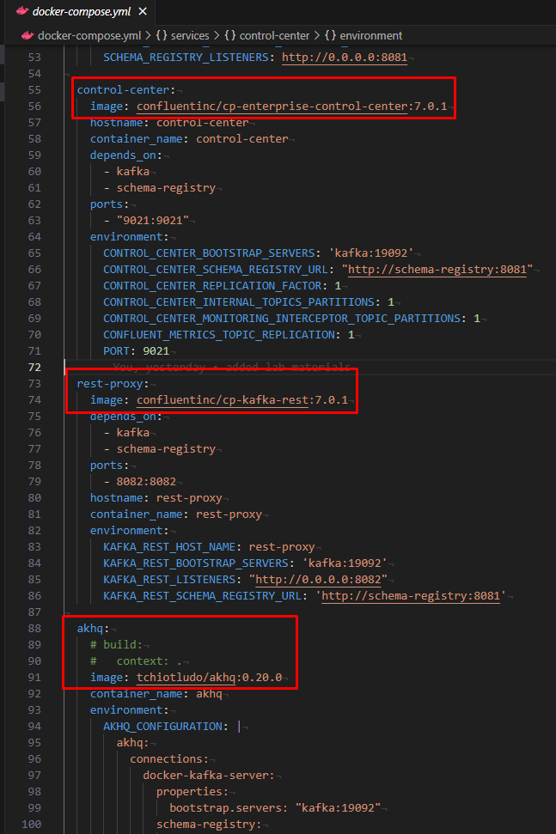
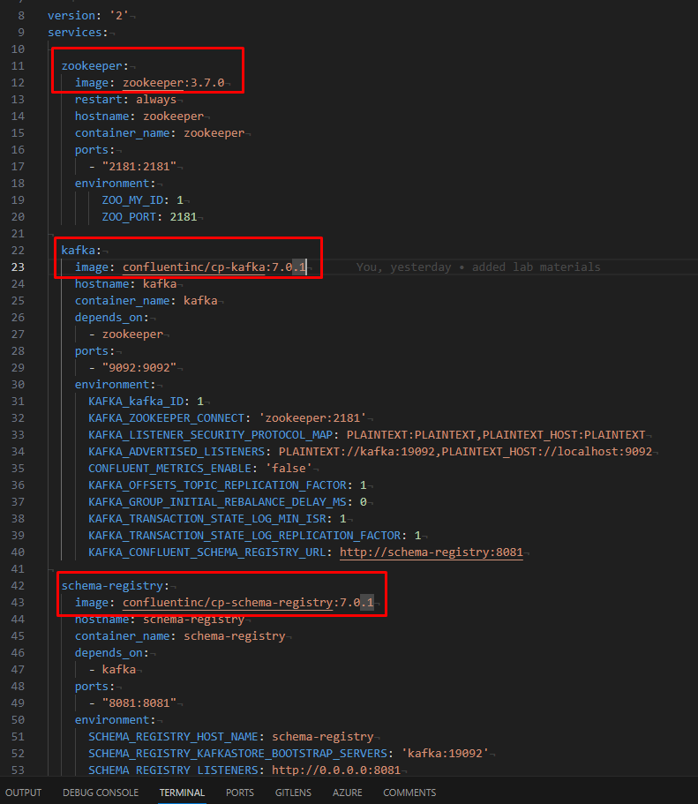
Lab example:
Each service is defined as a separate container
A container MUST have either the `image` or the `build` field configured
The `build` field is used when we have a local app that we want to be containerized
The `image` field is used to pull an service found(or hosted) online in a container format
The `ports` field is used to configure the list of ports to be exposed. The used format for a list item is:
`HOST:CONTAINER`
In a multi-service docker-compose, the `HOST_PORT` must be different for each service
The `environment` property is used to define the environment variables we want to pass to our container

Slide 10
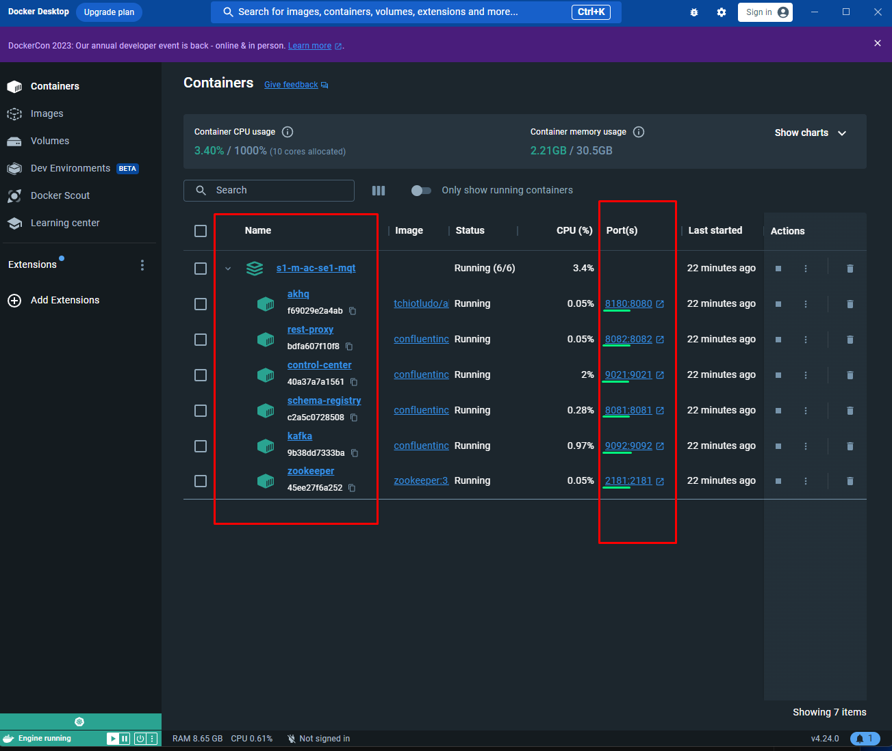
Lab example:
As defined in the docker-compose we have 6 services resulting in 6 containers
When we run `docker-compose up` the containers are started and logs are printed in the terminal(similar to using `docker-compose logs –f`)
Docker Desktop facilities a GUI for handling the container from where we can start, pause, stop, delete visualize and monitor the containers
Another useful feature of Docker is the ability to enter a container(like using a Linux OS without the GUI) for debugging or testing purposes

Slide 11
How to use docker-compose commands to build, run, stop, and remove the application
`docker-compose up`: This command will build and run your application as a set of interconnected containers. You can use the -d flag to run it in detached mode (in the background)
`docker-compose down`: This command will stop and remove your application and its containers, networks, and volumes. You can use the -v flag to also remove any anonymous volumes attached to the containers
`docker-compose ps`: This command will list the status of your application’s containers
`docker-compose logs`: This command will show the logs of your application’s containers. You can use the -f flag to follow the logs in real time
`docker-compose exec`: This command will execute a command in one of your application’s containers. For example, if you want to access the database container’s shell, you can type `docker-compose exec db bash`

Slide 12
Questions?

