Slide 1













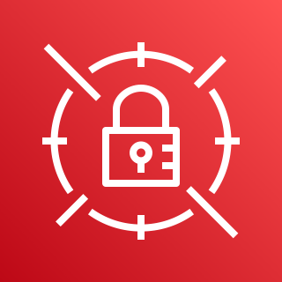




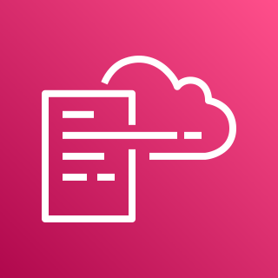
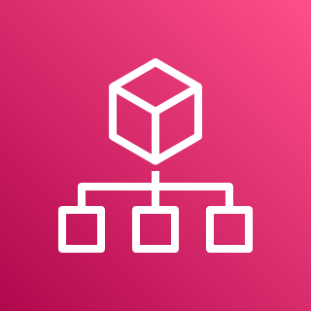


AWS Control Tower management account
AWS Control Tower home Region
Register enrolled account
in New Relic
CloudFormation Custom resource
Enroll Account using Account factory
Life cycle event
Admin
Setup New Relic integration stack
Dead letter queue
New Account
EventBridge rule
New Relic Stack Set
New Relic NerdGraph API key secret
New account
New Relic integration IAM role
New Relic Stack

