Slide 1
Gas Agency System
By
Surukulu Gobinda

Slide 2
INTRODUCTION
My name is Surukulu Gobinda and I joined this program one month ago.
I have worked on two projects, and I will explain these two projects in my report, one by one.
My first project name is Student-Teacher Booking Appointment and my another project name is Gas Agency System.

Slide 3
Gas Agency System

Slide 4
AIM OF THE PROJECT
GasEase is an innovative online gas booking system designed to streamline the process of ordering gas cylinders for households and businesses.
By transitioning from the traditional phone-based booking method to an online platform.
GasEase offers a more efficient, user-friendly, and transparent experience for both customers and administrators.

Slide 5
OBJECTIVE OF THIS PROJECT
The primary objective of GasEase is to revolutionize the traditional gas cylinder booking process by providing an efficient, user-friendly, and reliable online platform. The system aims to enhance the convenience and satisfaction of customers while streamlining the administrative tasks for gas agencies. The key objectives include:
Convenience for Customers:
Enable customers to book gas cylinders online anytime and from anywhere, eliminating the need for phone calls and reducing waiting times.
Provide a seamless registration and login process to ensure easy access to the system for all users.
Efficient Booking Process:
Allow users to book additional gas cylinders with just a few clicks, simplifying the entire process.
Implement a real-time booking system that promptly notifies users of their booking status and updates.

Slide 6
OBJECTIVE OF THIS PROJECT
Flexible Payment Options:
Offer multiple payment methods, including cash on delivery and digital payments via Paytm QR codes, to cater to diverse user preferences.
Ensure secure and reliable payment processing to build trust and convenience for users.
Transparent Booking History:
Provide users with access to their entire booking history, allowing them to manage and track their orders effectively.
Send email notifications for account balance updates and transaction acknowledgments, keeping users informed at all times.
Streamlined Administration:
Equip administrators with a dedicated dashboard to manage user accounts, verify information, and approve or reject booking requests efficiently.
Enable administrators to post notices and updates visible to all users, ensuring effective communication.

Slide 7
OBJECTIVE OF THIS PROJECT
Enhanced Security and Reliability:
Utilize Firebase for secure authentication and real-time database management to protect user data and ensure system reliability.
Implement comprehensive logging for all actions performed by the code to ensure transparency and facilitate troubleshooting.
Scalability and Maintainability:
Develop the code in a modular fashion, making it easy to maintain, test, and extend as the user base grows.
Deploy the application on a cloud platform to ensure scalability and high availability.
User Satisfaction and Engagement:
Create a user-friendly interface with a clean design, making it easy for users to navigate and use the system.
Continuously gather user feedback to improve and optimize the system, enhancing overall user satisfaction and engagement.

Slide 8
SOFTWARE USED
Front End: HTML5, CSS
Database: Firebase
Back End: Java Script
Technical Details
Frontend: Developed using HTML, CSS, and JavaScript to provide a responsive and intuitive user experience.
Backend: Utilizes Firebase Firestore for a NoSQL database, allowing for real-time data synchronization and storage.
Hosting: Can be deployed on Firebase Hosting for easy and scalable deployment.

Slide 9
USAGE INSTRUCTIONS
User Registration and Login:
New users can register easily by providing their name, email, and password.
Registered users can log in to their accounts to manage their bookings and view their history.
Cylinder Booking:
Users can book additional gas cylinders with just a few clicks when their existing cylinder is about to run out.
Booking requests are sent to the system administrator for approval.
Payment Options:
Users have flexible payment options, including cash on delivery and digital payments via Paytm QR codes.
Secure and convenient payment processing ensures a hassle-free experience.
Booking History:
Users can access their entire booking history to keep track of their past orders and manage their account effectively.

Slide 10
USAGE INSTRUCTIONS
Email Notifications:
Users receive email notifications for account balance updates and acknowledgment of each transaction, ensuring they are always informed about their orders.
Admin Dashboard:
Administrators have a dedicated dashboard to manage user accounts, verify user information, and approve or reject booking requests.
Admins can also post notices that are visible to all users, providing important updates and information.

Slide 11
ARCHITECTURE DIAGRAMS
Login
Admin
View Booking
Approve or Deny Bookings
Updating The Status
Login & Registration
User
Book Cylinders
View Bookings History
Flexible Payment Option

Slide 12
BENEFITS
Enhanced Customer Satisfaction:
Better User Experience: The ease of use, convenience, and reliability of the system lead to higher customer satisfaction and loyalty.
Transparency: Providing customers with access to their booking history and real-time notifications builds trust and transparency.
Competitive Advantage:
Modern Solution: By offering an advanced online booking system, gas agencies can differentiate themselves from competitors who rely on traditional methods.
Market Reach: An online platform allows agencies to reach a wider audience, including tech-savvy customers who prefer digital solutions.
Cost Efficiency:
Reduced Operational Costs: Automation and efficient management reduce the need for extensive staff and manual processes, lowering operational costs.
Resource Optimization: Real-time data and reports help in optimizing resource allocation and inventory management, reducing waste and ensuring timely deliveries.

Slide 13
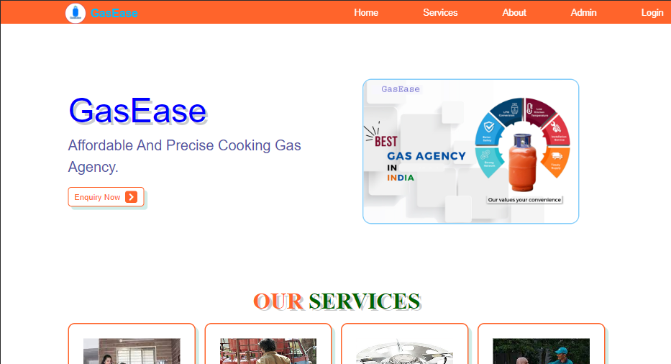
SCREENSHOTS

Slide 14
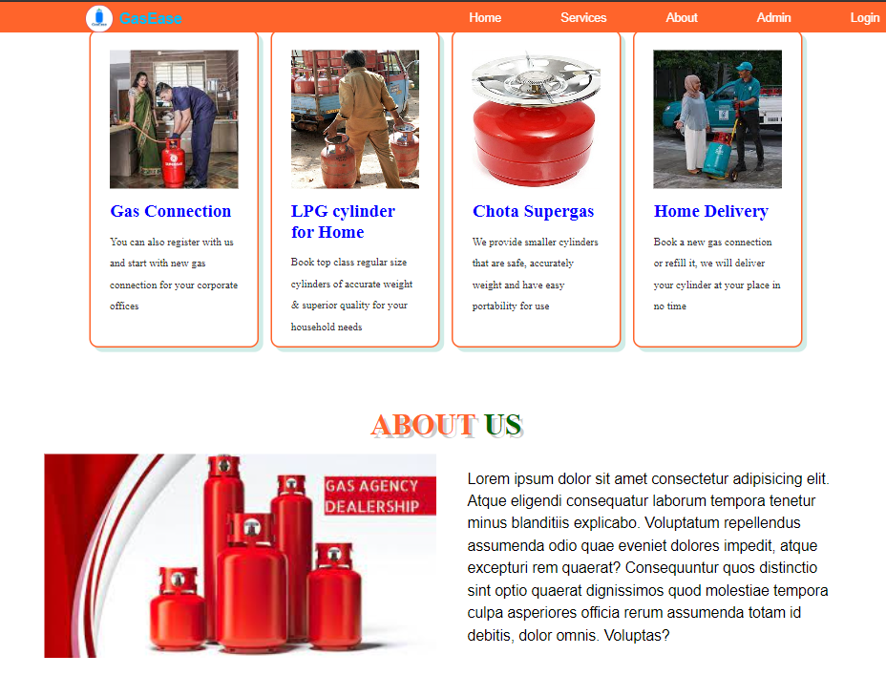
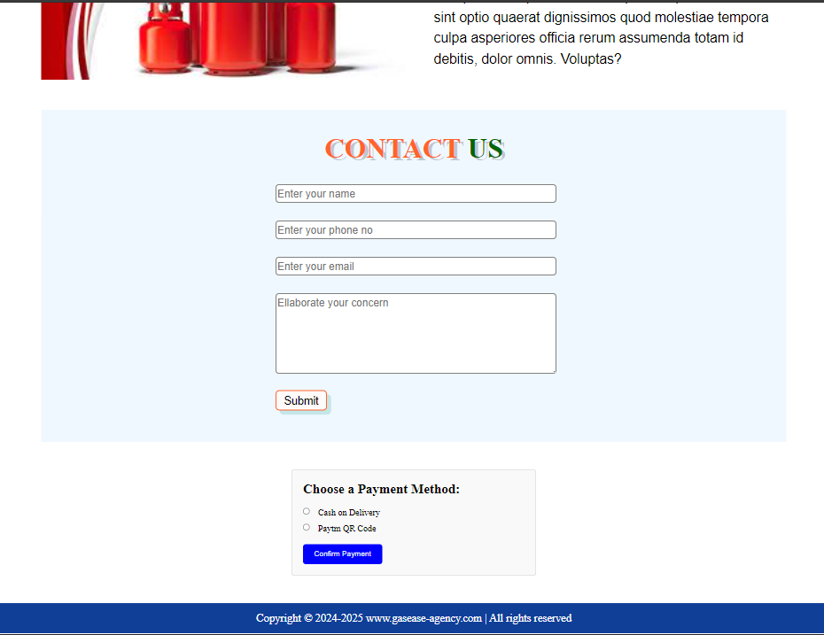
SCREENSHOTS

Slide 15
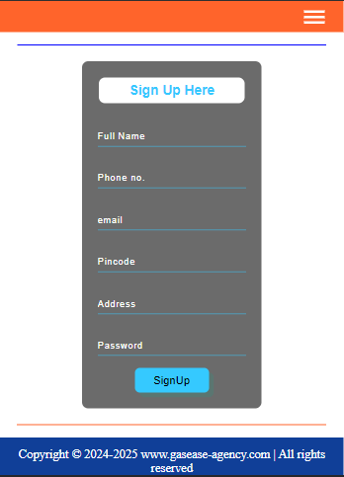
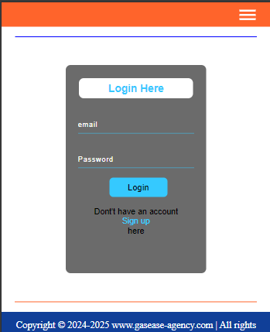
SCREENSHOTS

Slide 16
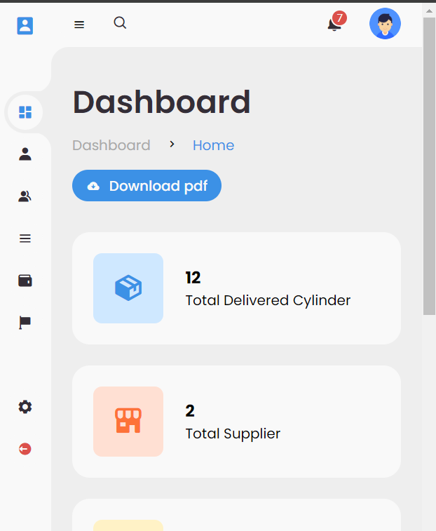
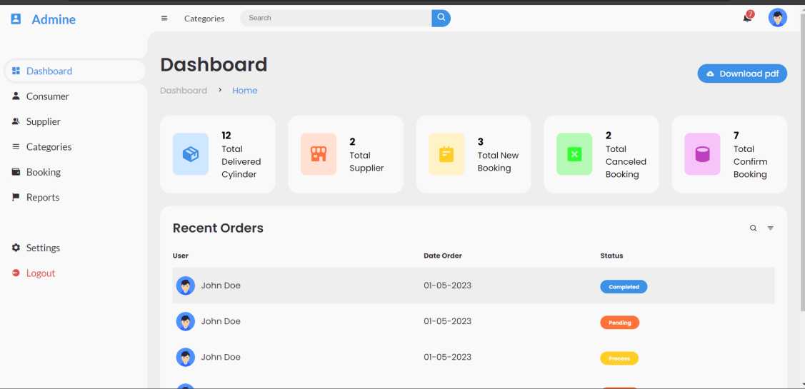
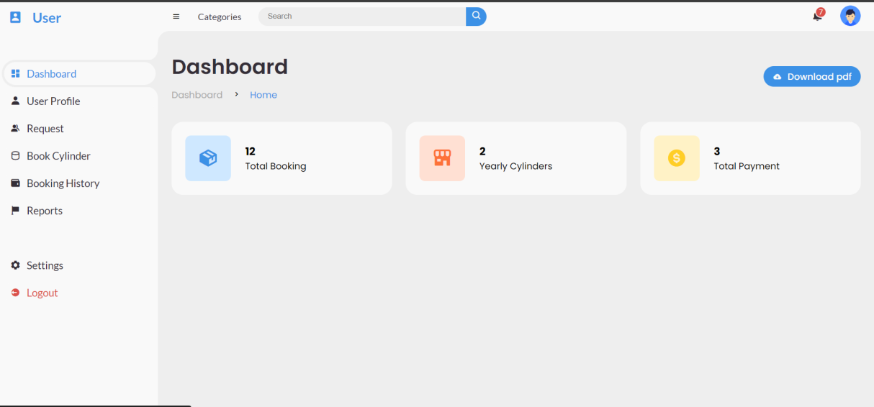
SCREENSHOTS

Slide 17
CONCLUSION
For Customers: GasEase provides unparalleled convenience, allowing users to book gas cylinders anytime and from anywhere. The user-friendly interface, flexible payment options, and real-time notifications enhance the overall booking experience, making it hassle-free and efficient. Access to booking history and instant email updates ensures transparency and keeps customers well-informed.
For Gas Agencies: The system significantly improves administrative efficiency by centralizing management tasks, automating processes, and providing real-time data. Administrators can easily manage user accounts, approve bookings, and communicate updates through a dedicated dashboard. Enhanced security measures and reliable database management ensure the safety and integrity of user data.
Overall Impact: GasEase offers a scalable and maintainable solution that can grow with increasing demand, ensuring long-term reliability and performance. By reducing operational costs and optimizing resource allocation, gas agencies can achieve higher efficiency and better serve their customers. The system's modern approach and advanced features provide a competitive advantage, helping agencies attract and retain tech-savvy customers.
My GitHub repo : https://github.com/SurukuluGobinda/Gas_Agency_System

