Slide 1
SURVEILIA
Chase Westlake, Kaden Taylor, Ben Kennedy, Ethan Pyle

Slide 2
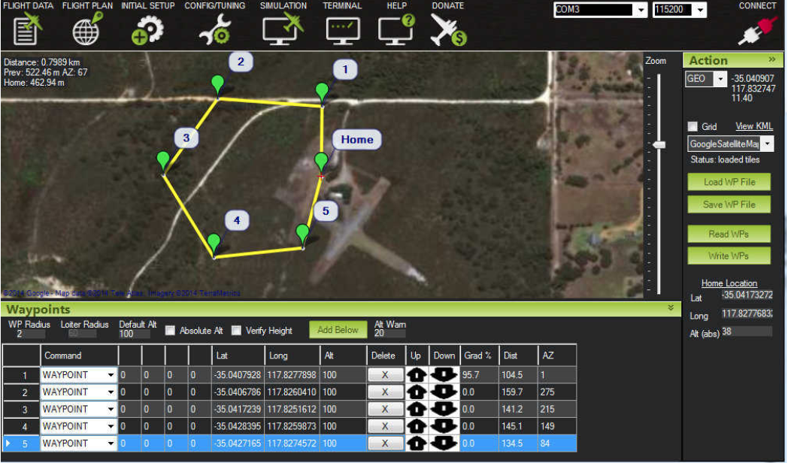
What is Surveilia?
Surveila is an automated security drone designed to provide deterrence and surveillance to property. Patrols are programmed routes specified through a configurable interface.

Slide 3
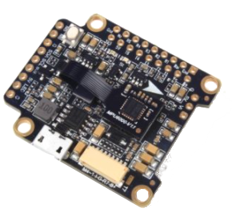
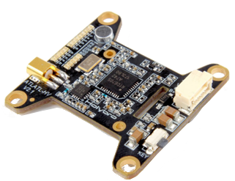
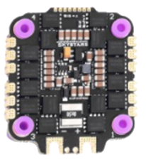
Electronics
Controlled by Kakute F7 V1.5 flight controller
Video managed by VTx: Atlatl HV V2
Motors managed by Skystars 45A 4-in-1 ESC.

Slide 4

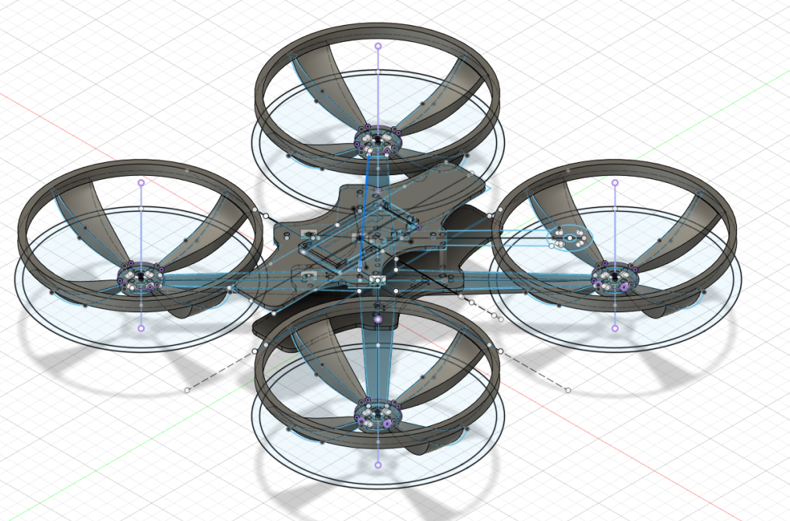
Software and Design
Fusion 360
3D printable drone design
Built entirely from scratch
Visual Studio
Designed using WPF Windows
Navigate between user settings and options
Map routes, view the current video feed, etc.

Slide 5
SURVEILIA

Slide 6
References
Atlatl HV V2 image: HV V2 image
Kakute F7 V1.5: F7 V1.5 image
4-in-1 ESC: ESC image
ArduPilot Mission Planner: Mission Planner image

