Slide 1
SURVEILIA
Chase Westlake, Kaden Taylor, Ben Kennedy, Ethan Pyle

Slide 2
What is Surveilia?
Surveilia is a security drone designed to aid in the security of property and possessions.
Patrols programmed routes during the day or night.
Automated to patrol avoiding manual use by the client.

Slide 3
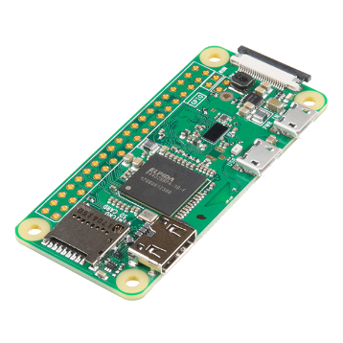
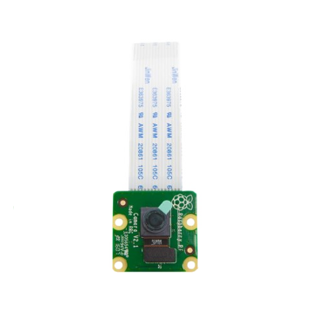
Electronics
Powered by a Raspberry Pi Zero W.
Raspberry Pi Camera – 8 Megapixel (V2)
2.4 GHz Mini WiFi Antenna with uFL Connector

Slide 4
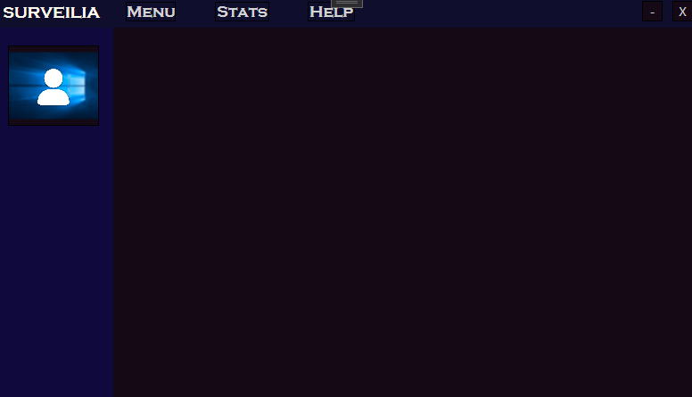
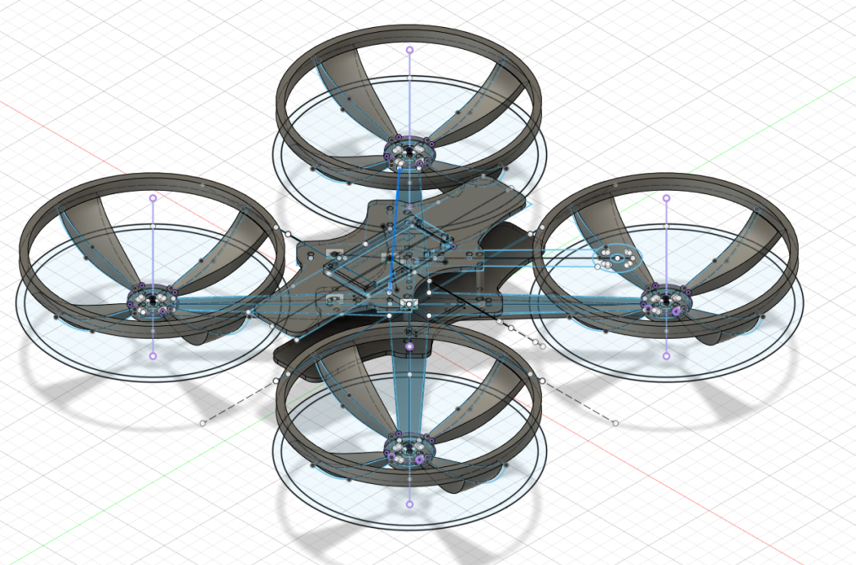
Software and Design
Fusion 360
3D printable drone design
Built entirely from scratch
Visual Studio
Designed using WPF Windows
Navigate between user settings and options
Map routes, view the current video feed, etc.

Slide 5
SURVEILIA

