Slide 1
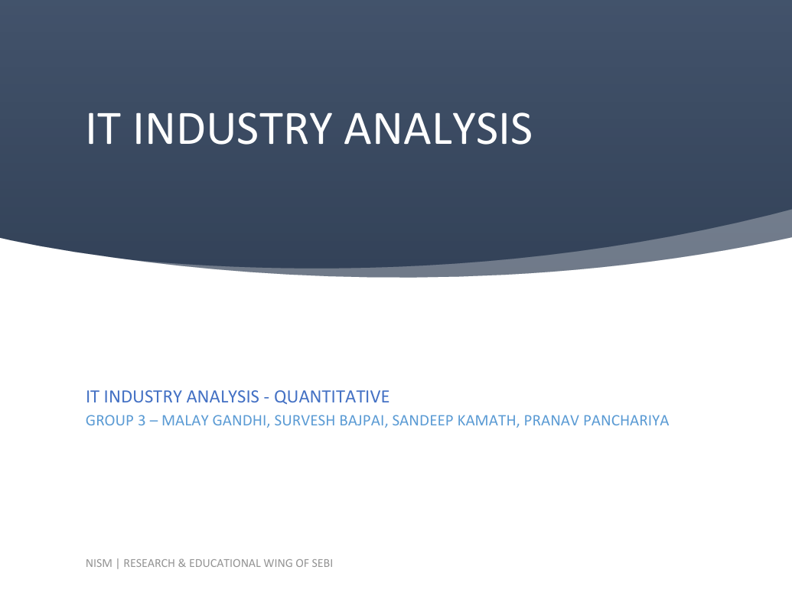

Slide 2
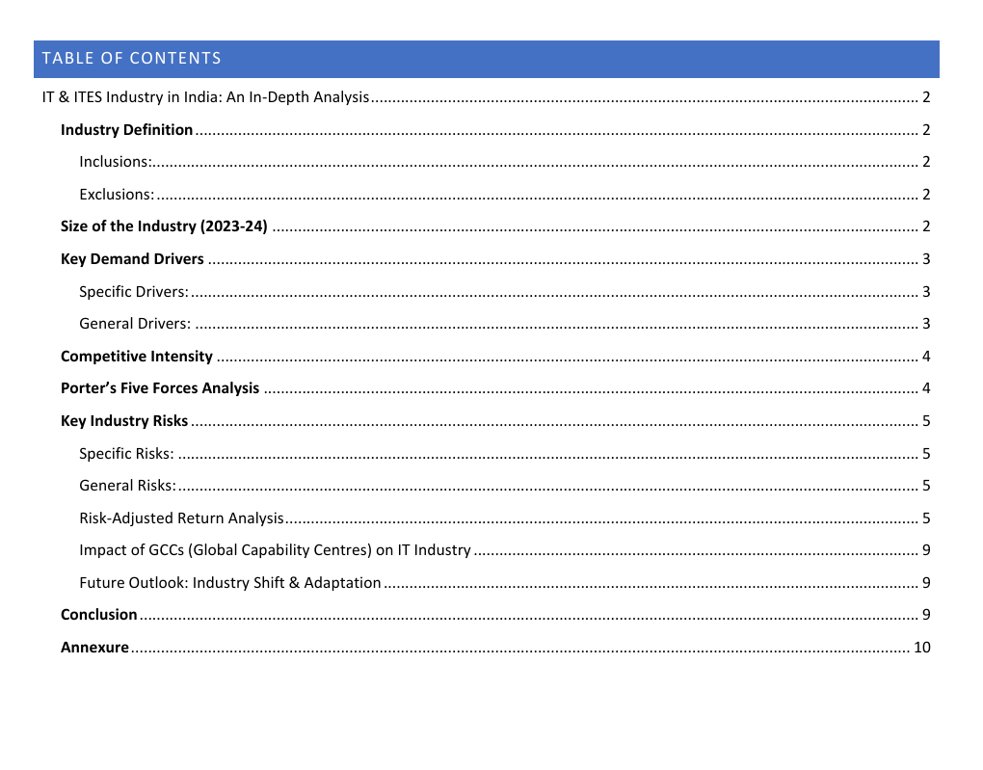

Slide 3
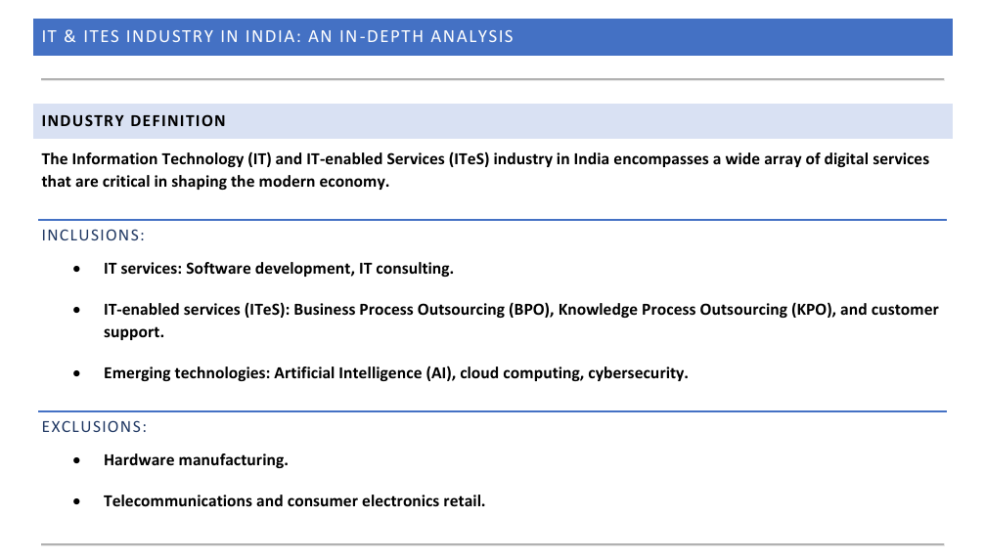

Slide 4
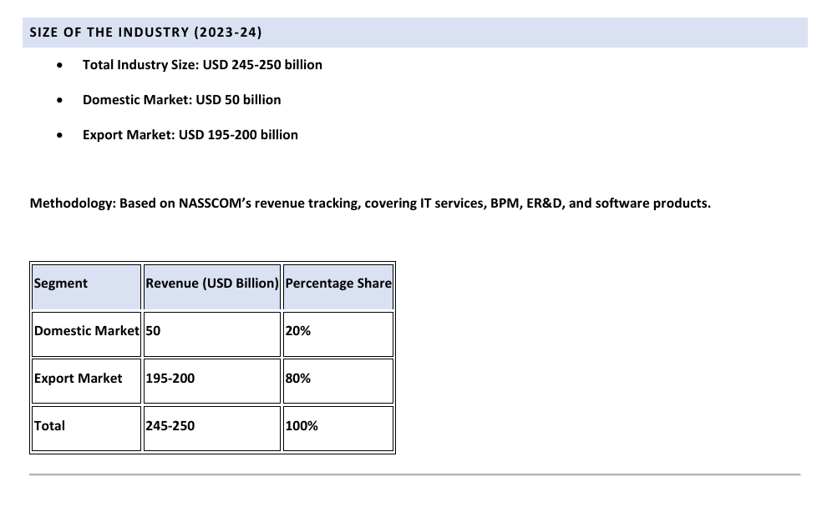

Slide 5
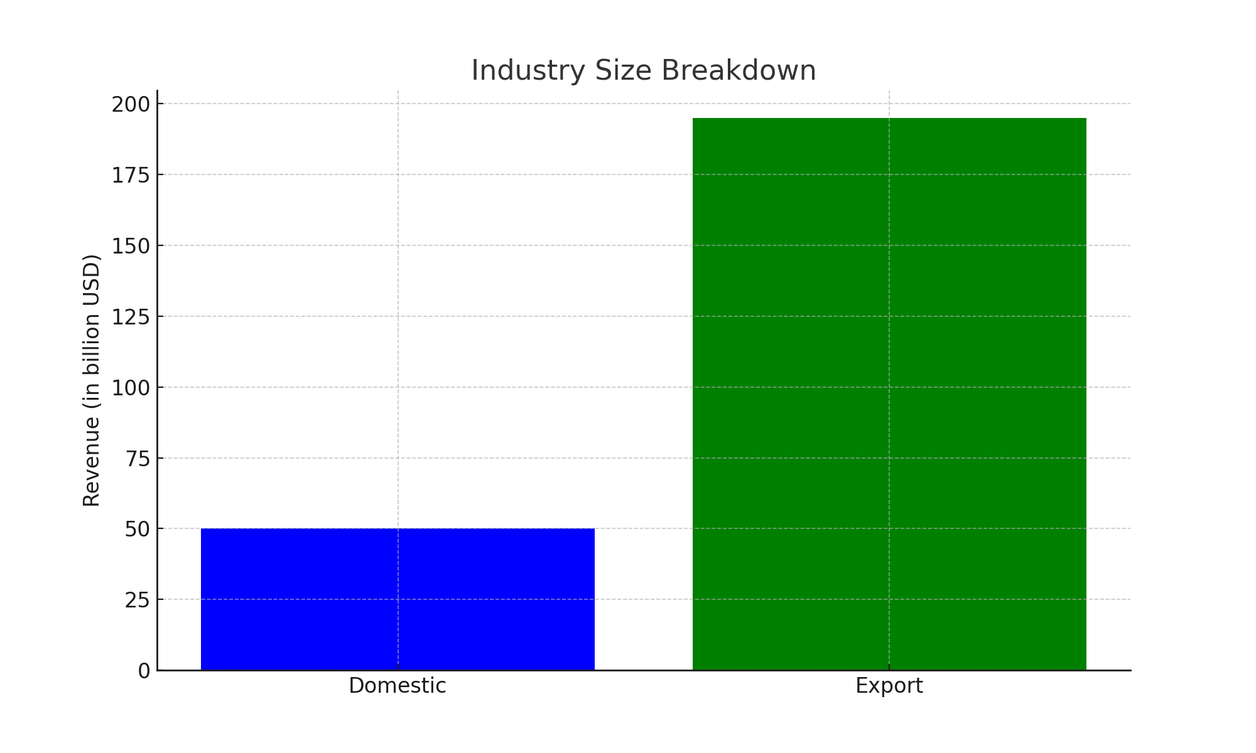

Slide 6
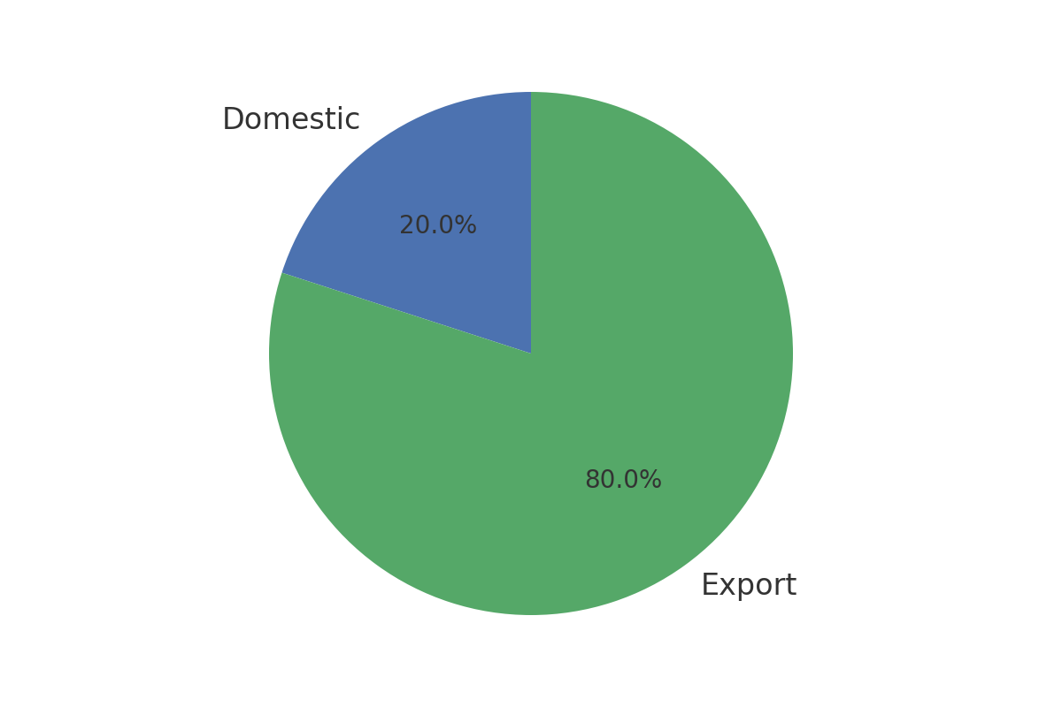
Size of the IT & ITeS Industry (2023-24)

Slide 7
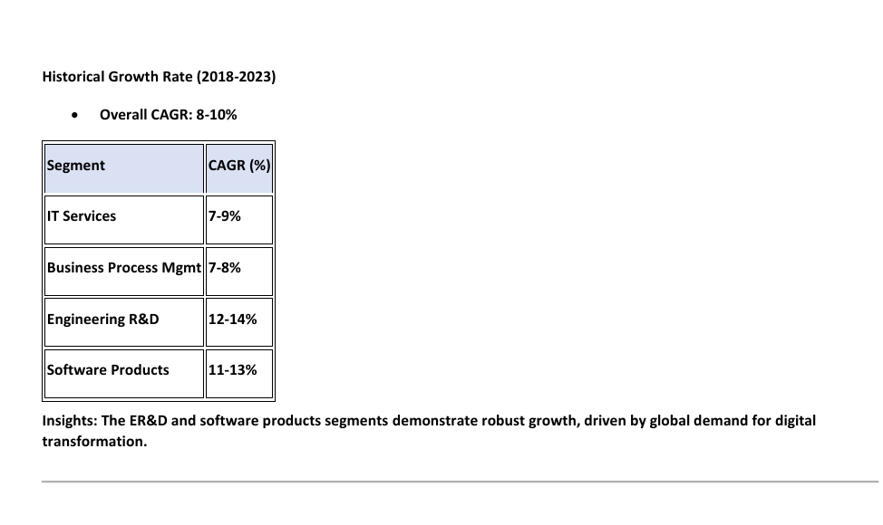

Slide 8
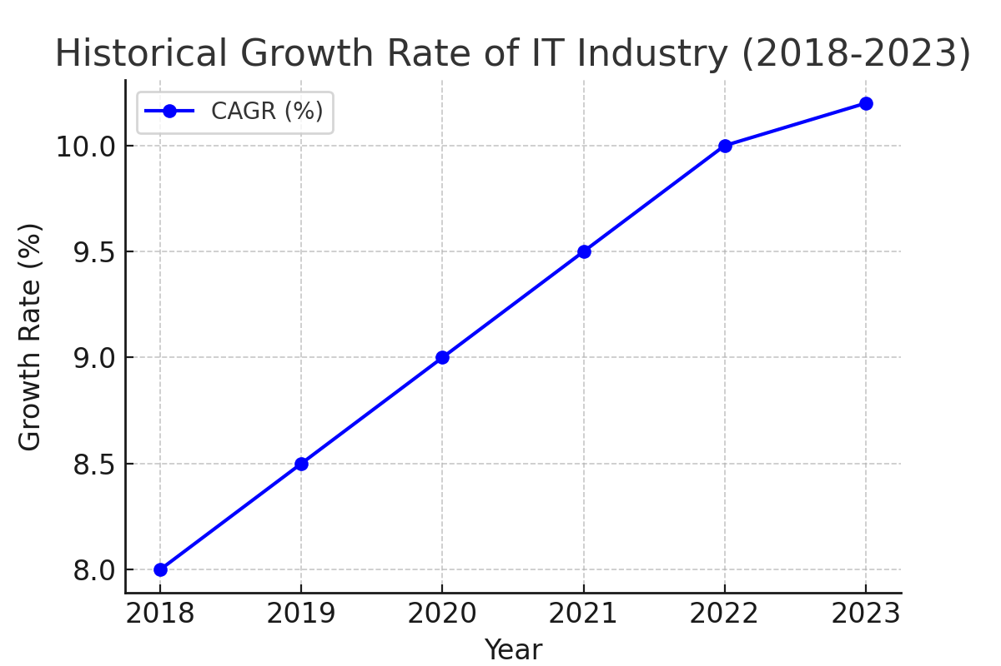
Historical Growth Rate (2018-2023)

Slide 9
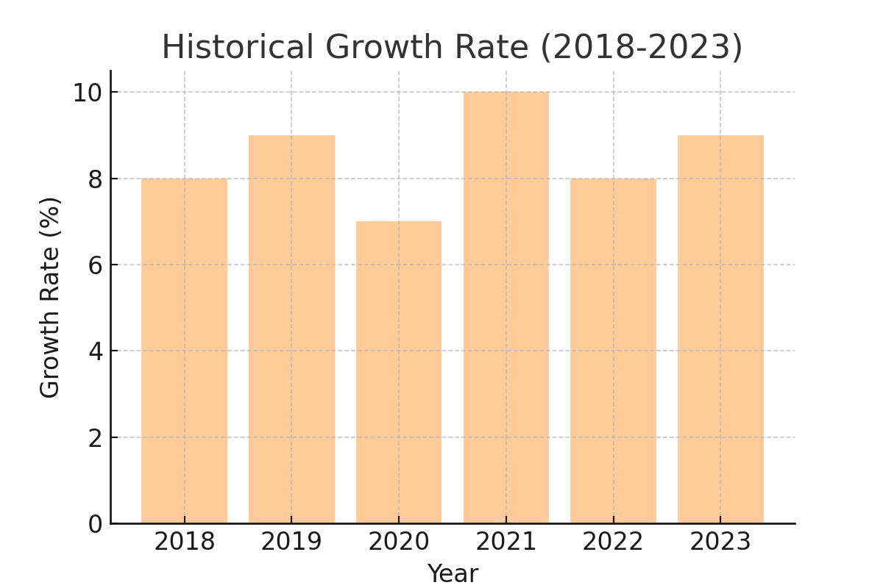
Historical Growth Rate
IT & ITeS CAGR (2018-2023): 8-10%

Slide 10
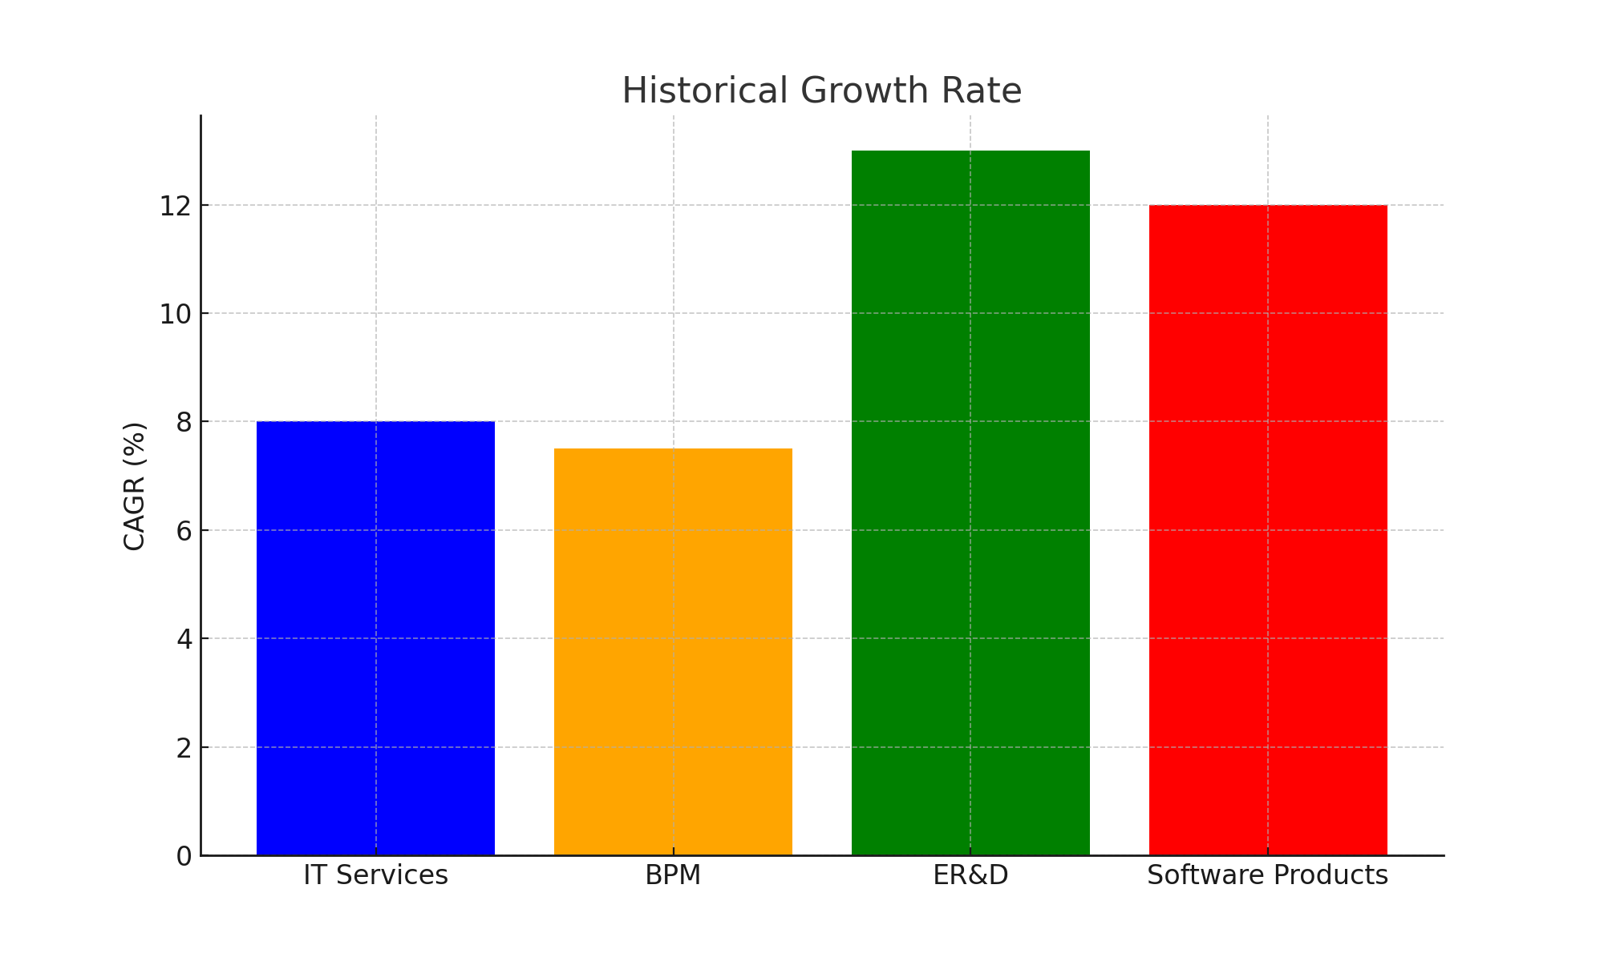
Historical Growth Rate (2018-2023)

Slide 11
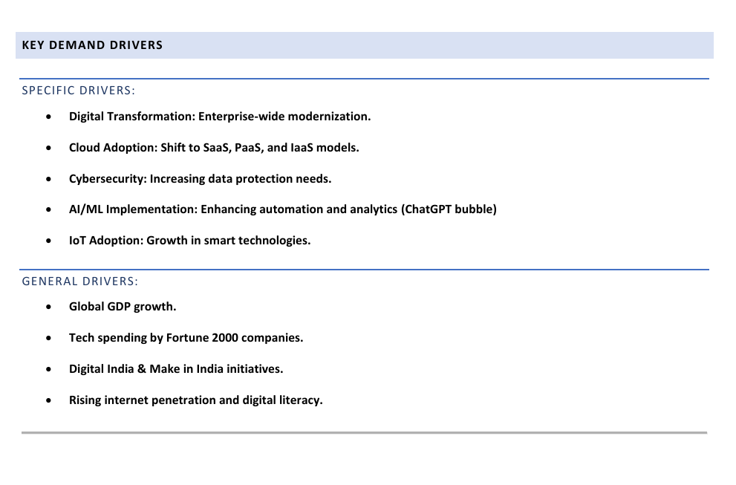

Slide 12
Key Demand Drivers
Driver Type | Examples
Specific Drivers | Digital Transformation, AI/ML Adoption, Cloud Growth
General Drivers | Global GDP Growth, Internet Penetration

Slide 13
Key Demand Drivers - General

Slide 14
Key Demand Drivers - Specific

Slide 15
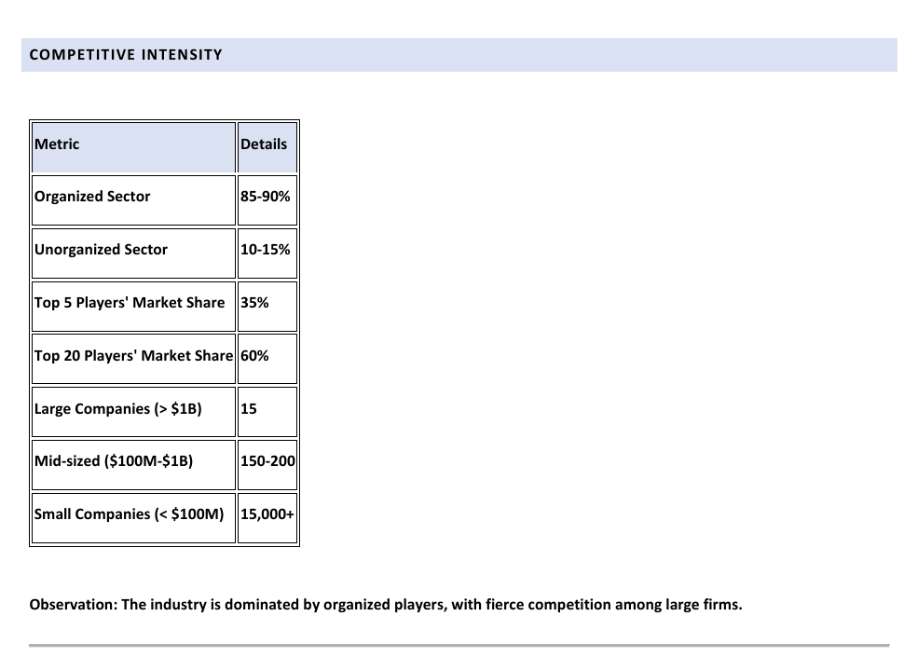

Slide 16
Competitive Intensity
Metric | Value
Organized Sector | 85-90%
Top 5 Players' Market Share | 35%
Large Companies (> $1B) | 15
Small Companies (< $100M) | 15,000+

Slide 17
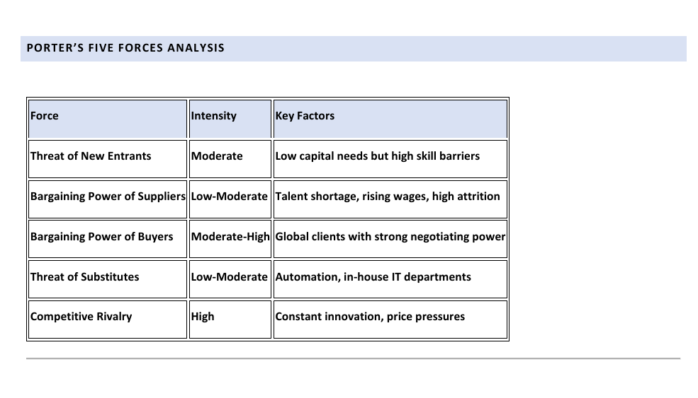

Slide 18
Porter's Five Forces Analysis
Force | Intensity
Threat of New Entrants | Moderate
Bargaining Power of Suppliers | Low-Moderate
Bargaining Power of Buyers | Moderate-High
Threat of Substitutes | Low-Moderate
Competitive Rivalry | High

Slide 19
Porter’s Five Forces - Intensity Levels

Slide 20
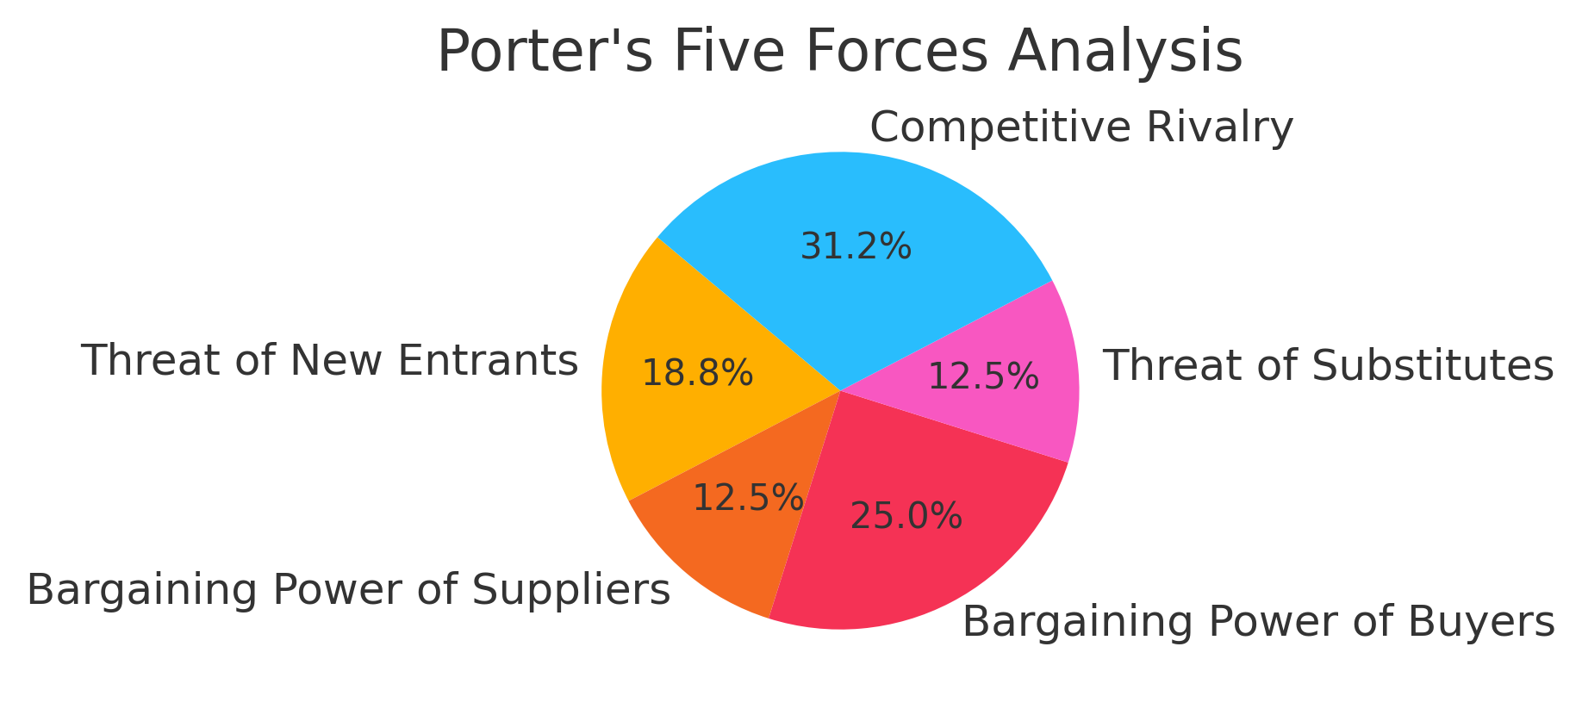
Porter's Five Forces Analysis

Slide 21
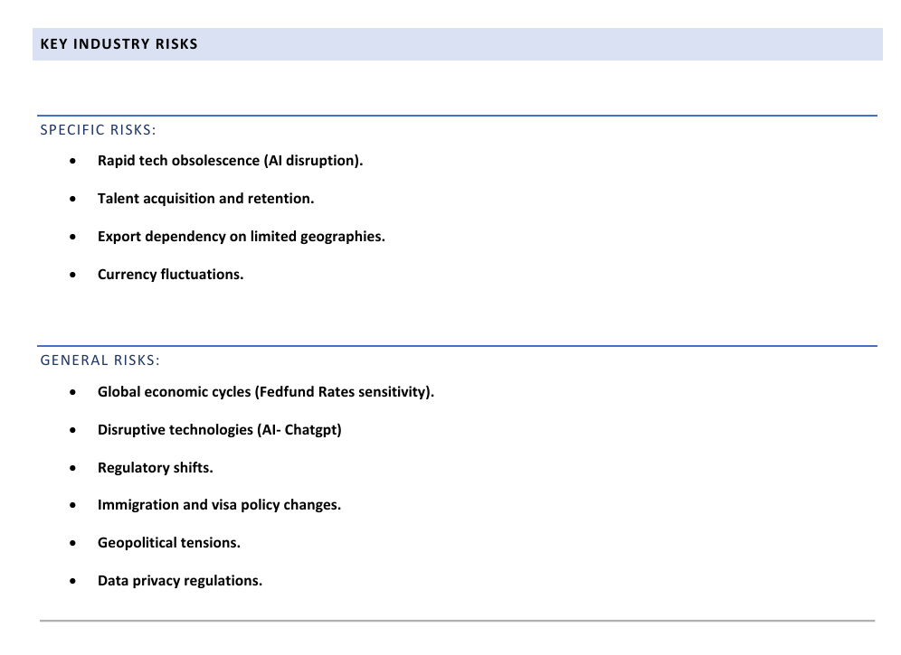

Slide 22
Key Industry Risks - General

Slide 23
Key Industry Risks - Specific

Slide 24
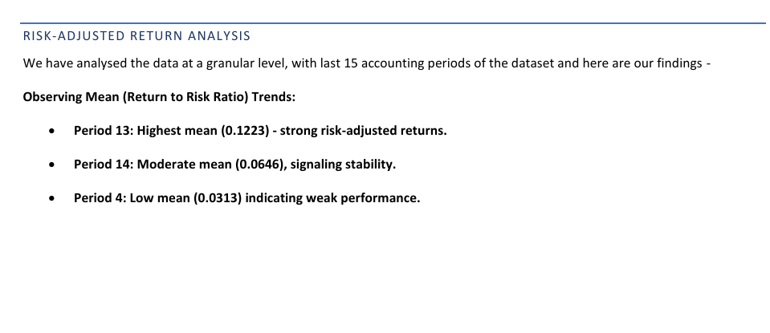

Slide 25
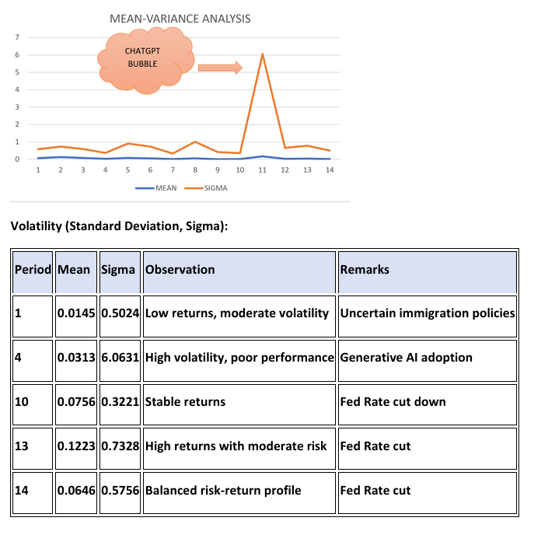

Slide 26
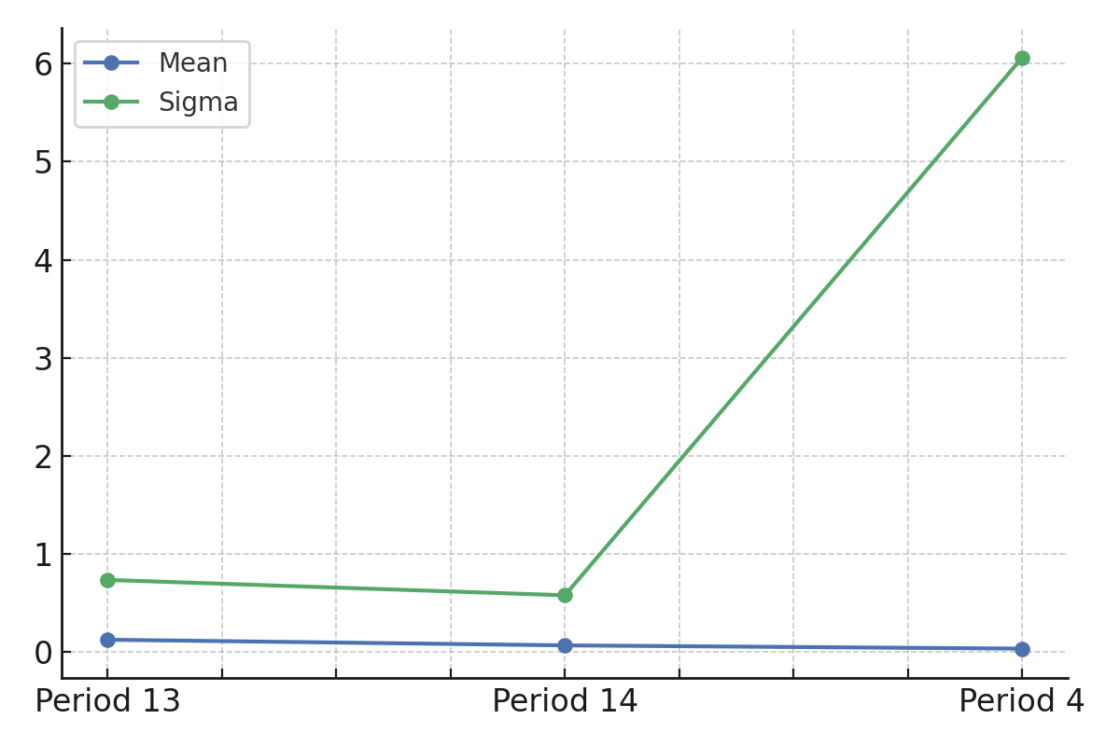
Risk-Adjusted Return Analysis

Slide 27
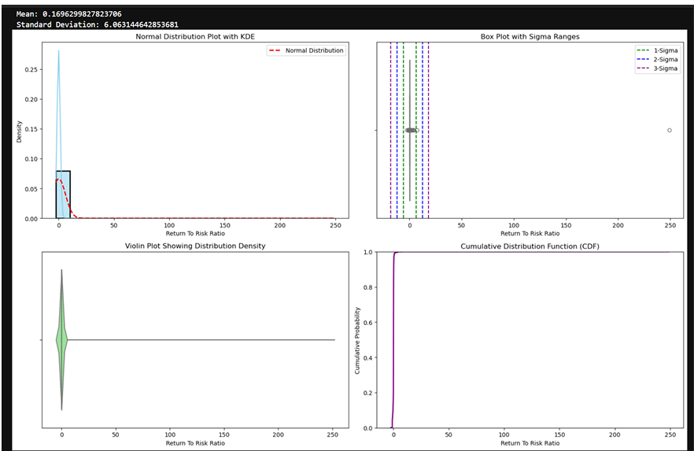

Slide 28
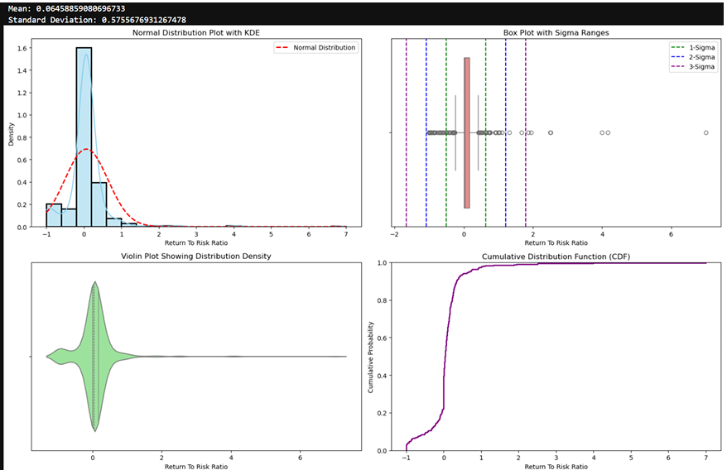

Slide 29
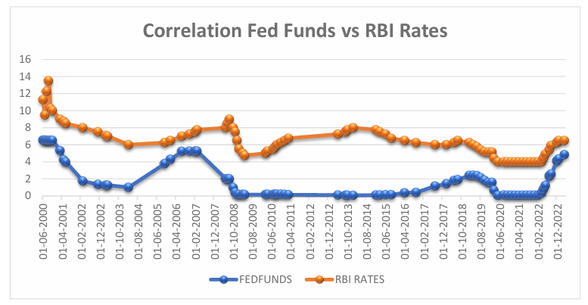

Slide 30
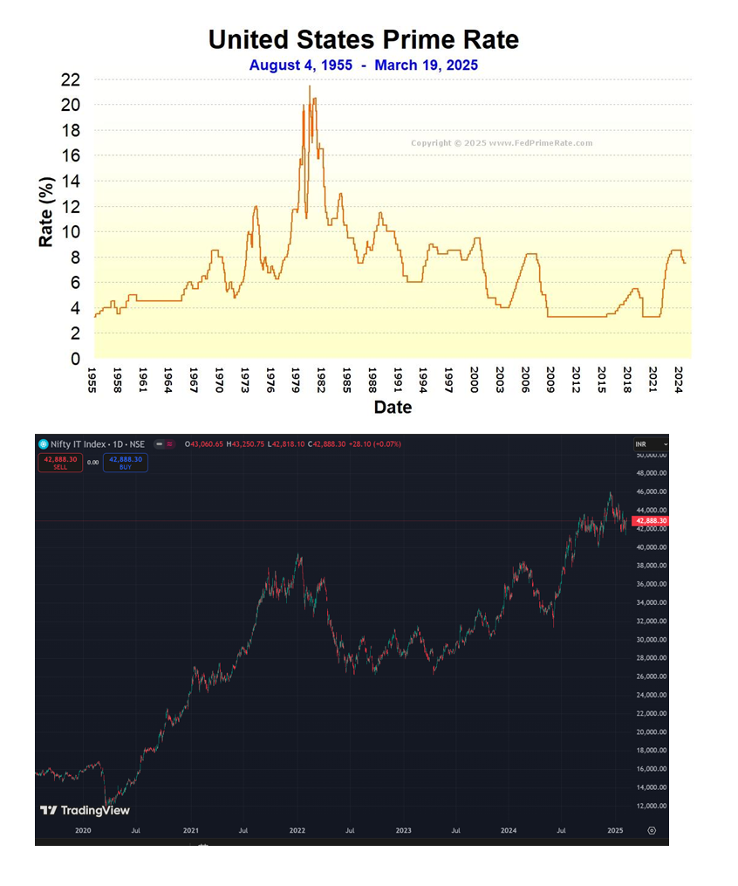

Slide 31
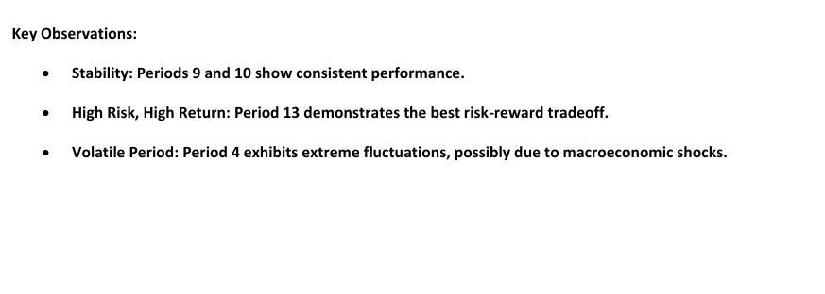

Slide 32
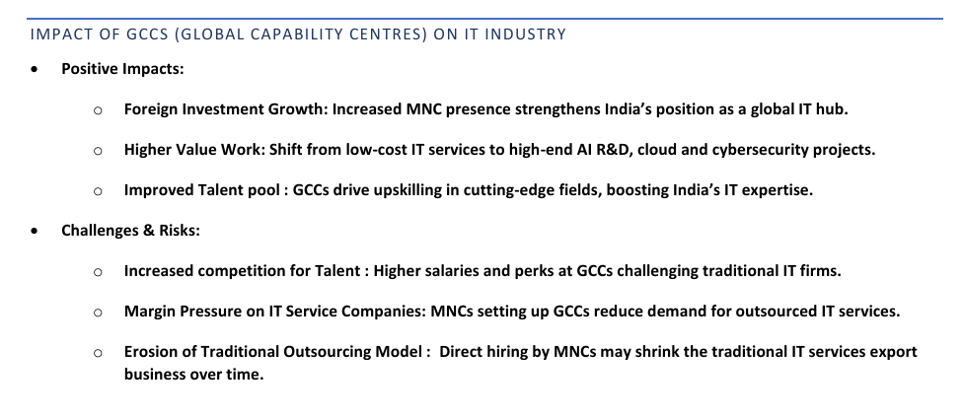

Slide 33
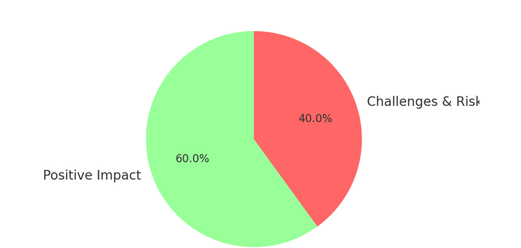
Impact of GCC (Global Capabilities Centres)

Slide 34
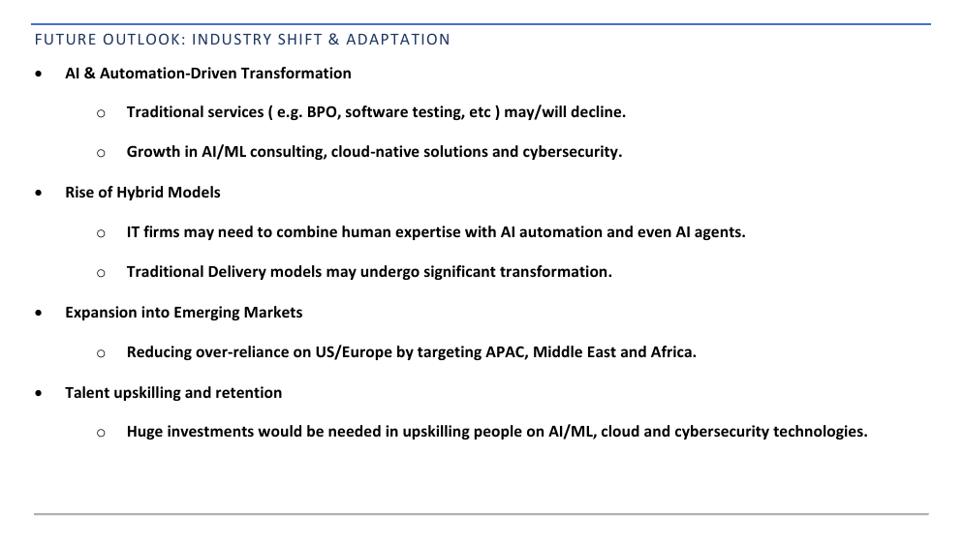

Slide 35
Future Trends in IT & ITES

Slide 36
AI & Automation Influence on IT Jobs

Slide 37
Future Projections for IT & ITES Industry

Slide 38
