Slide 1
PROJECT PRESENTATION
CS6240 - Parallel Programming In MapReduce
SUBMITTED BY:
Survi Satpathy
Prachi Sharma
Prakash Somasundaram

Slide 2
Transportation Databases
Data and statistics from the US Department of Transportation on Aviation, Maritime, Highway, Transit, Rail, Pipeline, Bike/Pedestrian and other modes of transportation.
The Transportation dataset is available on AWS as a public database under the “Economics” category. We access this on AWS console using a AWS-snapshot-id (snap-37668b5e).
We have used 2 datasets under Aviation category and 1 dataset from Rail category for this project.
Origin-Destination Survey Dataset: Data includes origin, destination and other itinerary details of passengers transported.
On-time performance Dataset: Summary information on the number of on-time, delayed, canceled and diverted flights from the year 1988 to 2008 are available in this dataset.
RailRoad Accident Dataset: Contains information about all the rail road accidents from year 1975 to 2008.

Slide 3
Analysis Overview
Found the best airline for the year 2007 based on a comprehensive ranking system of each airline by finding :
largest number of air routes covered by each airline
longest distance covered by each airline
lowest delay time for each airline
lowest delay percentage for each airline
Found the busiest airport for each quarter for the years ranging from 2000 to 2008 in the dataset, by computing the number of arriving passenger for every airport.(Using Hbase)
Found the average delay based of metrics like :
Carrier
Month
Hour
Found the number of Rail Road accidents for each state from 1975 to 2008.

Slide 4
Busiest Airport
Found the busiest airport for each quarter for the years ranging from 2000 to 2008 in the dataset.
Passenger Count – Compute the count of number of passengers to an airport for each quarter of the year. We used secondary sort to sort the input records of Origin Destination survey dataset by year & quarter.
To solve the problem, we need to sort the dataset on year, quarter and then by passenger count.
We used the secondary sort logic to sort by Year and Quarter. In the reduce task, for each pair of year and quarter we store the passenger count for each destination using a hashmap.
We find the destination with the maximum passenger count using the ValueComparator helper class. Thus, we emit the destination with maximum passenger count for each pair of year and quarter.
TransportPopulate - Populate the On-time performance dataset in to the HBase table to perform the equi-join.
Average Delay calculation – Compute the average delay for the busiest airports for each quarter of the years ranging from 2000 to 2008. We performed an equi-join of the On-time performance dataset and the result of the Passenger Count.
We added the result from the PassengerCount task to an arraylist <String> - busiestAirport
For each year, quarter and destination from the arraylist we find the average delay from the transportTable in HBase.

Slide 5
Busiest Airport
Passenger Count :
Compute the count of number of passengers to an airport for each quarter of the year. We used secondary sort to sort the input records of Origin Destination survey dataset by year & quarter.
TransportPopulate:
Populate the On-time performance dataset in to the HBase table to perform the equi-join.
Average Delay calculation:
Compute the average delay for the busiest airports for each quarter of the years ranging from 2000 to 2008. We performed an equi-join of the On-time performance dataset and the result of the Passenger Count.

Slide 6
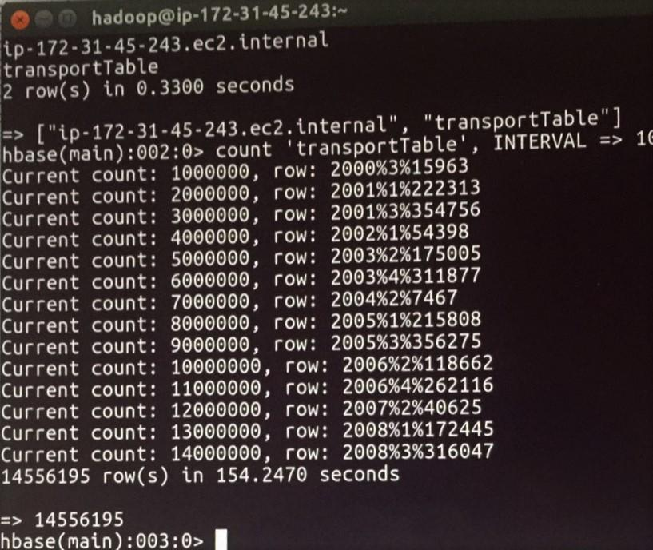
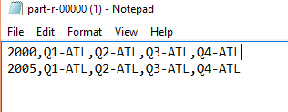
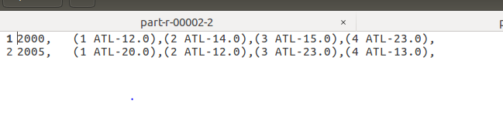
Busiest Airport(Outputs)
TransportPopulate :
Passenger Count:
Average Delay calculation:

Slide 7
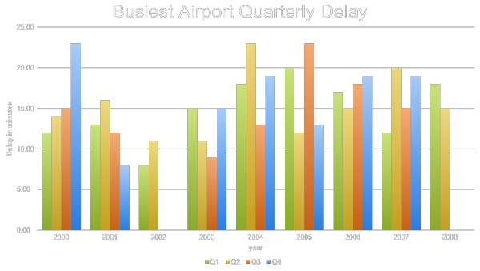

Slide 8
Best Airline
Found the best airline for the year 2007 by computing the average rank for each airline based on the below mentioned categories and reporting a 10-element-rank from highest to lowest.
Largest Number of Air Routes :
A route is considered as a pair of two different cities. For example, flight from Seattle to Vancouver is considered as a route. But the flight from Vancouver to Seattle is considered as a different flight. We count the total number of flights of each airline and report 10 airlines that have largest number of routes in descending order.
Longest Distance:
We add up all the distance traveled of each airline and report 10 airlines that have largest traveled distance in descending order.
Lowest Delay Time:
We add up all the time gap of flights of each airline and report 10 airlines that have lowest total delaying time in ascending order.
Lowest Delay Percentage:
First, we count the total number of flights of each airline and the number of delayed flights among the total flights. Then, we divided the number of delayed flights by the total number of flights to get percentages. To report the results, we sorted the list of results in ascending order and reported the first 10 of them.

Slide 9
Best Airline
Largest Number of Air Routes:
Found the number of air routes for each airline and selecting top 10 such airlines with the largest count.
Largest Number of Air Routes:
Found the number of air routes for each airline and selecting top 10 such airlines with the largest count.
Best Airline:
Gather up all four of the rank, from above mentioned categories, calculate the average rank of each airline and report 10 best airlines in ascending order
Lowest Delay Time:
Found the total delay time of each airline and reporting a 10-element-rank from lowest to highest
Lowest Delay Percentage:
Found the number of total flights of each airline and the number of delayed flights to get percentages. Results will be a 10-element-list of ranks from lowest percentage to highest

Slide 10
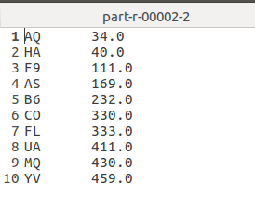
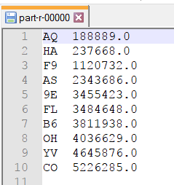
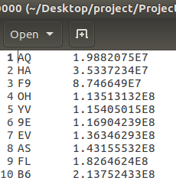
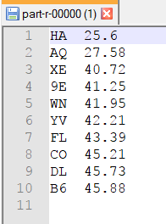
Outputs (Best Airline)
Largest Number of Air Routes:
Lowest Delay Time:
Longest Distance:
Lowest Delay Percentage:

Slide 11
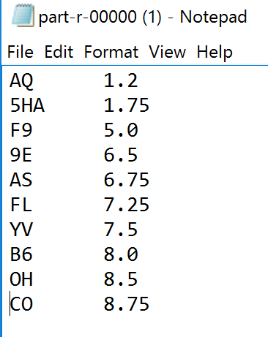
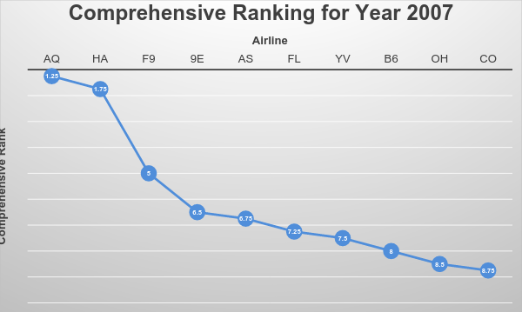
Best Airline Output & Graph

Slide 12
Statistical Delay Calculation
Found the average delay for categories carrier, month, hour.
CarrierAvgDelay – Found the average delay for each unique airline carrier.
CarrierAvgArrDelay - Calculated the average delay time for each airline carrier based on arrival delay minutes.
CarrierAvgDeptDelay - Calculated the average delay time for each airline carrier based on departure delay minutes.
HourlyAvgDelay – Found the average delay for each hour of the day.
HourlyAvgArrDelay - Calculated the average delay time for each hour of the day based on arrival delay minutes.
HourlyAvgDeptDelay - Calculated the average delay time for each hour of the day based on departure delay minutes.
MonthlyAvgDelay – Found the average delay for each month of the year
MonthlyAvgArrDelay - Calculated the average delay time for each month of the year 2007 based on arrival delay minutes.
MonthlyAvgDeptDelay - Calculated the average delay time for each month of the year 2007 based on departure delay minutes.

Slide 13
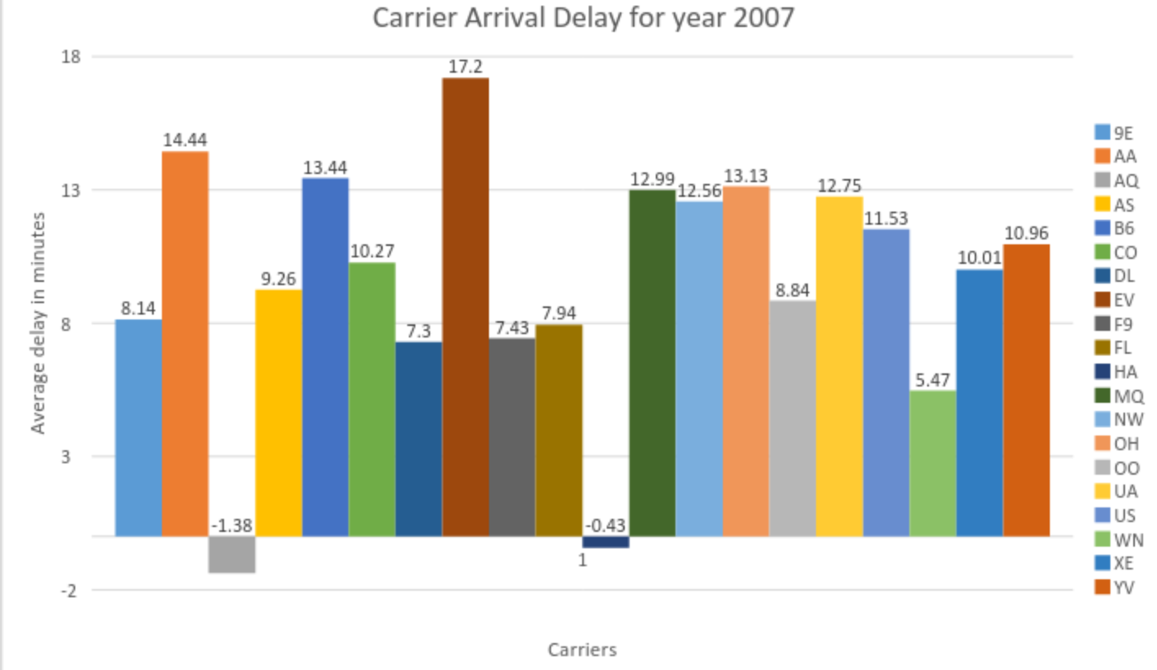
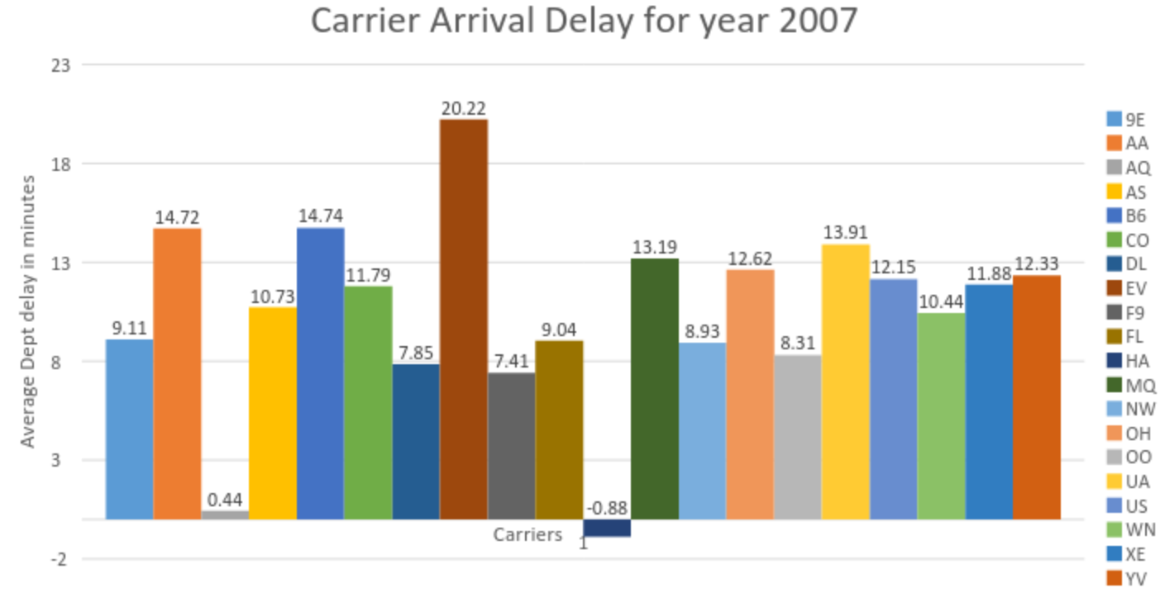
Statistical Delay Calculation Graph(Carrier)
CarrierAvgArrDelay - Calculated the average delay time for each airline carrier based on arrival delay minutes.
CarrierAvgDeptDelay - Calculated the average delay time for each airline carrier based on departure delay minutes.

Slide 14
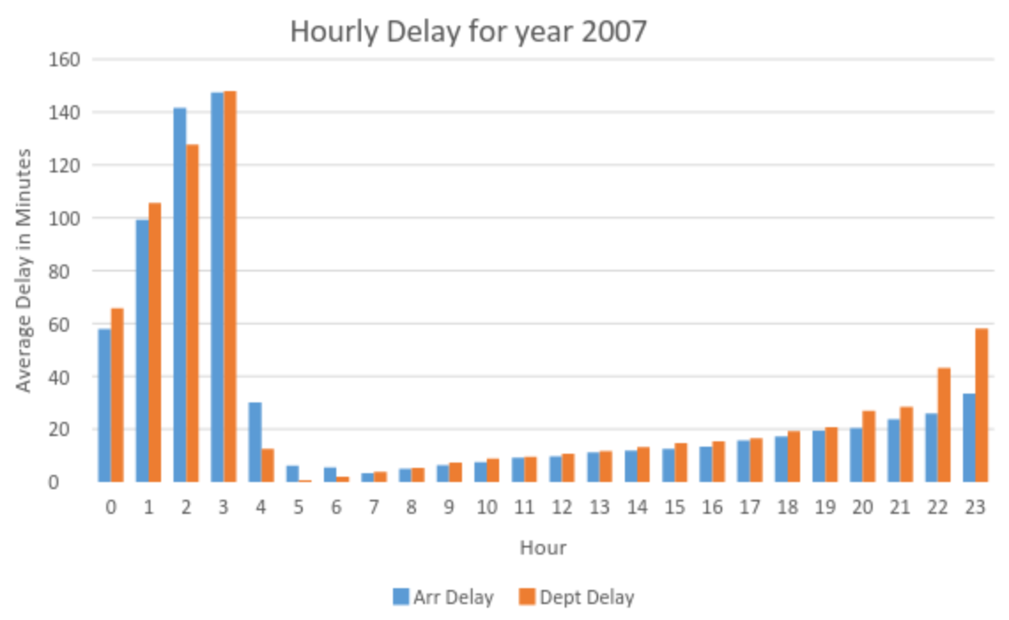
Statistical Delay Calculation Graph(Hour)
HourlyAvgArrDelay - Calculated the average delay time for each hour of the day based on arrival delay minutes.
HourlyDeptAvgDelay - Calculated the average delay time for each hour of the day based on departure delay minutes.

Slide 15
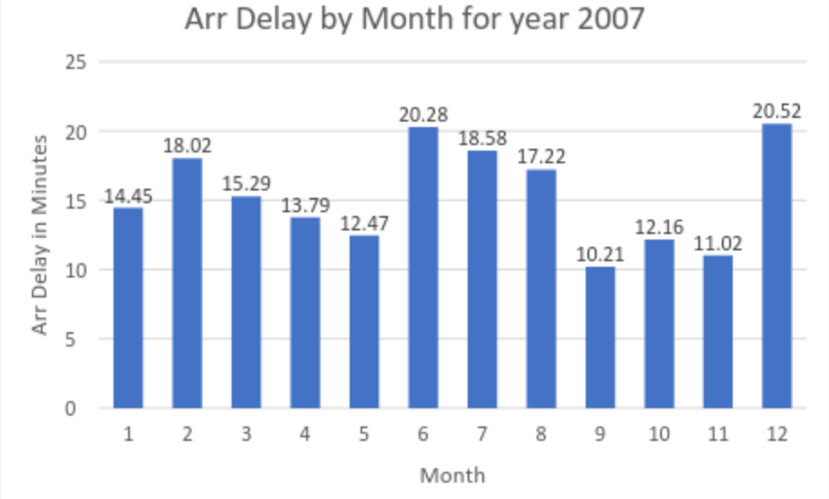
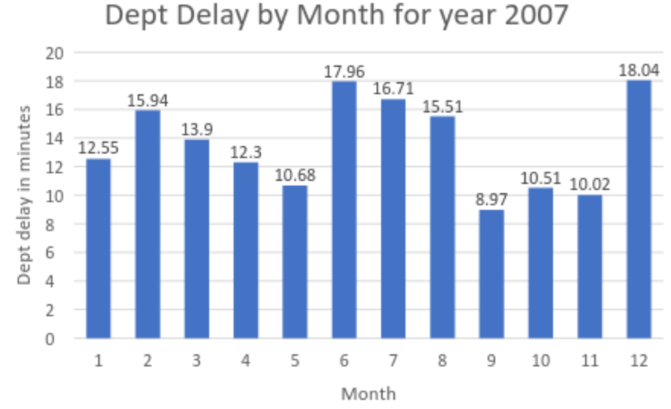
Statistical Delay Calculation Graph (Month)
MonthlyArrAvgDelay - Calculated the average delay time for each month of the year 2007 based on arrival delay minutes.
MonthlyDeptAvgDelay - Calculated the average delay time for each month of the year 2007 based on departure delay minutes.

Slide 16
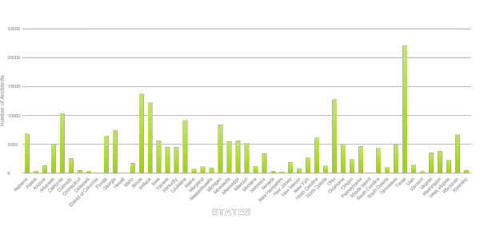
RAIL ACCIDENTS BY STATE (1975 – 2008)

Slide 17
THANK
YOU

