Slide 1
CS5100 Foundation of Artificial Intelligence
A Report on Identifying Personal Attacks in Wikipedia Comments
By Survi Satpathy
Spring 2018

Slide 2
Text Clean Up & Feature Selection
Text Cleanup Process
methods tried
Removal of punctuation marks
Removal of digits
URL removal
multiple newline or tab space replaced with a single white space
English stop words removal
methods included
Removal of punctuation marks
Removal of digits
URL removal
multiple newline or tab space replaced with a single white space
Features considered and used in the project
Character(Unigrams and Bigrams)
Words(Unigrams and Bigrams)

Slide 3
Optimizations
Optimization techniques:
Reducing noise by text cleanup process
Tokenization of text was improved by applying CountVectorizer with combination of analyzer as “word” and “char”.
Increasing the max-feature attribute of CountVectorizer and TfIDFVectorizer improved the performance
Cross-Validation score based on ROC AUC score was used to calculate the best classifier.This metric made use of the development and training dataset.
Used grid search and randomized search on the best classifier found to calculate the list of best parameters
Classification report was generated to chart the performance of the best classifier on the test data set

Slide 4
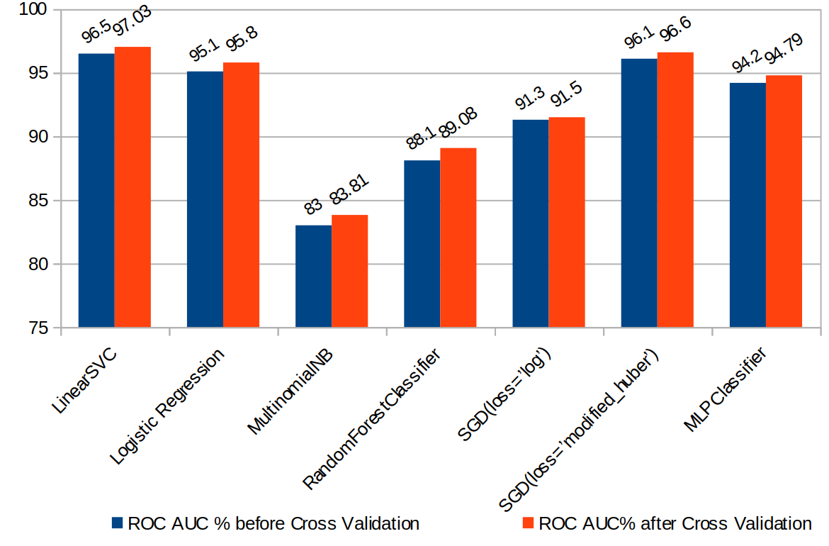
Classifiers Comparison with and without Cross Validation
LinearSVC was found to be the best Classifier before parameter tuning. This is because LinearSVC works well with high dimensional spaces specifically where the number of dimensions is greater than number of samples.

Slide 5
Parameter Tuning & Performance Metrics applied
Hyperparameters tuning of Linear SVM using GridSearchCV
{'C': 0.4, 'loss': 'squared_hinge', 'random_state': 37, 'tol': 0.001}
Hyperparameters tuning of Linear SVM using RandomizedSearchCV
{ 'C': 0.4, 'loss': 'squared_hinge', 'random_state': 37, 'tol': 0.001, 'max_iter': 2000 }
Accuracy percentage before applying hyperparameter tuning was = 95.6%
Accuracy percentage after applying hyperparameter tuning is = 96.6%
% difference between accuracies = 1 %
Performance Metrics learnt
The use of Precision,Recall, F1 score and support to understand the performance of a classifier
Classification report gives a summary table representing the precision, recall, f1 score and support
Using Cross validation each tuple from the training data can be used as a testing data input.

Slide 6
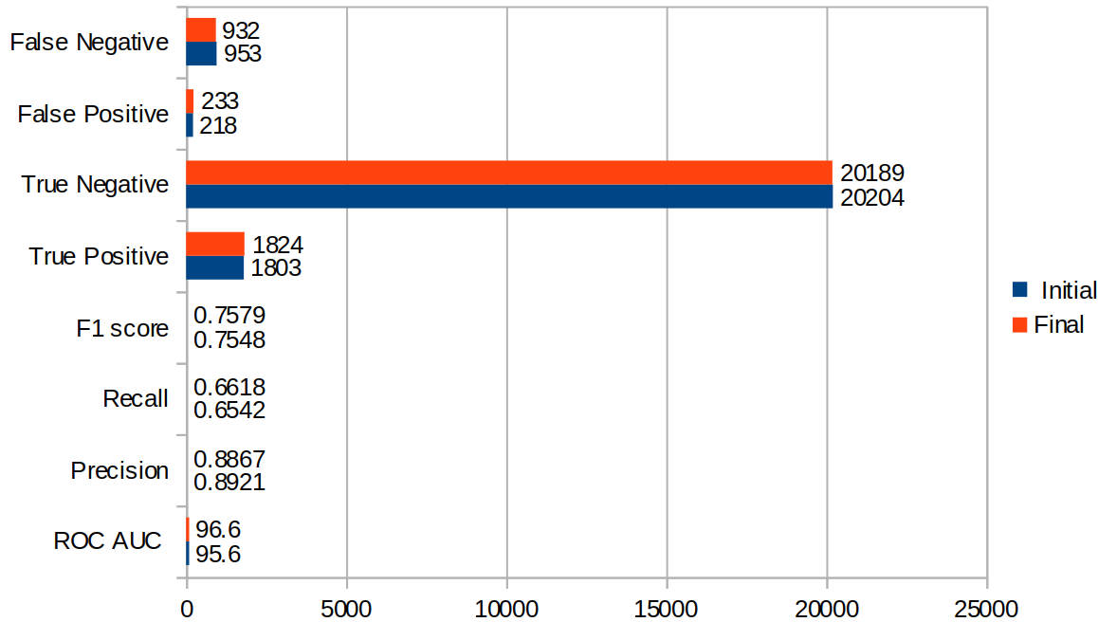
Final result metrics
Final result metrics as found by Linear SVM classifier

Slide 7
Interesting Facts learnt
Preprocessing and data cleanup has a great impact on the performance of any classifier.
GridSearchCV,RandomizedSearchCV are useful functions to find out the best parameters for any classifier
SGD can be successfully applied to large-scale and sparse machine learning problems often encountered in text classification and natural language processing. But SGD requires a number of hyperparameters such as the regularization parameter and the number of iterations.
MLP cannot guarantee that the that the minima it stops at during training is the global minima. Another disadvantage is is that the number of Hidden Neurons must be set by the user, setting this value too low may result in the MLP model underfitting while setting this value too high may result in overfitting.

Slide 8
Challenges faced
Finding the list of parameters that should be provided to the hyperparameter operation. This was a time consuming process as it needed carefully try outs for various values of the possible parameters to decide which suits best for the experiment
Finding the right combination of the features in the feature union function provided for tokenization of text. This was again achieved on a trial and error basis and hence was an exhaustive process

Slide 9

Conclusion
Linear support vector machine (SVM) has been proven to be the best text classification algorithm
Linear Regression is the to go method to use for binary classification as it performs fairly well with linear and correlated data
Multinomial NB works well for data which can easily be turned into counts, such as word counts in text.
Multi Layer Perceptron algorithm can get stuck in a local minima. Setting hidden layers too small can result in underfitting and setting it too high can lead to overfitting.

Slide 10
THANKS!
Any questions?

