Slide 1
IBM SPSS MODELER 18.6 | CLASSIFICATION PROJECT
LOAN ELIGIBILITY
PREDICTION
Predictive analytics for loan application assessment
College Project Presentation
Prepared using IBM SPSS Modeler

Slide 2
Executive Summary
Project overview and key findings
This project uses IBM SPSS Modeler 18.6 to explore loan application data and build classification models that estimate whether an application is likely to be approved or rejected.
APPROACH
KEY RESULT
DATA OVERVIEW
Prepare and define fields, split the data into training/testing sets, then build C5.0 and C&R Tree models.
C5.0 achieved 99.09% training accuracy and 98.24% testing accuracy in the reported analysis.
The target field distribution is 62.22% Approved and 37.78% Rejected.
The results are model-based estimates and should support—not replace—responsible lending review.
2

Slide 3
Introduction & Objectives
Why loan eligibility prediction matters
INTRODUCTION
PROJECT OBJECTIVES
Loan providers assess several applicant and financial factors before making a lending decision.
Predictive analytics can help identify patterns in historical applications and support more consistent assessment.
• Explore loan application attributes
• Prepare fields for modelling
• Train classification models in SPSS Modeler
• Evaluate model performance using testing data
• Visualize the Approved/Rejected distribution
Problem focus: use available applicant information to classify loan status.
3

Slide 4
Dataset Description
Main fields used in the loan application dataset
The dataset combines applicant profile, creditworthiness, loan details and asset-value information.
Applicant profile
Education, self-employed status, number of dependents
Financial details
Annual income, loan amount, loan term
Credit indicator
CIBIL score
Assets
Residential, commercial, luxury and bank asset values
Target field
loan_status: Approved / Rejected
Data source: loan_approval_dataset.csv (as used in the project stream).
4

Slide 5
Methodology
Workflow from data preparation to model evaluation
01
02
03
04
05
Load data
Define fields
Partition
Build models
Evaluate
Import CSV dataset
Set loan_status as target
70% training / 30% testing
C5.0 and C&R Tree
Analysis and scored output
EVALUATION NOTE
Reported C5.0 accuracy is based on the project's Analysis output. Testing performance is the more relevant estimate of generalization.
5

Slide 6
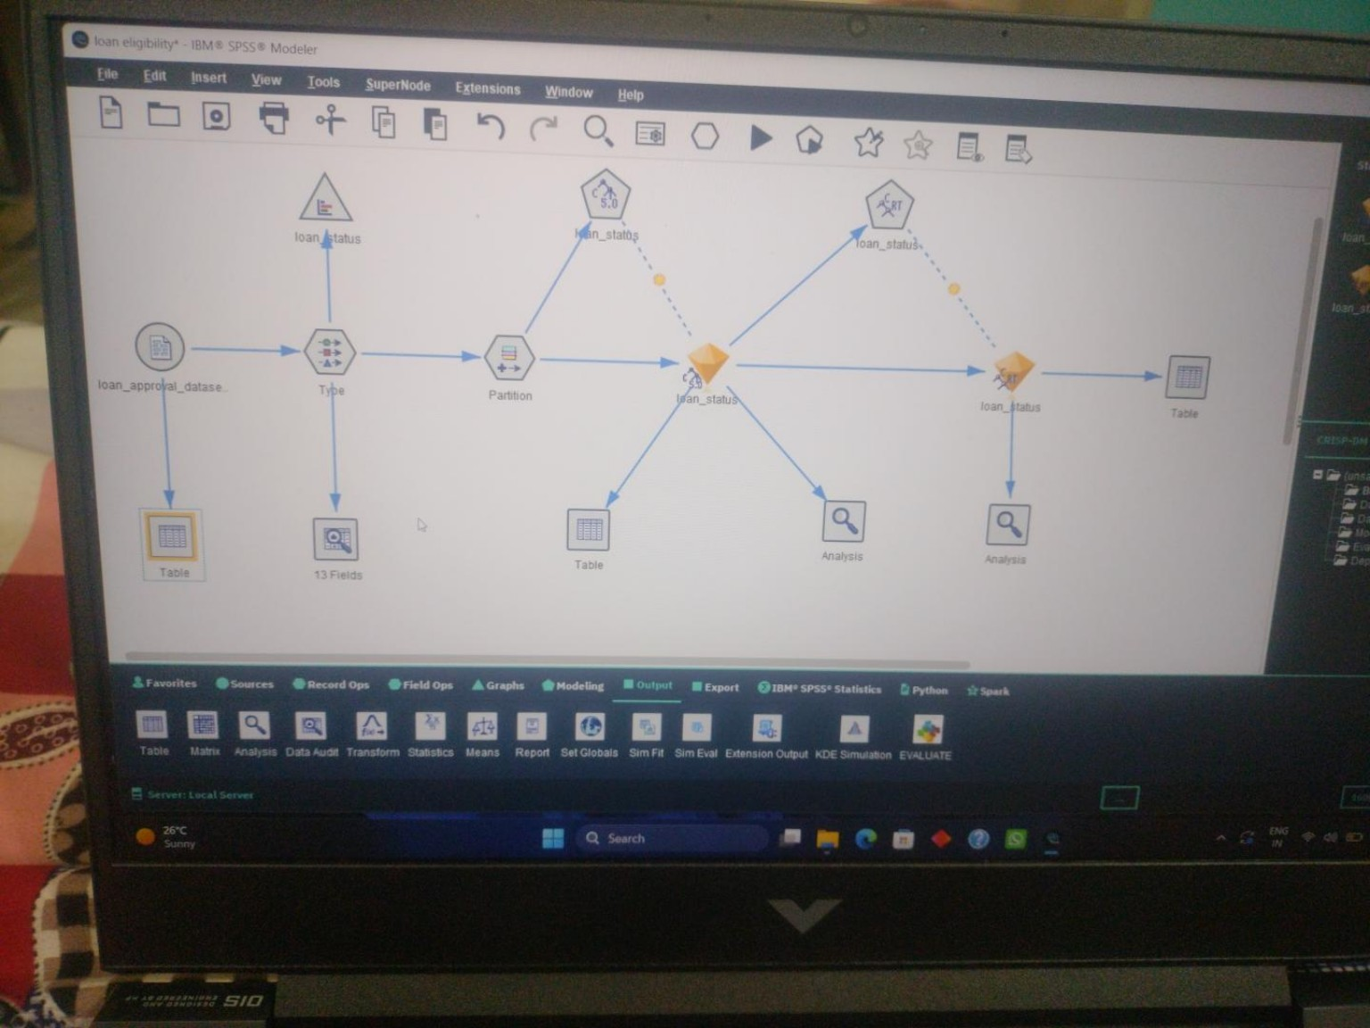
Complete SPSS Modeler Workflow
Full stream view from the project canvas
Complete stream screenshot supplied during the project discussion.
6

Slide 7
Results & Graphical Analysis
Reported C5.0 performance and target distribution
C5.0 model accuracy
Loan status distribution
TRAINING
TESTING
Approved
62.22%
99.09%
98.24%
Rejected
37.78%
Testing result: 1,287 correct (98.24%) and 23 wrong (1.76%) out of 1,310 records.
INTERPRETATION
The dataset contains more Approved than Rejected records. Distribution describes the dataset, not the model's prediction accuracy.
Important: high accuracy alone does not establish fairness, calibration, or suitability for real lending decisions.
7

Slide 8
Model Comparison & Discussion
C5.0 and C&R Tree are included in the workflow
Measure | C5.0 | C&R Tree
Model included | Yes | Yes
Reported test accuracy | 98.24% | Run Analysis and record actual result
Next comparison step | Use as baseline | Compare testing accuracy and errors
HOW TO COMPARE
TRANSPARENCY
Check test accuracy, correct/wrong counts, and whether either model overfits.
C&R Tree accuracy is not stated here because a verified result was not available in the screenshots.
Do not choose a model on accuracy alone; consider error types and business context.
8

Slide 9
Conclusion & Future Scope
CONCLUSION
FUTURE SCOPE
The project demonstrates a complete classification workflow in IBM SPSS Modeler. C5.0 achieved 98.24% testing accuracy on the reported test set.
• Validate on additional data
• Compare C5.0 and C&R Tree results
• Review false approvals/rejections
• Assess fairness and explainability
Loan status predictions can support analysis, but final lending decisions require broader checks and human oversight.
THANK YOU
Loan Eligibility Prediction | IBM SPSS Modeler 18.6

