Slide 1
Sequence Inc. Introduction for “Insert Client Logo”
Sequence, Inc
Quality and Compliance Services

Slide 2

Who is Sequence, Inc.
Quality and Compliance Services Leader in the Life Sciences Industry
.
Full-Service Quality and Compliance Service Provider
Headquartered in RTP, North Carolina
Offices in Boston and St. Louis
Provide Global Support
Business Units: Engineering, Laboratory Services, IT Compliance, Regulatory Compliance, Software Mgmt., and Technical Services.
13+ Years Serving Pharmaceutical, Biotech, Tobacco, Food, and Medical Device Manufacturers

Slide 3




















Sequence, Inc. Clients Include

Slide 4
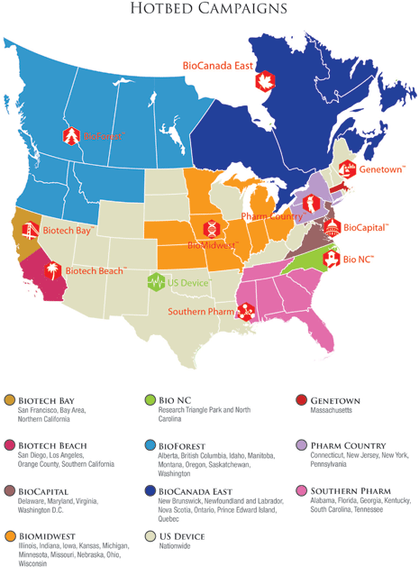
State of Sequence, Inc.
Full-Service Quality and Compliance Service Provider
Debt free and profitable from inception
11 year average revenue increase of 68% per year
3 year average revenue increase of 80% per year
Aggressive domestic growth forecast through 2020
Team of professionals who take pride in our work and care about our clients

Slide 5
Service Offerings
Software Management
Automation Design / Integration
Commissioning
Equipment/Automation Validation
Process/Cleaning/Utility Validation
Laboratory Instrument Validation
Method Validation
Tech Transfers
COTS Setup and Configuration
Requirements Gathering and Design
System Administration Support
Process Modeling/Optimization
Quality Programs and Compliance
IT Quality
Quality System Implementation
Regulatory Remediation
Internal/External Auditing
Enterprise System Validation
Compliance Assessments
Software Vendor Auditing
Laboratory Compliance
Engineering & Technical Services

Slide 6
Recent Projects
Novartis Vaccines – Greenfield Facility Startup
Becton Dickinson – Greenfield Facility Startup
Novo Nordisk – Facility Expansion
GSK – Global Serialization Compliance
bioMerieux – Facility Expansion
Hospira – Regulatory Remediation
Mallinckrodt – Global LIMS Implementation
bioMerieux – Laboratory Compliance Remediation
Bristol Myers Squibb – Process Intelligence Initiative
Biogen Idec – Laboratory Relocation

Slide 7
Relationship with “client”
Novartis Vaccines – Greenfield Facility Startup
Becton Dickinson – Greenfield Facility Startup
Novo Nordisk – Facility Expansion
GSK – Global Serialization Compliance
bioMerieux – Facility Expansion
Hospira – Regulatory Remediation
Mallinckrodt – Global LIMS Implementation
bioMerieux – Laboratory Compliance Remediation
Bristol Myers Squibb – Process Intelligence Initiative
Biogen Idec – Laboratory Relocation

Slide 8

Questions?

