Slide 1
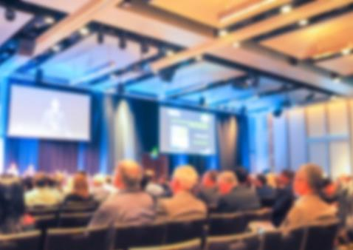


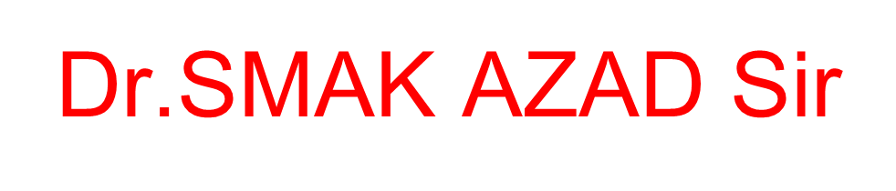
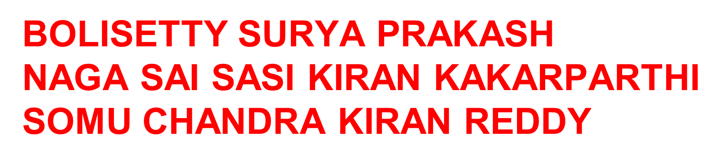

Slide 2
Movie Recommendation System Using ML
Capstone Review- I
Under Guidance of Dr.SMAK AZAD Sir
BOLISETTY SURYA PRAKASH
NAGA SAI SASI KIRAN KAKARPARTHI
SOMU CHANDRA KIRAN REDDY

Slide 3
Outline
Motivation
Abstract
Introduction
Methodology
Architecture
Gantt chart

Slide 4
Motivation
The goal of the project is to recommend a movie to the user. Providing related content out of relevant and irrelevant collection of items to users.
Enhancing the user Experience
Improving scalability
Accuracy of Recommendation system
Providing quality and relevant movie
Objectives

Slide 5
Abstract
In this hustling world, entertainment is a necessity for each one of us to refresh our mood and energy. Entertainment regains our confidence for work and we can work more enthusiastically.
For revitalising ourselves, we can listen to our preferred music or can watch movies of our choice.
For watching favourable movies online we can utilise movie recommendation systems, which are more reliable, since searching of preferred movies will require more and more time which one cannot afford to waste.
In this project, we are going to provide accurate movie recommendations based on the content the user likes the most, taking the attributes of the of the relevant movie name as a input given by user and hence using some engineering techniques to provide similar content recommendations.
Hybrid approach helps to get the advantages from both the approaches as well as tries to eliminate the drawbacks of both methods.

Slide 6
Introduction
A recommendation system or recommendation engine is a model used for information filtering where it tries to predict the preferences of a user and provide suggests based on these preferences.
These systems have become increasingly popular nowadays and are widely used today in areas such as movies, music, books, videos, clothing, restaurants, food, places and other utilities. These systems collect information about a user's preferences and then use this information to improve their suggestions in the future.
Movies are a part and parcel of life. There are different types of movies like some for entertainment, some for educational purposes, some are animated movies for children, and some are horror movies or action films.
Movies can be easily differentiated through their genres like comedy, thriller, animation, action etc. Other way to distinguish among movies can be either by releasing year, language, director etc.

Slide 7
Watching movies online, there are a number of movies to search in our most liked movies . Movie Recommendation Systems helps us to search our preferred movies among all of these different types of movies and hence reduce the trouble of spending a lot of time searching our favourable movies.
So, it requires that the movie recommendation system should be very reliable and should provide us with the recommendation of movies which are exactly same or most matched with our preferences.
A large number of companies are making use of recommendation systems to increase user interaction and enrich a user's shopping experience. Recommendation systems have several benefits, the most important being customer satisfaction and revenue. Movie Recommendation system is very powerful and important system.
But, due to the problems associated with pure collaborative approach, movie recommendation systems also suffers with poor recommendation quality and scalability issues.

Slide 8
Methodology
The approach proposed an integrative method by merging data preprocessing and vectorisation techniques to construct a movie recommendation system.
The proposed movie recommendation system gives finer similarity metrics and quality then the existing Movie recommendation system but the computation time which is less than the existing recommendation system.
This problem can be fixed by taking the clustered data points as an input dataset
The proposed approach is for improving the scalability and quality of the movie recommendation system .
We use a content based approach , by unifying Content-Based Filtering through which it can be clustered through the attributes of the input, so that the recommendations can be profited from each other.

Slide 9
Methodology
1.collecting the data sets: Collecting all the required data set from Kaggle web site.in this project we require movie.csv,ratings.csv,users.csv.
2.Data Analysis: make sure that that the collected data sets are correct and analysing the data in the csv files. i.e. checking whether all the column Fields are present in the data sets.
3.Algorithms: In our project we have only two algorithms one is cosine similarity and other is single valued decomposition are used to build the machine learning recommendation model.
4.Training and Testing the model: once the implementation of algorithm is completed . we have to train the model to get the result. We have tested it several times the model is recommend different set of movies to different users.
5.Improvements in the project: In the later stage we can implement different algorithms and methods for better recommendation.

Slide 10
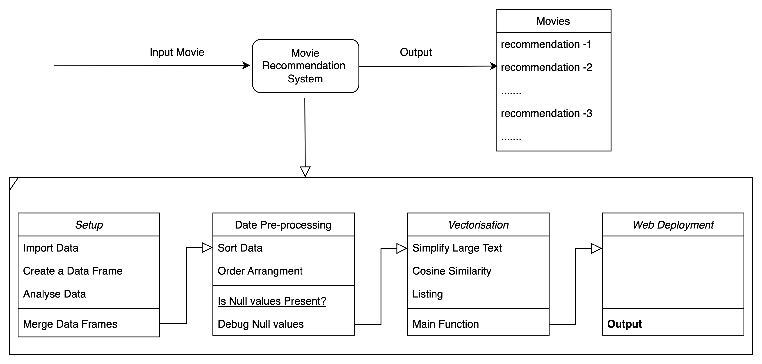
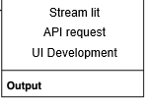
Architecture

Slide 11
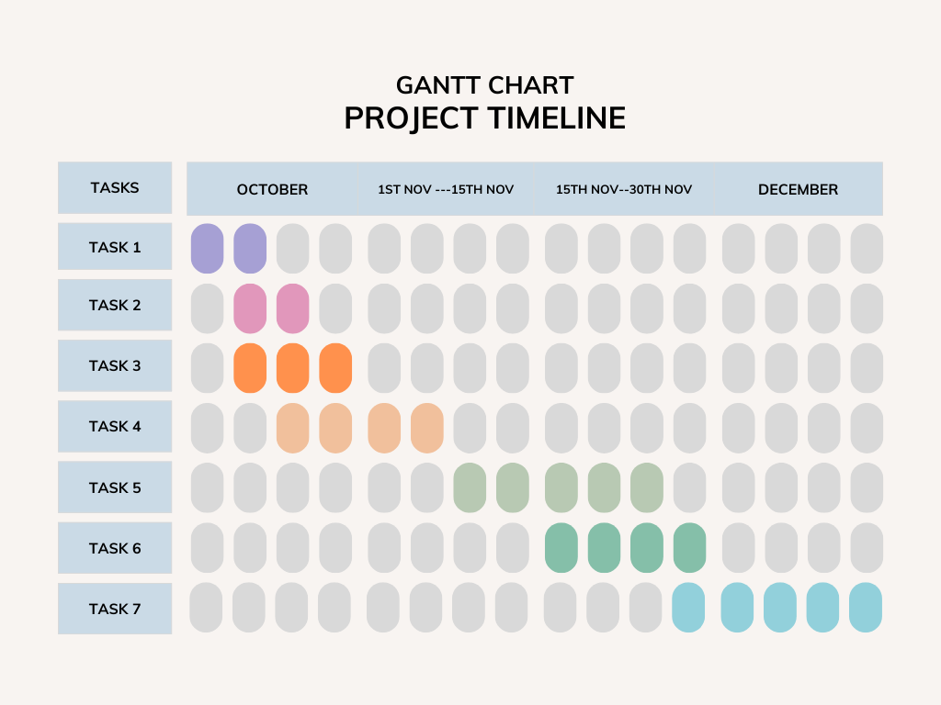
Gantt chart
Case study
Data collection
Data preprocessing
Vectorisation
Algorithm
UI
Development
Final
Deployment

Slide 12
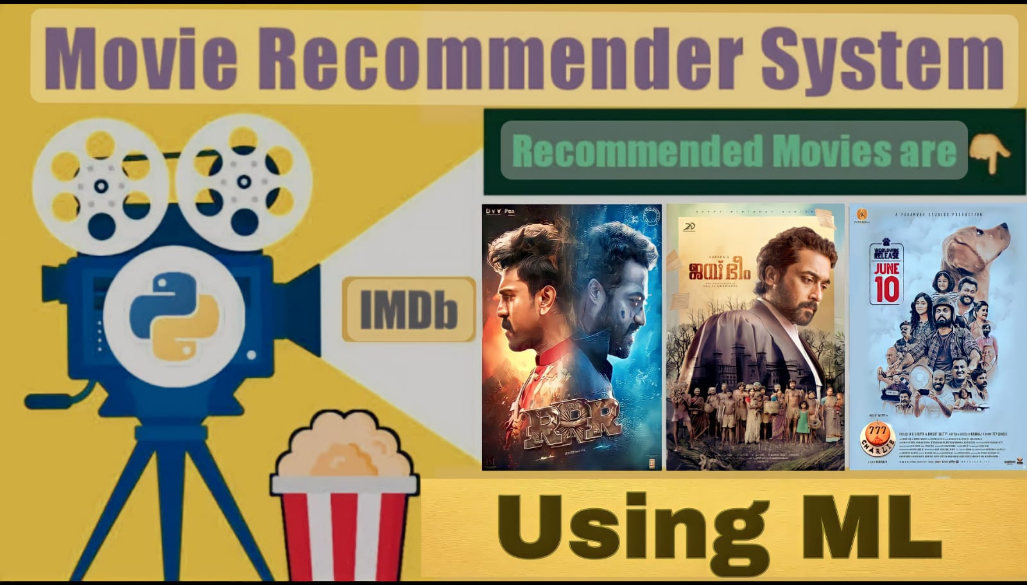

Slide 13
Thank You

