Slide 1



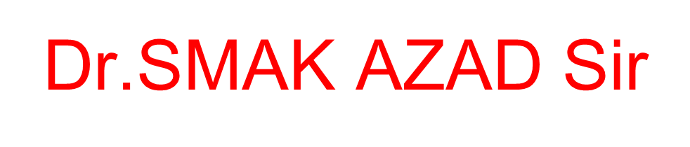


Slide 2
Movie Recommendation System Using ML
Capstone Review- Ⅱ
Under Guidance of Dr.Abdul Kalam Azad Sir
BOLISETTY SURYA PRAKASH
NAGA SAI SASI KIRAN KAKARPARTHI
SOMU CHANDRA KIRAN REDDY

Slide 3
Outline
Motivation
Abstract
Originality
Analytical Skills
Methodology
Architecture
Results & Discussions
Timeline

Slide 4
Motivation
The goal of the project is to recommend a movie to the user. Providing related content out of relevant and irrelevant collection of items to users.
Enhancing the user Experience
Improving scalability
Accuracy of Recommendation system
Providing quality and relevant movie
Objectives

Slide 5
Introduction
A recommendation system or recommendation engine is a model used for information filtering where it tries to predict the preferences of a user and provide suggests based on these preferences.
These systems have become increasingly popular nowadays and are widely used today in areas such as movies, music, books, videos, clothing, restaurants, food, places and other utilities. These systems collect information about a user's preferences and then use this information to improve their suggestions in the future.
Movies are a part and parcel of life. There are different types of movies like some for entertainment, some for educational purposes, some are animated movies for children, and some are horror movies or action films.
Movies can be easily differentiated through their genres like comedy, thriller, animation, action etc. Other way to distinguish among movies can be either by releasing year, language, director etc.

Slide 6
Originality
Factors:
The originality of a movie recommendation system using machine learning (ML) will depend on a number of factors, including the data that is used to train the system and the specific techniques and approaches that are used to build the system.
One way to increase the originality of a movie recommendation system is to use a diverse and comprehensive dataset that includes a wide variety of movies and user preferences. This can help the system to recommend a wider range of movies to users and avoid recommending the same types of movies over and over.
In addition, using innovative techniques and approaches to build the system can also increase its originality. For example, using advanced ML techniques like deep learning or incorporating additional data sources, such as social media data, can help the system to make more personalized and original recommendations to users.
Overall, the originality of a movie recommendation system using ML will depend on the efforts put into creating a diverse and comprehensive dataset and using innovative techniques to build the system

Slide 7
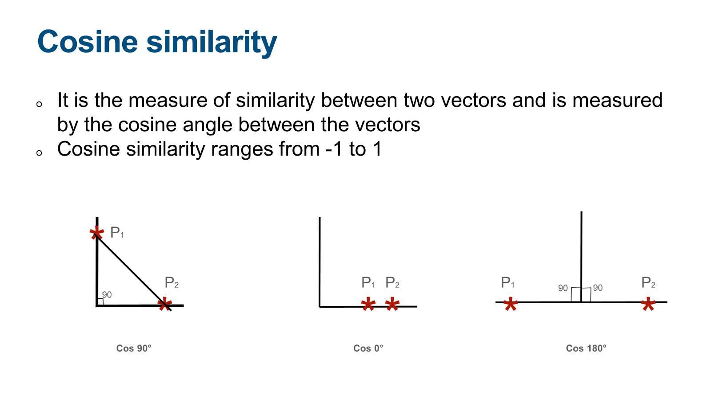
Cosine similarity

Slide 8
Cosine similarity is a measure of similarity between two vectors that is often used in recommendation systems and natural language processing tasks. Here are a few key points about how cosine similarity might be used in a movie recommendation system using machine learning with content filtering:
Vector representation of movies: In order to use cosine similarity, the movies being recommended must be represented as vectors of features or characteristics. These vectors could include features such as the genre, cast, plot summary, or ratings of the movies.
Calculating similarity: To calculate the cosine similarity between two movies, the dot product of the two movie vectors is divided by the product of their magnitudes. This results in a similarity score between 0 and 1, with higher values indicating greater similarity.
Recommendation generation: The cosine similarity scores between a given movie and all other movies in the dataset can be used to generate recommendations for the user. The movies with the highest similarity scores can be ranked and presented to the user as recommendations.
Content filtering: Cosine similarity can also potentially be used to filter out movies that contain inappropriate or offensive content. For example, the movie vectors could include a feature indicating the content rating of the movie, and the recommendation system could be configured to exclude movies with certain content ratings.
Overall, cosine similarity is a useful tool for calculating the similarity between movies in a recommendation system and can be used in combination with other techniques to generate personalized recommendations for users.

Slide 9
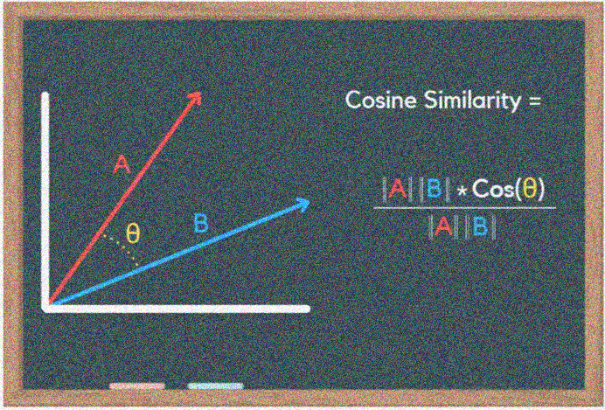
Using cosine similarity as a measure of similarity in a movie recommendation system using machine learning with content filtering is a common approach, and on its own may not necessarily contribute significantly to the originality of the project. However, there are other factors that could potentially contribute to the originality of your project, such as the specific data sources and features used as input, the evaluation metrics and results achieved, and any novel or innovative machine learning approaches or techniques that you have employed.

Slide 10
Analytical Skills
Developing a movie recommendation system using machine learning with content filtering requires a variety of analytical skills. Here are a few key areas where analytical skills might be important in this type of project:
Data analysis: Analyzing the data that will be used to build the recommendation system, including understanding the structure and content of the data, identifying any missing or inaccurate data, and cleaning and preprocessing the data as needed.
Feature selection: Identifying the most relevant and useful features to include in the movie vectors used to represent the movies in the recommendation system. This may involve selecting features based on their predictive power or relevance to the recommendation task.
Model evaluation: Evaluating the performance of the recommendation system using various metrics, such as accuracy, precision, recall, or mean squared error. This may involve designing and implementing appropriate evaluation protocols and analyzing the results to understand the strengths and limitations of the system.
Problem-solving: Identifying and addressing any challenges or issues that arise during the development of the recommendation system, such as improving the performance of the system or incorporating new features or data sources.
Overall, strong analytical skills are essential for developing a successful movie recommendation system using machine learning with content filtering, as they enable the developer to effectively analyze and understand the data, identify and implement the most appropriate approaches and techniques, and evaluate and refine the system as needed.

Slide 11
Methodology
The approach proposed an integrative method by merging data preprocessing and vectorisation techniques to construct a movie recommendation system.
The proposed movie recommendation system gives finer similarity metrics and quality then the existing Movie recommendation system but the computation time which is less than the existing recommendation system.
This problem can be fixed by taking the clustered data points as an input dataset
The proposed approach is for improving the scalability and quality of the movie recommendation system .
We use a content based approach , by unifying Content-Based Filtering through which it can be clustered through the attributes of the input, so that the recommendations can be profited from each other.

Slide 12
Methodology
1.collecting the data sets: Collecting all the required data set from Kaggle web site.in this project we require movie.csv,ratings.csv,users.csv.
2.Data Analysis: make sure that that the collected data sets are correct and analysing the data in the csv files. i.e. checking whether all the column Fields are present in the data sets.
3.Algorithms: In our project we have only two algorithms one is cosine similarity and other is single valued decomposition are used to build the machine learning recommendation model.
4.Training and Testing the model: once the implementation of algorithm is completed . we have to train the model to get the result. We have tested it several times the model is recommend different set of movies to different users.
5.Improvements in the project: In the later stage we can implement different algorithms and methods for better recommendation.

Slide 13
Data Collection
Movie Data set: https://www.kaggle.com/datasets/tmdb/tmdb-movie-metadata?select=tmdb_5000_movies.csv
Import Packages like numpy, pandas, etc
Create a data frame for the Data sets
Analyse the data
Get the first row of data set to review about columns present in the data set (dataset_name.head(1))
Merge two data frames i.e movies and credits
Merging of data frames is done based on title of the movie.

Slide 14
Data Pre-Processing
Arrange data as per requirement such as removing unwanted columns from data frame
We use genres, id, keywords, titile, overview, cast and crew
Import Ast and use ast.literal_eval( )
Using ast we simplify genres and keywords in a alphanumeric order
Removing white spaces between strings
Using Porter Stemmer removing morphological and inflexional endings

Slide 15
The code we provided is a Python script that builds a movie recommendation system using machine learning with content filtering. The script performs a number of operations to preprocess and prepare the data for use in the recommendation system, including:
Importing and merging two datasets: The script imports two datasets, tmdb_5000_movies.csv and tmdb_5000_credits.csv.
And merges them on the ‘title’ column to create a single dataset of movies cleaning and preprocessing the data: The script removes null values from the dataset, and applies a series of functions to convert various columns into lists of strings. These functions use the ‘ast’ library to parse strings containing lists of dictionaries, and extract specific values from the dictionaries.
Creating a tags column: The script concatenates the processed overview, genres, keywords, cast, and crew columns into a single tags column, which will be used as input to the recommendation system.
Stemming and tokenizing the text data: The script uses the nltk library to stem and tokenize the text data in the overview, genres, keywords, cast, and crew columns. This involves removing common morphological and inflexional endings from the words, and splitting the text into individual tokens.
Overall, the script performs a number of operations to preprocess and prepare the data for use in a movie recommendation system using machine learning with content filtering.

Slide 16
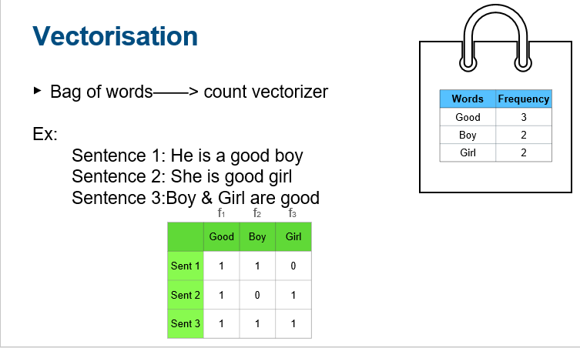

Slide 17
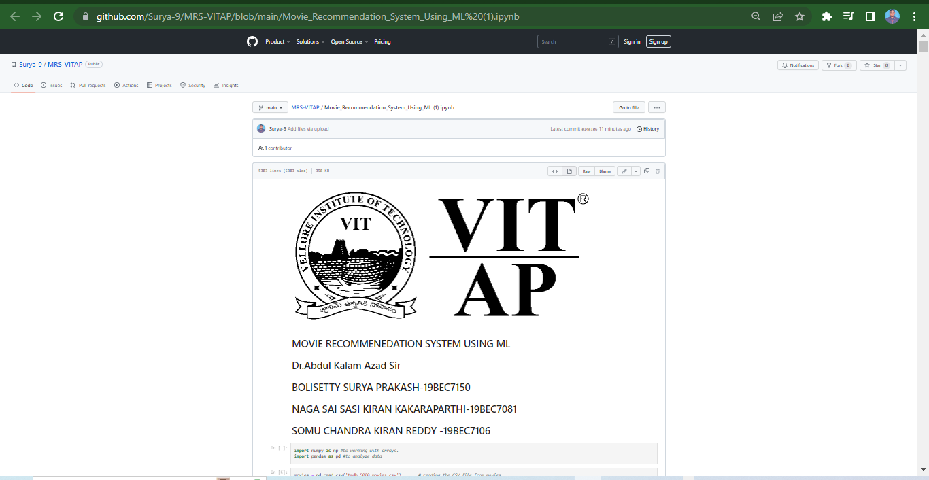
Code: (Back-End: Python)
Here I am attaching direct Python IPYNYB file URL by clicking we can get our source code. This screenshot is the URL interface
MRS_VITAP

Slide 18
Results:
The main principle of behind results are :
It looks like we have defined a function called recommend that takes in a movie title and returns a list of recommended movies. The function seems to be using a dataframe new_df that contains information about movies, and an array similarity that represents the similarity between movies.
The function first finds the index of the input movie in the dataframe using new_df[new_df['title'] == movie].index[0]. Then, it retrieves the row of similarity scores for the input movie from the similarity array using this index.
Next, the function sorts the list of movies by their similarity scores to the input movie in descending order, and returns the top five movies from this list.

Slide 19
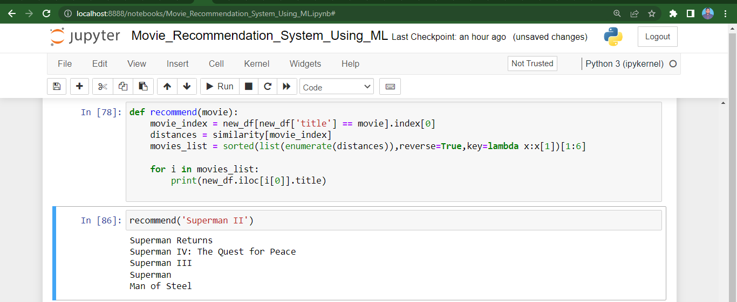
Results: Screenshots (Superman – II)

Slide 20
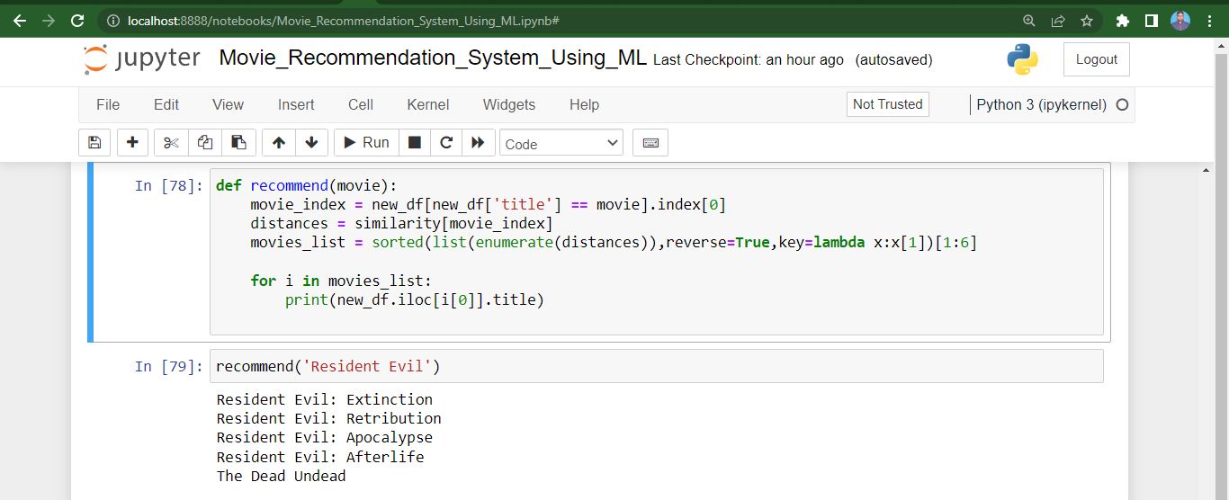
Resident Evil

Slide 21
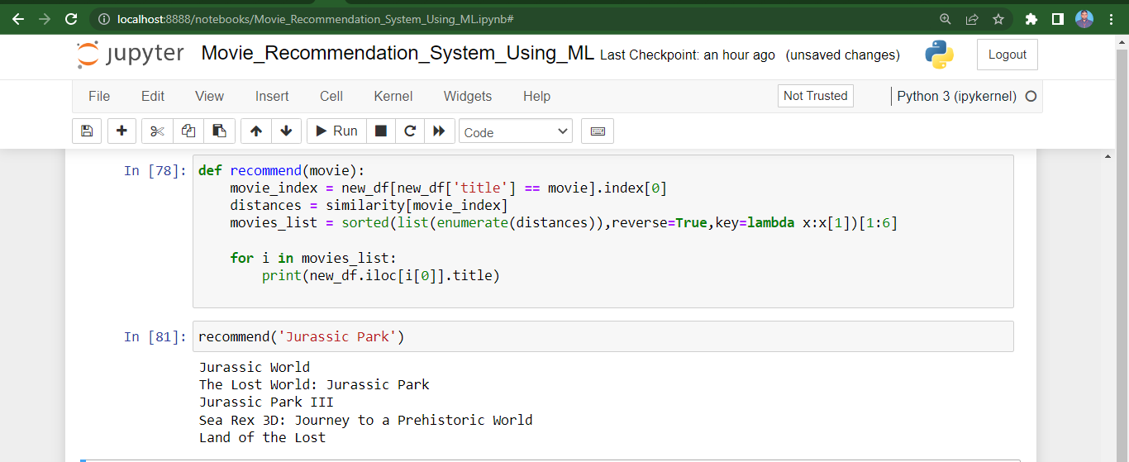
Jurassic Park

Slide 22
Discussion:
We can clearly observed that recommend function is working as intended, and is returning a list of movies that are similar to "Superman II."
The movies that are being returned are all part of the Superman film franchise, which makes sense since "Superman II" is also a part of this franchise.
Likewise , other films also , I have attached Resident Evil and Jurassic Park , the same mechanism applied through this search engines also like it will returning a list of movies that are similar to franchise and genre kind of movies.
In addition to content filtering, there are other approaches to building movie recommendation systems, such as collaborative filtering and hybrid approaches that combine elements of both content filtering and collaborative filtering.

Slide 23
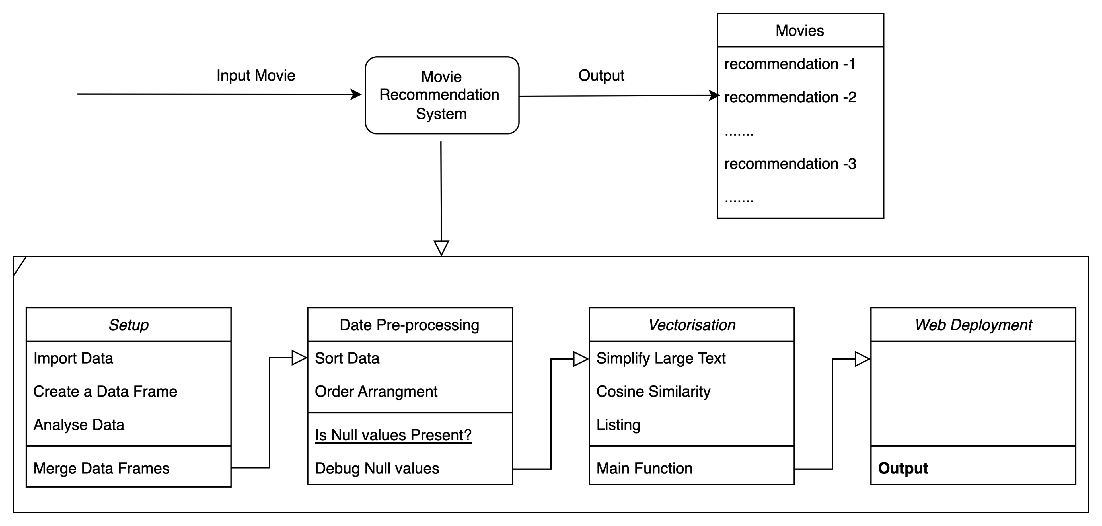
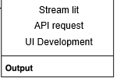
Architecture

Slide 24
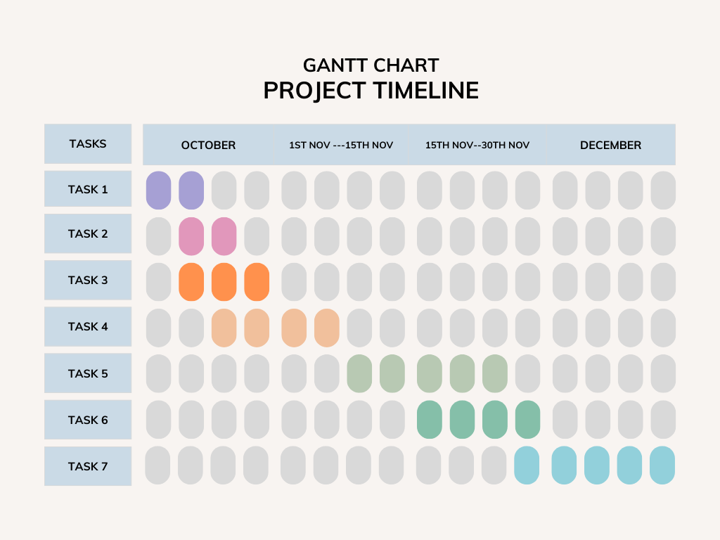
Gantt chart
Case study
Data collection
Data preprocessing
Vectorisation
Algorithm
UI
Development
Final
Deployment

Slide 25
Thank You

