Slide 1

Smart Tool for Robot-Bending Calibrated with FEM (by integrating ML-assisted path correction with a web-based interface for process control)
Team Members | Matriculation No
Arshen Joseph | 605556
Aryan Dinanath Gokhale | 605555
Mohammed Shazin Vidyanagar Fazalrahiman | 605637
Surya Nataraj Murugesan | 605528
Varun Pankaj | 605456
Under the guidance of:
Prof. Dr. Johannes Buhl Prof. Johannes Pusicha, M.Sc.
Date of Submission: 15-02-2026
IMET - Umformtechnik Metallischer Werkstoffe und Verbunde
Intelligent Forming Systems - Smart Tool for Robot-
Bending Calibrated with FEM

Slide 2
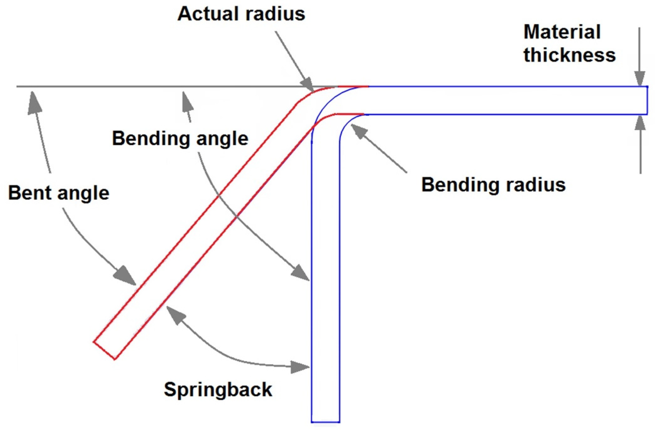
Problem Statement
Final bend angle ≠ applied tool rotation
Elastic recovery (springback) alters geometry
Trial-and-error tuning inefficient
Need calibrated relationship between tool motion and final angle
Source: MDPI-Springback Behavior of AA 7075-T6 Alloy in V-Shaped Bending
IMET - Umformtechnik Metallischer Werkstoffe und Verbunde
Intelligent Forming Systems - Smart Tool for Robot-
Bending Calibrated with FEM

Slide 3
Project Objective
FEM-based calibration of rotational bending behavior
Structured extraction of –rx and ryr dataset from parameter.k file
Inverse regression modeling for rotation prediction
Validation using RMSE within calibrated domain
Translation of predicted –rx and ryr into robot toolpath commands
Integration into interactive planning interface
IMET - Umformtechnik Metallischer Werkstoffe und Verbunde
Intelligent Forming Systems - Smart Tool for Robot-
Bending Calibrated with FEM

Slide 4
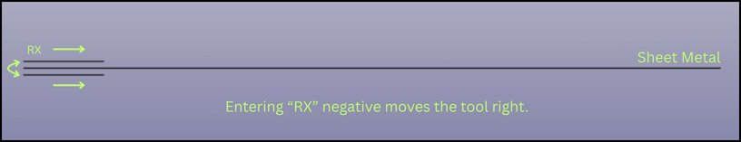
FEM Environment Setup
LS-DYNA via IMET remote platform
Sliding tool + Deformable sheet
Boundary: rx Upper Limit -10 Lower Limit -140
Controlled rotational actuation
IMET - Umformtechnik Metallischer Werkstoffe und Verbunde
Intelligent Forming Systems - Smart Tool for Robot-
Bending Calibrated with FEM

Slide 5
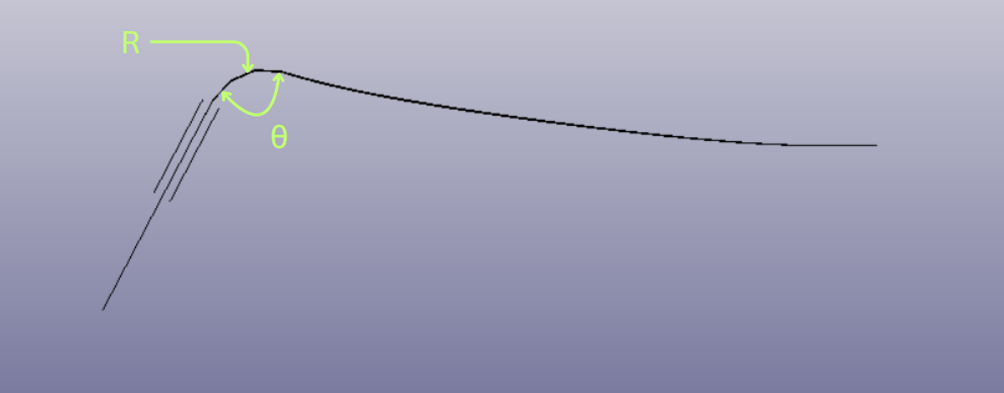
Observed Mechanical Behavior
Negative rx establishes tool-sheet contact (mm scale translation)
Rotation about Y-axis (ryr, in radians) induces bending
Resulting deformation exhibits smooth global curvature
Bending is not purely localized at a single hinge point
The curvature directly defines the inner bend radius
Behavior is consistent with continuous rotational loading
IMET - Umformtechnik Metallischer Werkstoffe und Verbunde
Intelligent Forming Systems - Smart Tool for Robot-
Bending Calibrated with FEM

Slide 6
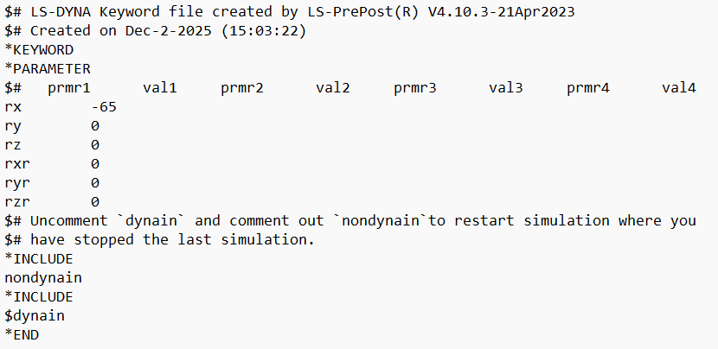
Motion Parameter Isolation Strategy
Parameter Study
Translation (rx) used to initiate tool-sheet contact
Rotation (ryr) used as primary bending actuator
All other DOF constrained to eliminate parasitic motion
Fresh simulation enforced using nondynain
IMET - Umformtechnik Metallischer Werkstoffe und Verbunde
Intelligent Forming Systems - Smart Tool for Robot-
Bending Calibrated with FEM

Slide 7
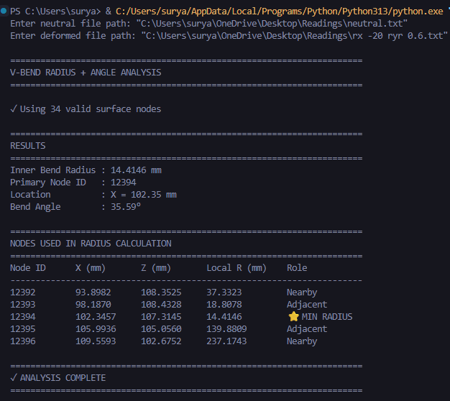
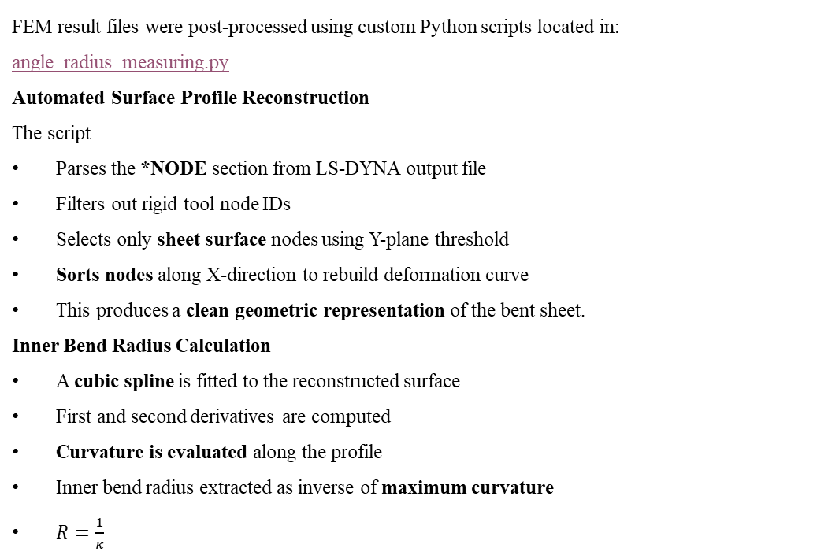
Data Extraction Method
FEM result files were post-processed using custom Python scripts located in: angle_radius_measuring.py
Automated Surface Profile Reconstruction
The script
Parses the *NODE section from LS-DYNA output file
Filters out rigid tool node IDs
Selects only sheet surface nodes using Y-plane threshold
Sorts nodes along X-direction to rebuild deformation curve
This produces a clean geometric representation of the bent sheet.
Inner Bend Radius Calculation
A cubic spline is fitted to the reconstructed surface
First and second derivatives are computed
Curvature is evaluated along the profile
Inner bend radius extracted as inverse of maximum curvature
$R=\frac{1}{κ}$
IMET - Umformtechnik Metallischer Werkstoffe und Verbunde
Intelligent Forming Systems - Smart Tool for Robot-
Bending Calibrated with FEM

Slide 8
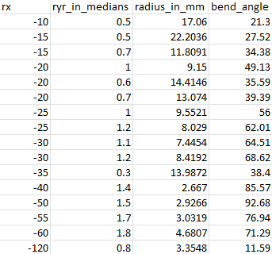
Data Distribution
Angle Response Under Combined rx–ryr Variation
Both rx (translation) and ryr (rotation) were varied
Final bend angle depends on combined contact and rotation effects
For higher penetration (more negative rx), bending response increases
Non-linear interaction observed between rx and ryr
IMET - Umformtechnik Metallischer Werkstoffe und Verbunde
Intelligent Forming Systems - Smart Tool for Robot-
Bending Calibrated with FEM

Slide 9
Forward Model (FEM → Angle Mapping)
In the LS-DYNA simulation, bending is controlled by:
rx → Tool translation (establishes contact)
ryr → Tool rotation about Y-axis (induces bending)
Each simulation produces a final bend angle after full unloading:
θfinal​=f(rx,ryr)
This relationship:
Is non-linear
Includes springback effects
Is computed numerically by FEM
(The forward mapping logic is implemented in: models
This file represents the FEM-calibrated forward behavior used for training.)
(rx, ryr)
LS-DYNA Simulation
Final Angle
IMET - Umformtechnik Metallischer Werkstoffe und Verbunde
Intelligent Forming Systems - Smart Tool for Robot-
Bending Calibrated with FEM

Slide 10
Inverse Design Requirement
Engineering Requirement
In real robot operation, the user specifies: 𝜃𝑡𝑎𝑟𝑔𝑒𝑡 ​
The system must compute : Required rotation ryr
Under defined contact condition rx
This forms the inverse problem: 𝜃𝑡𝑎𝑟𝑔𝑒𝑡→𝑟𝑒𝑞𝑢𝑖𝑟𝑒𝑑 𝑟𝑦𝑟
Why Direct Inversion Is Not Possible?
FEM produces numerical results, not equations
Relationship between rotation and angle is non-linear
Springback alters final geometry
Therefore, we use a data-driven regression approach.
(rx, ryr)
θ
Forward
θ_target
ML Model
ryr
Inverse
IMET - Umformtech
nik Metallischer Werkstoffe und Verbunde
Intelligent Forming Systems - Smart Tool for Robot-
Bending Calibrated with FEM

Slide 11
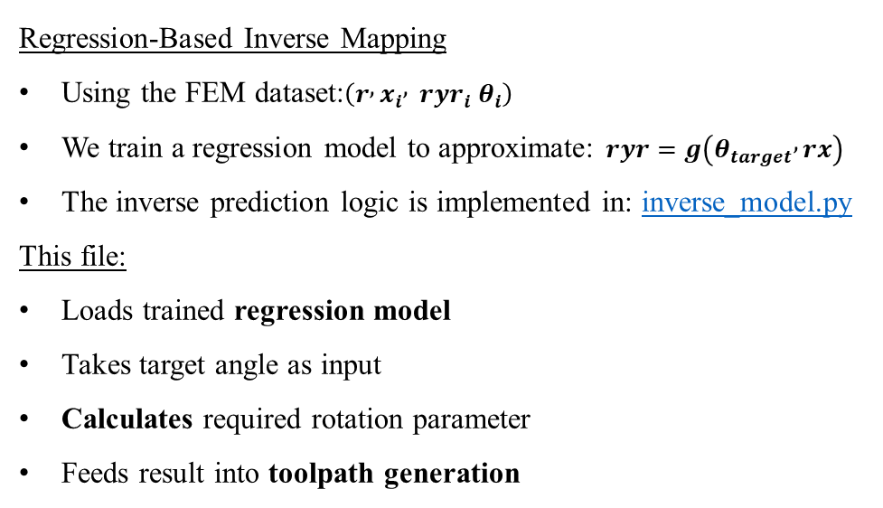
ML-Based Inverse Calculation
Regression-Based Inverse Mapping
Using the FEM dataset:$\left(r , x_{i} , ryr_{i} θ_{i}\right)$
We train a regression model to approximate: $ryr=g\left(θ_{target} , rx\right)$
The inverse prediction logic is implemented in: inverse_model.py
This file:
Loads trained regression model
Takes target angle as input
Calculates required rotation parameter
Feeds result into toolpath generation
Model performance validated using:
RMSE
R² score
Comparison with FEM ground truth
The ML model replaces repeated FEM simulations during calculation.
IMET - Umformtech
nik Metallischer Werkstoffe und Verbunde
Intelligent Forming Systems - Smart Tool for Robot-
Bending Calibrated with FEM

Slide 12
Bridging ML Output to Physical Simulation
After training the inverse regression model: θtarget​→calculated ryr
How This Calculation Is Used
User inputs desired bend angle
ML model computes required ryr
rx is kept as predefined contact baseline
Predicted ryr is written into LS-DYNA parameter file
FEM simulation can be re-run for validation
Why This Is Important
ML does not replace FEM
ML provides rapid parameter estimation
FEM remains the ground-truth validation tool
This ensures:
Physics consistency
Model accountability
Industrial applicability
IMET - Umformtech
nik Metallischer Werkstoffe und Verbunde
Intelligent Forming Systems - Smart Tool for Robot-
Bending Calibrated with FEM

Slide 13
Target Angle
Inverse_model.py
Predicted ryr
LS-DYNA Parameter File
Validated Final Geometry
Bridging ML Output to Physical Simulation
IMET - Umformtech
nik Metallischer Werkstoffe und Verbunde
Intelligent Forming Systems - Smart Tool for Robot-
Bending Calibrated with FEM

Slide 14
Toolpath Generation Logic
Once ryr is calculated:
The system translates it into structured motion commands.
Step 1 - Rotation Discretization
Instead of applying full rotation instantly:
Total calculated ryr is divided into small increments
Ensures gradual bending
Avoids unrealistic impulse loading
Example:
Predicted ryr = 1.5 rad Discretized into 10 steps:
0.15 → 0.30 → 0.45 → ... → 1.50
Step 2 - Step Sequence Construction
Each step represents:
Controlled incremental tool rotation
Applied under fixed contact condition (rx)
This produces smooth deformation progression.
Step 3 — CSV Export Format
Generated output:
step, ryr_deg
1, 0.15
2, 0.30
3, 0.45
…
Exported as: 📄 toolpath.csv
Why CSV?
Robot controllers accept structured motion sequences
Easy integration with industrial PLC systems
Transparent and editable format
IMET - Umformtech
nik Metallischer Werkstoffe und Verbunde
Intelligent Forming Systems - Smart Tool for Robot-
Bending Calibrated with FEM

Slide 15
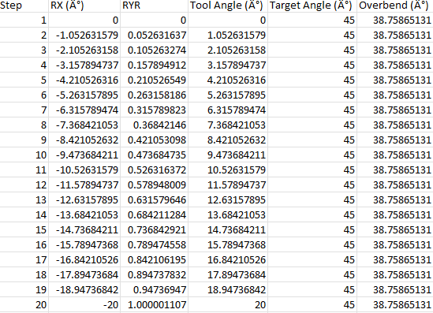
Downloaded CSV report from UI for Bend Angle 45˚
IMET - Umformtech
nik Metallischer Werkstoffe und Verbunde
Intelligent Forming Systems - Smart Tool for Robot-
Bending Calibrated with FEM

Slide 16
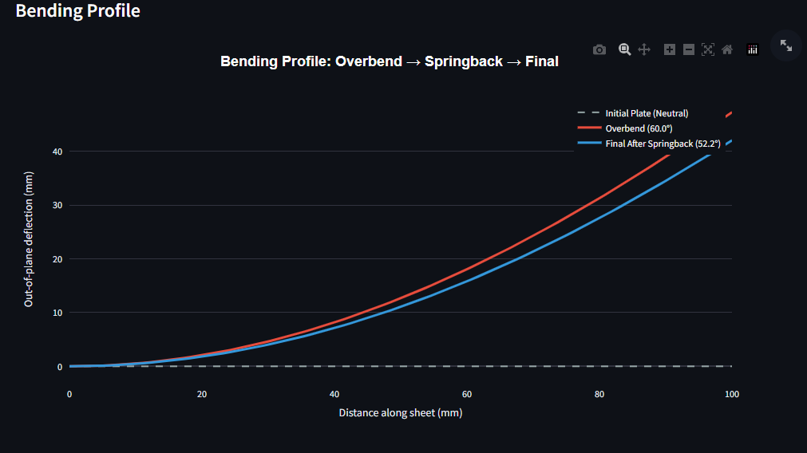
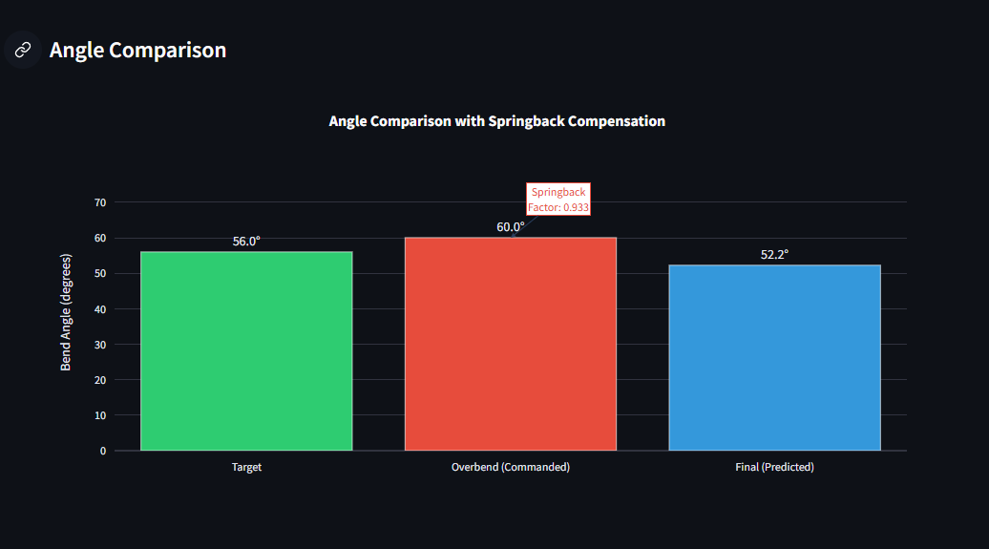
Integrated Prediction & Compensation Logic
What Happens Internally
User inputs target angle
Inverse model calculates required rotation
Forward model estimates post-springback response
Compensation logic adjusts tool command
Final relaxed angle matches target
IMET - Umformtech
nik Metallischer Werkstoffe und Verbunde
Intelligent Forming Systems - Smart Tool for Robot-
Bending Calibrated with FEM

Slide 17
Integrated Web-Based System
Deployed Interactive Application: ML Assisted Sheet Metal Bending with Springback
Application Layers
Interface Layer (Streamlit UI)
Entry point of the Streamlit application
Handles user input
Calls inverse model for prediction
Calls forward model for validation
Generates toolpath
Renders plots and tables
2. Model Layer
inverse_model.py
Predicts required rotation (RYR) from target angle
springback_model.py
Simulates forward springback response
3. Data Layer
FEM-generated calibration dataset
Trained regression models
Stored model weights
IMET - Umformtech
nik Metallischer Werkstoffe und Verbunde
Intelligent Forming Systems - Smart Tool for Robot-
Bending Calibrated with FEM

Slide 18
User Input (UI)
app.py
Inverse_model.py
Springback_model.py
Toolpath Generator
Visualization + CSV + Summary Report
IMET - Umformtech
nik Metallischer Werkstoffe und Verbunde
Intelligent Forming Systems - Smart Tool for Robot-
Bending Calibrated with FEM

Slide 19
Engineering Outcomes
Established a FEM-calibrated bending framework using controlled rx–ryr parameter variation
Automated extraction of bend angle and inner radius from LS-DYNA output
Constructed a structured dataset for supervised regression
Developed an inverse ML model for rotation prediction
Integrated compensation logic and toolpath generation into a deployable web interface
IMET - Umformtech
nik Metallischer Werkstoffe und Verbunde
Intelligent Forming Systems - Smart Tool for Robot-
Bending Calibrated with FEM

Slide 20
System Contribution
Replaces manual parameter tuning with data-driven prediction
Preserves FEM as physical ground truth
Enables rapid and reproducible bending planning
Demonstrates a scalable architecture for future material and geometry expansion
IMET - Umformtech
nik Metallischer Werkstoffe und Verbunde
Intelligent Forming Systems - Smart Tool for Robot-
Bending Calibrated with FEM

Slide 21
THANK YOU!
The End
IMET - Umformtech
nik Metallischer Werkstoffe und Verbunde
Intelligent Forming Systems - Smart Tool for Robot-
Bending Calibrated with FEM

