Slide 1
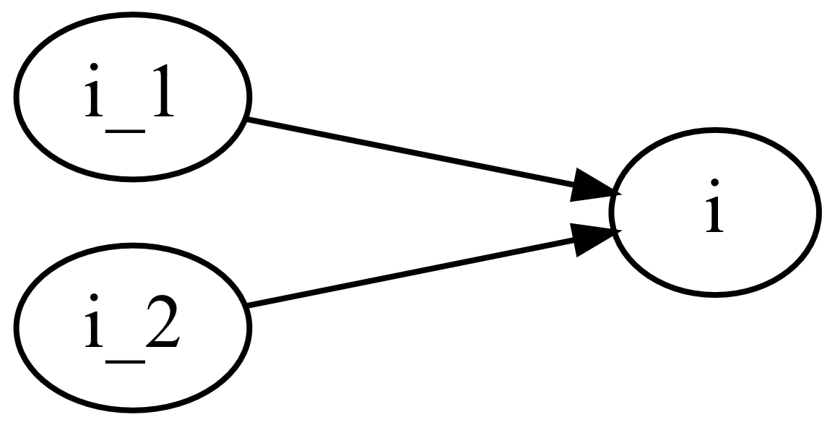
M0002_Two_stage_gear
This function calculates the total transmission ratio of a gearbox with two gear stages.
M0002_f_Two_stage_gear.m

Slide 2

M0002_Two_stage_gear
Gear ratios
$$i=i_{1}⋅i_{2}$$

