Slide 1
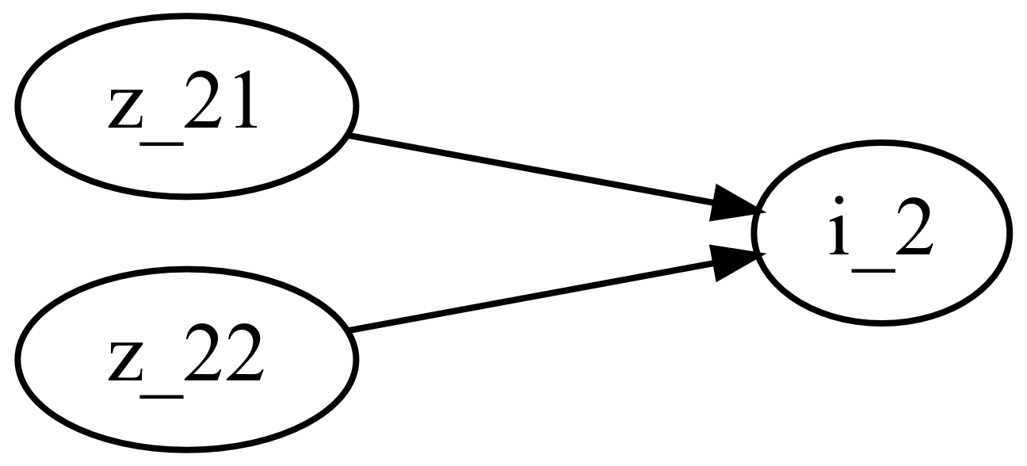
M0004_Worm_gear
This function calculates the gear ratio of a worm gear pair depending on the number of teeth of the two gears.
M0004_f_Worm_gear.m

Slide 2

M0004_Worm_gear
Number of teeth
$$i_{2}=\frac{z_{22}}{z_{21}}$$

