Slide 1
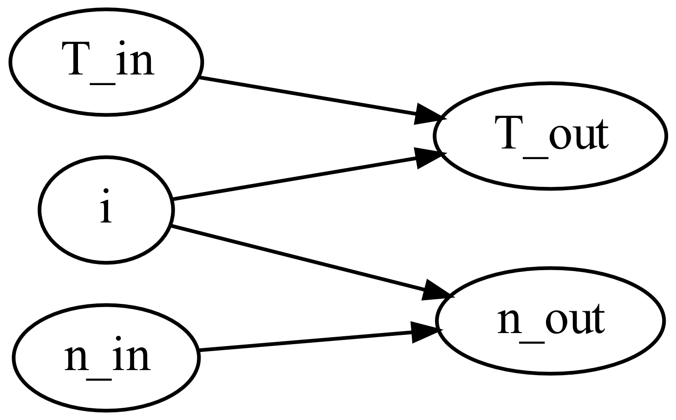
M0001_Transmission
This function calculates the output torque and rotational speed of a gearbox.
M0001_f_Transmission.m

Slide 2

M0001_Transmission
Input torque and rotational speed
Gear ratio
$$T_{out}=T_{in}⋅i$$
$$n_{out}=\frac{n_{in}}{i}$$

