Slide 1
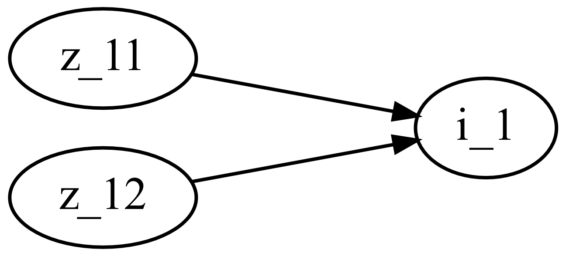
M0003_Spur_gear
This function calculates the gear ratio of a spur gear pair depending on the number of teeth of the two gears.
M0003_f_Spur_gear.m

Slide 2

M0003_Spur_gear
Number of teeth
$$i_{1}=\frac{z_{12}}{z_{11}}$$

