Slide 1

BBM Label Explorer
UPY1COB, MS/EFX-BEG, 06/24/2025

Slide 2
Introduction
A specialized tool for validating AUTOSAR/PSEC label naming conventions for variables with up-to-date BBM keywords database
Helps to create long name based on given label and vice versa
Technical Architecture
Frontend:
TypeScript/React with MUI
Backend:
Rust with Tauri framework

Slide 3
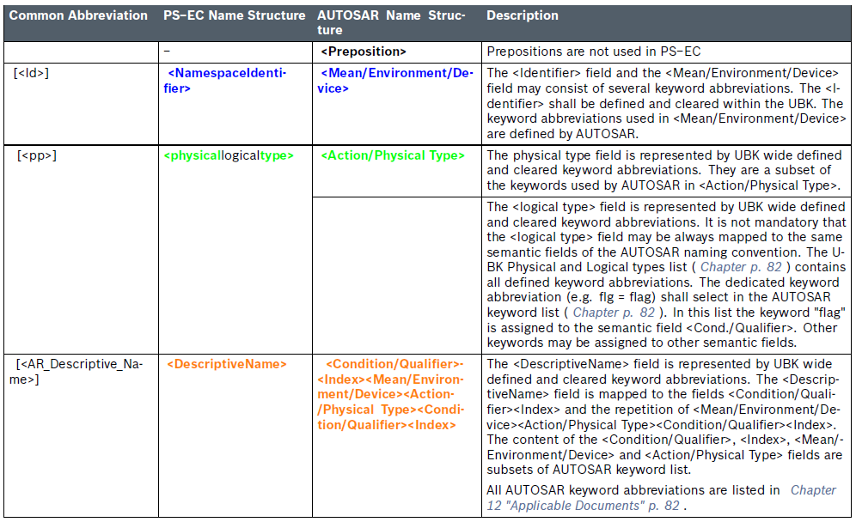
Label Structure
Label Format: `<Id>[_<pp>][<DescriptiveName>][_Ex]` [RB_tPressureControl_Ex]
Id: Identifier part (first segment)
pp: Physical Part (if present)
DescriptiveName: Descriptive part containing camelCase words
Ex: Extension part (if present)

Slide 4
Key Features

Slide 5
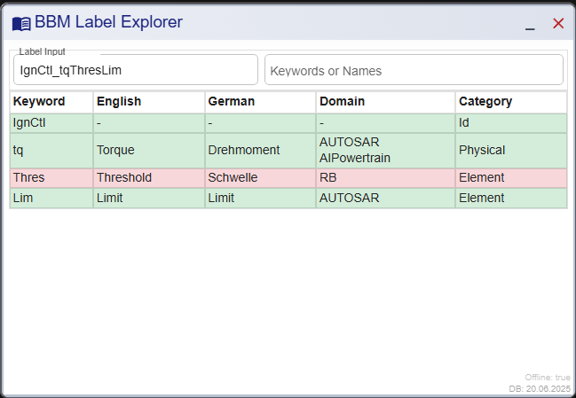
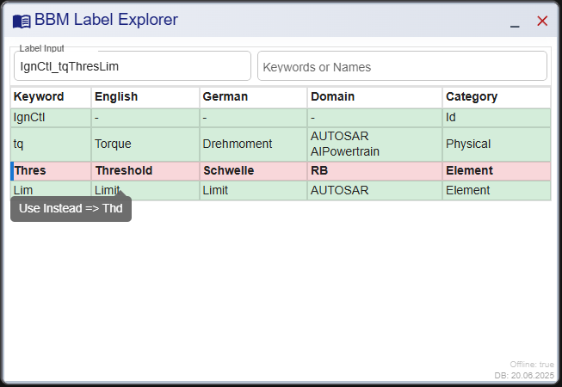
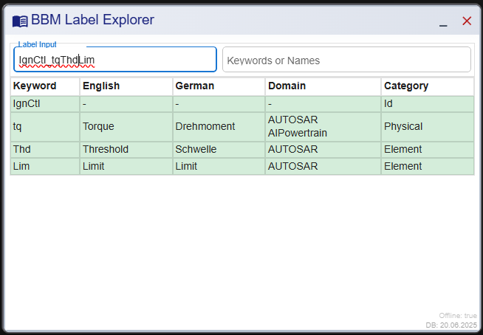
Showing suggestion in case of invalid keywords

Slide 6
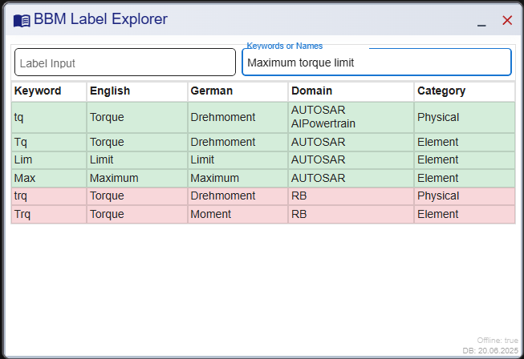
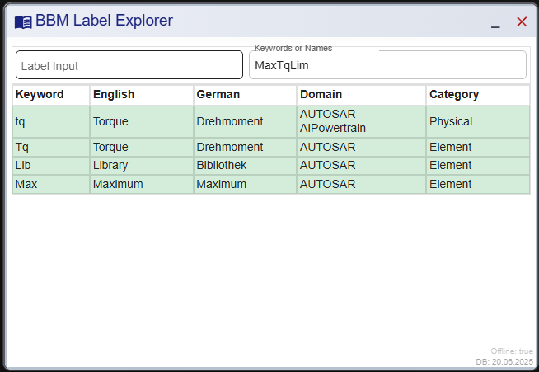
Creating label with long name and vice versa

Slide 7
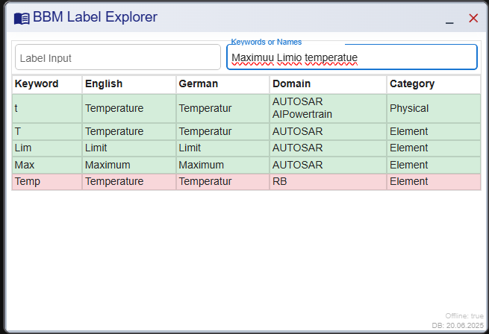
Typo tolerance

Slide 8
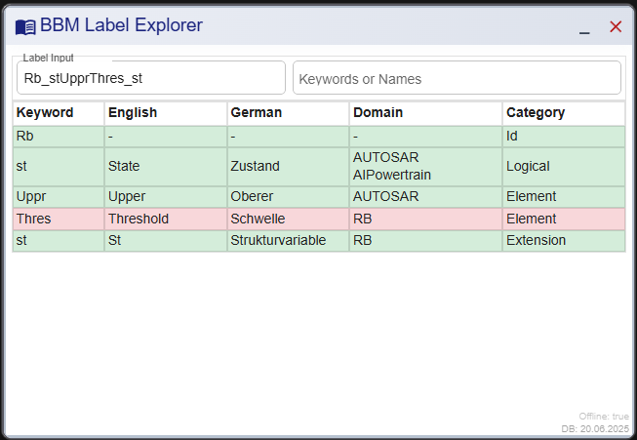
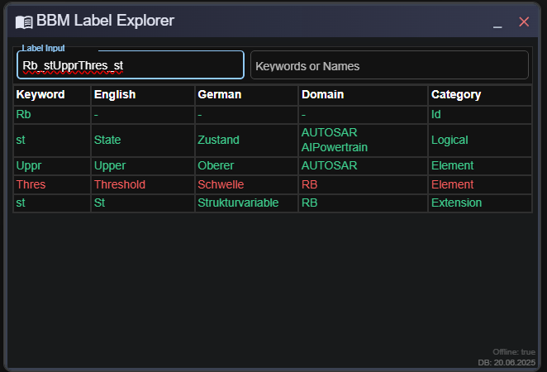
Dark/Light mode

Slide 9
Q&A

Slide 10
Thank you

