Slide 1
UNIT- III
Maximum likelihood and Bayesian parameter estimation: Introduction, maximum likelihood Estimation, Bayesian estimation, Bayesian parameter estimation–Gaussian case.

Slide 2
we saw how we could design an optimal classifier if we knew the prior probabilities P(ω_{i}) and the class-conditional densities p(x|ω_{i}).
Unfortunately, in pattern recognition applications we rarely if ever have this kind of complete knowledge about the probabilistic structure of the problem.
One approach to this problem is to use the samples to estimate the unknown probabilities and probability densities, and to use the resulting estimates as if they were the true values.
The number of available samples always seems too small, and serious problems arise when the dimensionality of the feature vector x is large. If we know the number of parameters in advance and our general knowledge about the problem permits us to parameterize the conditional densities, then the severity of these problems can be reduced significantly. Suppose, for example, that we can reasonably assume that p(x|ω_{i}) is a normal density with mean µ_{i} and covariance matrix Σ_{i} , although we do not know the exact values of these quantities.

Slide 3
This knowledge simplifies the problem from one of estimating an unknown function p(x|ω_{i}) to one of estimating the parameters µ_{i} and Σ_{i} .
Maximum Likelihood Estimation:
Maximum likelihood estimation methods have a number of attractive attributes. First, they nearly always have good convergence properties as the number of training samples increases. Further, maximum likelihood estimation often can be simpler than alternate methods, such as Bayesian techniques or other methods.
The General Principle:
Suppose that we separate a collection of samples according to class, so that we have c sets, D1, ..., Dc, with the samples in Dj having been drawn independently according to the probability law p(x|ωj ). We say such samples are i.i.d. — independent identically distributed random variables.

Slide 4
assume that p(x|ωj ) has a known parametric form, and is therefore determined uniquely by the value of a parameter vector θj.
For example, we might have p(x|ωj ) ∼ N(µj , Σj ), where θj consists of the components of µj and Σj . To show the dependence of p(x|ωj ) on θj explicitly, we write p(x|ωj ) as p(x|ωj , θj ).
Our problem is to use the information provided by the training samples to obtain good estimates for the unknown parameter vectors θ1, ..., θc associated with each category. To simplify t To simplify treatment of this problem, we shall assume that samples in Di give no information about θj if i ̸= j . — that is, we shall assume that the parameters for the different classes are functionally independent. This permits us to work with each class separately, and to simplify our notation by deleting indications of class distinctions. With this assumption we thus have c separate problems of the following form: Use a set D of training samples drawn independently from the probability density p(x|θ) to estimate the unknown parameter vector θ.

Slide 5

Suppose that D contains n samples, x1, ..., xn. Then, since the samples were drawn independently, we have
viewed as a function of θ, p(D|θ) is called the likelihood of θ with respect to the set of samples. The maximum likelihood estimate of θ is, by definition, the value θˆ that maximizes p(D|θ). Intuitively, this estimate corresponds to the value of θ that in some sense best agrees with or supports the actually observed training samples .
If p(D|θ) is a well behaved, differentiable function of θ, θˆ can be found by the standard methods of differential calculus. If the number of parameters to be set is p, then we let θ denote the p-component vector θ = (θ1, ..., θp)^{t}, and ∇_{θ} be the gradient operator

Slide 6
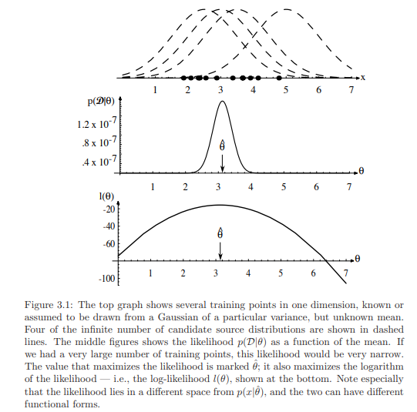

Slide 7


If p(D|θ) is a well behaved, differentiable function of θ, θˆ can be found by the standard methods of differential calculus. If the number of parameters to be set is p, then we let θ denote the p-component vector θ = (θ1, ..., θp) t , and ∇θ be the gradient operator
We define l(θ) as the log-likelihood function, l(θ) ≡ ln p(D|θ).
We can then write our solution formally as the argument θ that maximizes the log likelihood, i.e.,

Slide 8
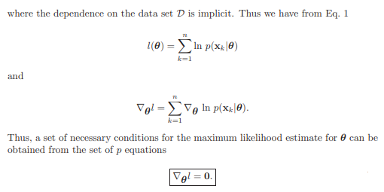
A solution θˆ to above Eq. could represent a true global maximum, a local maximum or minimum, or (rarely) an inflection point of l(θ).

Slide 9


The Gaussian Case: Unknown µ
To see how maximum likelihood methods results apply to a specific case, suppose that the samples are drawn from a multivariate normal population with mean µ and covariance matrix Σ. For simplicity, consider first the case where only the mean is unknown. Under this condition, we consider a sample point x_{k} and find:
Identifying θ with µ, we see from above equation that the maximum likelihood estimate for µ must satisfy

Slide 10

that is, each of the d components of µˆ must vanish. Multiplying by Σ and rearranging, we obtain:
The maximum likelihood estimate for the unknown population mean is just the arithmetic average of the training samples.

Slide 11
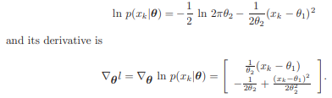

The Gaussian Case: Unknown µ and Σ
In the more general (and more typical) multivariate normal case, neither the mean µ nor the covariance matrix Σ is known. Thus, these unknown parameters constitute the components of the parameter vector θ. Consider first the univariate case with θ₁ = µ and θ₂ = σ² . Here the log-likelihood of a single point is:
By applying to the full log-likelihood leads to the conditions

Slide 12

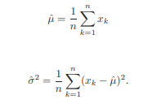
and
where ˆθ₁ and ˆθ₂ are the maximum likelihood estimates for θ₁ and θ₂, respectively. By substituting ˆµ = ˆθ₁, ˆσ² = ˆθ₂ and doing a little rearranging, we obtain the following maximum likelihood estimates for µ and σ ² :
and
While the analysis of the multivariate case is basically very similar, considerably more manipulations are involved. Just as we would predict, though, the result is that the maximum likelihood estimates for µ and Σ are given by:

Slide 13
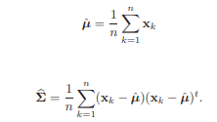
and
Thus, we find that the maximum likelihood estimate for the mean vector is the sample mean. The maximum likelihood estimate for the covariance matrix is the arithmetic average of the n matrices (x_{k} − µˆ)(x_{k} − µˆ)^{t}

Slide 14
Bayesian estimation
We now consider the Bayesian estimation or Bayesian learning approach to pattern classification problems. Although the answers we get by this method will generally be nearly identical to those obtained by maximum likelihood, there is a conceptual difference: whereas in maximum likelihood methods we view the true parameter vector we seek, θ, to be fixed, in Bayesian learning we consider θ to be a random variable, and training data allows us to convert a distribution on this variable into a posterior probability density.
The Class-Conditional Densities :
The computation of the posterior probabilities P(ωi |x) lies at the heart of Bayesian classification. Bayes’ formula allows us to compute these probabilities from the prior probabilities P(ωi) and the class-conditional densities p(x|ωi), but how can we proceed when these quantities are unknown?

Slide 15

The general answer to this question is that the best we can do is to compute P(ωi |x) using all of the information at our disposal. Part of this information might be prior knowledge, such as knowledge of the functional forms for unknown densities and ranges for the values of unknown parameters. Part of this information might reside in a set of training samples.
If we again let D denote the set of samples, then we can emphasize the role of the samples by saying that our goal is to compute the posterior probabilities P(ωi |x, D). From these probabilities we can obtain the Bayes classifier. Given the sample D, Bayes’ formula then becomes.

Slide 16

Although we could maintain this generality, we shall henceforth assume that the true values of the a priori probabilities are known or obtainable from a trivial calculation; thus we substitute P(ωi) = P(ωi |D). Furthermore, since we are treating the supervised case, we can separate the training samples by class into c subsets D1, ..., Dc, with the samples in Di belonging to ωi .
Although we could maintain this generality, we shall henceforth assume that the true values of the a priori probabilities are known or obtainable from a trivial calculation; thus we substitute P(ωi) = P(ωi |D). Furthermore, since we are treating the supervised case, we can separate the training samples by class into c subsets D1, ..., Dc, with the samples in Di belonging to ωi .

Slide 17
Second, because each class can be treated independently, we can dispense with needless class distinctions and simplify our notation. In essence, we have c separate problems of the following form: use a set D of samples drawn independently according to the fixed but unknown probability distribution p(x) to determine p(x|D). This is the central problem of Bayesian learning.
The Parameter Distribution Although the desired probability density p(x) is unknown, we assume that it has a known parametric form. The only thing assumed unknown is the value of a parameter vector θ. We shall express the fact that p(x) is unknown but has known parametric form by saying that the function p(x|θ) is completely known. Any information we might have about θ prior to observing the samples is assumed to be contained in a known prior density p(θ). Observation of the samples converts this to a posterior density p(θ|D), which, we hope, is sharply peaked about the true value of θ.

Slide 18

The Parameter Distribution
Although the desired probability density p(x) is unknown, we assume that it has a known parametric form. The only thing assumed unknown is the value of a parameter vector θ. We shall express the fact that p(x) is unknown but has known parametric form by saying that the function p(x|θ) is completely known. Any information we might have about θ prior to observing the samples is assumed to be contained in a known prior density p(θ). Observation of the samples converts this to a posterior density p(θ|D), which, we hope, is sharply peaked about the true value of θ.
Note that we are changing our supervised learning problem into an unsupervised density estimation problem. To this end, our basic goal is to compute p(x|D), which is as close as we can come to obtaining the unknown p(x). We do this by integrating the joint density p(x, θ|D) over θ. That is,

Slide 19

Where the integration extends over the entire parameter space. Now as discussed in Problem 12 we can write p(x, θ|D) as the product p(x|θ, D)p(θ|D). Since the selection of x and that of the training samples in D is done independently, the first factor is merely p(x|θ). That is, the distribution of x is known completely once we know the value of the parameter vector. Thus, Eq. 25 can be rewritten as
This key equation links the desired class-conditional density p(x|D) to the posterior density p(θ|D) for the unknown parameter vector. If p(θ|D) peaks very sharply about some value θˆ, we obtain p(x|D) ≃ p(x|θˆ), i.e., the result we would obtain by substituting the estimate θˆ for the true parameter vector. This result rests on the assumption that p(x|θ) is smooth, and that the tails of the integral are not important.
In general, if we are less certain about the exact value of θ, this equation directs us to average p(x|θ) over the possible values of θ. Thus, when the unknown densities have a known parametric form, the samples exert their influence on p(x|D) through the posterior density p(θ|D).

Slide 20
Bayesian Parameter Estimation:
Gaussian Case In this section we use Bayesian estimation techniques to calculate the a posteriori density p(θ|D) and the desired probability density p(x|D) for the case where p(x|µ) ∼ N(µ, Σ).
The Univariate Case: p(µ|D)
Consider the case where µ is the only unknown parameter. For simplicity we treat first the univariate case, i.e.,
where the only unknown quantity is the mean µ. We assume that whatever prior knowledge we might have about µ can be expressed by a known prior density p(µ). Later we shall make the further assumption that
where both µ₀ and σ₀² are known. Roughly speaking, µ₀ represents our best a priori guess for µ, and σ₀² measures our uncertainty about this guess.

Slide 21

Suppose now that n samples x1, ..., xn are independently drawn from the resulting population. Letting D = {x1, ..., xn}, we use Bayes’ formula to obtain
where α is a normalization factor that depends on D but is independent of µ. This equation shows how the observation of a set of training samples affects our ideas about the true value of µ; it relates the prior density p(µ) to an a posteriori density p(µ|D). Since p(xk|µ) ∼ N(µ, σ²) and p(µ) ∼ N(µ₀, σ₀² ), we have

Slide 22
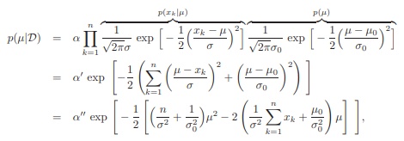
where factors that do not depend on µ have been absorbed into the constants α, α′ , and α′′. Thus, p(µ|D) is an exponential function of a quadratic function of µ, i.e., is again a normal density.

Slide 23




Since this is true for any number of training samples, p(µ|D) remains normal as the number n of samples is increased, and p(µ|D) is said to be a reproducing density and p(µ) is said to be a conjugate prior. If we write density p(µ|D) ∼ N(µ_{n}, σ_{n}² ) then µn and σ 2 n can be found by equating coefficients in above equation with corresponding coefficients in the generic Gaussian of the form:
Identifying coefficients in this way yields
a and
where ¯xn is the sample mean:

Slide 24
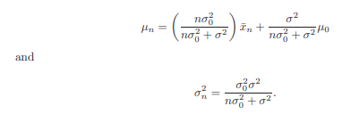

Slide 25
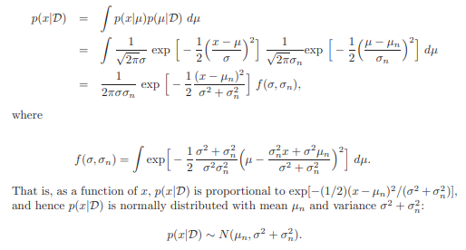
The Univariate Case: p(x|D)
Having obtained the a posteriori density for the mean, p(µ|D), all that remains is to obtain the “class-conditional” density for p(x|D)*

Slide 26
In other words, to obtain the class-conditional density p(x|D), whose parametric form is known to be p(x|µ) ∼ N(µ, σ ² ), we merely replace µ by µn and σ ² by σ² +σ²_{n} .
In effect, the conditional mean µ_{n} is treated as if it were the true mean, and the known variance is increased to account for the additional uncertainty in x resulting from our lack of exact knowledge of the mean µ.
There fore our final result:
The density p(x|D) is the desired class-conditional density p(x|ωj , Dj ), and together with the prior probabilities P(ωj ) it gives us the probabilistic information needed to design the classifier. This is in contrast to maximum likelihood methods that only make points estimates for ˆµ and ˆσ², rather that estimate a distribution for p(x|D).

Slide 27



The Multivariate Case:
The treatment of the multivariate case in which Σ is known but µ is not, is a direct generalization of the univariate case. For this reason we shall only sketch the derivation. As before, we assume that:
p(x|µ) ∼ N(µ, Σ) and p(µ) ∼ N(µ₀ , Σ₀),
where Σ, Σ₀, and µ₀ are assumed to be known. After observing a set D of n independent samples x1, ..., xn, we use Bayes’ formula to obtain:
which has the form:

Slide 28





Thus, p(µ|D) ∼ N(µ_{n}, Σ_{n}), and once again we have a reproducing density. Equating coefficients, we obtain the Eqs.
and
where µˆ_{n} is the sample mean
The solution of these equations for µ and Σ_{n} is simplified by knowledge of the matrix identity:
which is valid for any pair of nonsingular, d-by-d matrices A and B. After a little manipulation, we obtain the final results:

Slide 29



(which, as in the univariate case is a linear combination of µˆ_{n} and µ₀ ) and
The proof that p(x|D) ∼ N(µ_{n}, Σ + Σ_{n}) can be obtained as before by performing the integration
and the generalization is complete.

