Slide 1
UNIT- IV
Un-supervised learning and clustering: Introduction, mixture densities and identifiability, maximum likelihood estimates, application to normal mixtures, K-means clustering. Data description and clustering – similarity measures, criteria function for clustering.

Slide 2
Introduction:
Until now we have assumed that the training samples used to design a classifier were labeled by their category membership. Procedures that use labeled samples are said to be supervised. Now we shall investigate a number of unsupervised procedures, which use unlabeled samples.
One might wonder why anyone is interested in such an unpromising problem, and whether or not it is possible even in principle to learn anything of value from unlabeled samples.
Reasons for interest in unsupervised procedures:
i) Collecting and labeling a large set of sample patterns can be surprisingly costly. For instance, recorded speech is virtually free, but accurately labeling the speech — marking what word or phoneme is being uttered at each instant — can be very expensive and time consuming.

Slide 3
ii) Train with large amounts of (less expensive) unlabeled data, and only then use supervision to label the groupings found. This may be appropriate for large “data mining” applications where the contents of a large database are not known beforehand.
iii) Characteristics of the patterns can change slowly with time, for example in automated food classification as the seasons change. If these changes can be tracked by a classifier running in an unsupervised mode, improved performance can be achieved.
iv) we can use unsupervised methods to find features, that will then be useful for categorization. There are unsupervised methods that represent a form of data-dependent “smart preprocessing” or “smart feature extraction.”
v) In the early stages of an investigation it may be valuable to gain some insight into the nature or structure of the data. The discovery of distinct subclasses or similarities among patterns or of major departures from expected characteristics may suggest we significantly alter our approach to designing the classifier.

Slide 4

Mixture Densities and Identifiability:
We begin by assuming that we know the complete probability structure for the problem with the sole exception of the values of some parameters. To be more specific, we make the following assumptions:
The samples come from a known number c of classes.
The prior probabilities P(ωj ) for each class are known, j = 1,...,c.
The forms for the class-conditional probability densities p(x|ωj , θj ) are known, j = 1,...,c.
The values for the c parameter vectors θ1,..., θc are unknown.
The category labels are unknown.
Samples are assumed to be obtained by selecting a state of nature ωj with probability P(ωj ) and then selecting an x according to the probability law p(x|ωj , θj ). Thus, the probability density function for the samples is given by

Slide 5
where θ = (θ1,..., θc). For obvious reasons, a density function of this form is called a mixture density. The conditional densities p(x|ωj , θj ) are called the component densities, and the prior probabilities P(ωj ) are called the mixing parameters. The mixing parameters can also be included among the unknown parameters, but for the moment we shall assume that only θ is unknown.
Our basic goal will be to use samples drawn from this mixture density to estimate the unknown parameter vector θ. Once we know θ we can decompose the mixture into its components and use a Bayesian classifier on the derived densities, if indeed classification is our final goal.
Suppose that we had an unlimited number of samples, and that we used one of the nonparametric methods to determine the value of p(x|θ) for every x. If there is only one value of θ that will produce the observed values for p(x|θ), then a solution is at least possible in principle. However, if several different values of θ can produce the same values for p(x|θ), then there is no hope of obtaining a unique solution.

Slide 6

Identifiable:
A density p(x|θ) is said to be identifiable if θ != θ′ implies that there exists an x such that p(x|θ) != p(x|θ′ ).
Or in another way, a density p(x|θ) is not identifiable if we cannot recover a unique θ, even from an infinite amount of data.
In the discouraging situation where we cannot infer any of the individual parameters (i.e., components of θ), the density is completely unidentifiable.
Ex: Consider the case where x is binary and P(x|θ) is the mixture
Suppose, for example, that we know for our data that P(x = 1|θ)=0.6, and hence that P(x = 0|θ)=0.4. Then we know the function P(x|θ), but we cannot determine θ, and hence cannot extract the component distributions.

Slide 7


The most we can say is that θ1+θ2 = 1.2. Thus, here we have a case in which the mixture distribution is completely unidentifiable, and hence a case for which unsupervised learning is impossible in principle.
Maximum-Likelihood Estimates
Suppose now that we are given a set D = {x1,..., xn} of n unlabeled samples drawn independently from the mixture density.
where the full parameter vector θ is fixed but unknown. The likelihood of the observed samples is, by definition, the joint density
The maximum-likelihood estimate θˆ is that value of θ that maximizes p(D|θ).

Slide 8




If we assume that p(D|θ) is a differentiable function of θ, then we can derive some interesting necessary conditions for θˆ. Let l be the logarithm of the likelihood, and let ∇θi l be the gradient of l with respect to θi . Then
and
If we assume that the elements of θi and θj are functionally independent if i != j, and if we introduce the posterior probability
The gradient of the log-likelihood can be written in the form:

Slide 9


Since the gradient must vanish at the value of θi that maximizes l, the maximum likelihood estimate θˆ i must satisfy the conditions
Among the solutions to these equations for θˆi we may find the maximum-likelihood solution. In this case the search for the maximum value of p(D|θ) extends over θ and P(ωi), subject to the constraints:
P(ωi) ≥ 0 , i = 1,...,c and
Let Pˆ(ωi) be the maximum-likelihood estimate for P(ωi), and let θˆ_{i} be the maximum likelihood estimate for θi. It can be shown that if the likelihood function is differentiable and if Pˆ(ωi) != 0 for any i, then Pˆ(ωi) and θˆ_{i} must satisfy:

Slide 10



and
where

Slide 11

Application to Normal Mixtures
It is enlightening to see how these general results apply to the case where the component densities are multivariate normal, p(x|ωi,θi)∼N(µi,Σi). The following table illustrates a few of the different cases that can arise depending upon which parameters are known (×) and which are unknown (?):
Case 1: Unknown Mean Vectors
If the only unknown quantities are the mean vectors µi, then of course θi consists of the components of µi. Since the likelihood is:
Its derivative is:

Slide 12



The maximum-likelihood estimate µˆ_{i} must satisfy
After multiplying by Σi and rearranging terms, we obtain the solution:
Where
with p(x|ωi,µˆ_{i} )∼N(µˆ_{i},Σi), we obtain a tangled snarl of coupled simultaneous nonlinear equations. These equations usually do not have a unique solution, and we must test the solutions we get to find the one that actually maximizes the likelihood.

Slide 13

If we have some way of obtaining fairly good initial estimates µˆ_{i}(0) for the unknown means, the following iterative scheme for improving the estimates:
This is basically a gradient ascent or hill-climbing procedure for maximizing the log likelihood function. If the overlap between component densities is small, then the coupling between classes will be small and convergence will be fast.

Slide 14



Case 2: All Parameters Unknown
If µi , Σi , and P(ωi) are all unknown, and if no constraints are placed on the covariance matrix, then the maximum-likelihood principle yields useless singular solutions. The reason for this can be appreciated from the following simple example in one dimension. Let p(x|µ,σ² ) be the two-component normal mixture:
The likelihood function for n samples drawn from this probability density is merely the product of the n densities p(x_{k}|µ,σ² ). Suppose that we let µ = x₁, the value of the first sample. In this situation the density is
For the rest of the samples:

Slide 15


So that:
Thus, the first term at the right shows that by letting σ approach zero we can make the likelihood arbitrarily large, and the maximum-likelihood solution is singular. Normally, singular solutions are of no interest, and we are forced to conclude that the maximum-likelihood principle fails for this class of normal mixtures.
When we include the elements of Σi in the elements of the parameter vector θi , we must remember that only half of the off-diagonal elements are independent. In addition, it turns out to be much more convenient to let the independent elements of Σ⁻¹_{i} rather than Σi be the unknown parameters. With these observations, the actual differentiation of
with respect to the elements of µi and Σ⁻¹_{i} is relatively routine.

Slide 16


Let x_{p}(k) be the p^{th} element of x_{k}, µ_{p}(i) be the p^{th} element of µ_{i} , σ_{pq}(i) be the pq^{th} element of Σ_{i} , and σ^{pq}(i) be the pq^{th} element of Σ⁻¹_{i}. Then differentiation gives:
and
where δ_{pq} is the Kronecker delta. We substitute these results in above equations and perform a small amount of algebraic manipulation and thereby obtain the following equations for the local-maximum-likelihood estimate µˆ_{i} , Σˆ_{i} , and Pˆ(ω_{i}):

Slide 17
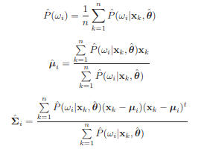
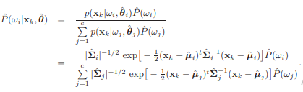
where

Slide 18

K-means clustering :
Of the various techniques that can be used to simplify the computation and accelerate convergence, we shall briefly consider one elementary, approximate method.
We know that the probability Pˆ(ωi |xk, θˆ) is large when the squared Mahalanobis distance (x_{k} − µˆ_{i} )^{t}Σˆ⁻¹_{i} (x_{k} − µˆ_{i} ) is small. Suppose that we merely compute the squared Euclidean distance ∥x_{k}− µˆ_{i}∥² , find the mean µˆ_{m} nearest to x_{k}, and approximate Pˆ(ω_{i}|x_{k}, θˆ) as
Then the iterative application leads to the following procedure for finding µˆ₁ ,..., µˆ_{c} .

Slide 19
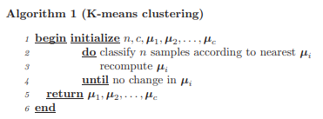
The computational complexity of the algorithm is O(ndcT) where d the number of features and T the number of iterations. In practice, the number of iterations is generally much less than the number of samples.

Slide 20
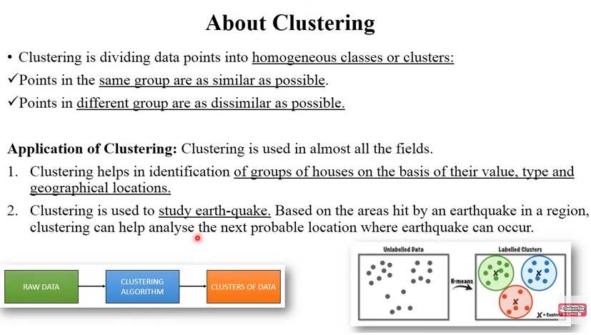

Slide 21
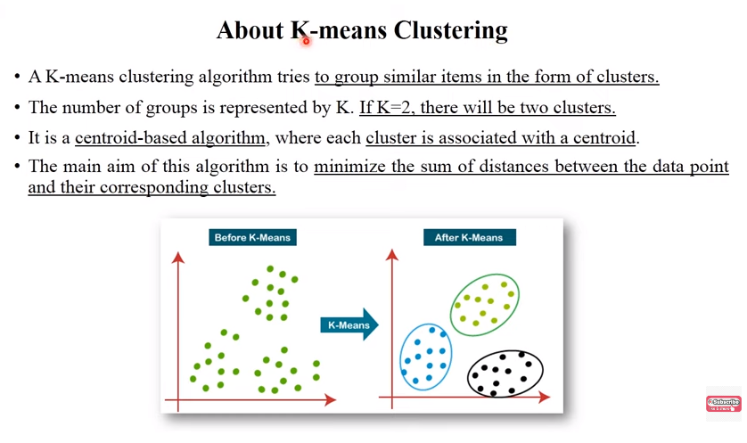

Slide 22
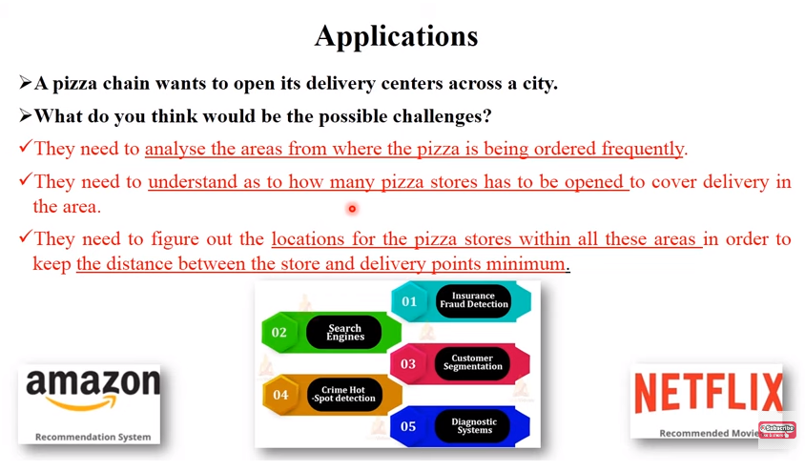

Slide 23
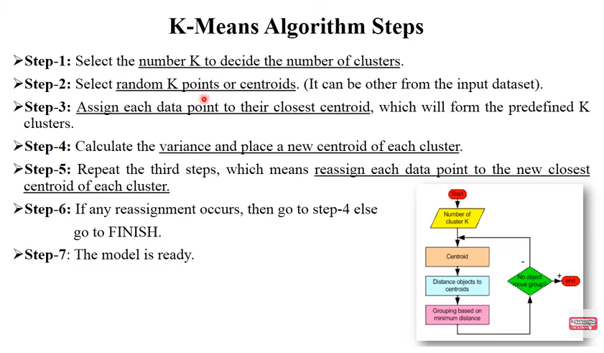

Slide 24
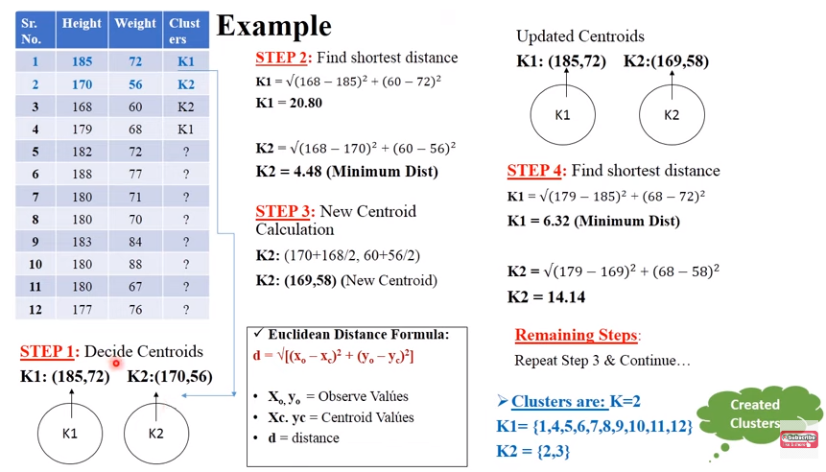

Slide 25
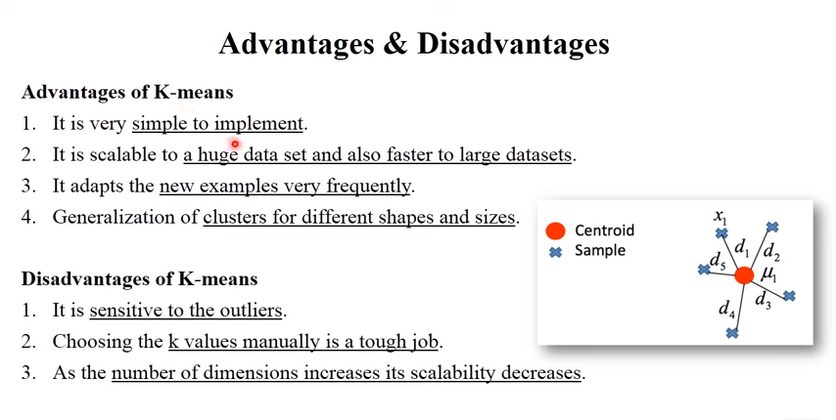

Slide 26
Data Description and Clustering :
Let us reconsider our original problem of learning something of use from a set of unlabeled samples. Suppose that we knew that these points came from a single normal distribution. Then the most we could learn form the data would be contained in the sufficient statistics — the sample mean and the sample covariance matrix.
The sample mean locates the center of gravity of the cloud; it can be thought of as the single point m that best represents all of the data in the sense of minimizing the sum of squared distances from m to the samples. The sample covariance matrix describes the amount the data scatters along various directions.
If the data points are actually normally distributed, then the cloud has a simple hyperellipsoidal shape, and the sample mean tends to fall in the region where the samples are most densely concentrated.
if the samples are not normally distributed, these statistics can give a very misleading description of the data. Bellow Figure shows four different data sets that all have the same mean and covariance matrix. Obviously, second-order statistics are incapable of revealing all of the structure in an arbitrary set of data

Slide 27
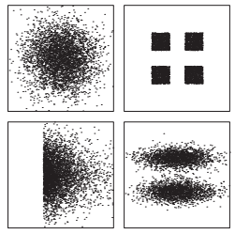
Figure: These four data sets have identical statistics up to second-order, i.e., the same mean µ and covariance Σ. In such cases it is important to include in the model more parameters to represent the structure more completely.
If we assume that the samples come from a mixture of c normal distributions, we can approximate a greater variety of situations. This corresponds to assuming that the samples fall in hyperellipsoidally shaped clouds of various sizes and orientations.

Slide 28
If the number of component densities is sufficiently high, we can approximate virtually any density function as a mixture model in this way, and use the parameters of the mixture to describe the data.
One alternative is to use one of the nonparametric methods described to estimate the unknown mixture density. If accurate, the resulting estimate is certainly a complete description of what we can learn from the data.
If the goal is to find subclasses, a more direct alternative is to use a clustering procedure. Roughly speaking, clustering procedures yield a data description in terms of clusters or groups of data points that possess strong internal similarities.
Formal clustering procedures use a criterion function, such as the sum of the squared distances from the cluster centers, and seek the grouping that extremizes the criterion function.

Slide 29
Similarity Measures:
Once we describe the clustering problem as one of finding natural groupings in a set of data, we are obliged to define what we mean by a natural grouping. In what sense are we to say that the samples in one cluster are more like one another than like samples in other clusters? This question actually involves two separate issues:
• How should one measure the similarity between samples?
• How should one evaluate a partitioning of a set of samples into clusters?
The most obvious measure of the similarity (or dissimilarity) between two samples is the distance between them. One way to begin a clustering investigation is to define a suitable distance function and compute the matrix of distances between all pairs of samples. If distance is a good measure of dissimilarity, then one would expect the distance between samples in the same cluster to be significantly less than the distance between samples in different clusters.

Slide 30
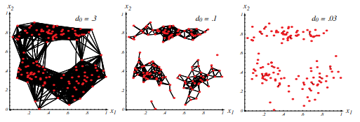
Suppose for the moment that we say that two samples belong to the same cluster if the Euclidean distance between them is less than some threshold distance d0. It is immediately obvious that the choice of d0 is very important. If d0 is very large, all of the samples will be assigned to one cluster. If d0 is very small, each sample will form an isolated, singleton cluster. To obtain “natural” clusters, d0 will have to be greater than the typical within-cluster distances and less than typical between-cluster distances
Figure 10.6: The distance threshold affects the number and size of clusters. Lines are drawn between points closer than a distance d0 apart for three different values of d0 — the smaller the value of d0, the smaller and more numerous the clusters.

Slide 31
One way to achieve invariance is to normalize the data prior to clustering. For example, to obtain invariance to displacement and scale changes, one might translate and scale the axes so that all of the features have zero mean and unit variance — standardize the data. To obtain invariance to rotation, one might rotate the axes so that they coincide with the eigenvectors of the sample covariance matrix. This transformation to principal components can be preceded and/or followed by normalization for scale.
However, we should not conclude that this kind of normalization is necessarily desirable. Consider, for example, the matter of translating and whitening — scaling the axes so that each feature has zero mean and unit variance. The rationale usually given for this normalization is that it prevents certain features from dominating distance calculations merely because they have large numerical values, much as we saw in networks trained with back propagation

Slide 32

More generally, one can abanInstead of scaling axes, we can change the metric in interesting ways. For instance, one broad class of distance metrics is of the form
where q ≥ 1 is a selectable parameter — the general Minkowski metric we considered metric in Setting q = 2 gives the familiar Euclidean metric while setting q = 1 the Manhattan or city block metric — the sum of the absolute distances along each city block metric of the d coordinate axes. Note that only q = 2 is invariant to an arbitrary rotation or.don the use of distance altogether and introduce a nonmetric similarity function s(x, x ′ ) to compare two vectors x and x ′ . Convention- similarity ally, this is a symmetric functions whose value is large when x and x function ′ are somehow “similar.” For example, when the angle between two vectors is a meaningful measure of their similarity, then the normalized inner product

Slide 33



Thus, s(x, x ′ ) is a measure of the relative possession of common attributes. Some simple variations are
the fraction of attributes shared, and
the ratio of the number of shared attributes to the number possessed by x or x′ .

Slide 34

Criterion Functions for Clustering:
We have just considered the first major issue in clustering: how to measure “similarity.” Now we turn to the second major issue: the criterion function to be optimized. Suppose that we have a set D of n samples x₁,..., x_{n} that we want to partition into exactly c disjoint subsets D₁,..., D_{c}. Each subset is to represent a cluster, with samples in the same cluster being somehow more similar than samples in different clusters. One way to make this into a well-defined problem is to define a criterion function that measures the clustering quality of any partition of the data. Then the problem is one of finding the partition that extremizes the criterion function.
The Sum-of-Squared-Error Criterion:
The simplest and most widely used criterion function for clustering is the sum-of squared-error criterion. Let ni be the number of samples in Di and let mi be the mean of those samples,

Slide 35

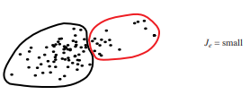

Then the sum-of-squared errors is defined by
This criterion function has a simple interpretation: for a given cluster Di , the mean vector mi is the best representative of the samples in Di in the sense that it minimizes the sum of the squared lengths of the “error” vectors x − mi in Di . Thus, Je measures the total squared error incurred in representing the n samples x1,..., xn by the c cluster centers m1,..., mc. The value of Je depends on how the samples are grouped into clusters and the number of clusters; the optimal partitioning is defined as one that minimizes Je. Clusterings of this type are often called minimum variance minimum partitions.

Slide 36


ii) Related Minimum Variance Criteria:
By some simple algebraic manipulation we can eliminate the mean vectors from the expression for Je and obtain the equivalent expression
Where
This equation leads us to interpret ¯s_{i} as the average squared distance between points in the i^{th} cluster, and emphasizes the fact that the sum-of-squared-error criterion uses Euclidean distance as the measure of similarity. It also suggests an obvious way of obtaining other criterion functions.
Ex: one can replace ¯si by the average, the median, or perhaps the maximum distance between points in a cluster.

Slide 37


More generally, one can introduce an appropriate similarity function s(x, x′ ) and replace ¯s_{i} by functions such as:
(OR)

Slide 38
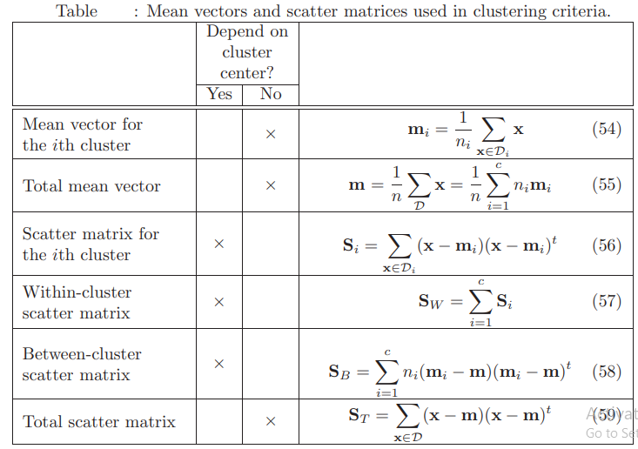

Slide 39
iii) Scattering Criteria
The scatter matrices Another interesting class of criterion functions can be derived from the scatter matrices used in multiple discriminant analysis.
It follows from these definitions that the total scatter matrix is the sum of the within-cluster scatter matrix and the between-cluster scatter matrix: ST = SW + SB
Note: The total scatter matrix does not depend on how the set of samples is partitioned into clusters; it depends only on the total set of samples.
The within-cluster and between-cluster scatter matrices taken separately do depend on the partitioning, of course. Roughly speaking, there is an exchange between these two matrices, the between-cluster scatter going up as the within-cluster scatter goes down. This is fortunate, since by trying to minimize the within-cluster scatter we will also tend to maximize the between-cluster scatter.

Slide 40

To be more precise in talking about the amount of within-cluster or between cluster scatter, we need a scalar measure of the “size” of a scatter matrix. The two measures that we shall consider are the trace and the determinant. In the univariate case, these two measures are equivalent, and we can define an optimal partition as one that minimizes SW or maximizes SB. In the multivariate case things are somewhat more complicated, and a number of related but distinct optimality criteria have been suggested.
The Trace Criterion :
Perhaps the simplest scalar measure of a scatter matrix is its trace — the sum of its diagonal elements. Roughly speaking, the trace measures the square of the scattering radius, since it is proportional to the sum of the variances in the coordinate directions. Thus, an obvious criterion function to minimize is the trace of S_{W} .

Slide 41

Since trS_{T} = trS_{W} +trS_{B} and trS_{T} is independent of how the samples are partitioned, we see that no new results are obtained by trying to maximize trS_{B}. However, it is comforting to know that in seeking to minimize the within-cluster criterion Je = trS_{W} we are also maximizing the between-cluster criterion.
The Determinant Criterion:
We use the determinant of the scatter matrix to obtain a scalar measure of scatter. Roughly speaking, the determinant measures the square of the scattering volume, since it is proportional to the product of the variances in the directions of the principal axes. Since S_{B} will be singular if the number of clusters is less than or equal to the dimensionality, |S_{B}| is obviously a poor choice for a criterion function.

Slide 42

However, if we assume that S_{W} is nonsingular, we are led to consider the determinant criterion function:
The partition that minimizes Jd is often similar to the one that minimizes Je, but the two need not be the same.
Invariant Criteria
It is not particularly hard to show that the eigen values λ₁,..., λ_{d} of S⁻¹_{W} S_{B} are invariant under nonsingular linear transformations of the data. Indeed, these eigen values are the basic linear invariants of the scatter matrices. Their numerical values measure the ratio of between-cluster to within-cluster scatter in the direction of the eigenvectors, and partitions that yield large values are usually desirable. the fact that the rank of S_{B} can not exceed c−1 means that no more than c−1 of these eigen values can be nonzero. Nevertheless, good partitions are ones for which the nonzero eigenvalues are large.

Slide 43



One can invent a great variety of invariant clustering criteria by composing appropriate functions of these eigenvalues. Some of these follow naturally from standard matrix operations. For example, since the trace of a matrix is the sum of its eigenvalues, one might elect to maximize the criterion function:
By using the relation S_{T} = S_{W}+ S_{B}, one can derive the following invariant relatives of trS_{W} and |S_{W}| :
and
Since all of these criterion functions are invariant to linear transformations, the same is true of the partitions that extremize them.

