Slide 1
UNIT-I
Introduction: Machine perception, pattern recognition example, pattern recognition systems, the Design cycle, learning and adaptation
Bayesian Decision Theory: Introduction, continuous features – two categories classifications, minimum error-rate classification-zero–one loss function, classifiers, discriminant functions, and decision surface

Slide 2
Introduction:
Bayesian decision theory is a fundamental statistical approach to the problem of pattern classification. This approach is based on quantifying the tradeoffs between various classification decisions using probability and the costs that accompany such decisions. It makes the assumption that the decision problem is posed in probabilistic terms, and that all of the relevant probability values are known.
Let us reconsider the hypothetical problem posed of designing a classifier to separate two kinds of fish: sea bass and salmon.
Suppose that an observer watching fish arrive along the conveyor belt finds it hard to predict what type will emerge next and that the sequence of types of fish appears to be random. In decision-theoretic terminology we would say that as each fish emerges nature is in one or the other of the two possible states:
Either the fish is a sea bass or the fish is a salmon.
state of nature: We let ω denote the state of nature, with ω = ω1 for sea bass and ω = ω2 for salmon. Because the state of nature is so unpredictable, we consider ω to be a variable that must be described probabilistically.

Slide 3
Prior:
Assume that there is some a priori probability (or simply prior) P(ω1) that the next fish is sea bass, and some prior probability P(ω2) that it is salmon.
If we assume there are no other types of fish relevant here, then P(ω1) and P(ω2) sum to one.
P(ω1) + P(ω2) =1
These prior probabilities reflect our prior knowledge of how likely we are to get a sea bass or salmon before the fish actually appears. It might, for instance, depend upon the time of year or the choice of fishing area.
Suppose for a moment that we were forced to make a decision about the type of fish that will appear next without being allowed to see it.
decision rule: Decide ω1 if P(ω1) > P(ω2);
Otherwise decide ω2.
This rule makes sense if we are to judge just one fish, but if we are to judge many fish, using this rule repeatedly may seem a bit strange.

Slide 4
How well it works depends upon the values of the prior probabilities. If P(ω1) is very much greater than P(ω2), our decision in favor of ω1 will be right most of the time. If P(ω1) = P(ω2), we have only a fifty-fifty chance of being right.
In general, the probability of error is the smaller of P(ω1) and P(ω2), and we shall see later that under these conditions no other decision rule can yield a larger probability of being right.
In most circumstances we are not asked to make decisions with so little information. In our example, we might for instance use a lightness measurement x to improve our classifier. Different fish will yield different lightness readings and we express this variability in probabilistic terms; we consider x to be a continuous random variable whose distribution depends on the state of nature, and is expressed as p(x|ω1).
This is the probability density function for x given that the state of nature is ω1.
This is the class-conditional probability density function and also called state-conditional probability density function.

Slide 5
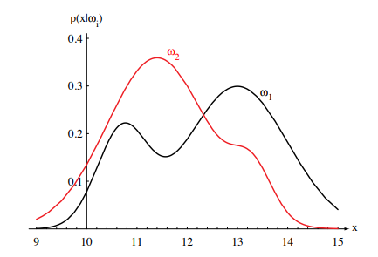
Note: The difference between p(x|ω1) and p(x|ω2) describes the difference in lightness between populations of sea bass and salmon (Fig.2.1)
Figure 2.1: Hypothetical class-conditional probability density functions show the probability density of measuring a particular feature value x given the pattern is in category ωi . If x represents the length of a fish, the two curves might describe the difference in length of populations of two types of fish. Density functions are normalized, and thus the area under each curve is 1.0.

Slide 6
Suppose that we know both the prior probabilities P(ωj ) and the conditional densities p(x|ωj ). Suppose further that we measure the lightness of a fish and discover that its value is x. How does this measurement influence our attitude concerning the true state of nature — that is, the category of the fish? .
We note first that the (joint) probability density of finding a pattern that is in category ωj and has feature value x can be written two ways:
p(ωj , x) = P(ωj |x)p(x) = p(x|ωj )P(ωj ).
Rearranging these leads us to Bayes’ formula:

Slide 7
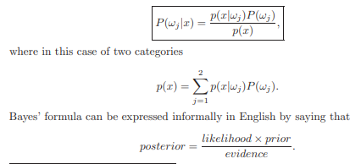
Bayes’ formula:

Slide 8

Bayes’ formula shows that by observing the value of x we can convert the prior probability P(ωj ) to the a posteriori probability (or posterior) probability P(ωj |x) — the probability of the state of nature being ωj given that feature value x has been measured. We call p(x|ωj ) the likelihood of ωj with respect to x
The variation of P(ωj |x) with x is illustrated in Fig. 2.2 for the case P(ω1)=2/3 and P(ω2)=1/3.
If we have an observation x for which P(ω1|x) is greater than P(ω2|x), we would naturally be inclined to decide that the true state of nature is ω1. Similarly, if P(ω2|x) is greater than P(ω1|x), we would be inclined to choose ω2. To justify this decision procedure, let us calculate the probability of error whenever we make a decision. Whenever we observe a particular x,
Clearly, for a given x we can minimize the probability of error by deciding ω1 if P(ω1|x) > P(ω2|x) and ω2 otherwise.

Slide 9
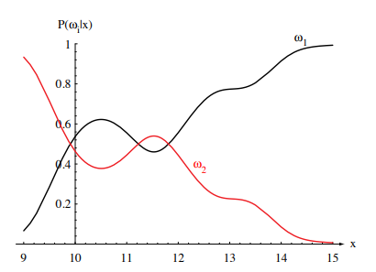
Figure 2.2: Posterior probabilities for the particular priors P(ω1) = 2/3 and P(ω2) = 1/3 for the class-conditional probability densities shown in Fig. 2.1. Thus in this case, given that a pattern is measured to have feature value x = 14, the probability it is in category ω2 is roughly 0.08, and that it is in ω1 is 0.92. At every x, the posteriors sum to 1.0

Slide 10

and if for every x we insure that P(error|x) is as small as possible, then the integral must be as small as possible. Thus we have justified the following Bayes’ decision rule for minimizing the probability of error:
Bayes’ Decision rule: Decide ω1 if P(ω1|x) > P(ω2|x);
Otherwise decide ω2,
and P(error|x) = min [P(ω1|x), P(ω2|x)].
Evidence: The evidence, p(x), is unimportant as far as making a decision is concerned. It is basically just a scale factor that states how frequently we will actually measure a pattern with feature value x and from above assures us that P(ω1|x) + P(ω2|x) = 1. By eliminating this scale factor, we obtain the following completely equivalent decision rule:
Decide ω1 if p(x|ω1)P(ω1) > p(x|ω2)P(ω2); otherwise decide ω2.

Slide 11
If for some x we have p(x|ω1) = p(x|ω2), then that particular observation gives us no information about the state of nature; in this case, the decision hinges entirely on the prior probabilities.
On the other hand, if P(ω1) = P(ω2), then the states of nature are equally probable; in this case the decision is based entirely on the likelihoods p(x|ωj ).
Bayesian Decision Theory – Continuous Features:
We shall now formalize the ideas just considered, and generalize them in four ways:
• by allowing the use of more than one feature
• by allowing more than two states of nature
• by allowing actions other than merely deciding the state of nature
• by introducing a loss function more general than the probability of error.

Slide 12
Feature Space: Allowing the use of more than one feature merely requires replacing the scalar x by the feature vector x, where x is in a d-dimensional Euclidean space R^{d} , called the feature space.
Allowing more than two states of nature provides us with a useful generalization for a small notational expense.
Allowing actions other than classification primarily allows the possibility of rejection, i.e., of refusing to make a decision in close cases; this is a useful option if being indecisive is not too costly.
Loss function: Formally, the loss function states exactly how costly each action is, and is used to convert a probability determination into a decision.

Slide 13
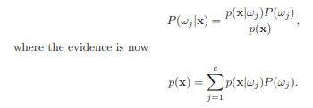
Let ω₁, ..., ω_{c} be the finite set of c states of nature (“categories”) and α₁, ...,
α_{a} be the finite set of a possible actions. The loss function λ(α_{i} |ω_{j} ) describes
the loss incurred for taking action α_{i} when the state of nature is ω_{j} .
Let the feature vector x be a d-component vector-valued random variable,
and let p(x|ω_{j} ) be the state conditional probability density function for x — the
probability density function for x conditioned on ω_{j} being the true state of
nature.
As before, P(ω_{j} ) describes the prior probability that nature is in state ω_{j.}
Then the posterior probability P(ω |x) can be computed from p(x|ω_{j} ) by Bayes’
formula:

Slide 14

Suppose that we observe a particular x and that we contemplate taking action αi . If the true state of nature is ω_{j} , by definition we will incur the loss λ(α_{i} |ω_{j} ). Since P(ω_{j} |x) is the probability that the true state of nature is ω_{j} , the expected loss associated with taking action αi is merely
RISK: In decision-theoretic terminology, an expected loss is called a risk, and R(α_{i} x) is called the conditional risk. Whenever we encounter a particular observation x, we can minimize our expected loss by selecting the action that minimizes the conditional risk. We shall now show that this Bayes decision procedure actually provides the optimal performance on an overall risk.

Slide 15

Rule : A general decision rule is a function α(x) that tells us which action to take for every possible observation. To be more specific, for every x the decision function α(x) assumes one of the a values α₁, ..., α_{a}.
The overall risk R is the expected loss associated with a given decision rule. Since R(α_{i} |x) is the conditional risk associated with action α_{i} , and since the decision rule specifies the action, the overall risk is given by:
where dx is our notation for a d-space volume element, and where the integral extends over the entire feature space. Clearly, if α(x) is chosen so that R(αi(x)) is as small as possible for every x, then the overall risk will be minimized. This justifies the following statement of the Bayes decision rule: To minimize the overall risk, compute the conditional risk

Slide 16

for i = 1,...,a and select the action α_{i} for which R(α_{i}|x) is minimum.
Bayes Risk:
The resulting minimum overall risk is called the Bayes risk, denoted R∗ and is the best performance that can be achieved.
Two-Category Classification:
Let us consider these results when applied to the special case of two-category classification problems.
Here action α1 corresponds to deciding that the true state of nature is ω1, and action α2 corresponds to deciding that it is ω2.
For notational simplicity, let λij = λ(αi |ωj ) be the loss incurred for deciding ωi when the true state of nature is ωj .
If we write out the conditional risk given by above equation, we obtain:
R(α1|x) = λ11P(ω1|x) + λ12P(ω2|x) and
R(α2|x) = λ21P(ω1|x) + λ22P(ω2|x).

Slide 17

The fundamental rule is: Decide ω1 if R(α1|x) < R(α2|x).
In terms of the posterior probabilities:
Decide ω1 if (λ21 − λ11)P(ω1|x) > (λ12 − λ22)P(ω2|x).
By employing Bayes’ formula, we can replace the posterior probabilities by the prior probabilities and the conditional densities.
This results in the equivalent rule:
Decide ω1 if (λ21 − λ11)p(x|ω1)P(ω1) > (λ12 − λ22)p(x|ω2)P(ω2),
and ω2 otherwise.
Another alternative, which follows at once under the reasonable assumption that λ21 > λ11, is to decide ω1 if:

Slide 18

Minimum-Error-Rate Classification: In classification problems, each state of nature is usually associated with a different one of the c classes, and the action αi is usually interpreted as the decision that the true state of nature is ωi .
zero-one loss function:
If action αi is taken and the true state of nature is ωj , then the decision is correct if i = j, and in error if i ̸= j. If errors are to be avoided, it is natural to seek a decision rule that minimizes the probability of error, i.e., the error rate. The loss function of interest for this case is hence the so-called symmetrical or zero-one loss function,
This loss function assigns no loss to a correct decision, and assigns a unit loss to any error; thus, all errors are equally costly.∗ The risk corresponding to this loss function is precisely the average probability of error, since the conditional risk is

Slide 19
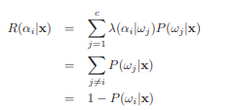
and P(ωi |x) is the conditional probability that action αi is correct. The Bayes decision rule to minimize risk calls for selecting the action that minimizes the conditional risk. Thus, to minimize the average probability of error, we should select the i that maximizes the posterior probability P(ωi |x).
In other words, for minimum error rate:
Decide ωi if P(ωi |x) > P(ωj |x) for all j ̸= i.

Slide 20
Classifiers, Discriminant Functions and Decision Surfaces:
i). The Multi-Category Case:
There are many different ways to represent pattern classifiers. One of the most useful is in terms of a set of discriminant functions:
g_{i}(x), i = 1, ..., c.
The classifier is said to assign a feature vector x to class ω_{i} if g_{i}(x) > gj (x) for all j ̸= i.
Thus, the classifier is viewed as a network or machine that computes c discriminant functions and selects the category corresponding to the largest discriminant.
A network representation of a classifier is illustrated in following Figure.

Slide 21
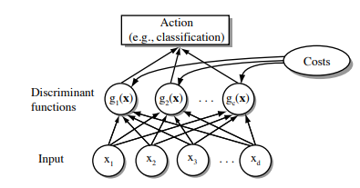
Figure : The functional structure of a general statistical pattern classifier which includes d inputs and c discriminant functions g_{i}(x). A subsequent step determines which of the discriminant values is the maximum, and categorizes the input pattern accordingly. The arrows show the direction of the flow of information, though frequently the arrows are omitted when the direction of flow is self-evident.

Slide 22
For the general case with risks, we can let g_{i}(x) = −R(α_{i} |x), since the maximum discriminant function will then correspond to the minimum conditional risk.
For the minimum error-rate case, we can simplify things further by taking g_{i}(x) = P(ω_{i}|x), so that the maximum discriminant function corresponds to the maximum posterior probability.
Clearly, the choice of discriminant functions is not unique. We can always multiply all the discriminant functions by the same positive constant or shift them by the same additive constant without influencing the decision.
More generally, if we replace every g_{i}(x) by f(g_{i}(x)), where f(·) is a monotonically increasing function, the resulting classification is unchanged.
This observation can lead to significant analytical and computational simplifications.

Slide 23
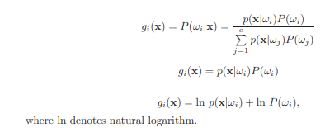
Decision Region:
Even though the discriminant functions can be written in a variety of forms, the decision rules are equivalent. The effect of any decision rule is to divide the feature space into c decision regions, R1,...,Rc. If g_{i}(x) > g_{j}(x) for all j ̸= i, then x is in R_{i} , and the decision rule calls for us to assign x to ω_{i} . The regions are separated by decision boundaries, surfaces in feature space where ties occur among the largest discriminant functions

Slide 24
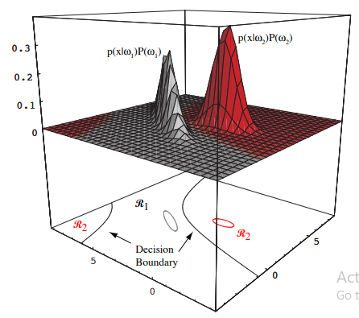
Figure: In this two-dimensional two-category classifier, the probability densities are Gaussian (with 1/e ellipses shown), the decision boundary consists of two hyperbolas, and thus the decision region R2 is not simply connected.

Slide 25
The Two-Category Case:
Dichotomizer:
While the two-category case is just a special instance of the multi category case, it has traditionally received separate treatment. Indeed, a classifier that places a pattern in one of only two categories has a special name called a dichotomizer.
Instead of using two discriminant functions g₁ and g₂ and assigning x to ω1 if g₁>g₂, it is more common to define a single discriminant function
g(x) ≡ g₁(x) − g₂(x),
and to use the following decision rule: Decide ω₁ if g(x)>0; otherwise decide ω₂. Thus, a dichotomizer can be viewed as a machine that computes a single discriminant function g(x), and classifies x according to the algebraic sign of the result.

Slide 26

From the various forms in which the minimum-error-rate discriminant function can be written, the following two are particularly convenient:

Slide 27
Problem:
Consider an e-mail SPAM classification for every incoming e-mail is either a normal email(ω₁) or junk mail (ω₂). We have two actions: α₁ keep the mail and α₂ put mail to /dev/null. We select a loss function λ(α₁|ω₁) =0, λ(α₁|ω₂)=1, λ(α₂|ω₁)=3 and λ(α₂|ω₂)=0. In addition, we know that P(ω₁) = 0.4, P(ω₂) = 0.6. Now, an e-mail has been received and its feature vector is x. Based on the feature vector, we have computed p(x|ω₁) = 0.35, p(x|ω₂) = 0.65. Find the posterior probabilities P(ω₁|x), P(ω₂|x) and conditional risk or minimum risk classifier R(α₁|x) and R(α₂|x).
Solution:
P(ω₁|x) = p(x|ω₁) * P(ω₁) = 0.35 * 0.4 = 0.14
P(ω₂|x) = p(x|ω₂) * P(ω₂) = 0.65 * 0.6 = 0.39
R(α₁|x) = λ(α₁|ω₁) * P(ω₁|x) + λ(α₁|ω₂) * P(ω₂|x) = 0 + 1 * 0.39 =0.39
R(α₂|x) = λ(α₂|ω₁) * P(ω₁|x) + λ(α₂|ω₂) * P(ω₂|x) = 3* 0.14 + 0= 0.42

Slide 28
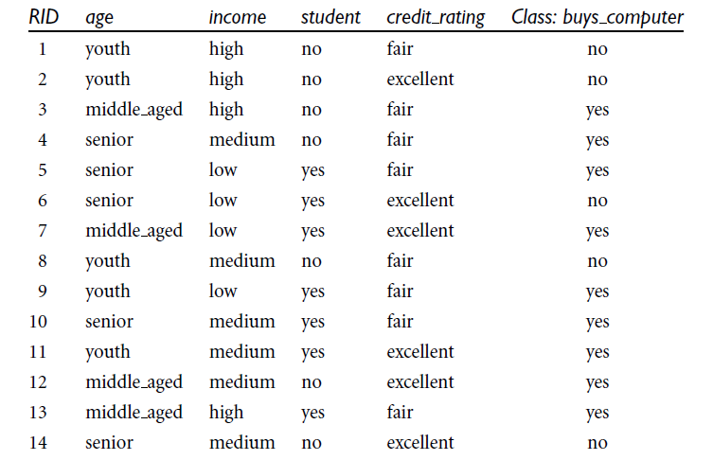

Slide 29
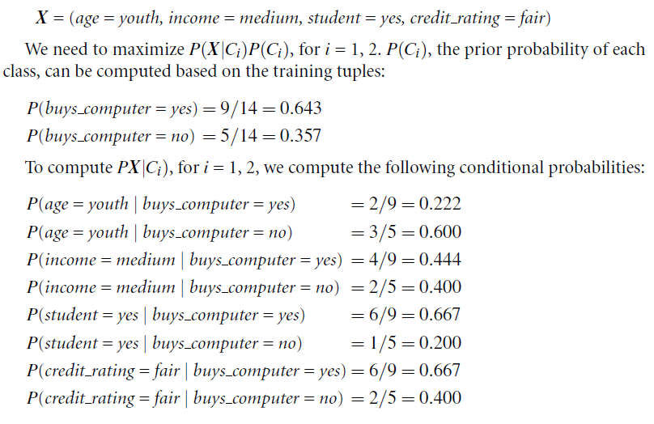

Slide 30
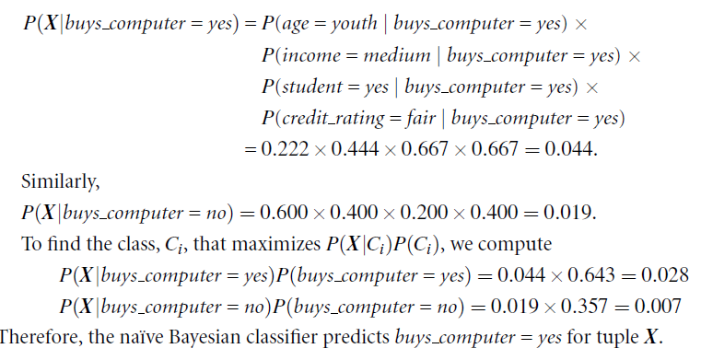

Slide 31
2. Assume there are 5 different features with class label <x1, x2, x3, x4, x5, class>: {Name, Give Birth, Can Fly, Live in Water, have legs, class} is given in below table as training data. Let assume all the features are independent each other when class is given. The entire dataset is grouped into two classes as Mammals and non-mammals. Estimate the probabilities using Bayesian (Naïve Bayes) Classifier when a new test sample is?
X=(Give Birth= yes, Cn fly=No, Live in water=yes, Have leggs=No, Class= ?)

Slide 32
Describe the different modules in Pattern recognition system? Explain the modules by clearly specifying roles of each module?
Discuss the Design cycle of pattern recognition
Define the following terms in pattern recognition.
a) Feature Extraction b)Over-fitting c) Missing features
d) Segmentation
4. Define the following terms with an example.
a) Supervised Learning b) Unsupervised Learning
c) Reinforcement Learning

Slide 33
Explain the bayes theorem with all the parameters? Describe any two approaches that serve as sources for the probability values?
2. Discuss the Bayes Decision Theorem for Continuous feature? Or Two category classification on minimize the overall risk or Derive the optimum decision rule to minimize risk R using Bayes decision rule for two-category classification.
3. Discuss Zero-One Loss Function for conditional risk decision rule.
4. Discuss in detail about discriminant function and decision surface (Multi category case and Two category case)

