Slide 1
UNIT- III
Maximum likelihood and Bayesian parameter estimation: Introduction, maximum likelihood Estimation, Bayesian estimation, Bayesian parameter estimation–Gaussian case.

Slide 2
we saw how we could design an optimal classifier if we knew the prior probabilities P(ω_{i}) and the class-conditional densities p(x|ω_{i}).
Unfortunately, in pattern recognition applications we rarely if ever have this kind of complete knowledge about the probabilistic structure of the problem.
One approach to this problem is to use the samples to estimate the unknown probabilities and probability densities, and to use the resulting estimates as if they were the true values.
The number of available samples always seems too small, and serious problems arise when the dimensionality of the feature vector x is large. If we know the number of parameters in advance and our general knowledge about the problem permits us to parameterize the conditional densities, then the severity of these problems can be reduced significantly. Suppose, for example, that we can reasonably assume that p(x|ω_{i}) is a normal density with mean µ_{i} and covariance matrix Σ_{i} , although we do not know the exact values of these quantities.

Slide 3
This knowledge simplifies the problem from one of estimating an unknown function p(x|ω_{i}) to one of estimating the parameters µ_{i} and Σ_{i} .
Maximum Likelihood Estimation:
Maximum likelihood estimation methods have a number of attractive attributes. First, they nearly always have good convergence properties as the number of training samples increases. Further, maximum likelihood estimation often can be simpler than alternate methods, such as Bayesian techniques or other methods.
The General Principle:
Suppose that we separate a collection of samples according to class, so that we have c sets, D1, ..., Dc, with the samples in Dj having been drawn independently according to the probability law p(x|ωj ). We say such samples are i.i.d. — independent identically distributed random variables.

Slide 4
assume that p(x|ωj ) has a known parametric form, and is therefore determined uniquely by the value of a parameter vector θj.
For example, we might have p(x|ωj ) ∼ N(µj , Σj ), where θj consists of the components of µj and Σj . To show the dependence of p(x|ωj ) on θj explicitly, we write p(x|ωj ) as p(x|ωj , θj ).
Our problem is to use the information provided by the training samples to obtain good estimates for the unknown parameter vectors θ1, ..., θc associated with each category. To simplify t To simplify treatment of this problem, we shall assume that samples in Di give no information about θj if i ̸= j . — that is, we shall assume that the parameters for the different classes are functionally independent. This permits us to work with each class separately, and to simplify our notation by deleting indications of class distinctions. With this assumption we thus have c separate problems of the following form: Use a set D of training samples drawn independently from the probability density p(x|θ) to estimate the unknown parameter vector θ.

Slide 5

Suppose that D contains n samples, x1, ..., xn. Then, since the samples were drawn independently, we have
viewed as a function of θ, p(D|θ) is called the likelihood of θ with respect to the set of samples. The maximum likelihood estimate of θ is, by definition, the value θˆ that maximizes p(D|θ). Intuitively, this estimate corresponds to the value of θ that in some sense best agrees with or supports the actually observed training samples .
If p(D|θ) is a well behaved, differentiable function of θ, θˆ can be found by the standard methods of differential calculus. If the number of parameters to be set is p, then we let θ denote the p-component vector θ = (θ1, ..., θp)^{t}, and ∇_{θ} be the gradient operator

Slide 6
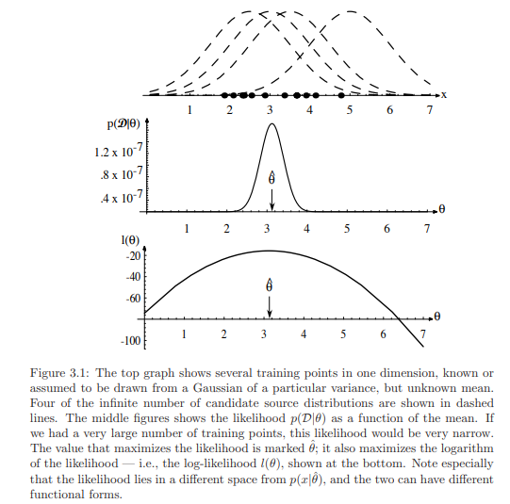

Slide 7


If p(D|θ) is a well behaved, differentiable function of θ, θˆ can be found by the standard methods of differential calculus. If the number of parameters to be set is p, then we let θ denote the p-component vector θ = (θ1, ..., θp) t , and ∇θ be the gradient operator
We define l(θ) as the log-likelihood function, l(θ) ≡ ln p(D|θ).
We can then write our solution formally as the argument θ that maximizes the log likelihood, i.e.,

Slide 8
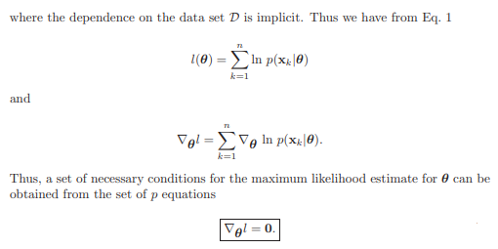
A solution θˆ to above Eq. could represent a true global maximum, a local maximum or minimum, or (rarely) an inflection point of l(θ).

Slide 9


The Gaussian Case: Unknown µ
To see how maximum likelihood methods results apply to a specific case, suppose that the samples are drawn from a multivariate normal population with mean µ and covariance matrix Σ. For simplicity, consider first the case where only the mean is unknown. Under this condition, we consider a sample point x_{k} and find:
Identifying θ with µ, we see from above equation that the maximum likelihood estimate for µ must satisfy

Slide 10

that is, each of the d components of µˆ must vanish. Multiplying by Σ and rearranging, we obtain:
The maximum likelihood estimate for the unknown population mean is just the arithmetic average of the training samples.

Slide 11
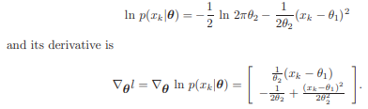

The Gaussian Case: Unknown µ and Σ
In the more general (and more typical) multivariate normal case, neither the mean µ nor the covariance matrix Σ is known. Thus, these unknown parameters constitute the components of the parameter vector θ. Consider first the univariate case with θ₁ = µ and θ₂ = σ² . Here the log-likelihood of a single point is:
By applying to the full log-likelihood leads to the conditions

Slide 12

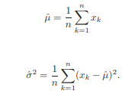
and
where ˆθ₁ and ˆθ₂ are the maximum likelihood estimates for θ₁ and θ₂, respectively. By substituting ˆµ = ˆθ₁, ˆσ² = ˆθ₂ and doing a little rearranging, we obtain the following maximum likelihood estimates for µ and σ ² :
and
While the analysis of the multivariate case is basically very similar, considerably more manipulations are involved. Just as we would predict, though, the result is that the maximum likelihood estimates for µ and Σ are given by:

Slide 13
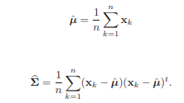
and
Thus, we find that the maximum likelihood estimate for the mean vector is the sample mean. The maximum likelihood estimate for the covariance matrix is the arithmetic average of the n matrices (x_{k} − µˆ)(x_{k} − µˆ)^{t}

