Slide 1
UNIT-I
Introduction: Machine perception, pattern recognition example, pattern recognition systems, the Design cycle, learning and adaptation
Bayesian Decision Theory: Introduction, continuous features – two categories classifications, minimum error-rate classification-zero–one loss function, classifiers, discriminant functions, and decision surface

Slide 2
Machine Perception:
It is natural that we should seek to design and build machines that can recognize patterns.
Ex:
i) Automated speech recognition,
ii) Fingerprint identification,
iii) Optical character recognition,
iv) DNA sequence identification and much more..
It is clear that reliable, accurate pattern recognition by machine would be immensely useful.

Slide 3
An Example:
Suppose that a fish packing plant wants to automate the process of sorting incoming fish on a conveyor belt according to species.
As a pilot project it is decided to try to separate sea bass from salmon using optical sensing.
We set up a camera, take some sample images and begin to note some physical differences between the two types of fish
length, lightness, width, number and shape of fins, position of the mouth, and so on

Slide 4
Model
Pre processing
Segmentation
Feature Extraction
Classification

Slide 5
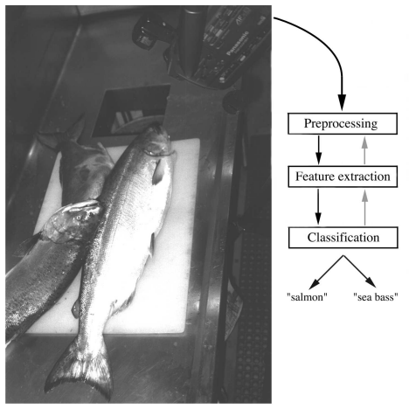
Fig 1.1. The objects to be classified are first sensed by a transducer (camera), whose signals are preprocessed, then the features extracted and finally the classification emitted (here either “salmon” or “sea bass”).

Slide 6
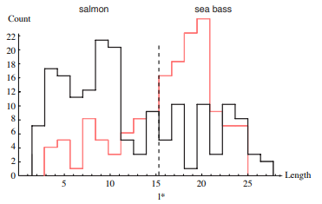
Figure 1.2: Histograms for the length feature for the two categories. No single threshold value l* (decision boundary) will serve to unambiguously discriminate between the two categories; using length alone, we will have some errors. The value l∗ marked will lead to the smallest number of errors, on average.

Slide 7
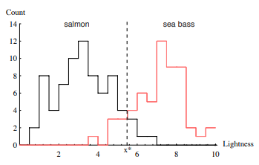
Figure 1.3: Histograms for the lightness feature for the two categories. No single threshold value x∗ (decision boundary) will serve to unambiguously discriminate between the two categories; using lightness alone, we will have some errors. The value x∗ marked will lead to the smallest number of errors, on average.

Slide 8
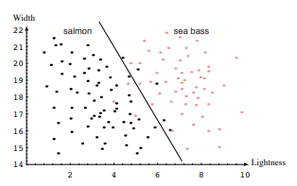
Figure 1.4: The two features of lightness and width for sea bass and salmon. The dark line might serve as a decision boundary of our classifier. Overall classification error on the data shown is lower than if we use only one feature as in Fig. 1.3, but there will still be some errors.

Slide 9

If we have two features for classifying fish — the lightness x1 and the width x2. The feature extractor has reduced the image of each fish to a point or feature vector X in a two-dimensional feature space, where
Our problem now is to partition the feature space into two regions, where for all patterns in one region we will call the fish a sea bass, and all points in the other we call it a salmon.
Suppose that we measure the feature vectors for our samples and obtain the scattering of points shown in Fig. 1.4. This plot suggests the following rule for separating the fish:
Classify the fish as sea bass if its feature vector falls above the decision boundary shown, and as salmon otherwise.

Slide 10
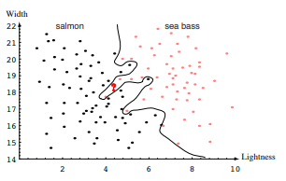
Figure 1.5: Overly complex models for the fish will lead to decision boundaries that are complicated. While such a decision may lead to perfect classification of our training samples, it would lead to poor performance on future patterns.

Slide 11
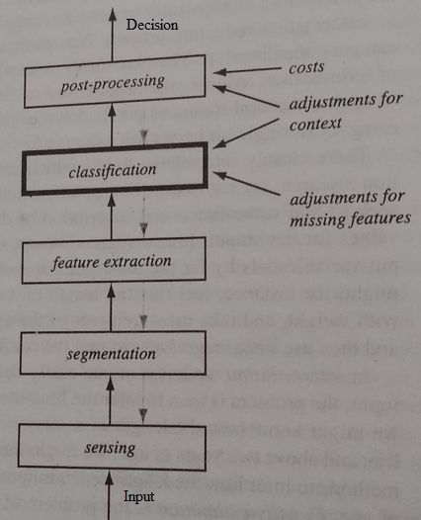
pattern recognition systems:

Slide 12
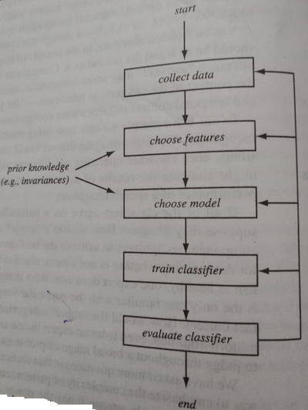
Design Cycle:

Slide 13
Learning and Adaptation:
Supervised Learning
Unsupervised Learning
Reinforcement Learning

