Slide 1
UNIT- II
Normal density: Univariate and multivariate density, discriminant functions for the normal Density different cases, Bayes decision theory – discrete features, compound Bayesian decision theory and context

Slide 2


The structure of a Bayes classifier is determined by the conditional densities p(x|ω_{i}) as well as by the prior probabilities. From the various density functions that have been investigated, none has received more attention than the multivariate normal or Gaussian density. However the multivariate normal density is also an appropriate model for an important situation, viz., the case where the feature vectors x for a given class ω_{i} are continuous valued, randomly corrupted versions of a single typical or prototype vector µ_{i}.
In this section we provide a brief exposition of the multivariate normal density, focusing on the properties of greatest interest for classification problems.
Expectation:
recall the definition of the expected value of a scalar function f(x), defined for some density p(x):
If we have samples in a set D from a discrete distribution, we must sum over all samples as
where P(x) is the probability mass at x.

Slide 3



Univariate Density:
We begin with the continuous univariate normal or Gaussian density,
for which the expected value of x is:
and where the expected squared deviation or variance is:
The univariate normal density is completely specified by two parameters: its mean µ and variance σ².
For simplicity, we write p(x) ∼ N(µ, σ 2 ) to say that x is distributed normally with mean µ and variance σ².

Slide 4
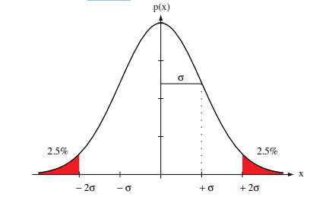
Samples from normal distributions tend to cluster about the mean, with a spread related to the standard deviation σ (Below Figure)
Figure: A univariate normal distribution has roughly 95% of its area in the range
|x − µ| ≤ 2σ, as shown. The peak of the distribution has value p(µ)=1/ √ 2πσ.

Slide 5

Entropy:
The entropy is a non negative quantity that describes the fundamental uncertainty in the values of points selected randomly from a distribution. It can be shown that the normal distribution has the maximum entropy of all distributions having a given mean and variance.
and measured in nats. If a log2 is used instead, the unit is the bit
Central Limit Theorem: The aggregate effect of a large number of small, independent random disturbances will lead to a Gaussian distribution

Slide 6


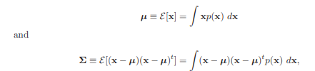
Multivariate Density:
The general multivariate normal density in d dimensions is written as
where x is a d-component column vector, µ is the d-component mean vector, Σ is the d-by-d covariance matrix, |Σ| and Σ⁻¹ are its determinant and inverse, respectively, and (x − µ)^{t} is the transpose of x − µ. Our notation for the inner product is:
and often called a dot product.
For simplicity, p(x) ∼ N(µ, Σ). Formally, we have
where the expected value of a vector or a matrix is found by taking the expected values of its components.

Slide 7

In other words, if x_{i} is the i^{th} component of x, µ_{i} the i^{th} component of µ, and σ_{ij} the ij^{th} component of Σ, then:
The covariance matrix Σ is always symmetric and positive semidefinite. We shall restrict our attention to the case in which Σ is positive definite, so that the determinant of Σ is strictly positive.† The diagonal elements σ_{ii} are the variances of the respective x_{i} (i.e., σ ²_{i} ), and the off-diagonal elements σ_{ij} are the covariances of x_{i} and x_{j}.
Ex: We would expect a positive covariance for the length and weight features of a population of fish.
statistically independence: If xi and x_{j} are statistically independent, σ_{ij} = 0.
if all the off-diagonal elements are zero, p(x) reduces to the product of the univariate normal densities for the components of x.

Slide 8
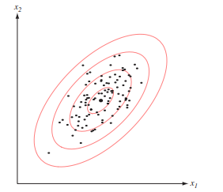
The multivariate normal density is completely specified by:
d + d(d + 1)/2 parameters.
The elements of the mean vector µ and the independent elements of the covariance matrix Σ.
Samples drawn from a normal population tend to fall in a single cloud or cluster as shown in Figure.
Figure: Samples drawn from a two-dimensional Gaussian lie in a cloud centered on the mean µ. The red ellipses show lines of equal probability density of the Gaussian.

Slide 9
The center of the cluster is determined by the mean vector, and the shape of the cluster is determined by the covariance matrix.
We know (From previous equations) that the loci of points of constant density are hyperellipsoids for which the quadratic form (x−µ)^{t} Σ⁻¹ (x−µ) is constant.
The principal axes of these hyperellipsoids are given by the eigenvectors of Σ; the eigenvalues determine the lengths of these axes.
MAHALANOBIS DISTANCE:
The quantity r² = (x − µ)^{t} Σ⁻¹ (x − µ) is called the squared Mahalanobis distance from x to µ.

Slide 10

Thus, the contours of constant density are hyperellipsoids of constant Mahalanobis distance to µ and the volume of these hyperellipsoids measures the scatter of the samples about the mean. It can be shown that the volume of the hyperellipsoid corresponding to a Mahalanobis distance r is given by:
V = V^{d} |Σ|^{1/2} r^{d} ,
where V^{d} is the volume of a d-dimensional unit hypersphere:
Thus, for a given dimensionality, the scatter of the samples varies directly with |Σ|^{1/2}

Slide 11

Discriminant Functions for the Normal Density:
we saw (Previous chapter) that the minimum-error-rate classification can be achieved by use of the discriminant functions:
g_{i}(x) = ln p(x|ω_{i}) + ln P(ω_{i}).
This expression can be readily evaluated if the densities p(x|ω_{i}) are multivariate normal, i.e., if p(x|ω_{i}) ∼ N(µ_{i} , Σ_{i}).
In this case, from:
We have:
Let us examine the discriminant function and resulting classification for a number of special cases.

Slide 12
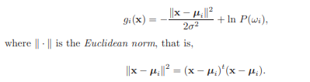
Case 1: Σ_{i} = σ²I
The simplest case occurs when the features are statistically independent, and when each feature has the same variance, σ² . In this case the covariance matrix is diagonal, being merely σ² times the identity matrix I.
|Σ_{i}| = σ^{2d} and
Σ_{i}⁻¹ = (1/σ² )I
Since both |Σ_{i}| and the (d/2) ln 2π term in are independent of i, they are unimportant additive constants that can be ignored. Thus we obtain the simple discriminant functions:

Slide 13

If the prior probabilities are not equal, the squared distance ∥x − µ∥² must be normalized by the variance σ² and offset by adding ln P(ω_{i}); thus, if x is equally near two different mean vectors, the optimal decision will favor the a priori more likely category.
Expansion of the quadratic form (x − µ_{i} )^{t} (x − µ_{i} ) yields:
Linear discriminant:
which appears to be a quadratic function of x. However, the quadratic term x^{t}x is the same for all i, making it an ignorable additive constant. Thus, we obtain the linear equivalent discriminant functions.
g_{i}(x) = w_{i}^{t}x + w_{i0} Where:

Slide 14
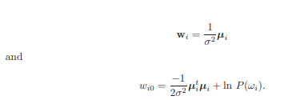
We call w_{i0} the threshold or bias in the i^{th} direction.
A classifier that uses linear discriminant functions is called a linear machine. The decision surfaces for a linear machine are pieces of hyperplanes defined by the linear equations g_{i}(x) = g_{j}(x) for the two categories with the highest posterior probabilities. For our particular case, this equation can be written as

Slide 15
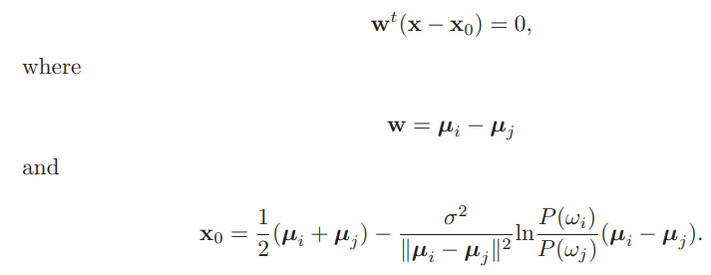
This equation defines a hyperplane through the point x0 and orthogonal to the vector w. Since w = µi − µj , the hyperplane separating Ri and Rj is orthogonal to the line linking the means. If P(ωi) = P(ωj ), the second term on the right of vanishes, and thus the point x0 is halfway between the means, and the hyperplane is the perpendicular bisector of the line between the means. If P(ωi) ̸= P(ωj ), the point x₀ shifts away from the more likely mean..

Slide 16
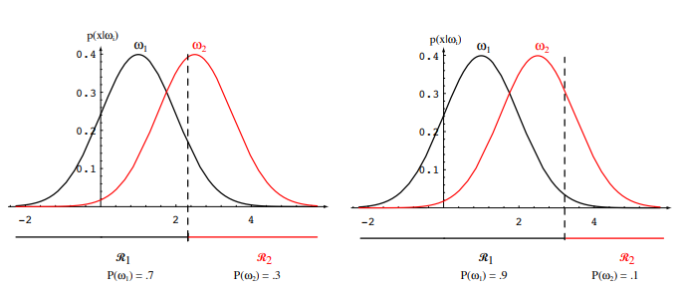
Note: If the variance σ² is small relative to the squared distance ∥µi − µj∥, then the position of the decision boundary is relatively insensitive to the exact values of the prior probabilities.
If the prior probabilities P(ωi) are the same for all c classes, then the ln P(ωi) term becomes another unimportant additive constant that can be ignored. When this happens, the optimum decision rule can be stated very simply:

Slide 17

Minimum distance classifier and template matching:
To classify a feature vector x, measure the Euclidean distance
∥x − µi∥ from each x to each of the c mean vectors, and assign x to the category of the nearest mean.
Such a classifier is called a minimum distance classifier. If each mean vector is thought of as being an ideal prototype or template for patterns in its class, then this is essentially a template matching procedure (nearest-neighbor algorithm).
Case 2: Σi = Σ
Another simple case arises when the covariance matrices for all of the classes are identical but otherwise arbitrary.
Since both |Σi | and the (d/2) ln 2π terms (in above Eq.) are independent of i, they can be ignored as superfluous additive constants. This simplification leads to the discriminant functions:

Slide 18


If the prior probabilities P(ω_{i}) are the same for all c classes, then the ln P(ωi) term can be ignored. In this case, the optimal decision rule can once again be stated very simply:
to classify a feature vector x, measure the squared Mahalanobis distance (x − µ_{i} )^{t}Σ⁻¹ (x − µ_{i} ) from x to each of the c mean vectors, and assign x to the category of the nearest mean.
Expansion of the quadratic form (x − µ_{i} )^{t}Σ⁻¹ (x − µ_{i} ) results in a sum involving a quadratic term x^{t}Σ⁻¹x which here is independent of i. After this term is dropped, the resulting discriminant functions are again linear as follows:
where
and
Since the discriminants are linear, the resulting decision boundaries are again hyperplanes. If R_{i} and R_{j} are contiguous, the boundary between them has the equation.

Slide 19


where,
and
Since w = Σ⁻¹ (µ_{i}−µ_{j} ) is generally not in the direction of µ_{i}−µ_{j} , the hyperplane separating Ri and Rj is generally not orthogonal to the line between the means.
However, it does intersect that line at the point x₀ which is halfway between the means if the prior probabilities are equal. If the prior probabilities are not equal, the optimal boundary hyperplane is shifted away from the more likely mean.

Slide 20


Case 3: Σ_{i} = arbitrary
In the general multivariate normal case, the covariance matrices are different for each category. The only term that can be dropped from previous equation is the (d/2) ln 2π term, and the resulting discriminant functions are inherently quadratic:
where
and
The decision surfaces are hyperquadrics, and can assume any of the general forms. Even in one dimension, for arbitrary covariance the decision regions need not be simply connected as follows:

Slide 21
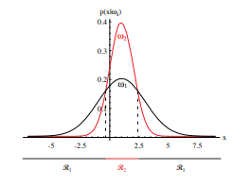
Figure: Non-simply connected decision regions can arise in one dimensions for Gaussians having unequal variance.

Slide 22
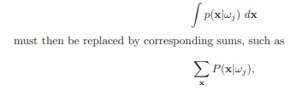
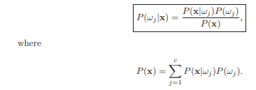
Bayes Decision Theory — Discrete Features:
Until now we have assumed that the feature vector x could be any point in a ddimensional Euclidean space, Rd . However, in many practical applications the components of x are binary-, ternary-, or higher integer valued, so that x can assume only one of m discrete values v1, ..., vm. In such cases, the probability density function p(x|ωj ) becomes singular; integrals of the form:

Slide 23

Independent Binary Features :
consider the two-category problem in which the components of the feature vector are binary-valued and conditionally independent. To be more specific we let x = (x₁, ..., x_{d})^{t} , where the components x_{i} are either 0 or 1, with:
and
This is a model of a classification problem in which each feature gives us a yes/no answer about the pattern. If p_{i} > q_{i} , we expect the i^{th} feature to give a “yes” answer more frequently when the state of nature is ω₁ than when when it is ω₂.

Slide 24
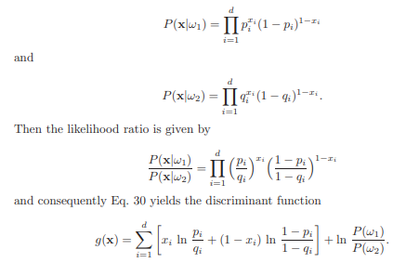

Slide 25
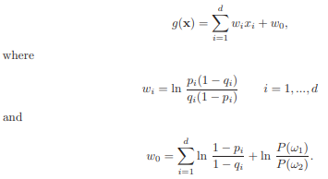
We note especially that this discriminant function is linear in the x_{i} and thus we can write

Slide 26
Let us examine these results to see what insight they can give. Recall first that we decide ω1 if g(x) > 0 and ω2 if g(x) ≤ 0. We have seen that g(x) is a weighted combination of the components of x.
If p_{i} = q_{i} , xi gives us no information about the state of nature, and w_{i} = 0, just as we might expect. If p_{i} > q_{i} , then 1 − p_{i} < 1 − q_{i} and wi is positive. Thus in this case a “yes” answer for xi contributes w_{i} votes for ω₁
And, for any fixed q_{i} < 1, wi gets larger as p_{i} gets larger. On the other hand, if p_{i} < q_{i} , wi is negative and a “yes” answer contributes |w_{i} | votes for ω₂.
Problem: Let’s consider a 3-D binary feature vector X= (x₁,x₂ , x₃)=(0,1,1). Let’s say, prior probabilities of class 1 is P(w1)=0.6 , while class2 is P(w2)=0.4 . The likely hood of each independent feature is given by p and q where: pi = P(xi=1/w1) and qi= P(xj=1/w2). The probabilities of each independent feature gives: p={ 0.8, 0.2, 0.5} and q= { 0.2, 0.5, 0.9}. Find out the equation for discriminant function

Slide 27
Discriminant function is:
w₁= ln ((0.8 * (1-0.2))/ (0.2 * (1- 0.8))) =
w₂= ln((0.2* (1-0.5))/ (0.5 * (1- 0.2))) =
w₃= ln ((0.5 * (1- 0.9))/ (0.9 * (1- 0.5)))=

Slide 29
Compound Bayesian Decision Theory and Context:
Consider our introductory example of designing a classifier to sort two types of fish.
Our original assumption was that the sequence of types of fish was so unpredictable that the state of nature looked like a random variable. Let us consider the possibility that the consecutive states of nature might not be statistically independent. We should be able to exploit such statistical dependence to gain improved performance. This is one example of the use of context to aid decision making.
The way in which we exploit such context information is somewhat different when we can wait for n fish to emerge and then make all n decisions jointly than when we must decide as each fish emerges. The first problem is a compound decision problem, and the second is a sequential compound decision problem. The former case is conceptually simpler, and is the one we shall examine here.
To state the general problem, let ω = (ω(1), ..., ω(n))^{t} be a vector denoting the n states of nature, with ω(i) taking on one of the c values ω1, ..., ωc. Let P(ω) be the prior probability for the n states of nature.

Slide 30

Let X = (x₁, ..., x_{n}) be a matrix giving the n observed feature vectors, with x_{i} being the feature vector obtained when the state of nature was ω(i). Finally, let p(X|ω) be the conditional probability density function for X given the true set of states of nature ω. Using this notation we see that the posterior probability of ω is given by:
The development of this theory parallels our discussion for the simple decision problem, and concludes that the optimal procedure is to minimize the compound conditional risk.
If each component ω(i) can have one of c values, there are c n possible values of ω to consider. Some simplification can be obtained if the distribution of the feature vector xi depends only on the corresponding state of nature ω(i), not on the values of the other feature vectors or the other states of nature.

Slide 31

In this case the joint density p(X|ω) is merely the product of the component densities p(xi |ω(i)):
While this simplifies the problem of computing p(X|ω), there is still the problem of computing the prior probabilities P(ω). This joint probability is central to the compound Bayes decision problem, since it reflects the interdependence of the states of nature. Thus it is unacceptable to simplify the problem of calculating P(ω) by assuming that the states of nature are independent.

