Slide 1
UNIT-V TARIFF AND POWER FACTOR IMPROVEMENT

Slide 2
Tariff
The rate at which electrical energy is supplied to a consumer is known as tariff.
Although tariff should include the total cost of producing and supplying electrical energy plus the profit, yet it cannot be the same for all types of consumers. It is because the cost of producing electrical energy depends to a considerable extent upon the magnitude of electrical energy consumed by the user and his load conditions.
Therefore, in all fairness, due consideration has to be given to different types of consumers (e.g., industrial, domestic and commercial) while fixing the tariff. This makes the problem of suitable rate making highly complicated.

Slide 3
Objectives of tariff
Like other commodities, electrical energy is also sold at such a rate so that it not only returns the cost but also earns reasonable profit. Therefore, a tariff should include the following items :
(i) Recovery of cost of producing electrical energy at the power station.
(ii) Recovery of cost on the capital investment in transmission and distribution systems.
(iii) Recovery of cost of operation and maintenance of supply of electrical energy e.g., metering equipment, billing etc.
(iv) A suitable profit on the capital investment.

Slide 4
Desirable Characteristics of a Tariff
A tariff must have the following desirable characteristics :
(i) Proper return : The tariff should be such that it ensures the proper return from each consumer. In other words, the total receipts from the consumers must be equal to the cost of producing and supplying electrical energy plus reasonable profit. This will enable the electric supply company to ensure continuous and reliable service to the consumers.
(ii) Fairness : The tariff must be fair so that different types of consumers are satisfied with the rate of charge of electrical energy. Thus a big consumer should be charged at a lower rate than a small consumer. It is because increased energy consumption spreads the fixed charges over a greater number of units, thus reducing the overall cost of producing electrical energy. Similarly, a consumer whose load conditions do not deviate much from the ideal (i.e., non variable) should be charged at a lower* rate than the one whose load conditions change appreciably from the ideal.

Slide 5
iii) Simplicity : The tariff should be simple so that an ordinary consumer can easily understand it. A complicated tariff may cause an opposition from the public which is generally distrust ful of supply companies.
(iv) Reasonable profit : The profit element in the tariff should be reasonable. An electric supply company is a public utility company and generally enjoys the benefits of monopoly. There fore, the investment is relatively safe due to non-competition in the market. This calls for the profit to be restricted to 8% or so per annum.
(v) Attractive : The tariff should be attractive so that a large number of consumers are encouraged to use electrical energy. Efforts should be made to fix the tariff in such a way so that consumers can pay easily.

Slide 6
Types of Tariff
There are several types of tariff.
However, the following are the commonly used types of tariff :
Simple tariff:
When there is a fixed rate per unit of energy consumed, it is called a simple tariff or uniform rate tariff.
In this type of tariff, the price charged per unit is constant i.e., it does not vary with increase or decrease in number of units consumed.
The consumption of electrical energy at the consumer’s terminals is recorded by means of an energy meter. This is the simplest of all tariffs and is readily understood by the consumers

Slide 7
Disadvantages of Simple Tariff:
There is no discrimination between different types of consumers since every consumer has to pay equitably for the fixed* charges.
(ii) The cost per unit delivered is high.
(iii) It does not encourage the use of electricity.

Slide 8
2.Flat rate tariff:
When different types of consumers are charged at different uniform per unit rates, it is called a flat rate tariff.
In this type of tariff, the consumers are grouped into different classes and each class of consumers is charged at a different uniform rate.
For instance, the flat rate per kWh for lighting load may be 60 paise, whereas it may be slightly less† (say 55 paise per kWh) for power load.
The different classes of consumers are made taking into account their diversity and load factors.
The advantage of such a tariff is that it is more fair to different types of consumers and is quite simple in calculations.
Disadvantages are
(i) Since the flat rate tariff varies according to the way the supply is used, separate meters are required for lighting load, power load etc. This makes the application of such a tariff expen sive and complicated.
(ii) A particular class of consumers is charged at the same rate irrespective of the magnitude of energy consumed. However, a big consumer should be charged at a lower rate as in his case the fixed charges per unit are reduced

Slide 9
3.Block rate tariff.
When a given block of energy is charged at a specified rate and the succeeding blocks of energy are charged at progressively reduced rates, it is called a block rate tariff.
In block rate tariff, the energy consumption is divided into blocks and the price per unit is fixed in each block.
The price per unit in the first block is the highest** and it is progressively reduced for the succeeding blocks of energy.
For example, the first 30 units may be charged at the rate of 60 paise per unit ; the next 25 units at the rate of 55 paise per unit and the remaining additional units may be charged at the rate of 30 paise per unit.
The advantage of such a tariff is that
The consumer gets an incentive to consume more electrical energy. This increases the load factor of the system and hence the cost of generation is reduced.
However, its principal defect is that it lacks a measure of the consumer’s demand. This type of tariff is being used for majority of residential and small commercial consumers.

Slide 10
4.Two-part tariff:
When the rate of electrical energy is charged on the basis of maximum demand of the consumer and the units consumed, it is called a two-part tariff.
In two-part tariff, the total charge to be made from the consumer is split into two components viz., fixed charges and running charges. The fixed charges depend upon the maximum demand of the consumer while the running charges depend upon the number of units consumed by the consumer.
Thus, the consumer is charged at a certain amount per kW of maximum†† demand plus a certain amount per kWh of energy consumed i.e.,

Slide 11
Total charges = Rs (b × kW + c × kWh)
where, b = charge per kW of maximum demand
c = charge per kWh of energy consumed
This type of tariff is mostly applicable to industrial consumers who have appreciable maximum demand.
Advantages
It is easily understood by the consumers.
It recovers the fixed charges which depend upon the maximum demand of the consumer but are independent of the units consumed.
Disadvantages
The consumer has to pay the fixed charges irrespective of the fact whether he has consumed or not consumed the electrical energy.
There is always error in assessing the maximum demand of the consumer.

Slide 12
5.Maximum demand tariff:
It is similar to two-part tariff with the only difference that the maximum demand is actually measured by installing maximum demand meter in the premises of the consumer.
This removes the objection of two-part tariff where the maximum demand is assessed merely on the basis of the rateable value.
This type of tariff is mostly applied to big consumers. However, it is not suitable for a small consumer (e.g., residential consumer) as a separate maximum demand meter is required

Slide 13
6.Power factor tariff:
The tariff in which power factor of the consumer’s load is taken into consideration is known as power factor tariff.
In an a.c. system, power factor plays an important role. A low* power factor increases the rating of station equipment and line losses. Therefore, a consumer having low power factor must be penalised.
The following are the important types of power factor tariff :
(i) kVA maximum demand tariff : It is a modified form of two-part tariff. In this case, the fixed charges are made on the basis of maximum demand in kVA and not in kW. As kVA is inversely proportional to power factor, therefore, a consumer having low power factor has to contribute more towards the fixed charges.
This type of tariff has the advantage that it encourages the consumers to operate their appliances and machinery at improved power factor.
(ii) Sliding scale tariff : This is also know as average power factor tariff. In this case, an average power factor, say 0·8 lagging, is taken as the reference. If the power factor of the consumer falls below this factor, suitable additional charges are made. On the other hand, if the power factor is above the reference, a discount is allowed to the consumer.
(iii) kW and kVAR tariff : In this type, both active power (kW) and reactive power (kVAR) supplied are charged separately. A consumer having low power factor will draw more reactive power and hence shall have to pay more charges.

Slide 14
7.Three-part tariff.
When the total charge to be made from the consumer is split into three parts viz., fixed charge, semi-fixed charge and running charge, it is known as a three-part tariff. i.e.,
Total charge = Rs (a + b × kW + c × kWh)
where
a = fixed charge made during each billing period. It includes interest and depreciation on the cost of secondary distribution and labour cost of collecting revenues
b = charge per kW of maximum demand
c = charge per kWh of energy consumed
It may be seen that by adding fixed charge or consumer’s charge (i.e., a) to two-part tariff, it becomes three-part tariff. The principal objection of this type of tariff is that the charges are split into three components. This type of tariff is generally applied to big consumers

Slide 15
8.Time of Day (ToD) Tariff
The Time of Day (ToD) tariff by the distribution licensees to its consumers is as approved by the Appropriate Commission for that particular category of consumer.
In most of the States the ToD tariff is applicable for Commercial and Industrial consumers. In some of the States ToD Tariff is applicable for other e.g. domestic and agricultural consumers also.
Ministry of Power has issued the Electricity (Rights of Consumers) Amendment Rules, 2023 wherein the rule for Time of Day (ToD) Tariff has also been specified. The main features of these Rules are:
ToD tariff for Commercial and Industrial consumers having maximum demand more than 10kW shall be made effective from a date not later than 1st April, 2024 and for other consumers except agricultural consumers, the ToD tariff shall be made effective not later than 1st April, 2025.
ToD tariff shall be made effective immediately after installation of smart meters for the consumers.

Slide 16
8.Time of Day (ToD) Tariff
ToD tariff, during the peak period of the day, for Commercial and Industrial consumers shall not be less than 1.20 times the normal tariff and for other consumers it shall not be less than 1.10 times the normal tariff.
Tariff for solar hours, of the day, to be specified by the State Commission shall be at least twenty percent (20%) less than the normal tariff for that category of consumers.
ToD tariff shall be applicable on energy charge component of the normal tariff.

Slide 17
8.Time of Day (ToD) Tariff
Advantages of ToD
The ToD tariff comprising separate tariffs for peak hours, solar hours and normal hours, sends price signals to consumers to manage their load in accordance with the Tariff.
Since, the tariff during the solar hours will be at least 20% less than the normal tariff, the consumer can shift consumption during solar hours when power cost is less and can be benefitted.
With awareness and effective utilisation of ToD tariff mechanism, consumers can reduce their expenditure on electricity consumption.
It optimizes generation capacity, helps utilities in maintaining load– generation balance and in reducing financial burden for arranging costly power to meet peak load, which ultimately would be beneficial to the end consumers.
It also improves the management of renewable generation fluctuations and incentivises more consumption during the periods of Renewable Energy generation, thereby providing benefits to consumers with availability of reliable and cleaner power at reasonable rates.

Slide 18
Power Factor:
The cosine of angle between voltage and current in an a.c. circuit is known as power factor.
In an a.c. circuit, there is generally a phase difference φ between voltage and current.
The term cos φ is called the power factor of the circuit.
If the circuit is inductive, the current lags behind the voltage and the power factor is referred to as lagging.
However, in a capacitive circuit, current leads the volt age and power factor is said to be leading

Slide 19
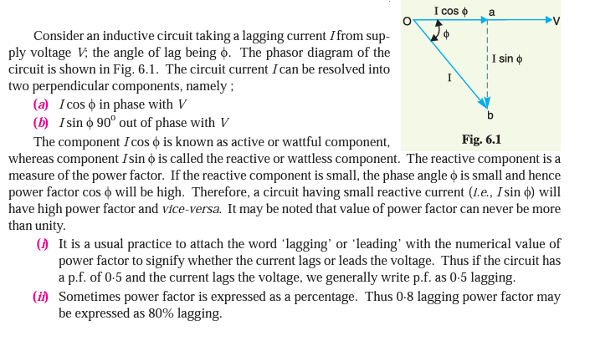

Slide 20
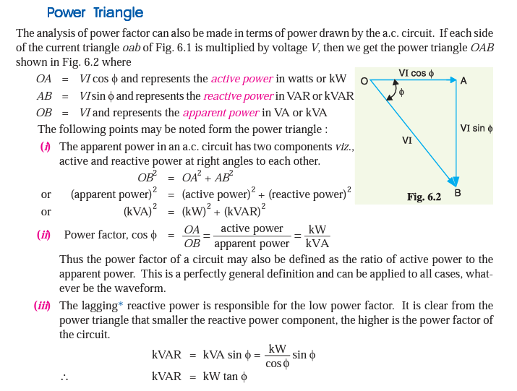

Slide 21
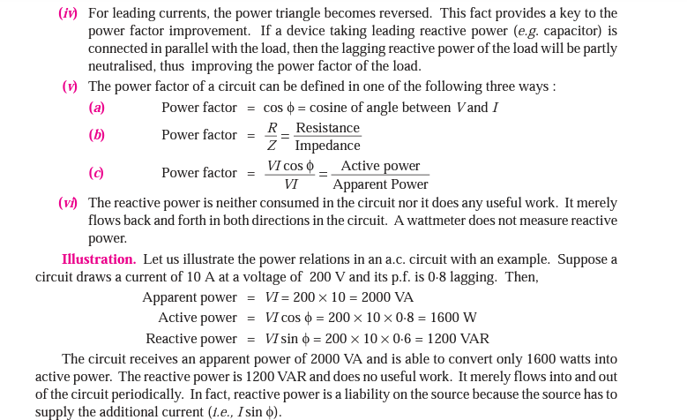

Slide 22
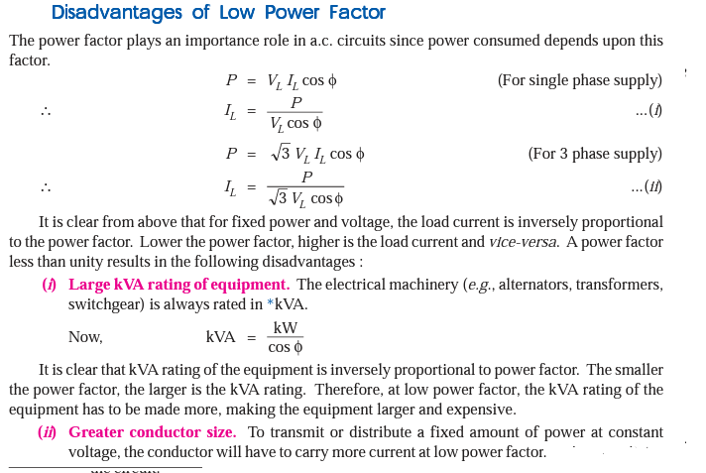

Slide 23
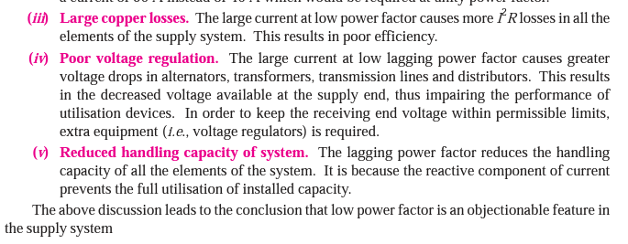

Slide 24
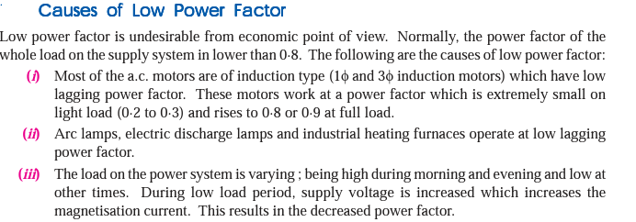


Slide 25
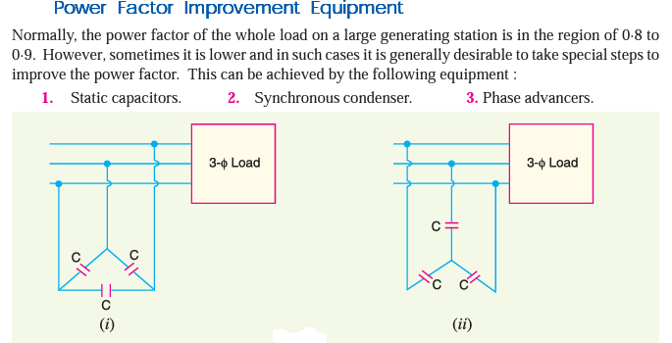

Slide 26
Static capacitor.
The power factor can be improved by connecting capacitors in parallel with the equipment operating at lagging power factor.
The capacitor (generally known as static capacitor) draws a leading current and partly or completely neutralises the lagging reactive component of load current. This raises the power factor of the load.
For three-phase loads, the capacitors can be connected in delta or star as shown in Fig
Advantages
They have low losses.
They require little maintenance as there are no rotating parts.
They can be easily installed as they are light and require no foundation.
They can work under ordinary atmospheric conditions.
Disadvantages
(i) They have short service life ranging from 8 to 10 years.
(ii) They are easily damaged if the voltage exceeds the rated value.
(iii) Once the capacitors are damaged, their repair is uneconomical

Slide 27
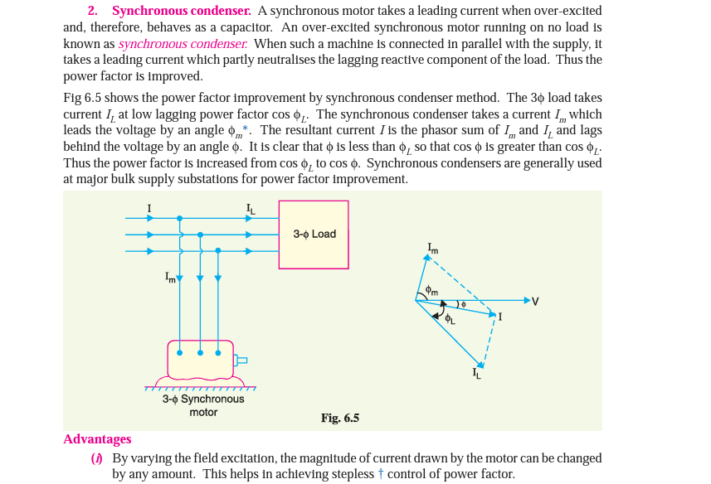

Slide 28
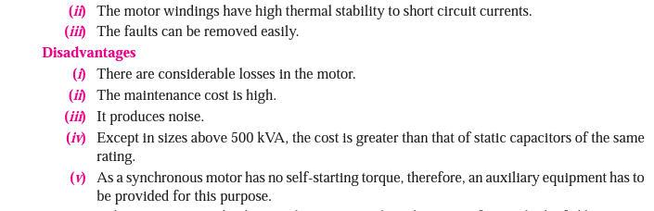

Slide 29
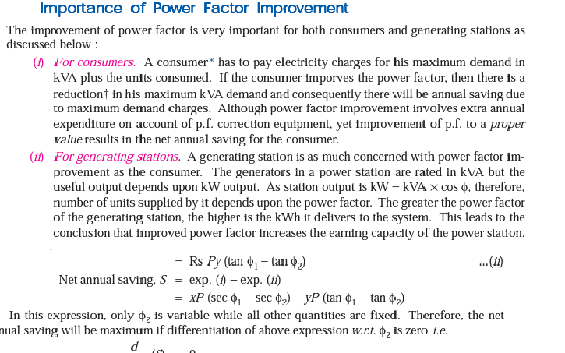


Slide 30
Most Economical Power Factor
If a consumer improves the power factor, there is reduction in his maximum kVA demand and hence there will be annual saving over the maximum demand charges.
However, when power factor is improved, it involves capital investment on the power factor correction equipment. The consumer will incur expenditure every year in the shape of annual interest and depreciation on the investment made over the p.f. correction equipment.
Therefore, the net annual saving will be equal to the annual saving in maximum demand charges minus annual expenditure incurred on p.f. correction equipment.
The value to which the power factor should be improved so as to have maximum net annual saving is known as the most economical power factor.
Consider a consumer taking a peak load of P kW at a power factor of cos φ1and charged at a rate of Rs x per kVA of maximum demand per annum. Suppose the consumer improves the power factor

Slide 31
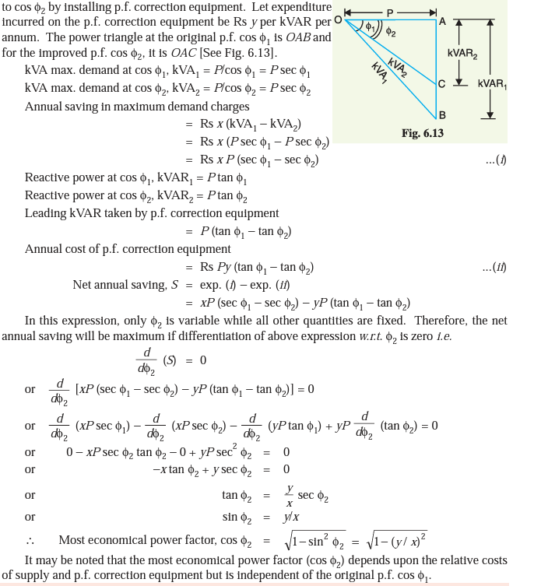

Slide 32
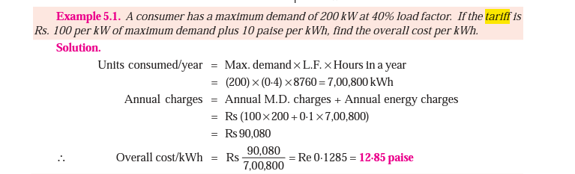

Slide 33
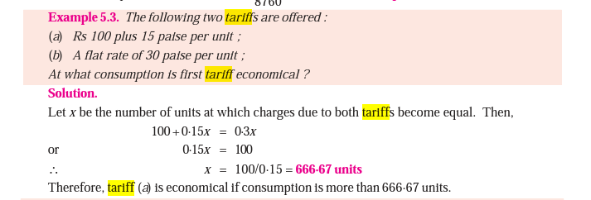

Slide 34
