Slide 1
UTILIZATION OF ELECTRICAL ENERGY
UNIT | NAME OF UNIT
1 | Electric Heating and Welding
2 | Illumination Engineering
3 | Electric Drives
4 | Electric Traction
5 | Refrigeration and Airconditioning

Slide 2
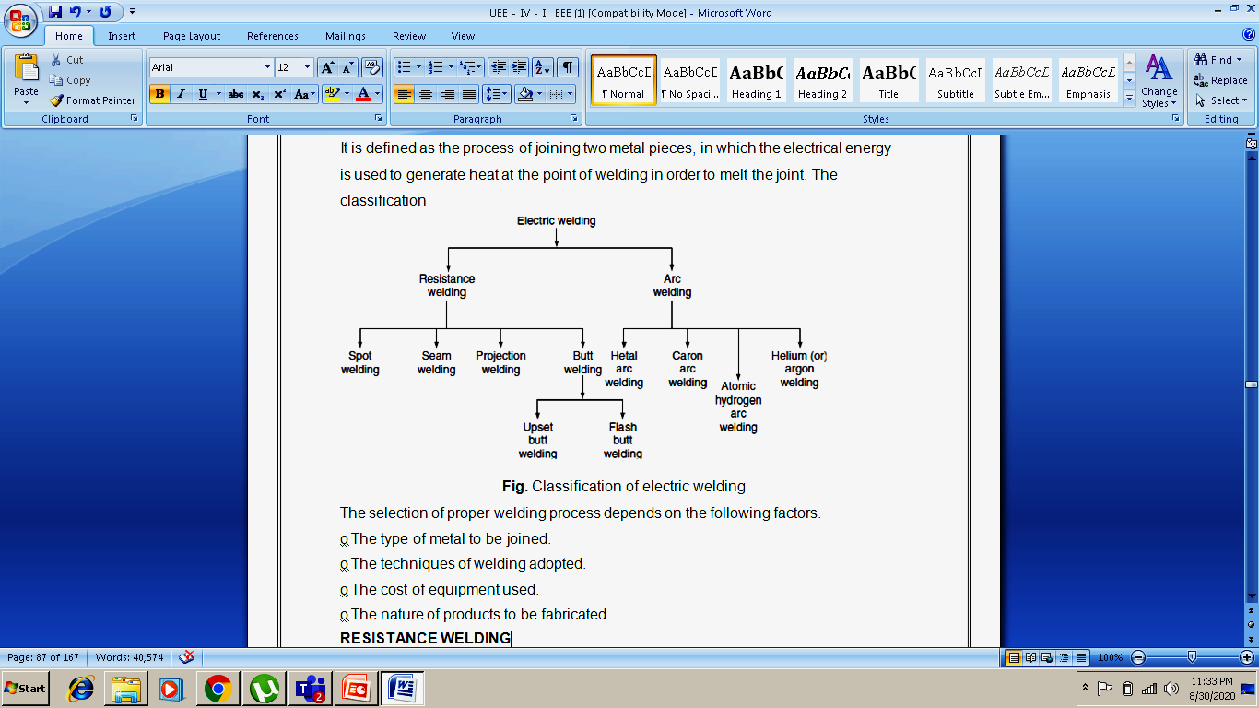
ELECTRIC WELDING
It is defined as the process of joining two metal pieces, in which the electrical energy is used to generate heat at the point of welding in order to melt the joint.

Slide 3
Advantages and Disadvantages of Welding
Some of the advantages of welding are:
Welding is the most economical method to permanently join two metal parts.
It provides design flexibility.
Welding equipment is not so costly.
It joins all the commercial metals.
Both similar and dissimilar metals can be joined by welding.
Portable welding equipment are available.
Some of the disadvantages of welding are:
Welding gives out harmful radiations and fumes.
Welding needs internal inspection.
If welding is not done carefully, it may result in the distortion of work piece.
Skilled welding is necessary to produce good welding.

Slide 4
Resistance Welding
Resistance welding is the process of joining two metals together by the heat produced due to the resistance offered to the flow of electric current at the junctions of two metals.
The heat produced by the resistance to the flow of current is given by:
H = I²Rt
where I is the current through the electrodes, R is the contact resistance of the interface, and t is the time for which current flows.
Here, the total resistance offered to the flow of current is made up of:
1. The resistance of current path in the work
2. The resistance between the contact surfaces of the parts being welded
3. The resistance between electrodes and the surface of parts being welded

Slide 5
Resistance Welding
In this process of welding, the heat developed at the contact area between the pieces to be welded reduces the metal to plastic state or liquid state, then the pieces are pressed under high mechanical pressure to complete the weld.
The electrical voltage input to the welding varies in between 4 and 12 V depending upon area, thickness, composition, etc. and usually power ranges from about 60 to 180 W for each sq. mm of area.
Any desired combination of voltage and current can be obtained by means of a suitable transformer in AC; hence, AC is found to be most suitable for the resistance welding.
The magnitude of current is controlled by changing the primary voltage of the welding transformer, which can be done by using an autotransformer or a tap-changing transformer.
Automatic arrangements are provided to switch off the supply after a pre-determined time from applying the pressure, why because the duration of the current flow through the work is very important in the resistance welding.

Slide 6
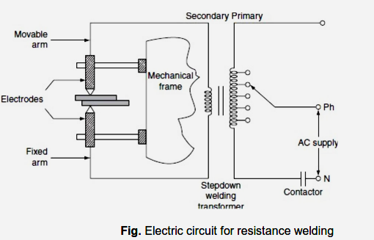
Resistance Welding
This method of welding consists of a tap-changing transformer, a clamping device for holding the metal pieces, and some sort of mechanical arrangement for forcing the pieces to form a complete weld.

Slide 7
Resistance Welding
Advantages
Welding process is rapid and simple.
Localized heating is possible, if required.
No need of using filler metal.
Both similar and dissimilar metals can be welded.
Comparatively lesser skill is required.
Maintenance cost is less.
It can be employed for mass production.
Disadvantages
Initial cost is very high.
High maintenance cost.
The workpiece with heavier thickness cannot be welded, since it requires high input current.
Applications
It is used by many industries manufacturing products made up of thinner gauge metals.
It is used for the manufacturing of tubes and smaller structural sections.

Slide 8
Types of Resistance Welding
Depending upon the method of weld obtained and the type of electrodes used, the resistance welding is classified as:
Spot welding
Seam welding
Projection welding
Butt welding
Spot welding:
Spot welding means the joining of two metal sheets and fusing them together between copper electrode tips at suitably spaced intervals by means of heavy electric current passed through the electrodes.

Slide 9
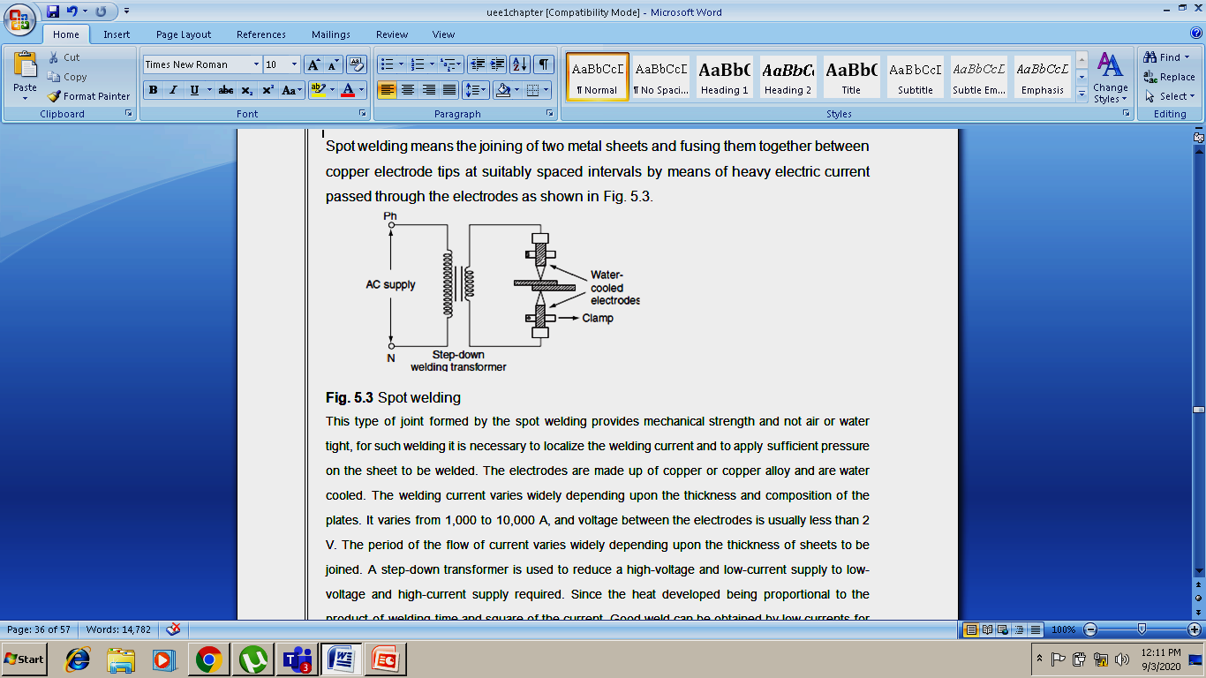
Resistance Spot Welding
This type of joint formed by the spot welding provides mechanical strength and not air or water tight, for such welding it is necessary to localize the welding current and to apply sufficient pressure on the sheet to be welded.
The electrodes are made up of copper or copper alloy and are water cooled. The welding current varies widely depending upon the thickness and composition of the plates.

Slide 10
Resistance Spot Welding
It varies from 1,000 to 10,000 A, and voltage between the electrodes is usually less than 2 V.
The period of the flow of current varies widely depending upon the thickness of sheets to be joined.
A step-down transformer is used to reduce a high-voltage and low-current supply to low-voltage and high-current supply required.
Since the heat developed being proportional to the product of welding time and square of the current, good weld can be obtained by low currents for longer duration and high currents for shorter duration.
The longer welding time usually produces stronger weld but it involves high energy expenditure, electrode maintenance, and lot of distortion of workpiece.
When voltage applied across the electrodes, the flow of current will generate heat at the three junctions, i.e., heat developed, between the two electrode tips and workpiece, between the two workpieces to be joined.

Slide 11
Resistance Spot Welding
Advantages of Resistance Spot Welding
Comparatively Low cost
Resistance Spot Welding (RSW) method doesn't need highly skilled worker.
Distortion or warping of parts is eliminated though it leaves some depressions or indentation.
The joint made is highly uniform.
Automatic or semi-automatic operation both can be done.
There is no need for edge preparation.
Welding can be done in quick succession. It just needs a few seconds to make the joint.
Disadvantages of Resistance Spot Welding
The equipment cost is high so it can has an effect on the initial cost.
Skilled welders or technicians are needed for the maintenance and controlling.
Some metals need special surface preparation for making the RSW a success.
The thick jobs are not easy to weld.

Slide 12
Resistance Spot Welding
Applications of Resistance Spot Welding
Spot welding of thick steel plates has been done and it has replaced the need for riveting.
The welding of two or more sheet metals can be joined by mechanical means more economically by using the spot welding methods. We don't need gas tight joints.
Spot welding can be used for attaching braces, pads or clips with cases, bases and covers which are mainly product of sheet metal forming.
Automobile and aircraft industries relies greatly of spot welding these days.

Slide 13
Resistance Seam Welding
Seam welding is the process of joining two similar or dissimilar materials at the seam by the use of electric current and pressure.
Seam welding is nothing but the series of continuous spot welding.
If number spots obtained by spot welding are placed very closely that they can overlap, it gives rise to seam welding.
In this welding, continuous spot welds can be formed by using wheel type or roller electrodes instead of tipped electrodes.
The process is mostly used on metals since they conduct electricity easily and can sustain relatively high pressures.
Seam welding is obtained by keeping the job under electrodes. When these wheel type electrodes travel over the metal pieces which are under pressure, the current passing between them heats the two metal pieces to the plastic state and results into continuous spot welds.
In this welding, the contact area of electrodes should be small, which will localize the current pressure to the welding point.

Slide 14
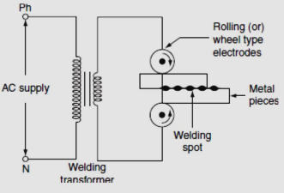
Resistance Seam Welding
After forming weld at one point, the weld so obtained can be cooled by splashing water over the job by using cooling jets.
In general, it is not satisfactory to make a continuous weld, for which the flow of continuous current build up high heat that causes burning and wrapping of the metal piece.

Slide 15
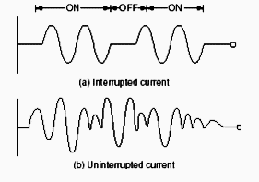
Resistance Seam Welding
To avoid this difficulty, an interrupter is provided on the circuit which turns on supply for a period sufficient to heat the welding point.
The series of weld spots depends upon the number of welding current pulses.
Seam welding is very important, as it provides leak proof joints.

Slide 16
Resistance Seam Welding
Advantages
This welding is known for forming the clear weld.
There are only a few types of the welding processes during which no gas formation takes place or not any other fumes are emitted. And the seam welding is one such type of the welding process.
Another benefit of this welding process is that there is no requirement of the filler material during this welding method.
Nowadays, every field in the world is becoming automating. Seam welding can be automated so there is no need of addition labors for doing this process.
With the help of the continuous spot welding, you can form the gas-tight as well as liquid tight joints.

Slide 17
Resistance Seam Welding
Disadvantages
This welding process is very difficult to carry out for the sheets of metals which have a thickness larger than 3 mm. So, it is suggested that use this technique if you have sheets of metals which have a thickness smaller than 3 mm. In simple world, it is not applicable if you have metal pieces above a specific thickness.
You have to follow a particular path in this welding process. That means that rollers always move in a straight line. So, if you want to make a weld at some complex place then, this process is not applicable.
There is a need of highly-skilled operator or a machine that can handle the speed of the roller as per the situations.

Slide 18
Resistance Seam Welding
Applications
It plays an important role in the manufacturing of all types of the barrels as well as almost every type of the exhaust system.
Its large number of use is done in case of aircraft tanks, refrigerators, oil transformers, etc.
It is also used in the welding of the stainless steel, nickel alloys, and magnesium alloys.

Slide 19
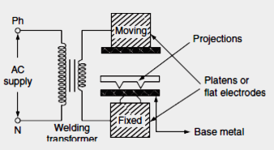
Projection Welding
It is a modified form of the spot welding. In the projection welding, both current and pressure are localized to the welding points as in the spot welding.
But the only difference in the projection welding is the high mechanical pressure applied on the metal pieces to be welded, after the formation of weld.
The electrodes used for such welding are flat metal plates known as platens. The two pieces of base metal to be welded are held together in between the two platens, one is movable and the other is fixed

Slide 20
Projection Welding
One of the two pieces of metal is run through a machine that makes the bumps or projections of required shape and size in the metal.
As current flows through the two metal parts to be welded, which heat up and melt.
These weld points soon reach the plastic state, and the projection touches the metal then force applied by the two flat electrodes forms the complete weld.
The projection welding needs no protective atmosphere as in the spot welding to produce successful results.
This welding process reduces the amount of current and pressure in order to join two metal surfaces, so that there is less chance of distortion of the surrounding areas of the weld zone.
Due to this reason, it has been incorporated into many manufacturing processes.

Slide 21
Projection Welding
This heat produced by resistance is concentrated at the projections on the workpiece because when the two workpieces are placed together, the sheets touch only at the points of projections.
Usually two or three projections are welded at the same time.
When welding workpieces of unequal thickness, projection is made in thicker workpiece and for dissimilar materials welding projections are made in the one with high thermal conductivity.
When pressure is applied to the workpiece by the platens, these projections collapse and get fused and weld nuggets are formed at the place of projections. Hence a quality weld is formed between two metal pieces.

Slide 22
Projection Welding
Advantages
This projection welding requires a very small supply of current. As less current passes through the electrodes, the life of electrodes increases. This process also require less pressure for welding.
Unlike spot welding, there is no limitation on the thickness of the metals to be welded.
Unlike spot welding, more than one spot can be made in single operation.
This process is suitable for automation.
Filler metals are not used in this process. Hence, clean weld joints are obtained in this process.
This process is also effective in welding joints which are in complicated locations.
This process gives a good heat balance while welding.

Slide 23
Projection Welding
Disadvantages
Projection formation in projection welding is a complicated process and it takes time.
Only a skilled person can form projections of different required shape like spherical projections.
This process is not applicable to all types of work pieces, the composition of work piece has to be considered while choosing this welding process.
It can not be applied to some type of brasses and coppers.
Projections cannot be made in thin work pieces.
Equipments are costlier.

Slide 24
Projection Welding
Applications
Projection Welding is most commonly used when special nuts, small fasteners, special bolts, studs and similar parts are used as projection on the portion of the part to be welded.
Projection Welding is also used for welding parts of refrigerator, condensers, refrigerator racks, grills, etc
Apart from that, projection welding is used in automobile workshops, ship building works and sheet metalworking.

Slide 25
Resistance Butt Welding
Butt welding is similar to the spot welding; however, the only difference is, in butt welding, instead of electrodes the metal parts that are to be joined or butted together are connected to the supply.
The three basic types of the butt welding process are:
1. Upset butt welding
2. Flash butt welding
3. Percussion butt welding
Upset butt welding:
In upset welding, the two metal parts to be welded are joined end to end and are connected across the secondary of a welding transformer.
Due to the contact resistance of the metals to be welded, heating effect is generated in this welding.
When current is made to flow through the two electrodes, heat will develop due to the contact resistance of the two pieces and then melts.

Slide 26
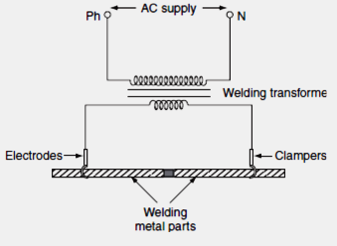
Resistance Butt Welding-Upset butt
By applying high mechanical pressure either manually or by toggle mechanism, the two metal pieces are pressed.
When jaw-type electrodes are used that introduce the high currents without treating any hot spot on the job.
This type of welding is usually employed for welding of rods, pipes, and wires and for joining metal parts end to end.

Slide 27
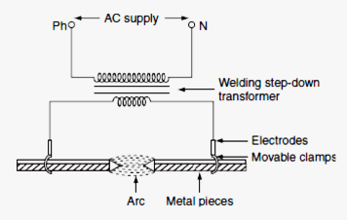
Resistance Butt Welding-Flash butt
Flash butt welding:
Flash butt welding is a combination of resistance, arc, and pressure welding.
This method of welding is mainly used in the production welding.
In this method of welding, the two pieces to be welded are brought very nearer to each other under light mechanical pressure.
These two pieces are placed in a conducting movable clamps.

Slide 28
Resistance Butt Welding-Flash butt
When high current is passed through the two metal pieces and they are separated by some distance, then arc established between them.
This arc or flashing is allowed till the ends of the workpieces reach melting temperature, the supply will be switched off and the pieces are rapidly brought together under light pressure.
As the pieces are moved together, the fused metal and slag come out of the joint making a good solid joint.
Following are the advantages of the flash butt welding over the upset welding:
Less requirement of power.
When the surfaces being joined, it requires only less attention.
Weld obtained is so clean and pure; due to the foreign metals appearing on the surfaces will burn due to flash or arc.

Slide 29
Resistance Butt Welding - Percussion
Percussion welding:
It is a form of the flash butt welding, where high current of short duration is employed using stored energy principle.
This is a self-timing spot welding method. Percussion welding arrangement consists of one fixed holder and the other one is movable.
The pieces to be welded are held apart, with the help of two holders, when the movable clamp is released, it moves rapidly carrying the piece to be welded.
There is a sudden discharge of electrical energy, which establishes an arc between the two surfaces and heating them to their melting temperature, when the two pieces are separated by a distance of 1.5 mm apart.
As the pieces come in contact with each other under heavy pressure, the arc is extinguished due to the percussion blow of the two parts and the force between them affects the weld.

Slide 30
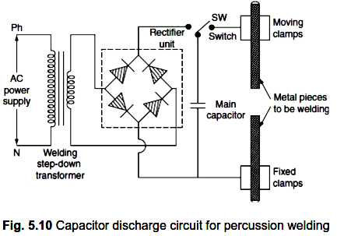
Resistance Butt Welding - Percussion
The percussion welding can be obtained in two methods; one is capacitor energy storage system and the other is magnetic energy storage system.

Slide 31
Resistance Butt Welding - Percussion
The capacitor ‘C’ is charged to about 3,000 V from a controlled rectifier. The capacitor is connected to the primary of welding transformer through the switch and will discharge.
This discharge will produce high transient current in the secondary to join the two metal pieces.
Percussion welding is difficult to obtain uniform flashing of the metal part areas of the cross section grater than 3 sq. cm.
Advantage of this welding is so fast, extremely shallow of heating is obtained with a span of about 0.1 sec. It can be used for welding a large number of dissimilar metals.
Applications
It is useful for welding satellite tips to tools, sliver contact tips to copper, cast iron to steel, etc.
Commonly used for electrical contacts.
The metals such as copper alloys, aluminium alloys, and nickel alloys are percussion welded.

Slide 32
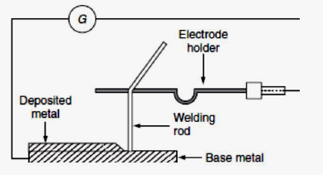
Electric Arc Welding
Electric arc welding is the process of joining two metallic pieces or melting of metal is obtained due to the heat developed by an arc struck between an electrode and the metal to be welded or between the two electrodes.
In this process, an electric arc is produced by bringing two conductors (electrode and metal piece) connected to a suitable source of electric current, momentarily in contact and then separated by a small gap, arc blows due to the ionization and give intense heat.

Slide 33
Electric Arc Welding
The heat so developed is utilized to melt the part of work piece and filler metal and thus forms the weld.
In this method of welding, no mechanical pressure is employed; therefore, this type of welding is also known as 'non-pressure welding’.
The length of the arc required for welding depends upon the following factors:
The surface coating and the type of electrodes used
The position of welding
The amount of current used
When the supply is given across the conductors separated by some distance apart, the air gap present between the two conductors gets ionized, as the arc welding is in progress, the ionization of the arc path and its surrounding area increases.
This increase in ionization decreases the resistance of the path. Thus, current increases with the decrease in voltage of arc.

Slide 34
Electric Arc Welding
It also known as negative resistance characteristics of an arc. Thus, it will be seen that this decrease in resistance with increase in current does not remain the arc steadily.
This difficulty can be avoided, with the supply, it should fall rapidly with the increase in the current so that any further increase in the current is restricted.
For the arc welding, the temperature of the arc should be 3,500°C. At this temperature, mechanical pressure for melting is not required.
Both AC and DC can be used in the arc welding. Usually 70–100 V on AC supply and 50–60 V on DC supply system is sufficient to struck the arc in the air gap between the electrodes.
Once the arc is struck, 20–30 V is only required to maintain it. However, in certain cases, there is any danger of electric shock to the operator, low voltage should be used for the welding purpose.
Thus, DC arc welding of low voltage is generally preferred. Electric arc welding is extensively used for the joining of metal parts, the repair of fractured casting, and the fillings by the deposition of new metal on base metal, etc.

Slide 35
Electric Arc Welding
Various types of electric arc welding are:
1. Carbon arc welding
2. Metal arc welding
3. Atomic hydrogen arc welding
4. Inert gas metal arc welding
5. Submerged arc welding
Carbon arc welding
It is one of the processes of arc welding in which arc is struck between two carbon electrodes or the carbon electrode and the base metal.
In this process of welding, the electrodes are placed in an electrode holder used as negative electrode and the base metal being welded as positive.
Unless, the electrode is negative relative to the work, due to high temperature, there is a tendency of the particles of carbon will fuse and mix up with the base metal, which causes brittleness.

Slide 36
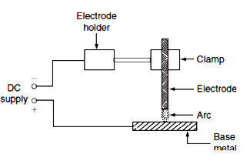
Carbon Arc Welding
DC is preferred for carbon arc welding since there is no fixed polarity maintained in case of AC. In the carbon arc welding, carbon or graphite rods are used as electrodes.
Due to longer life and low resistance, graphite electrodes are used, and thus capable of conducting more current.
The arc produced between electrode and base metal; heat the metal to the melting temperature, on the negative electrode is 3,200°C and on the positive electrode is 3,900°C.

Slide 37
Carbon Arc Welding
This process of welding is normally employed where addition of filler metal is not required.
The carbon arc is easy to maintain, and also the length of the arc can be easily varied.
One major problem with carbon arc is its instability which can be overcome by using an inductor in the electrode of 2.5-cm diameter and with the current of about of 500–800 A employed to deposit large amount of filler metal on the base metal. Filler metal and flux may not be used depending upon the type of joint and material to be welded.
Advantages
The heat developed during the welding can be easily controlled by adjusting the length of the arc.
It is quite clean, simple, and less expensive when compared to other welding process.
Easily adoptable for automation.
Both the ferrous and the non-ferrous metals can be welded.

Slide 38
Carbon Arc Welding
Disadvantages
Input current required in this welding, for the workpiece to rise its temperature to melting/welding temperature, is approximately double the metal arc welding.
In case of the ferrous metal, there is a chance of disintegrating the carbon at high temperature and transfer to the weld, which causes harder weld deposit and brittlement.
A separate filler rod has to be used if any filler metal is required.
Applications
It can be employed for the welding of stainless steel with thinner gauges.
Useful for the welding of thin high-grade nickel alloys and for galvanized sheets using copper silicon manganese alloy filler metal.

Slide 39
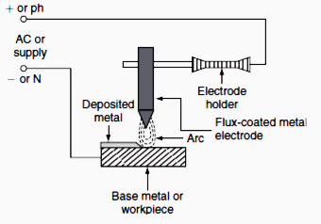
Metal Arc Welding
Metal Arc Welding:
In metal arc welding, the electrodes used must be of the same metal as that of the work-piece to be welded.
The electrode itself forms the filler metal. An electric arc is stuck by bringing the electrode connected to a suitable source of electric current, momentarily in contract with the work pieces to be welded and withdrawn apart.

Slide 40
Metal Arc Welding
The arc produced between the work piece and the electrode results high temperature of the order of about 2,400°C at negative metal electrode and 2,600°C at positive base metal or work piece.
This high temperature of the arc melts the metal as well as the tip of the electrode, then the electrode melts and deposited over the surface of the workpiece, forms complete weld.
Both AC and DC can be used for the metal arc welding. The voltage required for the DC metal arc welding is about 50–60 V and for the AC metal arc welding is about 80–90 V.
In order to maintain the voltage drop across the arc less than 13 V, the arc length should be kept as small as possible, otherwise the weld will be brittle.
The current required for the welding varies from 10 to 500 A depending upon the type of work to be welded.

Slide 41
Metal Arc Welding
The main disadvantage in the DC metal arc welding is the presence of arc blow, i.e., distortion of arc stream from the intended path due to the magnetic forces of the non-uniform magnetic field and arc blow is considerably reduced with AC.
For obtaining good weld, the flux-coated electrodes must be used, so the metal which is melted is covered with slag produces a non oxidizing gas or a molten slag to cover the weld, and also stabilizes the arc.

Slide 42
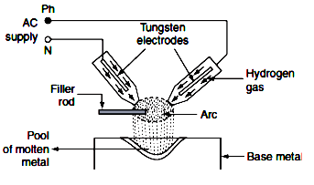
Atomic Hydrogen Arc Welding
Atomic hydrogen arc welding:
In atomic hydrogen arc welding, the heat for the welding process is produced from an electric arc struck between two tungsten electrodes in an atmosphere of hydrogen.
Here, hydrogen serves mainly two functions; one acts as a protective screen for the arc and the other acts as a cooling agent for the glowing tungsten electrode tips.

Slide 43
Atomic Hydrogen Arc Welding
As the hydrogen gas passes through the arc, the hydrogen molecules are broken up into atoms, absorbs heat from the glowing tungsten electrodes so that these are cooled.
But, when the atoms of hydrogen recombine into molecules outside the arc, a large amount of heat is liberated.
This extra heat is added to the intense heat of arc, which produces a temperature of about 4,000°C that is sufficient to melt the surfaces to be welded, together with the filler rod if used.
Moreover hydrogen includes oxygen and some other gases that might combine with the molten metal and forms oxides and other impurities.
Hydrogen also removes oxides from the surface of work piece. Thus, this process is capable of producing strong, uniform, smooth, and ductile welds.
In the atomic hydrogen arc welding, the arc is maintained between the two non-consumable tungsten electrodes under a pressure of about 0.5 kg/cm².

Slide 44
Atomic Hydrogen Arc Welding
In order to obtain equal consumption of electrodes, AC supply is used. Arc currents up to 150 A can be used.
High voltage about 300 V is applied for this welding through a transformer. For striking the arc between the electrodes the open circuit voltage required varies from 80 to 100 V.
As the atomic hydrogen welding is too expensive, it is usually employed for welding alloy steel, carbon steel, stainless steel, aluminium, etc.

Slide 45
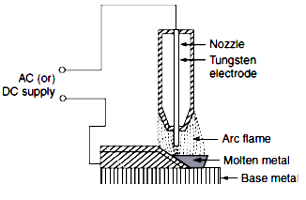
Inert Gas Metal Arc Welding
Inert gas metal arc welding:
It is a gas-shielded metal arc welding, in which an electric arc is stuck between tungsten electrode and work piece to be welded.
Filler metal may be introduced separately into the arc if required. A welding gun, which carries a nozzle, through this nozzle, inert gas such as beryllium or argon is blown around the arc and onto the weld.

Slide 46
Inert Gas Metal Arc Welding
As both beryllium and argon are chemically inert, so the molten metal is protected from the action of the atmosphere by an envelope of chemically reducing or inert gas.
As molten metal has an affinity for oxygen and nitrogen, if exposed to the atmosphere, thereby forming their oxides and nitrides, which makes weld leaky and brittle. Thus, several methods of shielding have been employed.
With the use of flux coating electrodes or by pumping, the inert gases around the arc produces a slag that floats on the top of molten metal and produces an envelope of inert gas around the arc and the weld.
Advantages
Flux is not required since inert gas envelope protects the molten metal without forming oxides and nitrates so the weld is smooth, uniform, and ductile.
Distortion of the work is minimum because the concentration of heat is possible.
Applications
The welding is employed for light alloys, stainless steel, etc.
The welding of non-ferrous metal such as copper, aluminium, etc.

Slide 47
Submerged Arc Welding
Submerged arc welding:
It is an arc welding process, in which the arc column is established between above metal electrode and the workpiece.
Electric arc and molten pool are shielded by blanket of granular flux on the workpiece.
Initially to start an arc, short circuit path is provided by introducing steel wool between the welding electrode and the workpiece.
This is due to the coated flux material, when cold it is non-conductor of the electricity but in molten state, it is highly conductive.
Welding zone is shielded by a blanket of flux, so that the arc is not visible. Hence, it is known as 'submerged arc welding’.
The arc so produced, melts the electrode, parent the metal and the coated flux, which forms a protective envelope around both the arc and the molten metal.
As the arc in progress, the melted electrode metal forms globules and mix up with the molten base metal, so that the weld is completed.

Slide 48
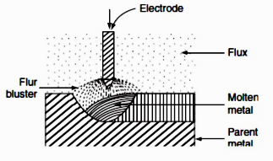
Submerged Arc Welding
In this welding, the electrode is completely covered by flux. The flux may be made of silica, metal oxides, and other compounds fused together and then crushed to proper size.
Therefore, the welding takes place without spark, smoke, ash, etc.
Thus, there is no need of providing protective shields, smoke collectors, and ventilating systems.
Voltage required for the submerged arc welding varies from 25 to 40 V. Current employed for welding depends upon the dimensions of the workpiece.

Slide 49
Submerged Arc Welding
Normally, if DC supply is used employing current ranging from 600 to 1,000 A, the current for AC is usually 2,000 A.
Advantages
Deep penetration with high-quality weld is possible.
Job with heavy thickness can be welded.
The weld so obtained has good ductility, impact strength, high corrosion resistance, etc.
The submerged arc welding can be done manually or automatically.
Applications
The submerged arc welding is widely used in the heavy steel plant fabrication work.
It can be employed for welding high strength steel, corrosion resistance steel, and low carbon steel.
It is also used in the ship-building industry for splicing and fabricating subassemblies, manufacture of vessels, tanks, etc.

Slide 50
COMPARISON BETWEEN RESISTANCE AND ARC WELDING
S.No. | Resistance Welding | Arc Welding
1. | The source of supply is AC only. | The source of supply is either AC (1- ϕ or 3-ϕ) or DC.
2. | The head developed is mainly due to the flow of current in contact resistance. | The heat developed is mainly due to the striking of arc between electrodes or an electrode and the workpiece.
3. | The temperature attained by the workpiece is not so high. | The temperature of the arc is so high, so proper care should be taken during the welding.
4. | External pressure is required. | No external pressure is required hence the welding equipment is more simple and easy to control.
5. | Filler metal is not required to join two metal pieces. | Suitable filler electrodes are necessary to get proper welding strength.
6. | It cannot be used for repair work; it is suitable for mass production. | It is not suitable for mass production. It is most suitable for repair works and where more metal is to be deposited.
7. | The power consumption is low. | The power consumption is high.
8. | The operating power factor is low. | The operating power factor is high.
9. | Bar, roller, or flat type electrodes are used (not consumable). | Bare or coated electrodes are used (consumable or non-consumable).

Slide 51
Electric Welding Equipment
Electric welding accessories required to carry out proper welding operation are:
1. Electric welding power sets.
2. Electrode holder to hold the electrodes.
3. Welding cable for connecting electrode and workpiece to the supply.
4. Face screen with colored glass.
5. Chipping hammers to remove slag from molten weld.
6. Wire brush to clean the weld.
7. Earth clamp and protective clothing.

Slide 52
COMPARISON BETWEEN DC AND AC WELDING
S.No. | DC Welding | AC Welding
1. | Motor generator set or rectifier is required in case of the availability of AC supply. | Only transformer is required.
2. | The cost of the equipment is high. | The cost of the equipment is cheap.
3. | Arc stability is more. | Arc stability is less.
4. | The heat produced is uniform. | The heat produced is not uniform.
5. | Both bare and coated electrodes can be used. | Only coated electrodes should be used.
6. | The operating power factor is high. | The power factor is low. So, the capacitors are necessary to improve the power factor.
7. | It is safer since no load voltage is low. | It is dangerous since no load voltage is high.
8. | The electric energy consumption is 5–10 kWh/kg of deposited metal. | The electrical energy consumption is 3–4 kWh/kg of deposited metal
9. | Arc blow occurs due to the presence of non-uniform magnetic field. | Arc blow will not occur due to the uniform magnetic field.
10. | The efficiency is low due to the rotating parts. | The efficiency is high due to the absence of rotating parts.

Slide 53
