Slide 1
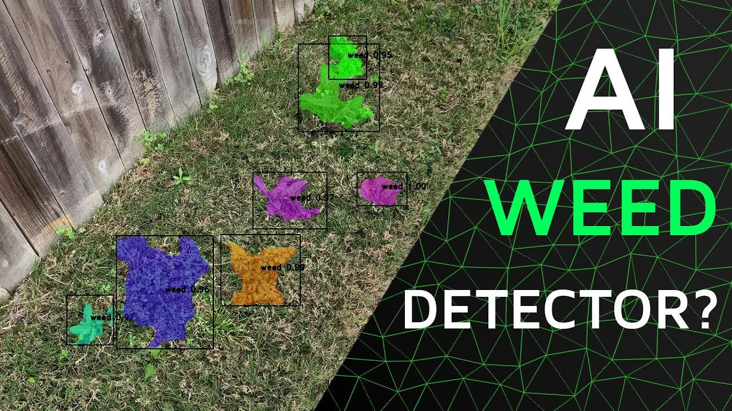
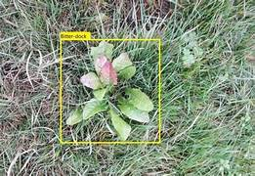
Weed Detection
Using AI

Slide 2
Abstract:
Weeds impact agriculture by competing with crops for resources. This project develops an AI-based system to detect weeds and recommend pesticides using CNNs like YOLOv5 and Faster R-CNN. A large, labeled image dataset improves model performance. The system suggests appropriate pesticides using a rule-based or machine learning model. A user-friendly application provides immediate analysis and recommendations from field images. This tool enhances weed management, reduces herbicide use, and supports sustainable farming.

Slide 3
Introduction:
Crop farming plays a vital role in the global economy, contributing significantly to GDP and providing food, revenue, and employment. However, agricultural growth faces challenges like climate change, pollution, and particularly, weed infestation, which competes with crops for essential resources, leading to significant crop loss.
Traditional weed management methods, such as manual surveillance, are costly, labor-intensive, and often ineffective.
This project aims to leverage AI, specifically deep learning (DL) and convolutional neural networks (CNNs), for efficient weed detection and pesticide recommendation. By using advanced image recognition techniques, this system can identify and classify weeds accurately, reducing the need for manual intervention.
A user-friendly application allows farmers to upload field images for real-time analysis, promoting sustainable farming practices by minimizing herbicide use and improving crop yields. This approach addresses the limitations of traditional methods and enhances agricultural productivity through smart farming techniques.

Slide 4
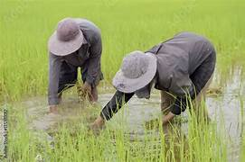
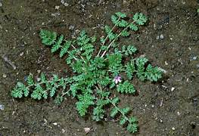
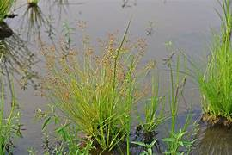
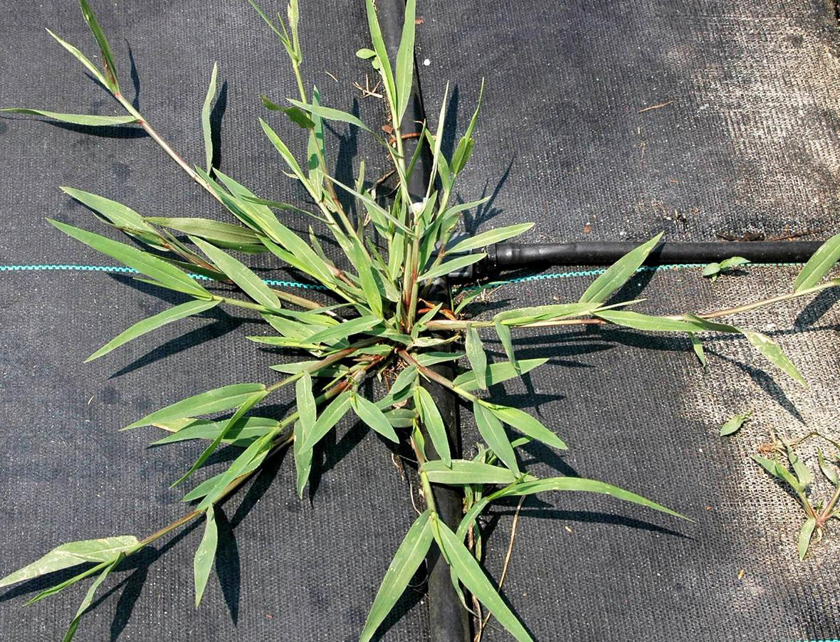

Slide 5
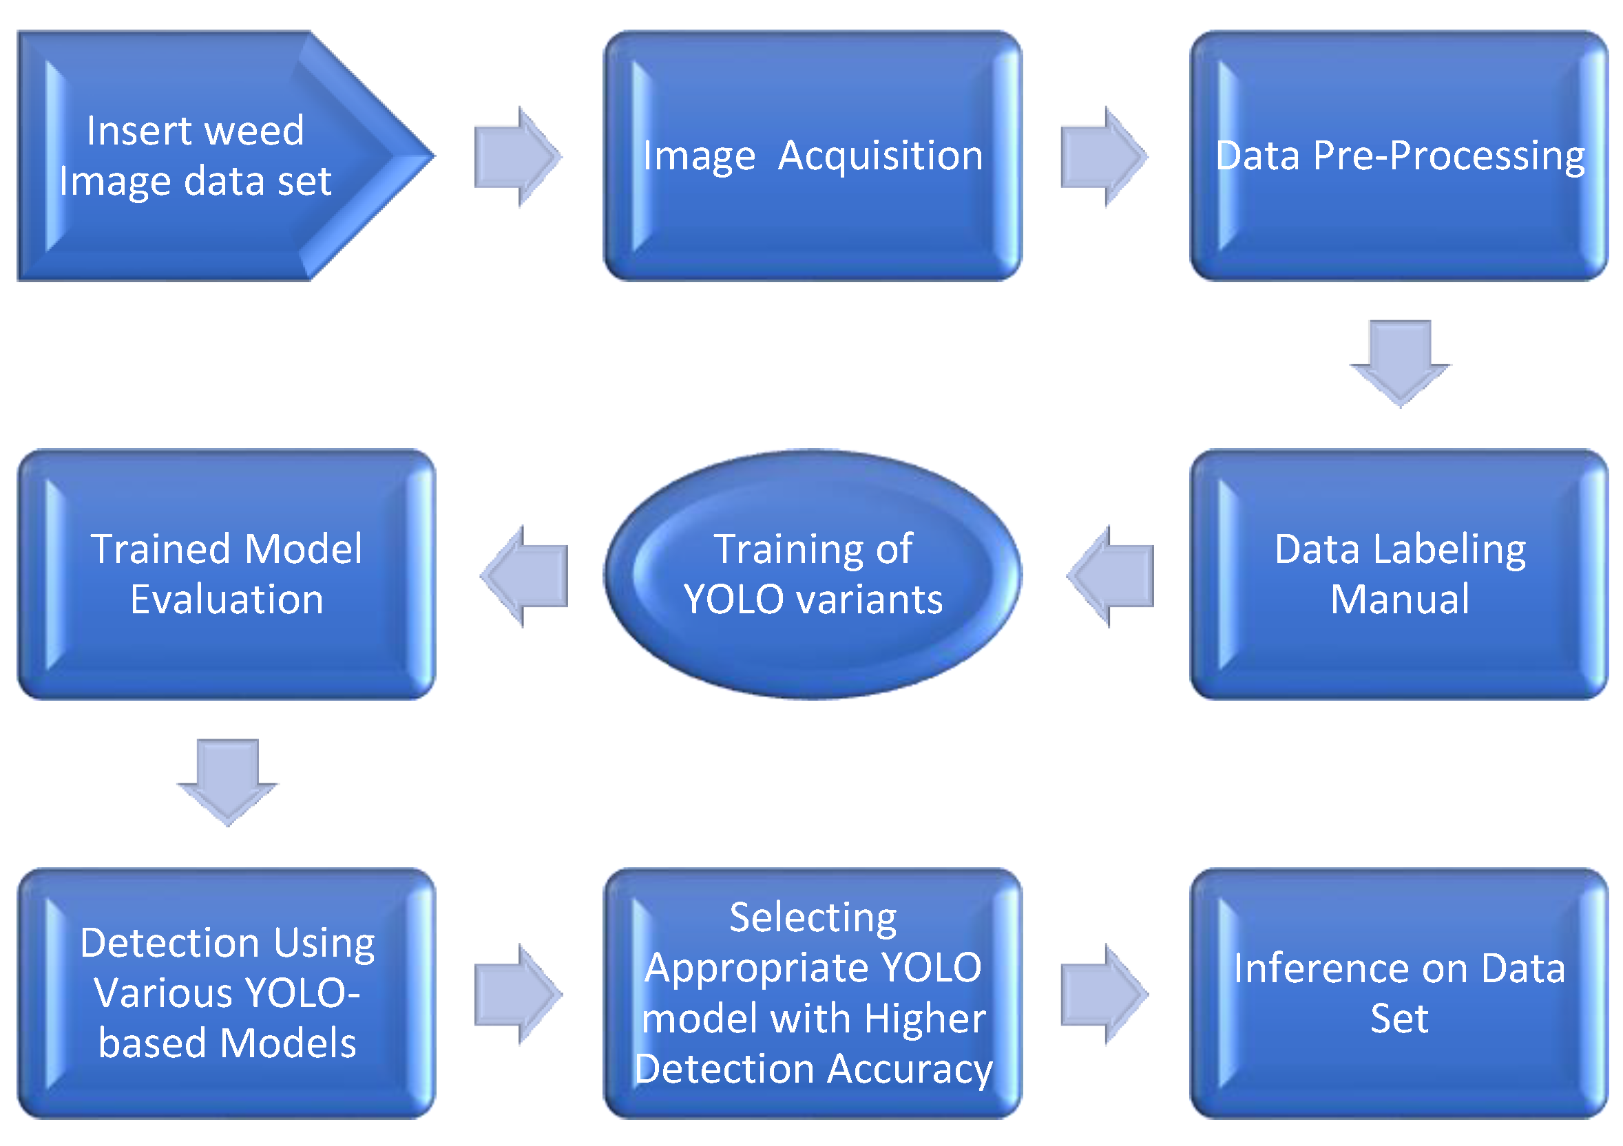
Block Diagram:

Slide 6
Technologies:
Convolutional Neural Networks (CNNs)
YOLOv5
Faster R-CNN
Image processing techniques
Machine learning and deep learning algorithms
Rule-based systems or machine learning models
Large labeled image dataset
User interface development

Slide 7
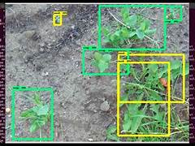
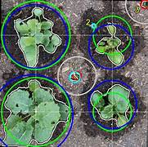
Applications:
Precision Agriculture
Enhanced Crop Yield
Environmental Sustainability
Time and Labor Savings
Data-Driven Insights
Integrated Pest Management (IPM)
Research and Innovation

Slide 8
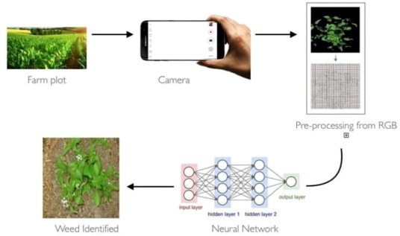
work flow of API

Slide 9
Outcomes:
Improved Crop Yields
Reduced Chemical Usage
Environmental Sustainability
Cost Savings
Enhanced Food Security
Targeted Pesticide Recommendations

Slide 10
Steps to Implementation:
1. Data collection:
Gathering crops and weeds datasets
2.Data Pre – Processing:
Remove noisy data and remove unwanted data
3.Model Training:
Split Dataset: Splitting annotated dataset into training and validation sets (e.g., 80% for training, 20% for validation).

Slide 11
4.Evaluation and Testing
Evaluate the trained model on the validation set to measure its performance
Use the trained model to detect weeds in new images or videos
Train the Model: Use the train.py script to start training.

Slide 12
YOLOv5:
YOLOv5 can be used to detect multiple weeds in a single image quickly. It processes the image in one go and predicts bounding boxes and class probabilities for each detected object, making it suitable for real-time weed detection in fields.

Slide 13
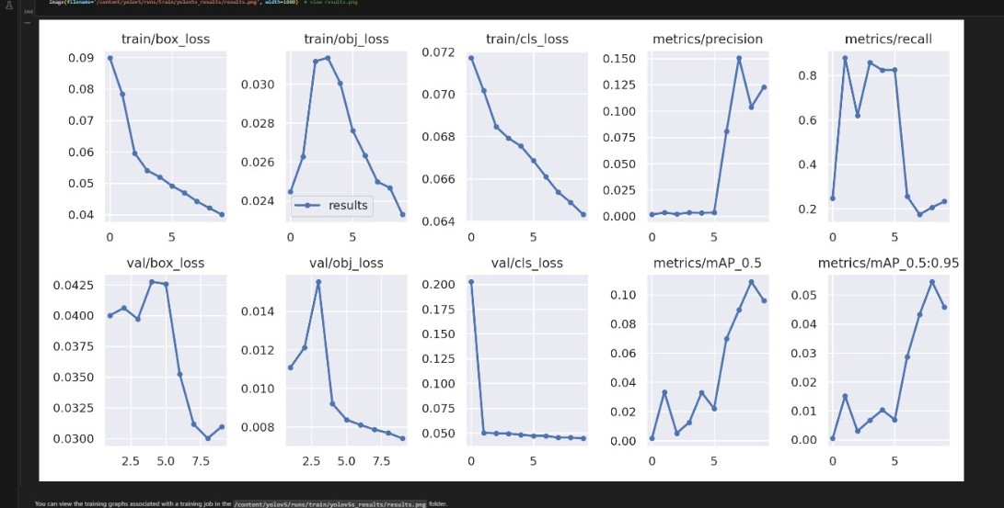
Results: Evaluate custom yolov5 detector performance

Slide 14
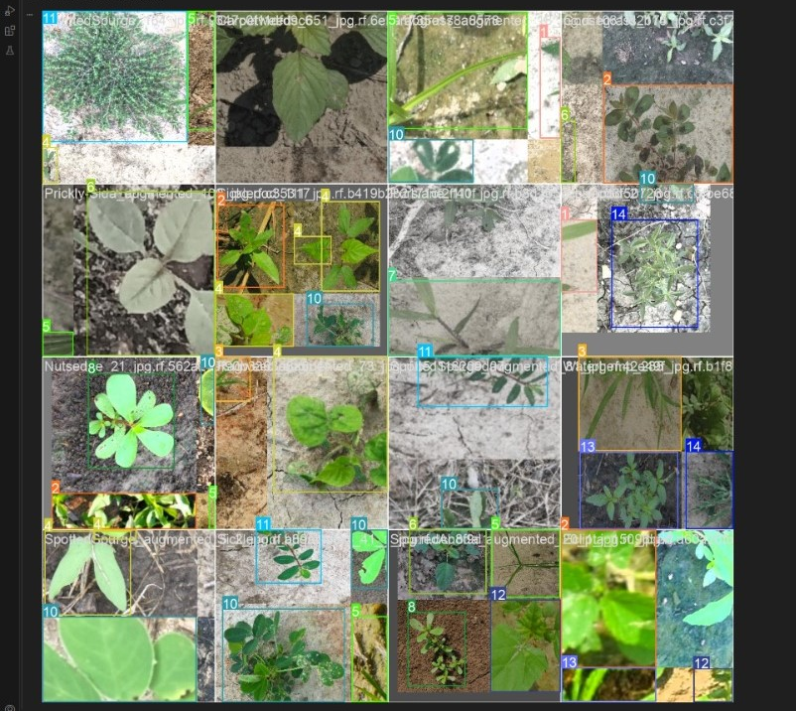
Ground Truth and Augmented Training data

Slide 15
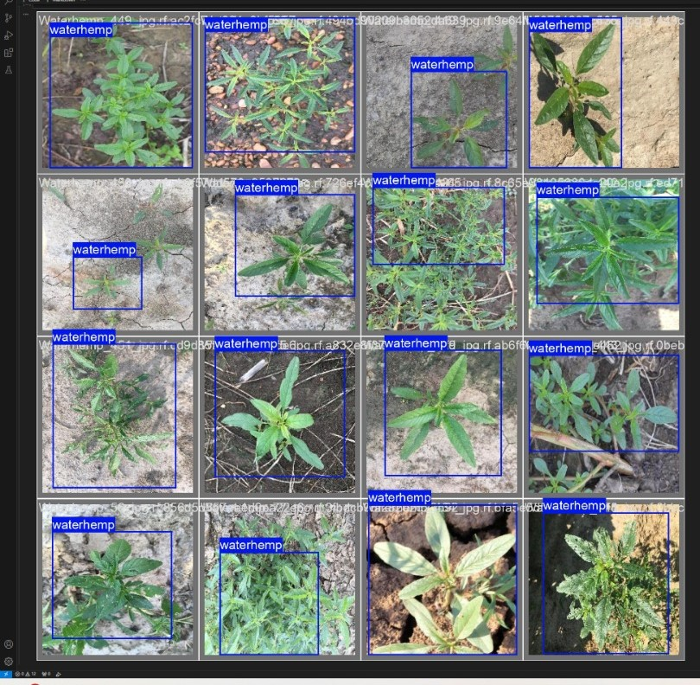
Visualizing our Training data with labels

Slide 16
9.Conclusion:
Deep learning for weed detection, Using YOLOv5 for weed detection offers a powerful tool for precision agriculture.
Its ability to provide real-time, accurate, and efficient weed identification can significantly reduce the need for manual intervention, lower herbicide usage, and improve crop yields. Continued advancements in data collection, model training, and deployment technologies will further enhance the capabilities and adoption of YOLOv5 in agricultural application

Slide 17
THANK YOU

